Slide 1
Attention Triumphs
Birbal’s cleverness and
the King’s test
Notes:
Notes for Teacher - < Information for further reference or explanation >
Suggestions: <Ideas/ Images/ Animations / Others – To make better representation of the content >
Source of Multimedia used in this slide - <Please provide source URL where we find the image and the license agreement>

Slide 2
Concept-Value Connection
Notices are meant to convey specific information in a clear and concise manner. It requires careful attention to details to ensure that the message is accurate, complete, and easily understandable.
Paying attention to details is an important skill that can lead to high quality results and success in any endeavour.

Slide 3
Birbal’s cleverness and the King’s test
Once upon a time, Birbal was chosen to go as an ambassador to a faraway kingdom.
Notes:
https://www.rawpixel.com/image/9065694/image-watercolor-vintage-public-domain

Slide 4
The King’s test
The king there had heard about Birbal's cleverness and wanted to test it. He asked his ministers to dress up just like him and sit in a row, all looking the same.

Slide 5
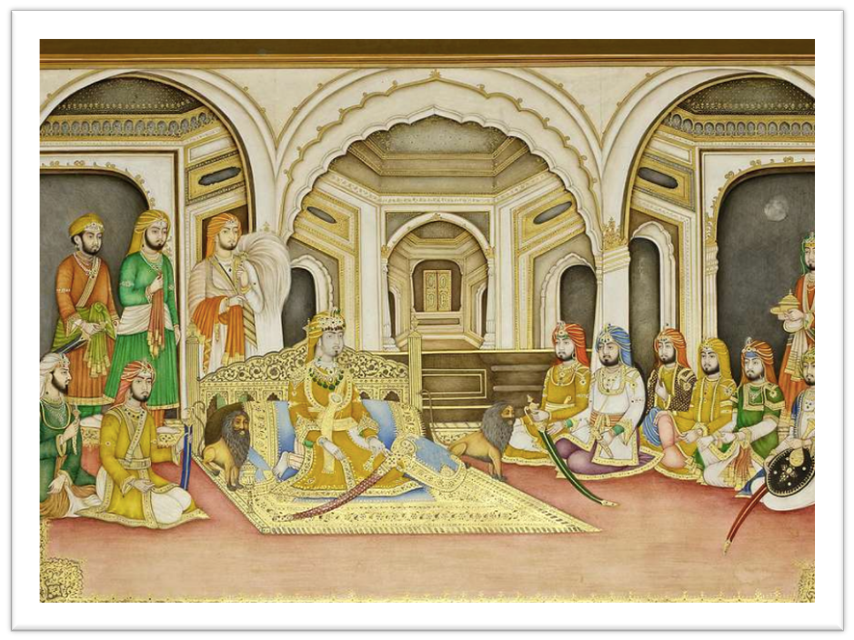
Birbal enters
When Birbal entered the courtroom to introduce himself, he was surprised to see everyone dressed alike and sitting on a similar kind of throne.

Slide 6
Birbal’s cleverness
Birbal didn't get flustered. He attentively looked at each person. Then he went up to one of them and greeted him politely. It turned out to be the real king!

Slide 7
Birbal’s cleverness and the King’s test
My lord, you had a special kind of confidence that none of the others had. They kept looking at you for approval. That's how I got my clue that you are the real king.
How did you figure out I am the real king?

Slide 8
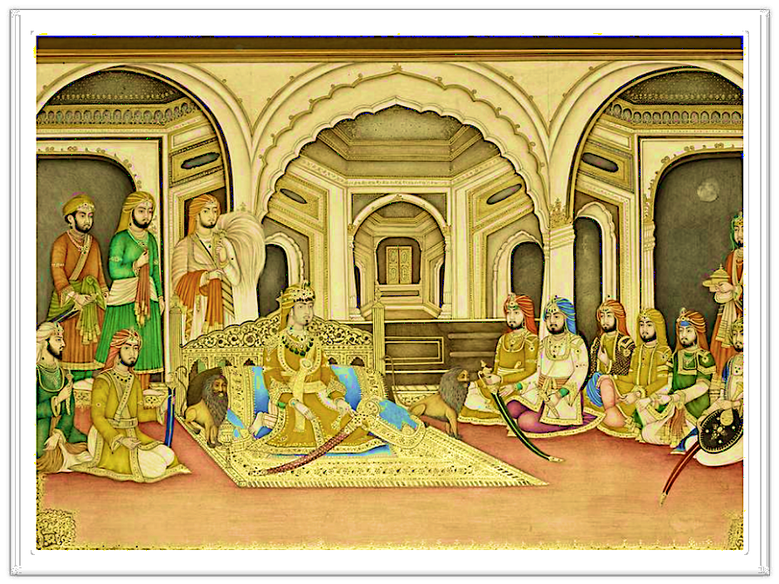
Delighted King
The king was delighted and impressed and praised Birbal for his extraordinary perceptiveness and attention to subtle details.

Slide 9
Attention to Detail
In this story, Birbal's cleverness in figuring out the real king shows how important it is to pay close attention to details.
It's a useful skill that can help in many situations, just like it did for Birbal! The difference between something good and something great is attention to detail.

Slide 10
Points to ponder
Paying attention to details:
Makes challenges easier to tackle.
Helps in understanding difficult concepts.
Minimises the need for revisions and corrections.
Encourages critical thinking.

Slide 11
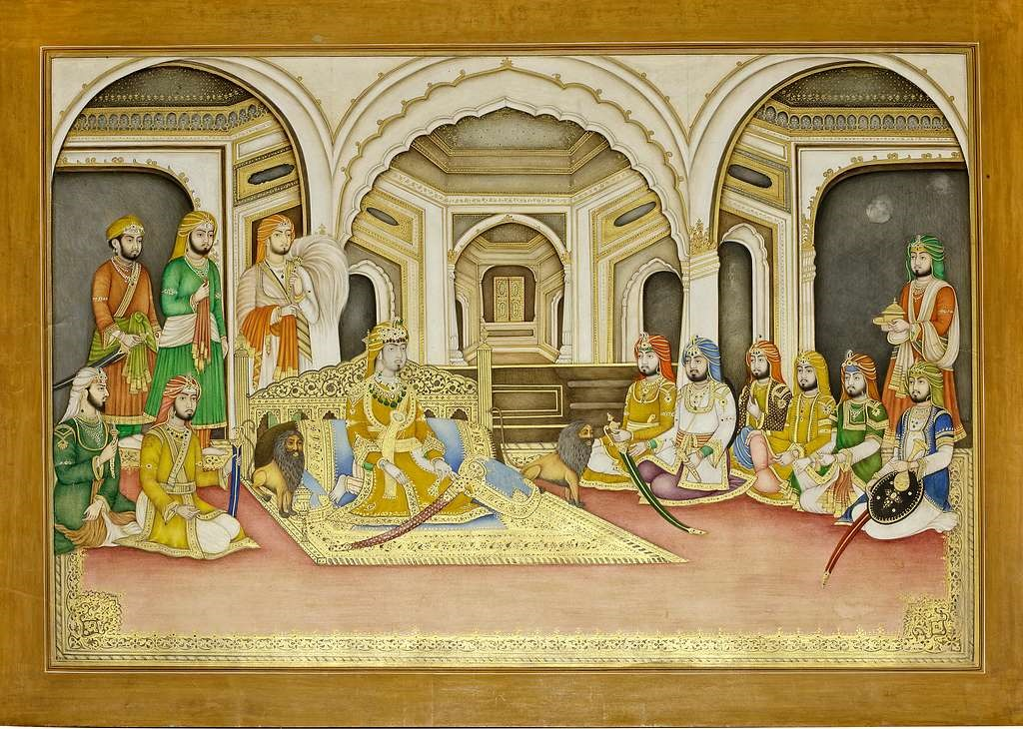
Attribution / Citation
Slide # | Thumbnail | Source link | Author
3, 5, 6, 7, 8 |  | https://www.rawpixel.com/image/9065694/image-watercolor-vintage-public-domain | Rawpixel
4, 5, 6, 7, 8 |  | https://picryl.com/media/painting-of-the-durbar-court-of-raja-bharpur-singh-of-nabha-state-enthroned-5bf9af | Picryl
Notes:
Notes for Teacher - < Information for further reference or explanation >
Suggestions: <Ideas/ Images/ Animations / Others – To make better representation of the content >
Source of Multimedia used in this slide - <Please provide source URL where we find the image and the license agreement>

