Slide 1
Modal Verbs

Slide 2
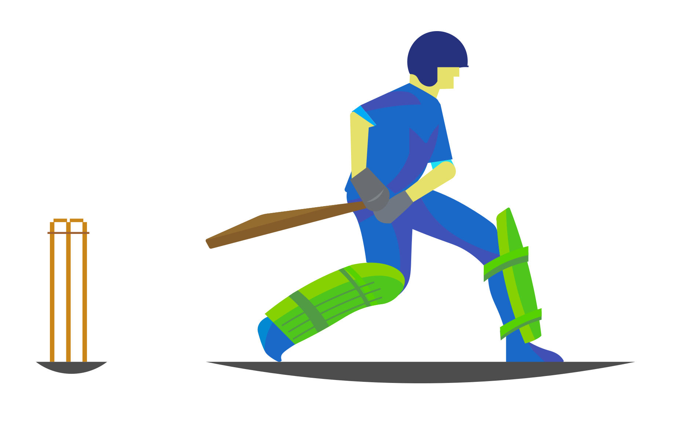
What are Modal Verbs?
I should have run faster,
I could have taken the catch.
I might have become the little master,
And we would have won the match!
So…
Next time we will practice more,
We should raise a big score.
We can bat better and make the ball spin,
We must, we should, we ought to make our country win.
Notes:
Notes for Teacher – Read the above motivational poem with appropriate voice modulation.
After reading the motivational poem, ask some questions. Start with direct questions. For example:
What should the player have done better?
What would that have resulted in?
What will they do next time?
What do they believe they can do?
Generate a discussion: Ask the students what verbs are used to express the mood of the players? What do they believe in?
Direct the discussion to the topic for the day - modal verbs.
Suggestions: Not applicable
Source of Multimedia used in this slide - https://openclipart.org/detail/343450/cricketer-colour-remix

Slide 3
Modal Verbs
Verbs such as can, may, will, shall, should, would, could, might, ought to.
They are used along with the main verb to express:
Necessity
Possibility
Permission
Obligation
Notes:
Notes for Teacher - < Information for further reference or explanation >
Suggestions: <Ideas/ Images/ Animations / Others – To make better representation of the content >
Source of Multimedia used in this slide - <Please provide source URL where we find the image and the license agreement>

Slide 4
Recap
Possibility / Permission
Ability / Request
Offer / Invitation
Prediction / Request
May
Can
Shall
Will
E.g. 1: He ____ come early today.
E.g. 2: ____ I come in?
E.g. 1: She ____ get good marks if she works hard.
E.g.2: ____ you do it today?
E.g. 1: ____ I get you a glass of water?
E.g. 2: I ____ carry your bag.
E.g. 1: I ____ reach tomorrow at 5pm.
E.g. 2: ____ you lend me your pen?
Notes:
Notes for Teacher - < Information for further reference or explanation >
Suggestions: <Ideas/ Images/ Animations / Others – To make better representation of the content >
Source of Multimedia used in this slide - PPT icons

Slide 5
Modal Verbs
Modal verbs help us in expressing our feelings and thoughts in a better way.
It helps the listener figure out what the speaker is trying to communicate. For example:
It may rain today.
It might rain today.
It should rain today since the clouds are dark.
It must rain today. For the past one week there has been no rain.
Notes:
Notes for Teacher – The difference can be explained using the following hints:
May rain indicates a possibility of rain.
Might rain indicates a remote possibility of rain.
Should rain shows cause / effect – Since the clouds are dark it should rain.
Must rain indicates compulsion.
The teacher can then tell the students that they’ll be learning some new modal verbs,
Suggestions: <Ideas/ Images/ Animations / Others – To make better representation of the content >
Source of Multimedia used in this slide - PPT icons

Slide 6
1. Could
To ask permission or make a request
E.g. 1: Could I borrow your pen?
E.g. 2: Could you lend me your book for a day?
To indicate ability in the past
E.g. 1: I could walk really fast when I was young.
E.g. 2: I could read without glasses till the age of 30.
As past tense for ‘can’ in indirect speech
Direct speech –
Shyam said, “I can walk alone.”
Indirect speech –
Shyam said that he could walk alone.
To show possibility
E.g. 1: If I had money, I could buy that car.
Notes:
Notes for Teacher - < Information for further reference or explanation >
Suggestions: <Ideas/ Images/ Animations / Others – To make better representation of the content >
Source of Multimedia used in this slide - <Please provide source URL where we find the image and the license agreement>

Slide 7
2. Would
To express a desire
E.g. 1: I would like to give him something.
E.g. 2: I would not go to the party alone.
To make a request
E.g. 1: Would you please open the door?
As past tense for ‘will’ in indirect speech
Direct speech – He said, “I will see you tomorrow.”
Indirect speech – He said that he would see me tomorrow.
To indicate past activity
E.g. 1: During her school days, she would complete her homework by 5 p.m.
Notes:
Notes for Teacher - < Information for further reference or explanation >
Suggestions: <Ideas/ Images/ Animations / Others – To make better representation of the content >
Source of Multimedia used in this slide - <Please provide source URL where we find the image and the license agreement>

Slide 8
3. Should
E.g. 1: You should take help from your friend.
E.g. 2: Meera should do the project herself.
To give advice
To express duty or obligation
E.g. 1: We should obey our teachers.
Direct speech –
Raju said, “I shall complete my homework by tomorrow.”
Indirect speech –
Raju said that he should complete his homework by the next day.
As past tense for ‘shall’ in indirect speech
Notes:
Notes for Teacher - < Information for further reference or explanation >
Suggestions: <Ideas/ Images/ Animations / Others – To make better representation of the content >
Source of Multimedia used in this slide - <Please provide source URL where we find the image and the license agreement>

Slide 9
4. Must
To indicate obligation / compulsion
E.g. 1: You must take the medical tests today.
E.g. 2: You must reach by 11am.
To express strong possibility
E.g. 1: The thief must have hidden the money in the garden.
To show determination
E.g. 1: I must practice Maths every day.
Notes:
Notes for Teacher - < Information for further reference or explanation >
Suggestions: <Ideas/ Images/ Animations / Others – To make better representation of the content >
Source of Multimedia used in this slide - <Please provide source URL where we find the image and the license agreement>

Slide 10
5. Might & Ought to
To indicate remote possibility
It might rain today.
Might
As past tense for ‘may’ in indirect speech
Direct speech – Reeta said, “I may be late for school.”
Indirect speech –
Reeta said that she might be late for school.
Might
To show duty
or obligation
E.g. 1: We ought to be kind to others.
E.g. 2: We ought to respect our parents.
Ought to
Notes:
Notes for Teacher - < Information for further reference or explanation >
Suggestions: <Ideas/ Images/ Animations / Others – To make better representation of the content >
Source of Multimedia used in this slide - <Please provide source URL where we find the image and the license agreement>

Slide 11
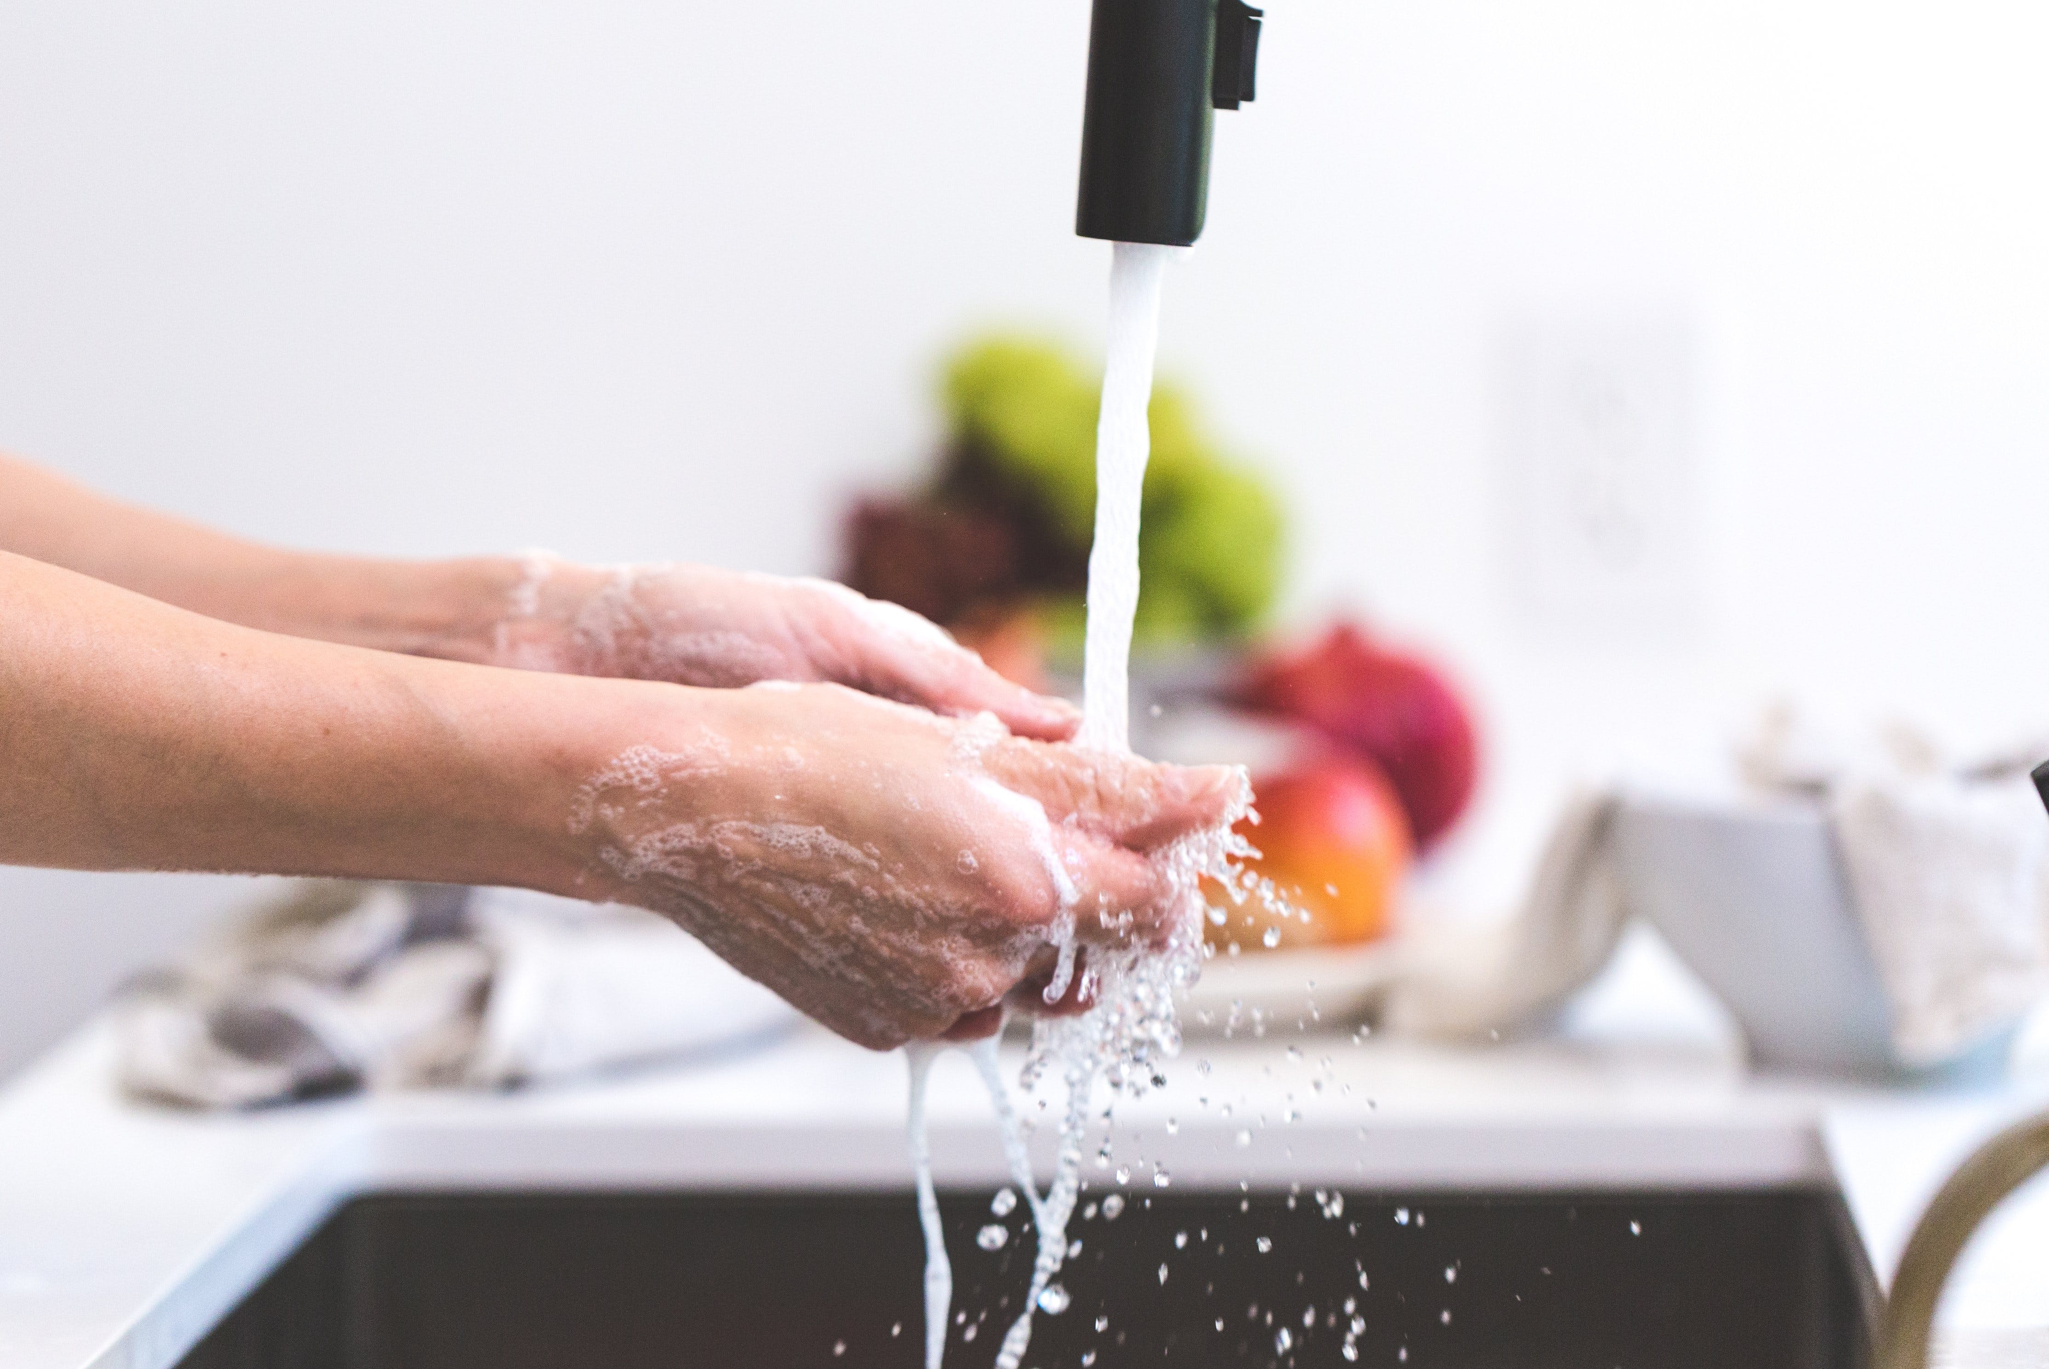
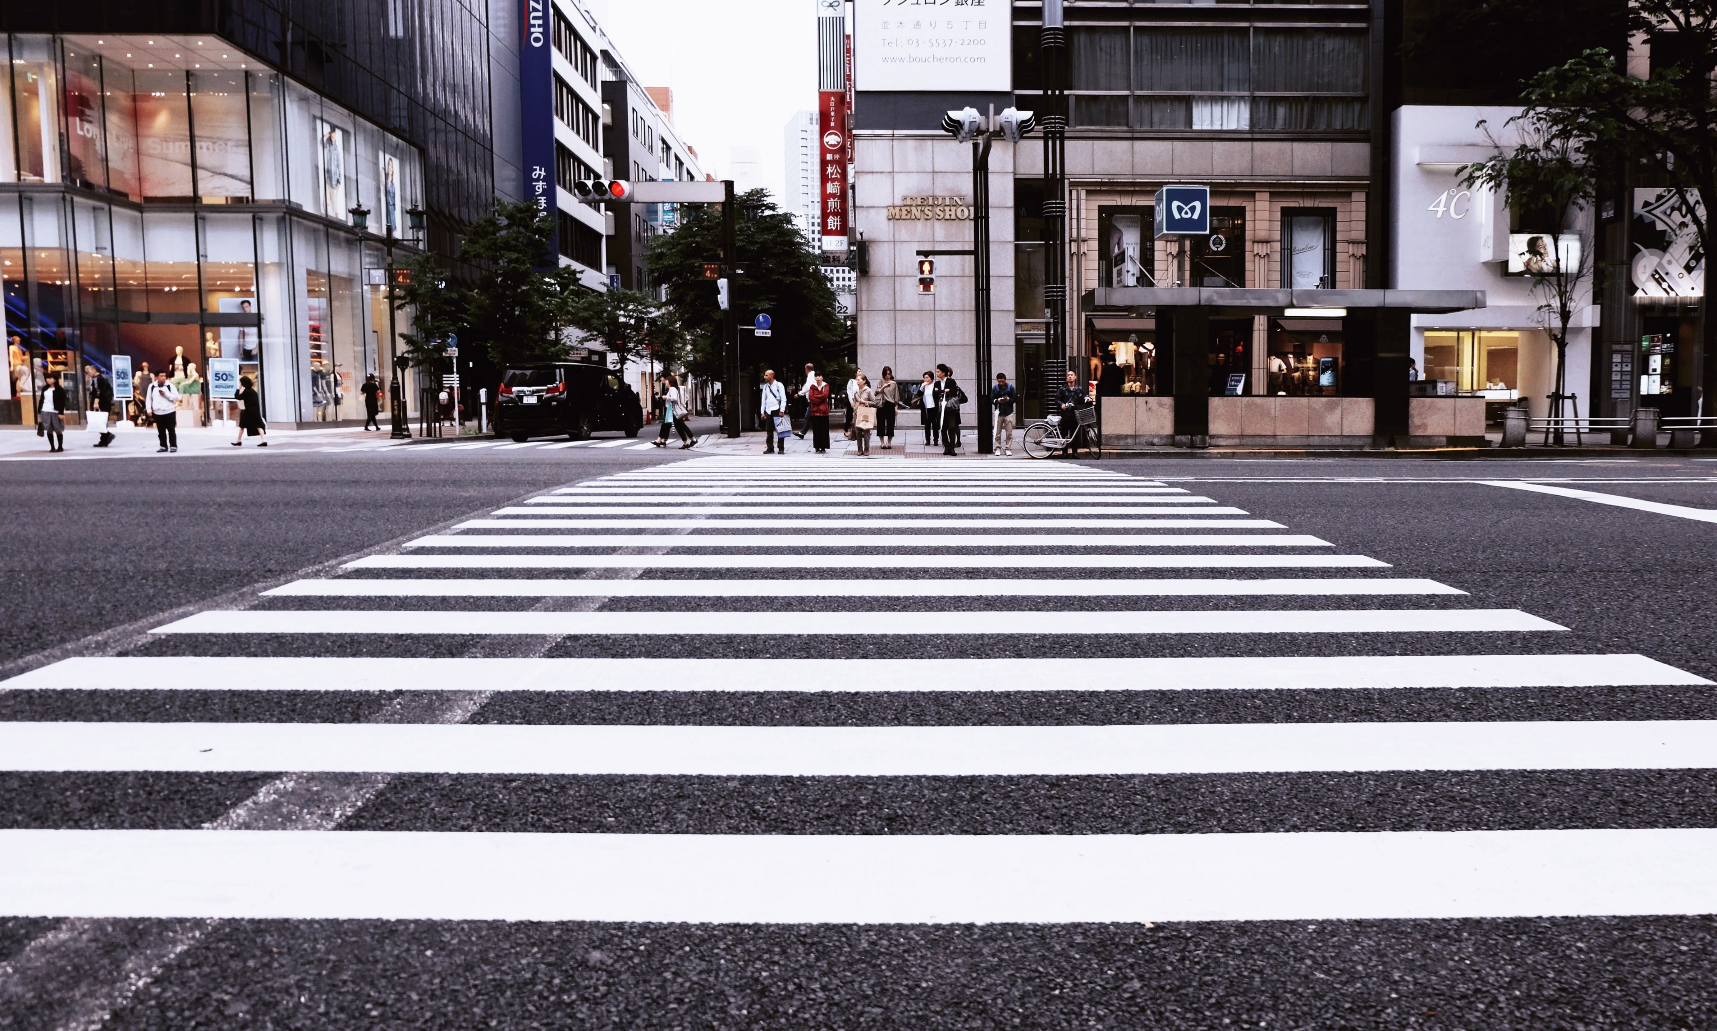
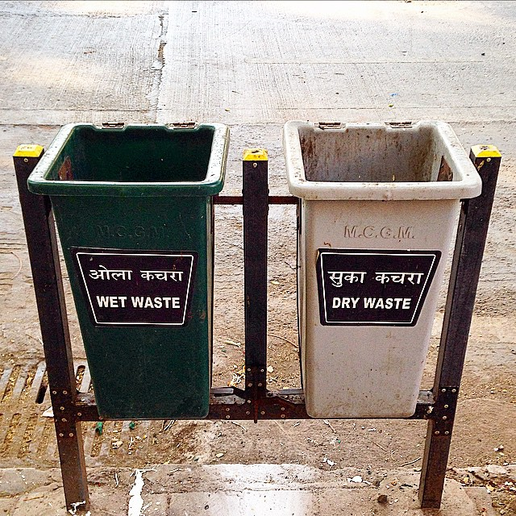
What do these signs say?
2
3
4
5
1
We should segregate garbage into wet and dry waste to keep the environment clean.
We ought to wash our hands before and after meals.
Pedestrians should cross the road here.
We should say thank you when we receive something.
We must be silent here.
Notes:
Notes for Teacher - Show the signs / symbols that are often seen in daily life. For example, traffic rules, signs related to health and hygiene, etc. Sentences ((using modal verbs) will be displayed on what they indicate. Students can match the signs with their corresponding meanings.
Suggestions: <Ideas/ Images/ Animations / Others – To make better representation of the content >
Source of Multimedia used in this slide -
Zebra crossing - https://pxhere.com/en/photo/1366651
Washing hands - https://www.pexels.com/photo/cooking-hands-handwashing-health-545013/
Wet and Dry bins - https://www.flickr.com/photos/gauravonomics/16079057092
Silence please - https://www.flickr.com/photos/94688236@N08/9021558258
Thank you - https://www.pexels.com/photo/thank-you-signage-2072165/

Slide 12
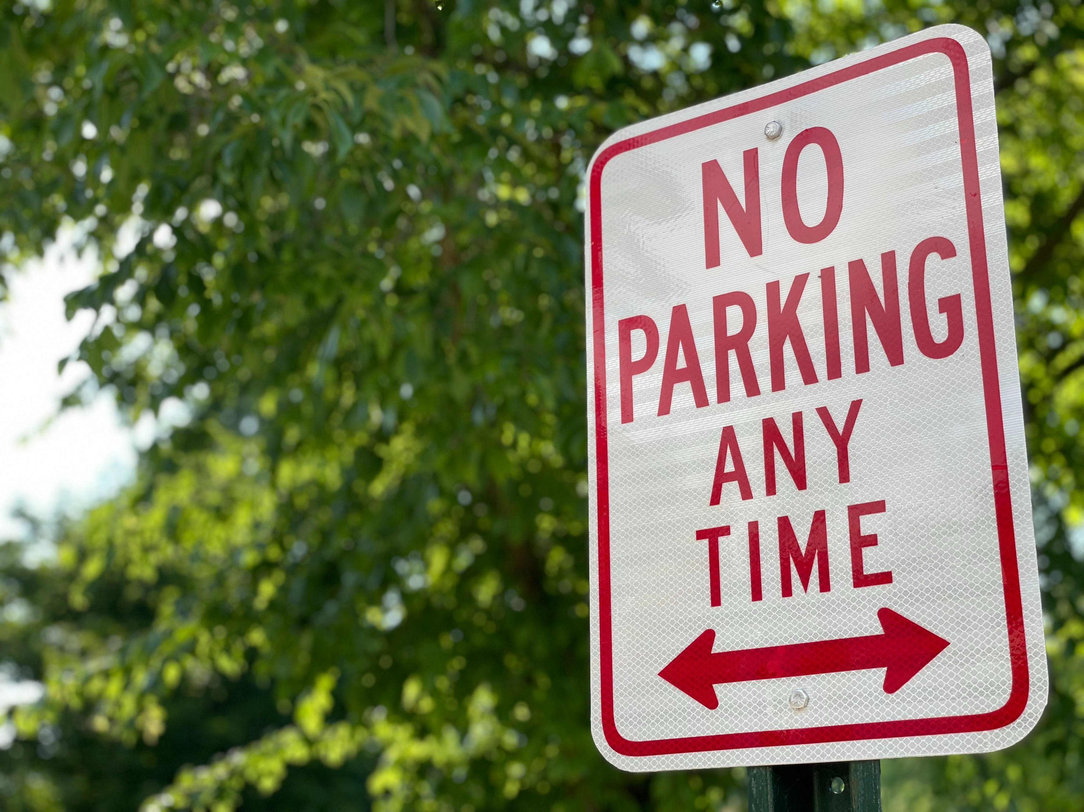
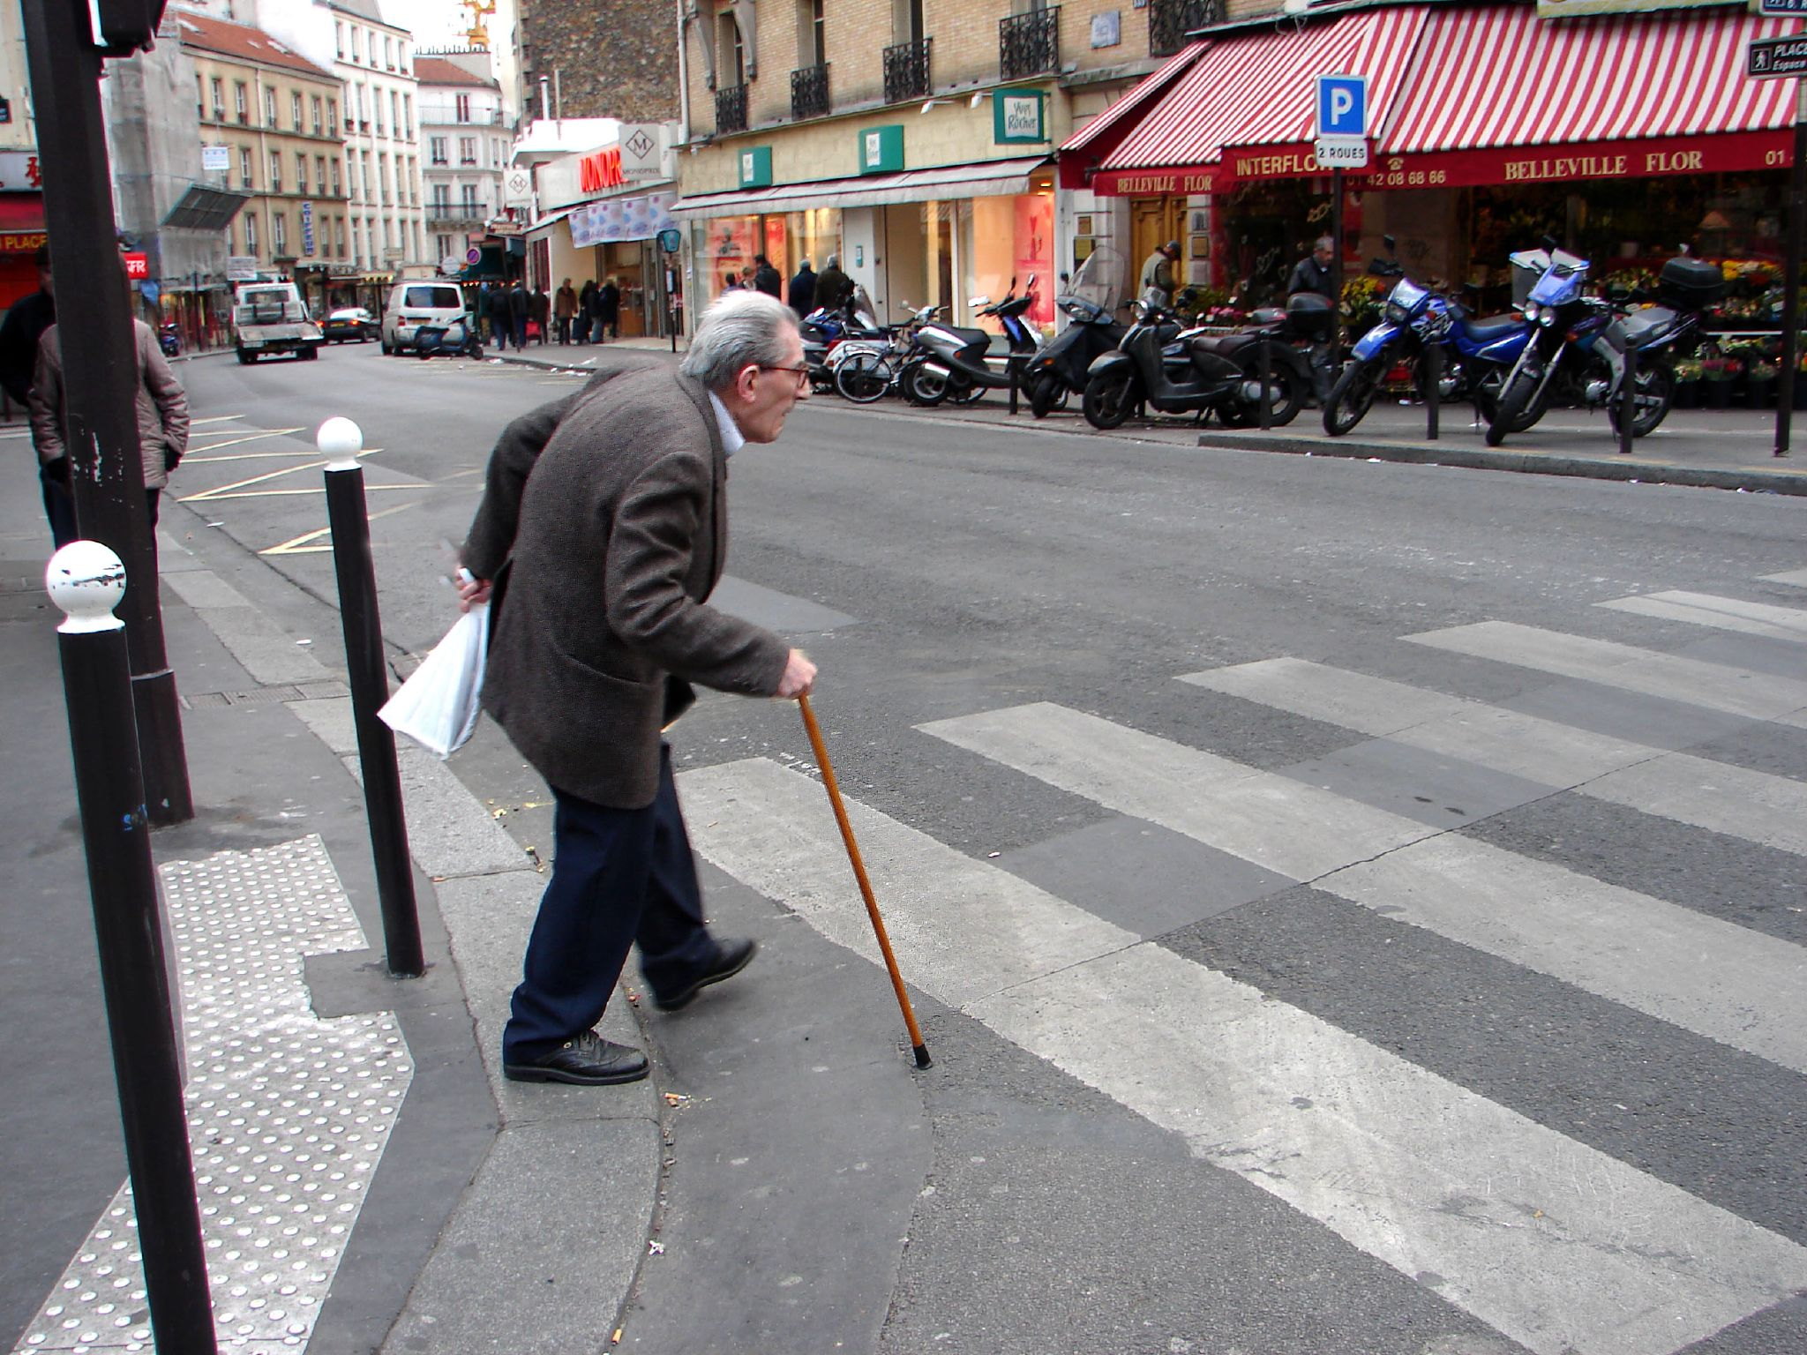
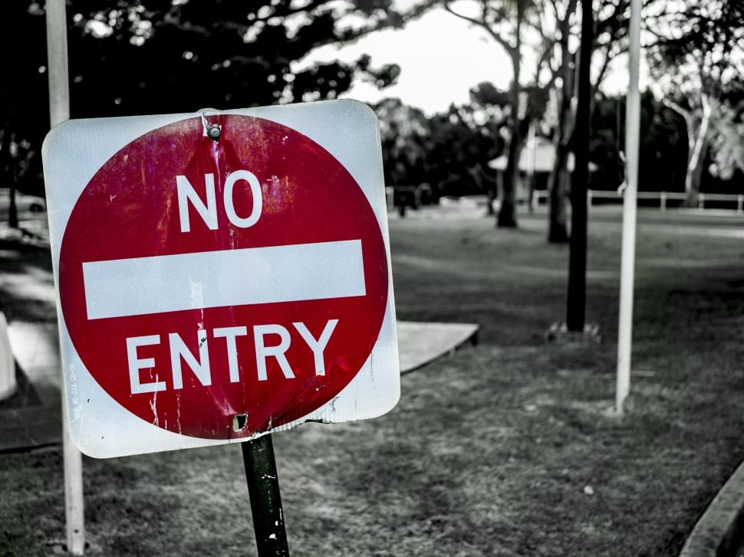
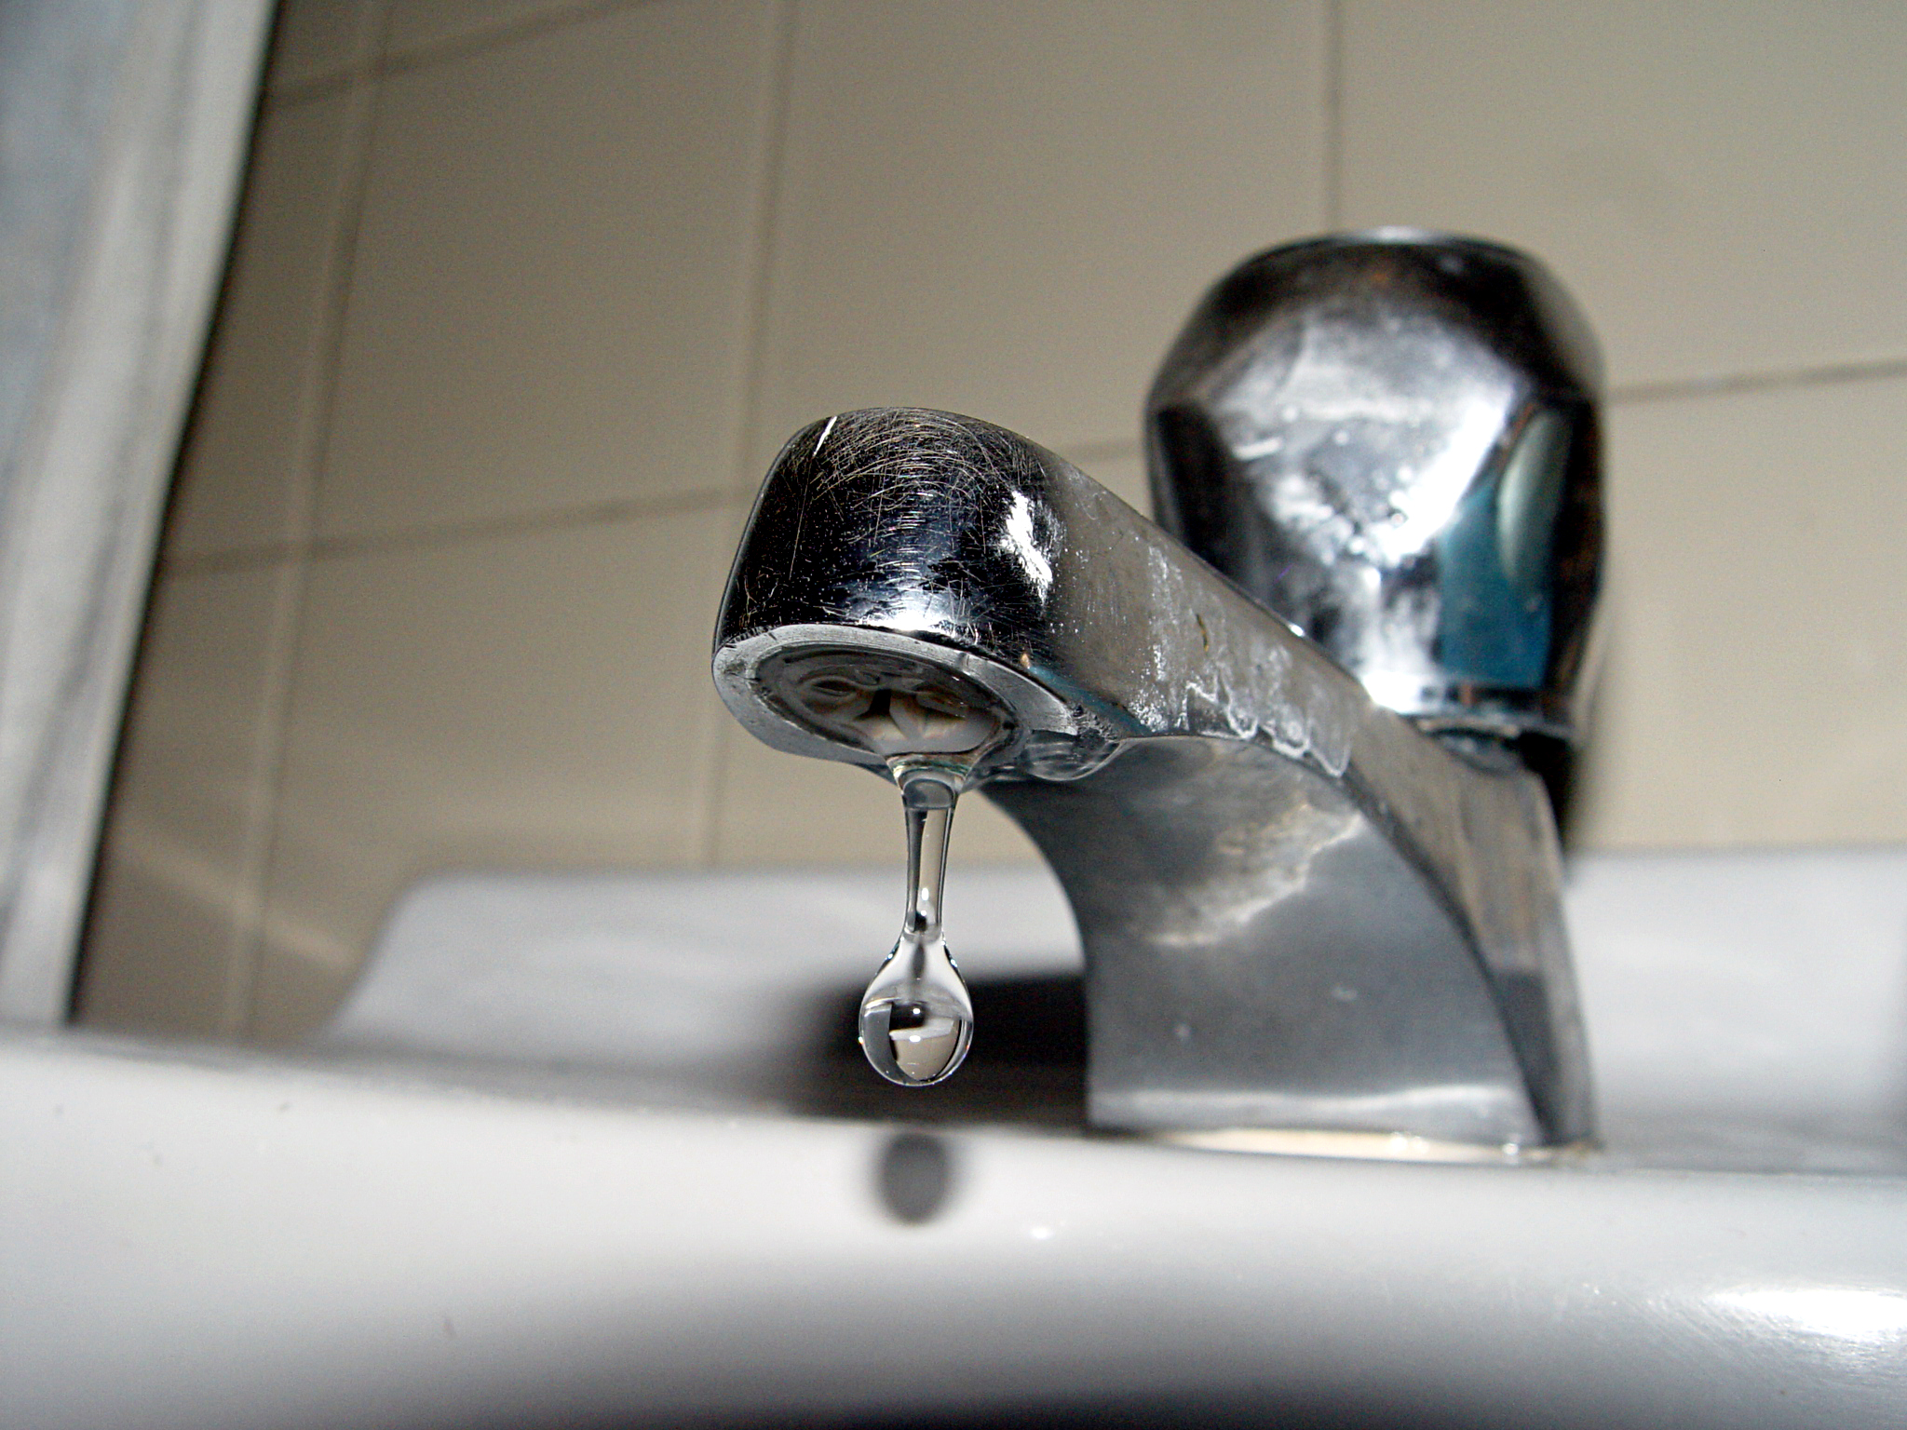
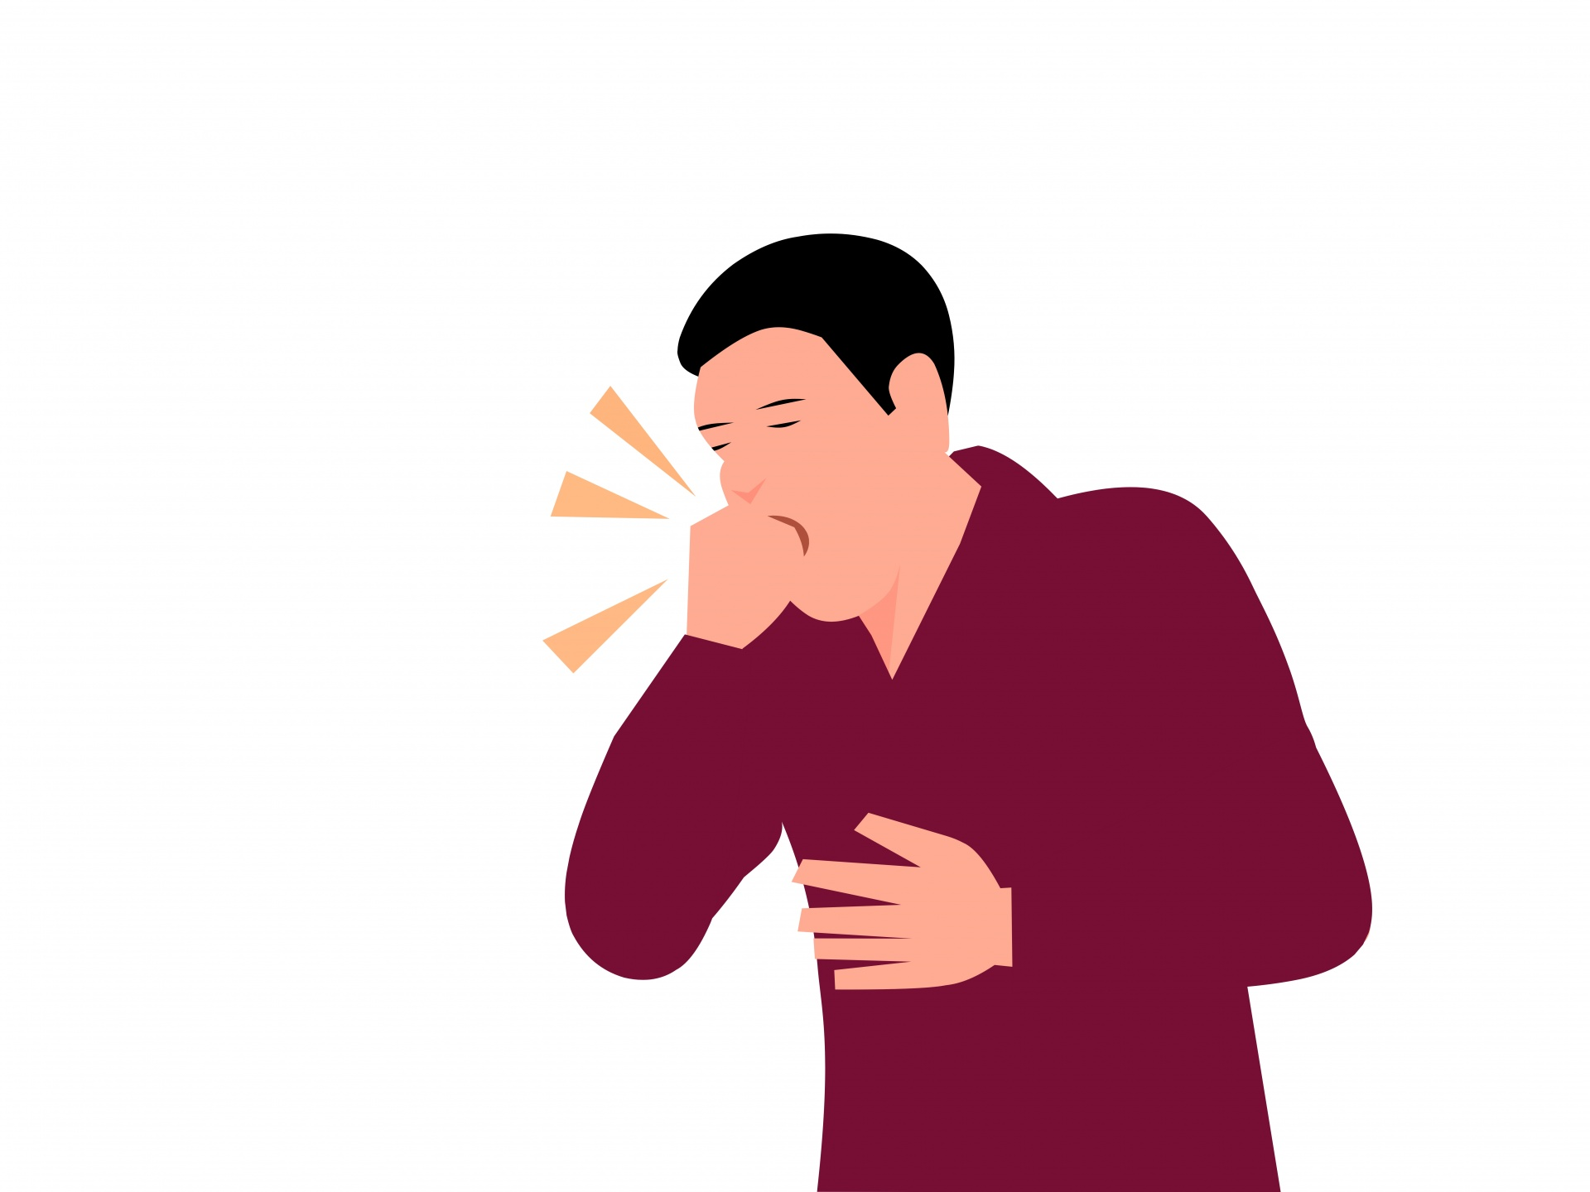
What do these signs say?
6
7
8
9
10
We could help the old man to cross the road.
We might have to go back because it is a no entry zone.
We cannot park the car here.
We must cover our mouth while coughing.
We would be able to save water if we did this.
Notes:
Notes for Teacher - Show the signs / symbols that are often seen in daily life. For example, traffic rules, signs related to health and hygiene, etc. Sentences ((using modal verbs) will be displayed on what they indicate. Students can match the signs with their corresponding meanings.
Suggestions: <Ideas/ Images/ Animations / Others – To make better representation of the content >
Source of Multimedia used in this slide -
Old man crossing - https://www.flickr.com/photos/joyoflife/100717997
Tap - https://commons.wikimedia.org/wiki/File:Dropping_faucet.jpg
No parking - https://www.pexels.com/photo/a-no-parking-sign-8309523/
No entry - https://www.peakpx.com/599297/white-and-red-no-entry-signage
Coughing - https://www.publicdomainpictures.net/en/view-image.php?image=492623&picture=cough-and-influenza

Slide 13
Attribution / Citation
Slide # | Thumbnail | Source link | Author
2 |  | https://openclipart.org/detail/343450/cricketer-colour-remix | j4p4n
11 |  | 1. Zebra crossing - https://pxhere.com/en/photo/1366651 2. Washing hands - https://www.pexels.com/photo/cooking-hands-handwashing-health-545013/ 3. Wet and Dry bins - https://www.flickr.com/photos/gauravonomics/16079057092 4. Silence please - https://www.flickr.com/photos/94688236@N08/9021558258 5. Thank you - https://www.pexels.com/photo/thank-you-signage-2072165/ | 1. pxhere.com 2. Burst 3. Gaurav Mishra 4. Funmilayo 5. George Dolgikh
12 |  | 1. Old man on road - https://www.flickr.com/photos/joyoflife/100717997 2. Tap - https://commons.wikimedia.org/wiki/File:Dropping_faucet.jpg 3. No parking - https://www.pexels.com/photo/a-no-parking-sign-8309523/ 4. No entry - https://www.peakpx.com/599297/white-and-red-no-entry-signage 5. Coughing - https://www.publicdomainpictures.net/en/view-image.php?image=492623&picture=cough-and-influenza | 1. Julie Kertesz 2. Angelo Gonzalez 3. Steve DiMatteo 4. peakpx.com 5. Mohamed Mahmoud Hassan

