Slide 1
Measures of Central Tendency
Notes:
Notes for Teacher - Welcome the children warmly and introduce the PowerPoint with excitement, mentioning that today they’ll learn about selecting the best cricket players through a fun story.
Suggestions: <Ideas/ Images/ Animations / Others – To make better representation of the content >
Source of Multimedia used in this slide - <Please provide source URL where we find the image and the license agreement>

Slide 2
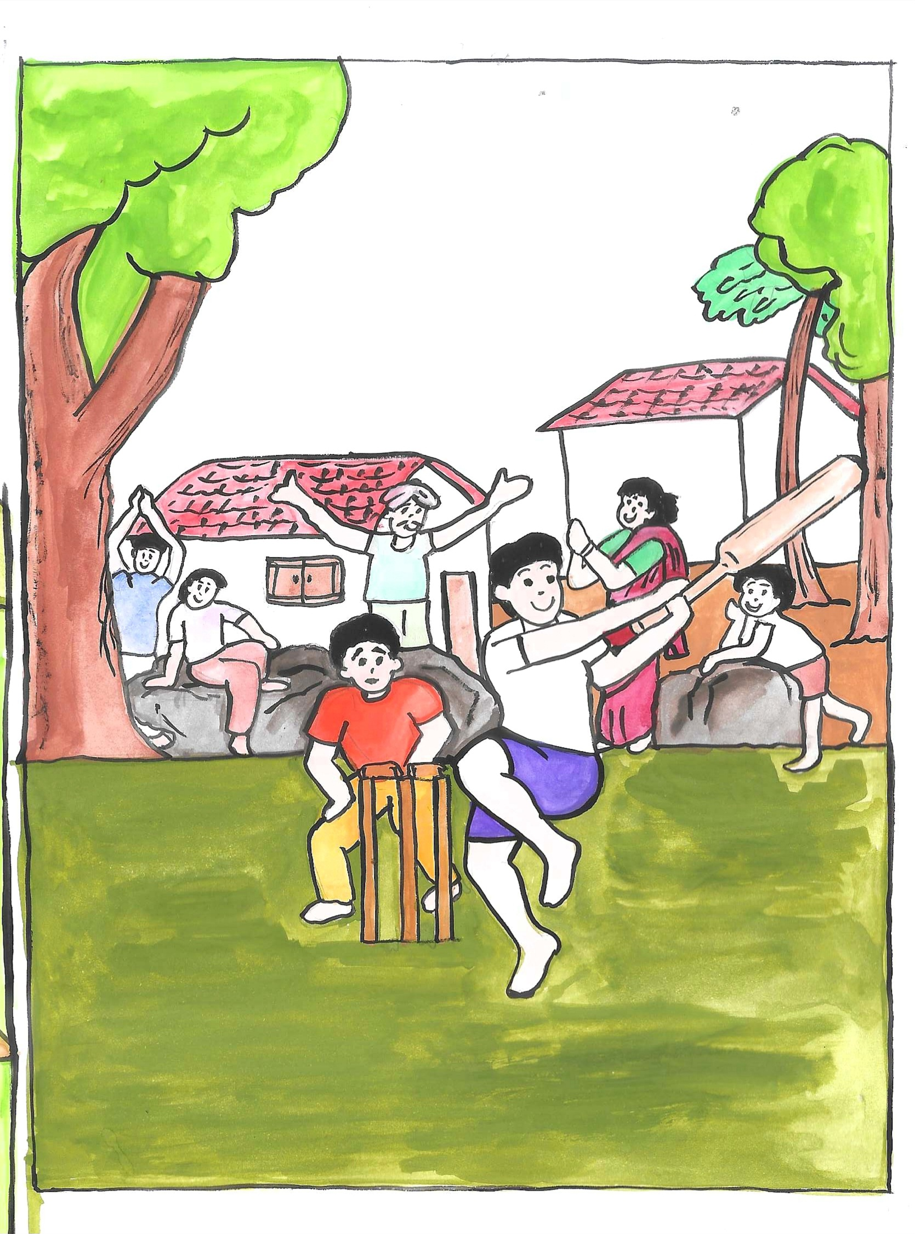
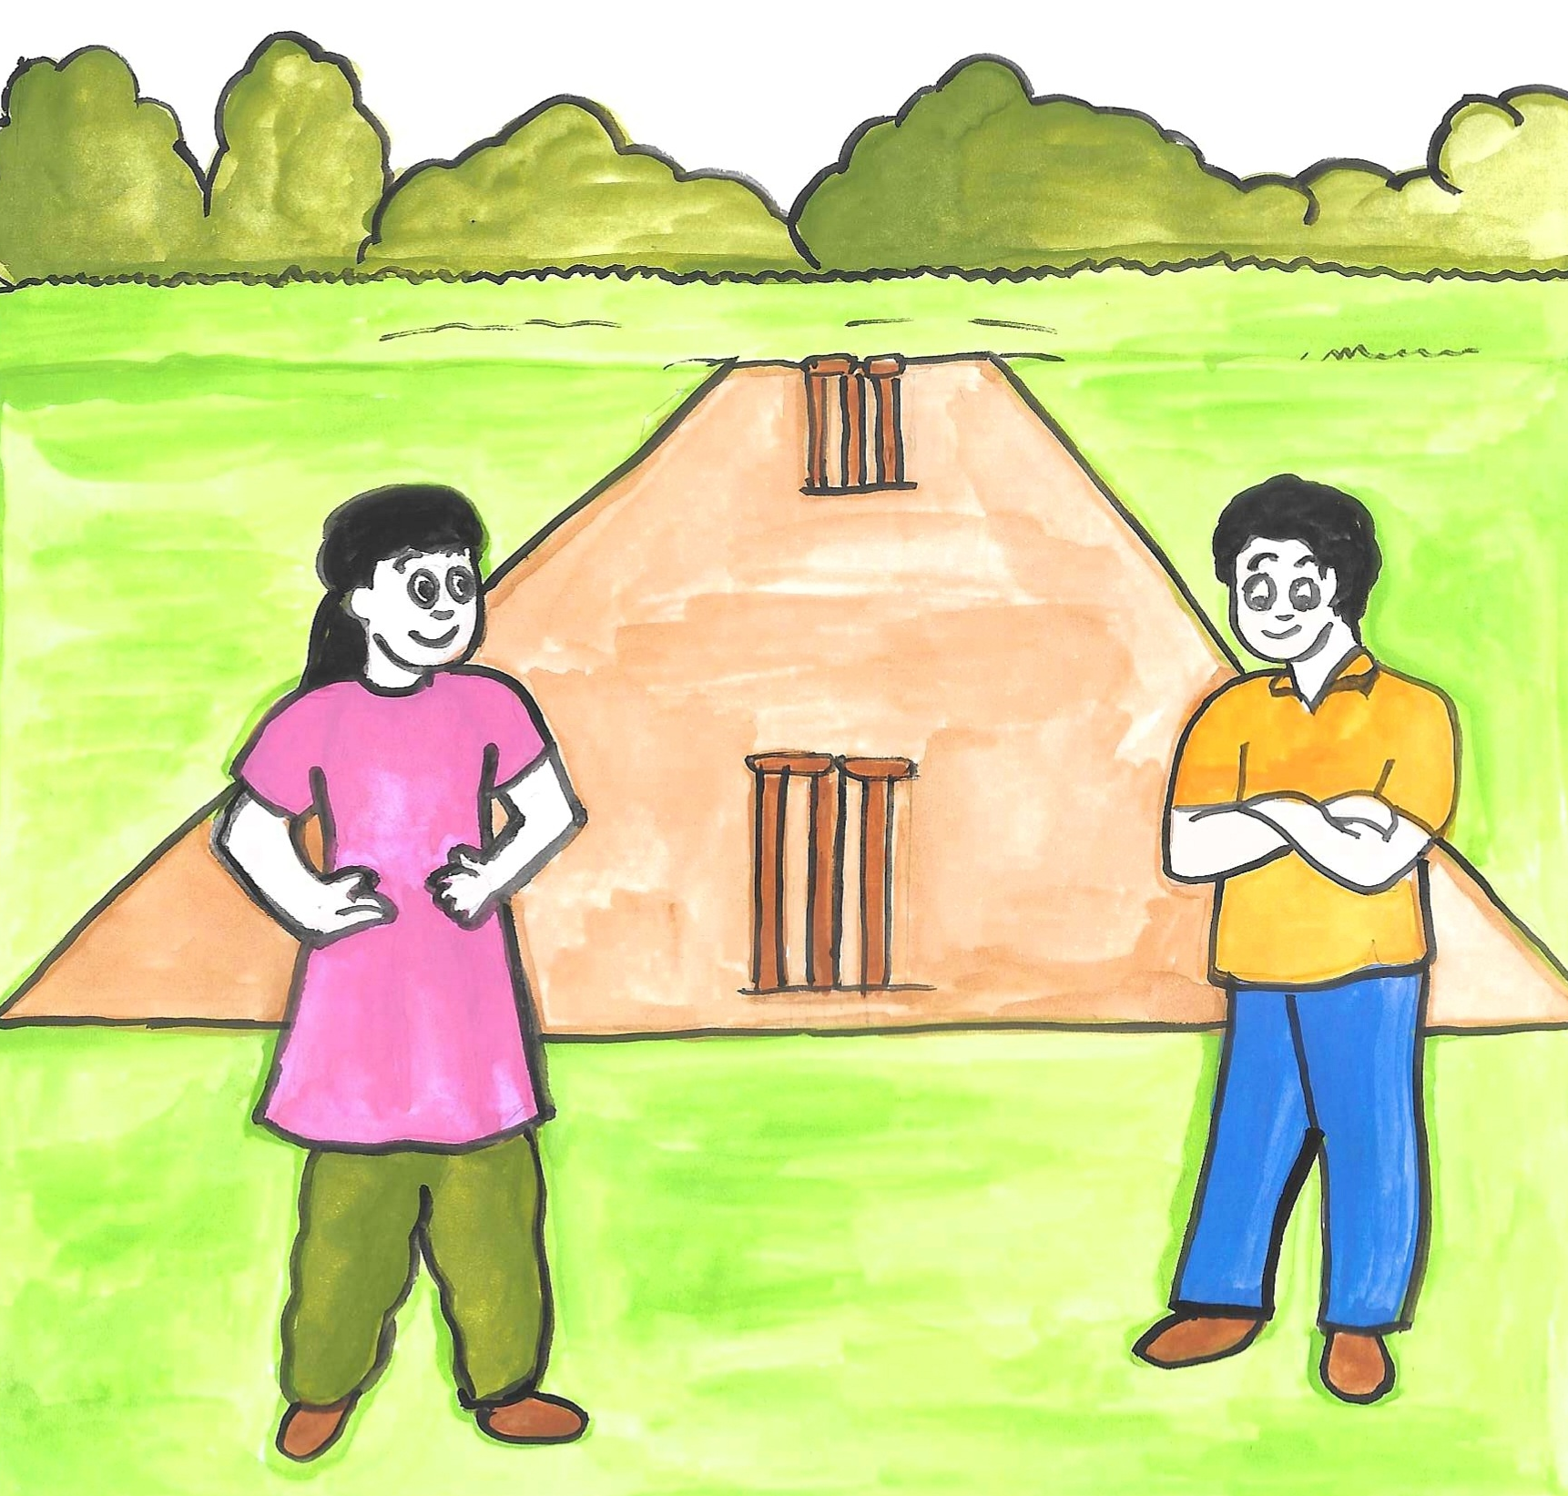
The village fervor
On one fine day, Meena and Raju stood by the cricket pitch, very excited!
Cricket is our favorite game. It makes our village one big happy family.
We are going to choose five best cricket players!
Notes:
Notes for Teacher - Tell the children about how cricket brings their village together, just like a big happy family. Encourage them to think of their own experiences with cricket in the village.
Suggestions: <Ideas/ Images/ Animations / Others – To make better representation of the content >
Source of Multimedia used in this slide - <Please provide source URL where we find the image and the license agreement>
Cricket Pitch:
Village game: https://drive.google.com/file/d/1yL35UzEnV4jvpCK3QonjS_mt2DsNXUuB/view (Media Bank)

Slide 3
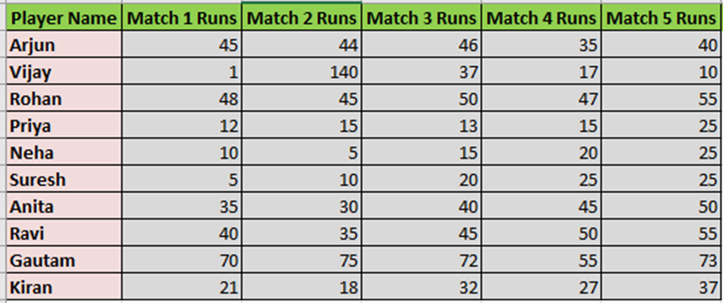
Meet the strategists
Raju and Meena, the smart children of the village, are planning their cricket team!
Notes:
Notes for Teacher - Introduce Raju and Meena as smart children who are planning their cricket team. Highlight their excitement and determination to succeed. Suggestions: <Ideas/ Images/ Animations / Others – To make better representation of the content >
Source of Multimedia used in this slide - <Please provide source URL where we find the image and the license agreement>

Slide 4
Selection dilemma
How do we pick the best five from these ten players? We need a good plan.
Kids, numbers will show you who to choose. Look at the scores carefully!
Dadi’s wisdom comes to the rescue!
Notes:
Notes for Teacher - Explain that picking the best players is not easy and that Raju and Meena need a good plan. Show how they feel puzzled at first, just like when the children face a difficult task. Share how Dadi, the wise elder, suggests using numbers to pick the best players. Emphasize that sometimes older people can give good advice because of their experience. Suggestions: <Ideas/ Images/ Animations / Others – To make better representation of the content >
Source of Multimedia used in this slide - <Please provide source URL where we find the image and the license agreement>

Slide 5
Diving into 'Mean'
Arjun | 45 | 44 | 46 | 35 | 40
Let's start with the ‘Mean'. It tells us who plays well most of the time.
Sum of all scores
Mean =
Example: The arithmetic mean of Arjun’s runs would be
=
=
= 42
Formula:
Number of scores
45+44+46+35+40
5
210
5
Notes:
Notes for Teacher - Explain the concept of 'mean' as an average. Use simple words to show how it helps find out who plays well most of the time, like when children share candies equally.
Suggestions: <Ideas/ Images/ Animations / Others – To make better representation of the content >
Source of Multimedia used in this slide - <Please provide source URL where we find the image and the license agreement>

Slide 6
Raju and Meena at work
See how we find out Arjun's mean score? It's easy!
=
= 42
45+44+46+35+40
5
Arjun | 45 | 44 | 46 | 35 | 40
210
5
Notes:
Notes for Teacher - Show the children how Raju and Meena calculate the mean score for Arjun, making it a simple step-by-step process they could follow themselves.
Suggestions: <Ideas/ Images/ Animations / Others – To make better representation of the content >
Source of Multimedia used in this slide - <Please provide source URL where we find the image and the license agreement>

Slide 7
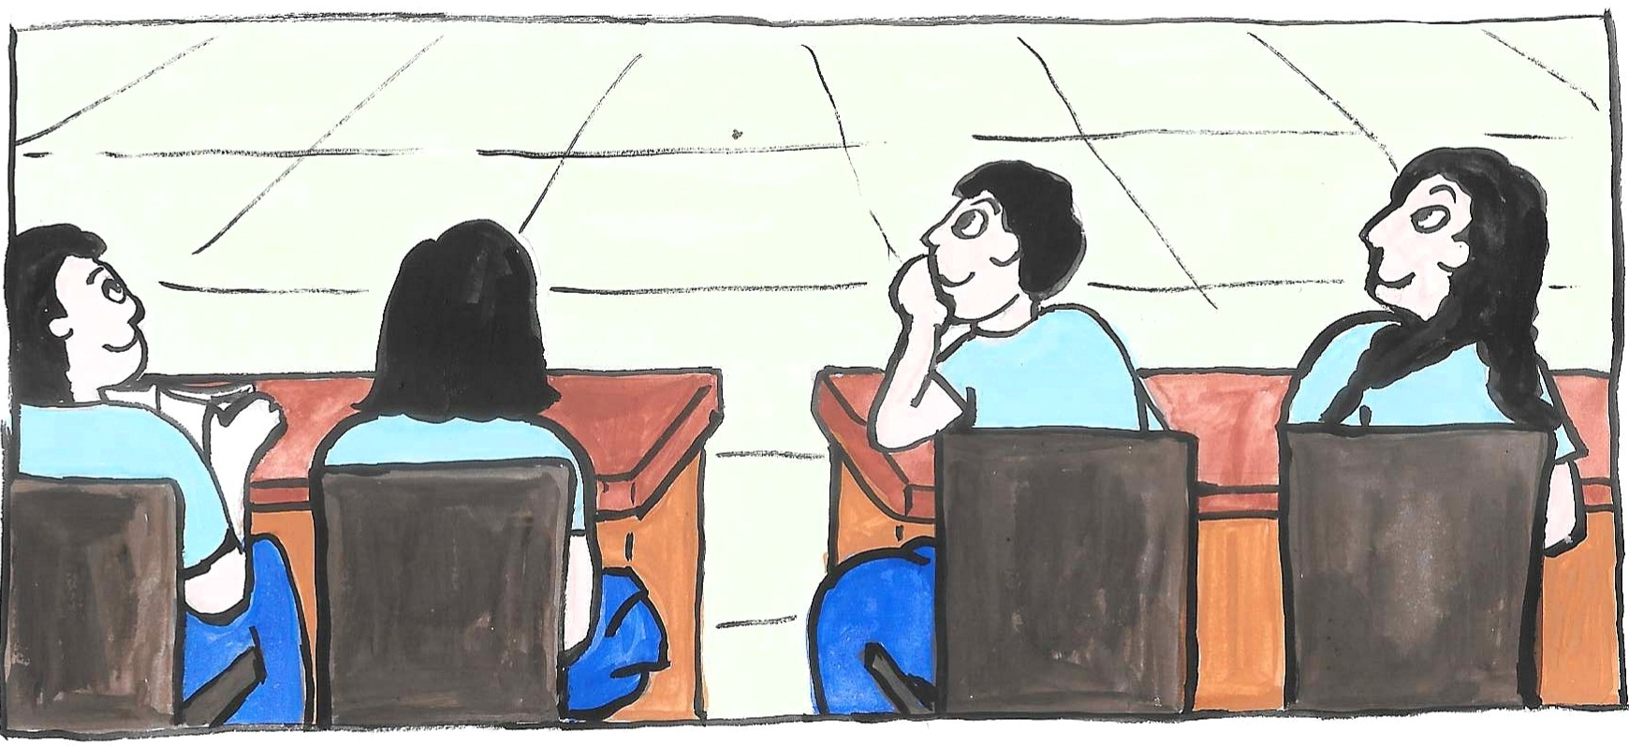
Interactive turn
Now it's your turn. Who wants to help us?
Notes:
Notes for Teacher - Encourage the children to think about how they would calculate the mean for other players. Ask if they feel ready to help Raju and Meena.
Suggestions: <Ideas/ Images/ Animations / Others – To make better representation of the content >
Source of Multimedia used in this slide - <Please provide source URL where we find the image and the license agreement>

Slide 8
Your mission begins!
Together, we can find the top players. Let's do it!
Notes:
Notes for Teacher - Motivate the children to take on the task of calculating mean scores, making it sound like an exciting mission to find the top players. Display the TLM (Chart with score table for their reference). As and when children calculate the mean, elicit from them and put it on the chart.
Suggestions: <Ideas/ Images/ Animations / Others – To make better representation of the content >
Source of Multimedia used in this slide - <Please provide source URL where we find the image and the license agreement>

Slide 9
Mean of the top 5 players
Gautam
Ravi
5
1
3
Mean - 69
Mean - 45
Vijay
Mean - 41
Rohan
Arjun
2
4
Look at Vijay's scores. He got one high score, but all the others are low.
Mean - 49
Mean - 42
Notes:
Notes for Teacher – Get the children to observe these line graphs, and note how consistent the players are. Point towards Vijay’s score and make them think how inconsistent his scores are.
Suggestions: <Ideas/ Images/ Animations / Others – To make better representation of the content >
Source of Multimedia used in this slide - <Please provide source URL where we find the image and the license agreement>
Ribbon – PPT Icon - Prize

Slide 10
Questions to ponder upon
Help me understand!
1
By looking at Vijay's score in the five matches, what do you understand about his performance as a player?
2
Can you consider his performance as consistent?
When we compare the scores of Anita (6th rank) and Vijay (5th rank), who do you think is more consistent?
3
Is there any method to find the best player other than the method of finding Mean?
4
Notes:
Note for teacher: With the help of the TLM ask the students these questions and elicit their responses.

Slide 11
Median to the rescue
I know why you are confused, Raju. Vijay’s scores are going up and down!
Yes Meena… how do we decide in such a case?
Children, for just such a scenario, we have ‘Median’, to help you come to a decision.
Median refers to the value which lies in the middle of the data, when arranged in an increasing or decreasing order.
Notes:
Notes for Teacher - Introduce the median as a way to find out what score a player usually gets. Explain it in a way that makes it sound like a hero coming to the rescue.
Suggestions: <Ideas/ Images/ Animations / Others – To make better representation of the content >
Source of Multimedia used in this slide - <Please provide source URL where we find the image and the license agreement>

Slide 12
Finding the median
We have Vijay at rank 5 and Anita at rank 6
Let's line up their scores in order and see which score is in the middle.
Vijay: 1, 10, 17, 37, 140
Median: 17
Anita: 30, 35, 40, 45, 50
Vijay | 1 | 140 | 37 | 17 | 10
Median: 40
Anita | 35 | 30 | 40 | 45 | 50
Notes:
Notes for Teacher - Show how to line up scores and find the middle one, using visuals to help. Explain that the median is like finding the middle seat in a row. Also explain that to find the median in a dataset with an even number of entries, sort the data in order, find the two middle numbers, and calculate their average. This average is the median.
Suggestions: <Ideas/ Images/ Animations / Others – To make better representation of the content >
Source of Multimedia used in this slide - <Please provide source URL where we find the image and the license agreement>

Slide 13
Decision time
Vijay:
Mean - 41
Median - 17
With these mean and median, who will be our fifth player?
Anita:
Mean - 40
Median - 40
Notes:
Notes for Teacher - Ask the children to think about who might be the best player based on the mean and median. Create a sense of anticipation and decision-making. Clear if there is any confusion or misconception.
Suggestions: <Ideas/ Images/ Animations / Others – To make better representation of the content >
Source of Multimedia used in this slide - <Please provide source URL where we find the image and the license agreement>
Question Marks: https://pixabay.com/vectors/question-interrogation-423604/ (guilaine)

Slide 14
Final team huddle
So, there we are! These numbers help us make our dream team.
Notes:
Notes for Teacher - Celebrate as Raju and Meena almost complete their team. Encourage the children to feel proud of the work they’ve done.
Suggestions: <Ideas/ Images/ Animations / Others – To make better representation of the content >
Source of Multimedia used in this slide - <Please provide source URL where we find the image and the license agreement>
Question Marks: https://pixabay.com/vectors/question-interrogation-423604/ (guilaine)

Slide 15
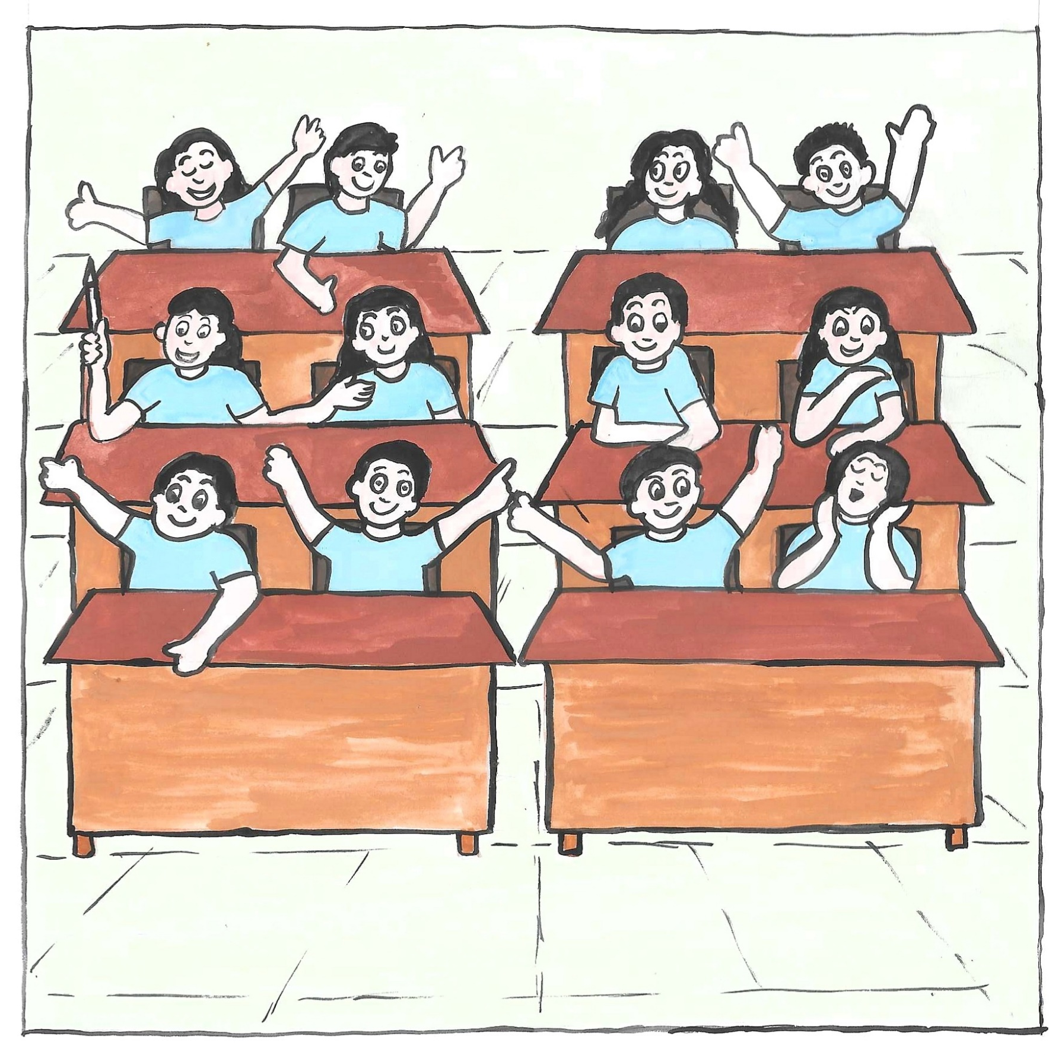
Conclusion and next steps
Great job! Thanks for helping us in selecting the best 5 batsmen.
Notes:
Notes for Teacher: Encourage children to think about other situations where they can use mean and median, like comparing scores in games or even grades in class. This will help them see how useful numbers can be in making fair and smart decisions.
Suggestions: <Ideas/ Images/ Animations / Others – To make better representation of the content >
Source of Multimedia used in this slide - <Please provide source URL where we find the image and the license agreement>

Slide 16
What else?
Oh, yes!
In all their scores, 45 runs are the most scored runs!
Children, shall I tell you another interesting concept? It is called ‘Mode’.
Interesting! Can we spot Mode in our top players’ scores here?
Mode is the value that appears most frequently in a data set.
Notes:
Notes for Teacher: Explain the concept of mode and conclude the session by saying, the mode represents the most frequent value in data sets. For instance, market researchers use it to identify the best-selling items, such as the most popular snacks in a store." Suggestions: <Ideas/ Images/ Animations / Others – To make better representation of the content >
Source of Multimedia used in this slide - <Please provide source URL where we find the image and the license agreement>

Slide 17
Attribution / Citation
Slide # | Thumbnail | Source link | Author
12 |  | https://pixabay.com/vectors/question-interrogation-423604/ | guilaine
2 - 14 | All illustrations | Media Bank - Cricket
Notes:
Notes for Teacher - < Information for further reference or explanation >
Suggestions: <Ideas/ Images/ Animations / Others – To make better representation of the content >
Source of Multimedia used in this slide - <Please provide source URL where we find the image and the license agreement>

