Slide 1
INTRODUCTION TO
RATIONAL NUMBERS

Slide 2
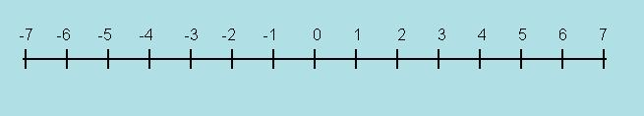
Rational Numbers
Introduction To Rational Numbers
The number system consists of
      Natural numbers N (1,2,3,….)
      Whole numbers W (0,1,2,3,…)
      Integers Z (….,-2,-1,0,1,2,…)
All the above set of numbers can be located on a number line.
Notes:
Source of Multimedia Objects (Image/audio/ Video/Animation) used in this slide -
1. Clip art

Slide 3
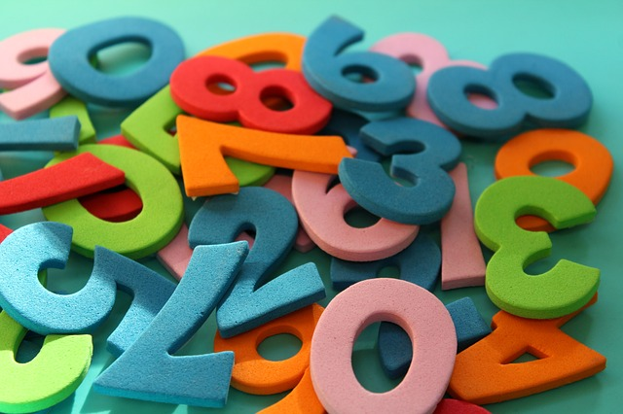
Integers
Introduction To Rational Numbers
An Integer is a whole number (not a fractional number) that can be positive, negative, or zero.
Notes:
Source of Multimedia Objects (Image/audio/ Video/Animation) used in this slide -
1. https://pixabay.com/photos/digits-counting-mathematics-4014181/

Slide 4
Introduction To Rational Numbers
Integers
We know that operations on integers are closed
under Addition,Subtraction and Multiplication.
Addition of integers results in an integer.
-1 + (-2) = -3
Subtraction of integers results in an integer.
        -5 - (-3) = -5 + 3 = -2
Multiplication of integers results in an integer.
4 x -2 = -8

Slide 5
Introduction To Rational Numbers
Integers
Consider the operation division of integers
48/6 = 8 , 39/13 = 3, -25/5 = -5 are Integers.
However consider the following cases.
-5/2 = ? ,-9/13 = ?,3/2 = ?.....
The answer to the above division is not in the set of integers.
(i.e.) the quotient is not an integer.

Slide 6
Introduction To Rational Numbers
Integers
Location of 3/2 on number line
Consider a line segment 3 units long extending from 0 to 3.
3/2 means that it is exactly half the distance from 0 to 3.
Locate the midpoint between 0 to 3 and name the midpoint as A.
Point A represents the number 3/2 on the number line.
← 3 units →
A (3/2)
Notes:
Source of Multimedia Objects (Image/audio/ Video/Animation) used in this slide -
1. Clip Art and power point tools

Slide 7
Introduction To Rational Numbers
Integers
← 3 units →
A (3/2)
Clearly, Point A is not an element in the set of integers.
Hence a new system of numbers is to be introduced in order to name the numbers such as 3/2, -4/5….etc.
We extend the number system by introducing quotient of integers called Rational numbers.
Notes:
Source of Multimedia Objects (Image/audio/ Video/Animation) used in this slide -
1. Clip Art and power point tools

Slide 8
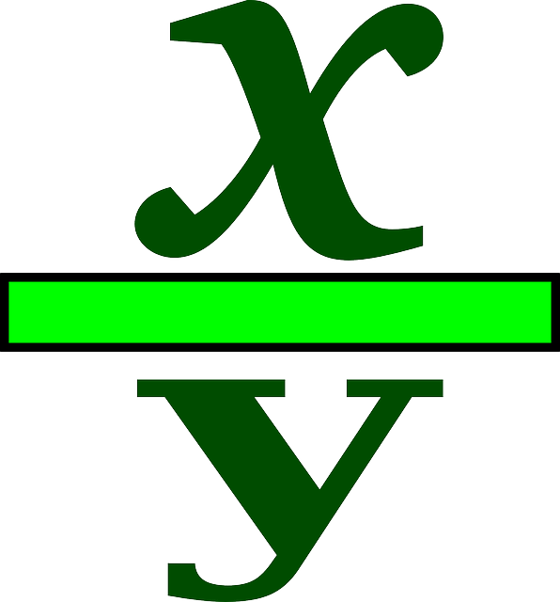
Introduction To Rational Numbers
Rational Number
A number is considered a Rational number if it can be written as one integer divided by another integer.
Rational number is a number of the form x/y where x and y are integers and y≠0.
Examples: -2/5, 4/7, 3/-8,…..

Slide 9
Introduction To Rational Numbers
Rational Number
Rational numbers gets its name from the root word ‘Ratios’.
Set of Rational numbers is denoted by letter ‘Q’.
Let us see a chart which clearly explains the number system including rational numbers.

Slide 10
Introduction To Rational Numbers
Rational Number
FROM THIS CHART IT IS CLEAR THAT
Every natural number n is a rational number as it can be expressed as n/1 .Example 3=3/1 is of the form p/q
Every whole number w is a rational number as it can be expressed as w/1 .Example 0=0/1 is of the form p/q
Every integer z is a rational number as it can be expressed as z/1 .Example 7=-7/1 is of the form p/q
RATIONAL NUMBERS(Q)
INTEGERS (I)
WHOLE NUMBERS(W)
NATURAL NUMBERS (N)

Slide 11
Introduction To Rational Numbers
Rational Number
RATIONAL NUMBERS(Q)
INTEGERS (I)
WHOLE NUMBERS(W)
NATURAL NUMBERS (N)
However all rational numbers are not
Natural numbers or Whole Numbers or Integers.

Slide 12

Introduction To Rational Numbers
Fraction
a
Fractions are ratios of the form a/b where a and b are natural numbers .Examples are 3/4, 9/5, 1/7…etc.
b
Note that all fractions are of the form p/q.
Hence all fractions are rational numbers but all rational numbers need not be fractions.

Slide 13
Introduction To Rational Numbers
Rational Number
Types of rational numbers
The rational numbers are either positive or negative.
POSITIVE RATIONAL NUMBER | NEGATIVE RATIONAL NUMBER
A rational number p/q is said to be positive if both p and q are positive integers or both are negative integers. | A rational number p/q is said to be negative if its numerator and denominator are of opposite signs such that one of them is a positive integer and other is a negative integer.
Examples are ¼, -2/-3, -6/-7, 3/8….etc | Examples are -5/3, 1/-2, -4/7,-3/4….etc

Slide 14
Introduction To Rational Numbers
Positive Rational Number
Observe that a rational number is positive if both numerator and denominator are of the same sign.
Note:
Every natural number is a positive rational number.
Every whole number is a positive rational number except 0 which is neither positive nor negative.
Every positive integer is a positive rational number.

Slide 15
Introduction To Rational Numbers
Negative Rational Number
Observe that a rational number is negative if numerator and denominator are of opposite signs.
Note:
Every negative integer is a negative rational number.

Slide 16




MM Index
Slide# | Thumbnail | Source and Attribution
2, 6 & 7 |  | Clip Art and power point tools
3 |  | https://pixabay.com/photos/digits-counting-mathematics-4014181/
8 & 9 |  | https://pixabay.com/vectors/fraction-variables-math-division-27885/
12 |  | https://pixabay.com/vectors/fraction-symbol-icon-27235/

