Slide 1
I
I
E
P
DISCOVERY OF RATIONAL NUMBERS
Integral Education FOR ALL, BY ALL
Notes:
1

Slide 2

RATIONAL NUMBER
A number is considered a rational number if it can be written as one integer divided by another integer.
Pythagoras discovered Rational numbers
Notes:
Source of Multimedia Objects (Image/audio/ Video/Animation) used in this slide -
1. https://pixabay.com/vectors/fraction-variables-math-division-27885/

Slide 3
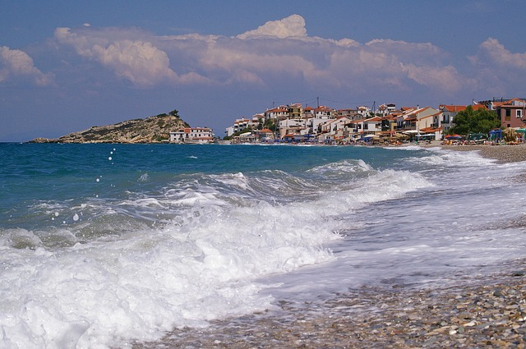
PYTHAGORAS
Pythagoras (580 – 500 BC) was born in a Greek island in the eastern Aegean Sea called Samos.
Due to conflicts in Samos, he moved to a peaceful place called Croton.
Notes:
https://pixabay.com/photos/wave-samos-kokk%C3%A1ri-surf-summer-849275/

Slide 4
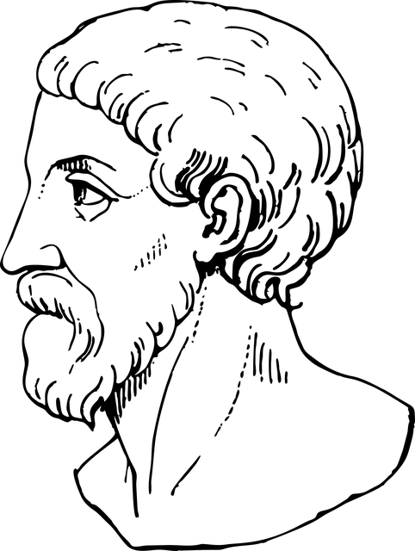
PYTHAGORAS
He formed Pythagorean School for ethical and religious purposes.
It was a strict society governed by a set of rules.
The members recognized one another by means of secret signs.
Notes:
https://pixabay.com/vectors/pythagoras-greek-mathematician-5649998/

Slide 5
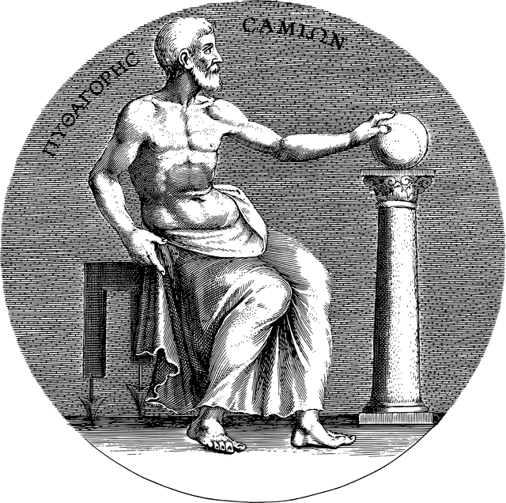
PYTHAGOREAN SCHOOL
Their attire was simple.
They had a restricted diet.
They considered that all quantities could be explained by whole numbers and their ratios (rational numbers).
Notes:
https://pixabay.com/vectors/pythagoras-portrait-line-art-greek-5652846/

Slide 6
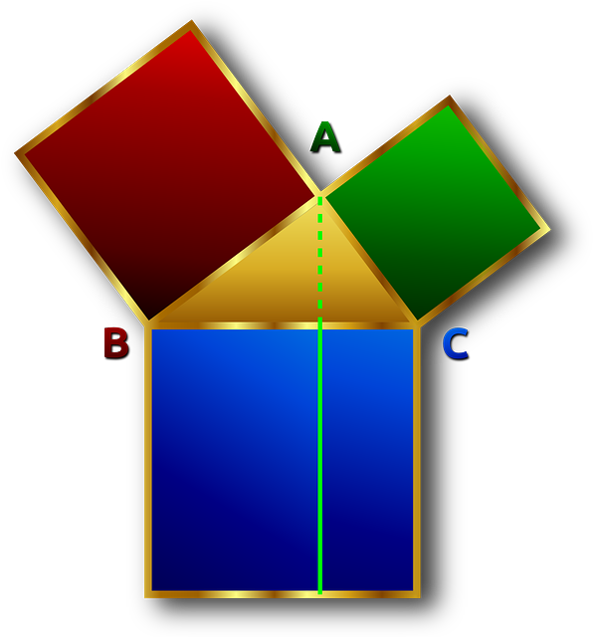
PYTHAGOREAN SCHOOL
The Pythagorean School became politically active on
the side of aristocracy.
The citizens turned against him and his followers burning his house.
Unfortunately, very little is known about Pythagoreans due to their very secretive ways.
Notes:
https://pixabay.com/vectors/rectangular-perpendicular-pythagoras-153525/

Slide 7
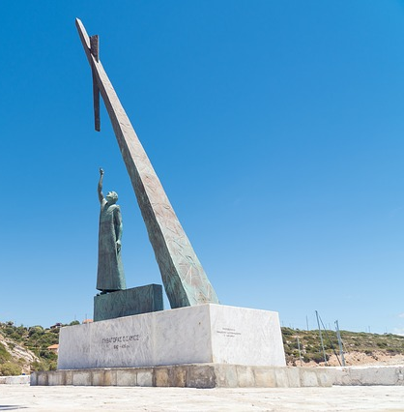
PYTHAGOREAN SCHOOL
As a result he moved to Southern Italy and there he died at the age of eighty.
Pythagoras left no written works, but his ideas were carried on by his eager disciples.
Notes:
Source of Multimedia Objects (Image/audio/ Video/Animation) used in this slide -
1. https://pixabay.com/photos/statue-pythagoras-math-village-3754825/

Slide 8


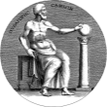
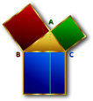
MM Index
Slide# | Thumbnail | Source and Attribution
2 |  | https://pixabay.com/vectors/fraction-variables-math-division-27885/
3 |  | https://pixabay.com/photos/wave-samos-kokk%C3%A1ri-surf-summer-849275/
4 |  | https://pixabay.com/vectors/pythagoras-greek-mathematician-5649998/
5 |  | https://pixabay.com/vectors/pythagoras-portrait-line-art-greek-5652846/
6 |  | https://pixabay.com/vectors/rectangular-perpendicular-pythagoras-153525/
7 |  | https://pixabay.com/photos/statue-pythagoras-math-village-3754825/

