Slide 1
RATIONAL NUMBERS
ON NUMBER LINE

Slide 2
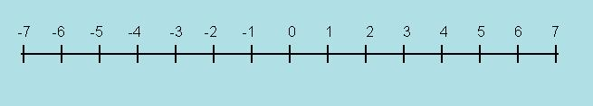
Introduction
Rational Numbers on Number Line
Consider the number line shown below.
Observe that the Positive Integers are represented to the right of zero and Negative Integers are represented to the left of zero.
Notes:
Source of Multimedia Objects (Image/audio/ Video/Animation) used in this slide -
1. Clip art

Slide 3
Representation on a Number Line
Rational Numbers on Number Line
Representation of rational numbers on the number line also follow the same rules.
A positive rational number is represented to the right of zero and a negative rational number is represented to the left of zero.
Notes:
Source of Multimedia Objects (Image/audio/ Video/Animation) used in this slide -
1. https://openclipart.org/detail/132205/set-of-number-rays

Slide 4
Rational Numbers on Number Line
Steps for Plotting
Check if the rational number is positive or negative number.
If positive, it is plotted to the right of zero.
If negative, it is plotted to the left of zero.
Consider the denominator of the rational number.
Divide each unit length on the number line into as many equal parts as in the denominator of the rational number.
Now, plot the rational number by counting the number of parts as in the numerator.

Slide 5
Rational Numbers on Number Line
Illustration
To plot Rational Number 4/5 on the number line
Step 1: 4/5 is a positive rational number. Hence, it would be located to the right of zero.
Step 2: 4/5 is less than 1. So, the rational number lies between 0 and 1. Here, the denominator is 5. Hence, divide each unit length into 5 equal parts.
Notes:
Source of Multimedia Objects (Image/audio/ Video/Animation) used in this slide -
1. Clip Art and power point tools

Slide 6
Rational Numbers on Number Line
Illustration
Step 3:
In the rational number 4/5, the numerator is 4. Hence count 4 places to the right of zero to locate the rational number 4/5 on the number line.
4/5
Notes:
Source of Multimedia Objects (Image/audio/ Video/Animation) used in this slide -
1. Clip Art and power point tools

Slide 7
Rational Numbers on Number Line
Illustration
To plot Rational Number -3/2 on the number line
Step 1: -3/2 is a negative rational number. Hence it would be located to the left of zero.
Step 2: -3/2 is less than -1 and lies between -1 and -2.
In the rational number -3/2, the denominator is 2. Hence divide each unit length into 2 equal parts.
Notes:
Source of Multimedia Objects (Image/audio/ Video/Animation) used in this slide -
1. Clip Art and power point tools

Slide 8
Rational Numbers on Number Line
Illustration
Step 3:
In the rational number -3/2, the numerator is -3. Hence count 3 places to the left of zero to locate the rational number -3/2 on the number line.
-3/2
Notes:
Source of Multimedia Objects (Image/audio/ Video/Animation) used in this slide -
1. Clip Art and power point tools

Slide 9
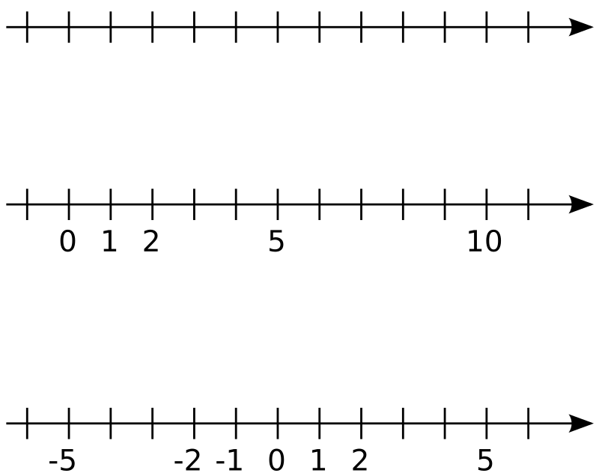
MM Index
Slide# | Thumbnail | Source and Attribution
2,3,5,6,7,8 |  | https://openclipart.org/detail/132205/set-of-number-rays

