Slide 1

RATIONAL NUMBERS IN DAILY LIFE

Slide 2
Rational Numbers In Daily Life
We observe that rational numbers are used extensively in many real life situations.
Notes:
Source of Multimedia used in this slide:
https://pixabay.com/vectors/fraction-math-mathematics-algebra-27242/

Slide 3
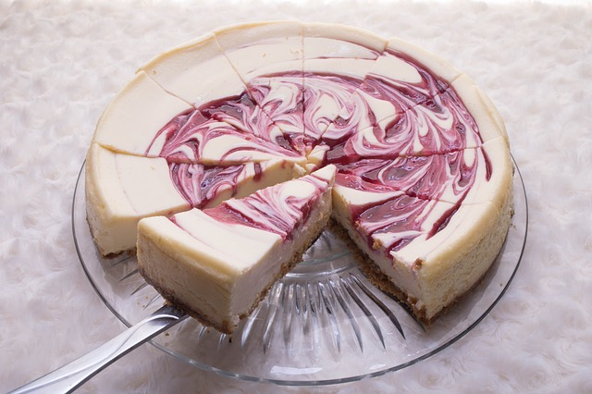
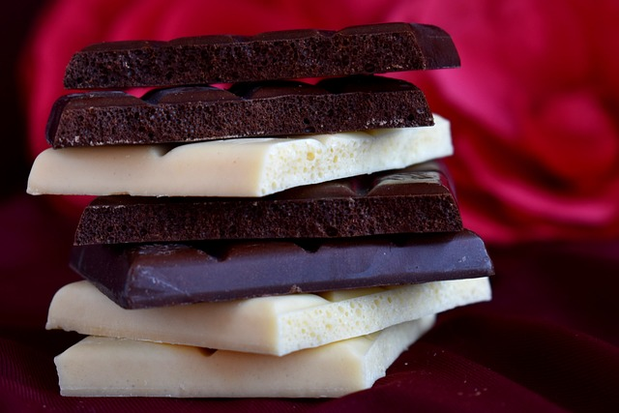
Rational Numbers In Daily Life
1) Whenever a bar of chocolate or a cake or fruit is to be shared amongst people, rational numbers are involved.
Example
When a bar of chocolate is divided amongst four friends, each one gets ¼th of the chocolate. 1/4 is a rational number.
Notes:
Source of Multimedia used in this slide:
https://pixabay.com/photos/cake-pie-sweet-food-tasty-2064637/
https://pixabay.com/photos/chocolate-white-chocolate-3422325/

Slide 4

Rational Numbers In Daily Life
2) Rational numbers are involved in Banking Transactions. Interest rates on loans or deposits in banks are expressed in percentage.
Example
The rate of interest on a loan could be 7 percent
i.e. 7/100 which is a rational number.
Notes:
Source of Multimedia used in this slide:
https://pixabay.com/illustrations/woman-girl-percent-prices-shopping-1169324/

Slide 5


Rational Numbers In Daily Life
17/20
3) Test scores in exams are expressed as rational numbers.
Example
Mohan scored 17/20 in Maths unit test.
Notes:
Source of Multimedia used in this slide:
https://pixabay.com/illustrations/icon-survey-check-form-mark-test-2967800/
https://pixabay.com/illustrations/board-school-uni-learn-work-test-361516/

Slide 6

Rational Numbers In Daily Life
4) Reporting of statistics involves use of rational numbers.
Examples
3/4 of the total class strength consists of boys.
2/3 of the population of the constituency cast their votes on election day.
Notes:
Source of Multimedia used in this slide:
https://pixabay.com/illustrations/hand-finger-show-touch-success-577356/

Slide 7
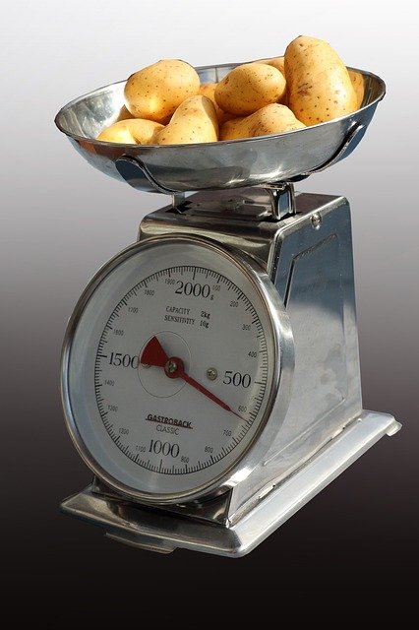
Rational Numbers In Daily Life
5) In purchase of fruits, vegetables, grocery in daily life we take the help of rational numbers.
Examples
The price of ½ kg of potatoes is 10rupees.
Ram purchased ¼ kilo of apples at the stall.
Sita bought 3 and half kilo of wheat at the grocery shop.
Notes:
Source of Multimedia used in this slide:
https://pixabay.com/photos/kitchen-scale-horizontal-1636489/

Slide 8
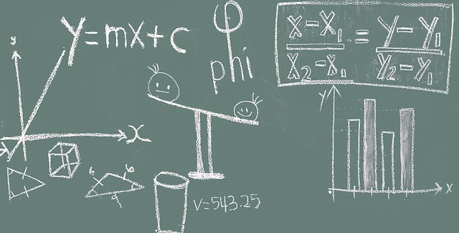

Rational Numbers In Daily Life
6) Mathematical Formulae also contain rational numbers.
Examples
Area of semicircle=(1/2)
Volume of cone=(1/3)h
Notes:
Source of Multimedia used in this slide:
https://pixabay.com/photos/math-blackboard-education-classroom-1547018/

Slide 9









MM Index
Slide# | Thumbnail | Source and Attribution
2 |  | https://pixabay.com/vectors/fraction-math-mathematics-algebra-27242/
3 |  | https://pixabay.com/photos/cake-pie-sweet-food-tasty-2064637/ https://pixabay.com/photos/chocolate-white-chocolate-3422325/
4 |  | https://pixabay.com/illustrations/woman-girl-percent-prices-shopping-1169324/
5 |  | https://pixabay.com/illustrations/icon-survey-check-form-mark-test-2967800/ https://pixabay.com/illustrations/board-school-uni-learn-work-test-361516/
6 |  | https://pixabay.com/illustrations/hand-finger-show-touch-success-577356/
7 |  | https://pixabay.com/photos/kitchen-scale-horizontal-1636489/
8 |  | https://pixabay.com/photos/math-blackboard-education-classroom-1547018/

