Slide 1
Addition
of
Rational Numbers
Notes:
Notes for Teacher – N/A
Suggestions: N/A
Source of Multimedia Objects (Image/audio/ Video/Animation) used in this slide -
https://commons.wikimedia.org/wiki/File:Dyadic_rational.svg

Slide 2
Addition of Rational Numbers
Introduction
Addition of rational numbers is similar to addition of integers and fractions
We add the numerators to find the sum for fractions with same denominator
The LCM of the denominators is determined for fractions having different denominators
Equivalent fractions are found with LCM as the denominator
The fractions now have same denominator and hence their sum is found by adding up the numerators
Notes:
Notes for Teacher – N/A
Suggestions: N/A
Source of Multimedia Objects (Image/audio/ Video/Animation) used in this slide - N/A

Slide 3
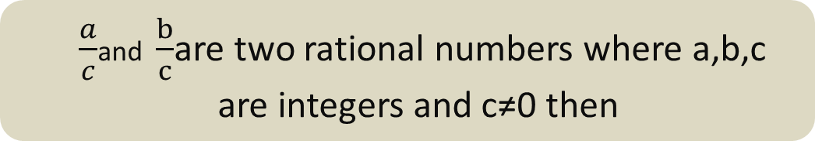
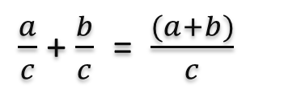
Addition of Rational Numbers
Addition of rational numbers having same denominator
$\frac{a}{c}$and $\frac{b}{c}$are two rational numbers where a,b,c are integers and c≠0 then
$\frac{a}{c}$ + $\frac{b}{c}$=$\frac{(a+b)}{c}$
When the denominators are the same, the sum of two rational numbers is obtained by adding up the numerators
Notes:
Notes for Teacher – N/A
Suggestions: N/A
Source of Multimedia Objects (Image/audio/ Video/Animation) used in this slide - N/A

Slide 4
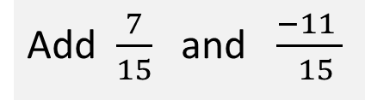
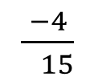
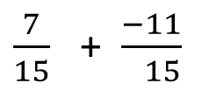
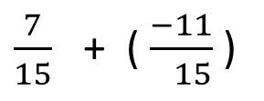
Addition of Rational Numbers
Example
Add $\frac{7}{15}$ and $\frac{−11 }{ 15}$
$\frac{7}{15}$ + $\frac{−11}{ 15}$
$\frac{7}{15}$ + ( $\frac{−11}{ 15}$ )
$$\frac{−4}{ 15}$$
Notes:
Notes for Teacher – N/A
Suggestions: N/A
Source of Multimedia Objects (Image/audio/ Video/Animation) used in this slide - N/A

Slide 5
Addition of Rational Numbers
Case – 2 : Addition of rational numbers having different denominators
When two rational numbers have different denominators then the LCM of the denominators is taken
Equivalent fractions of both the rational numbers with same denominator are obtained
The two rational numbers are added as in case-1
Notes:
Notes for Teacher – N/A
Suggestions: N/A
Source of Multimedia Objects (Image/audio/ Video/Animation) used in this slide - N/A

Slide 6

Addition of Rational Numbers
Add $\frac{5}{12}$ and $\frac{7}{18}$
Step 1
Find the LCM of the denominators 12 and 18
LCM = (12, 18)
= 36
Notes:
Notes for Teacher – N/A
Suggestions: N/A
Source of Multimedia Objects (Image/audio/ Video/Animation) used in this slide - N/A

Slide 7



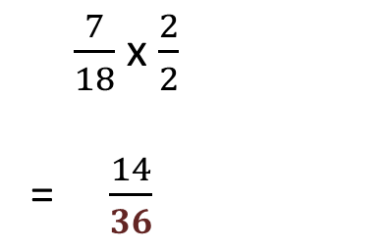
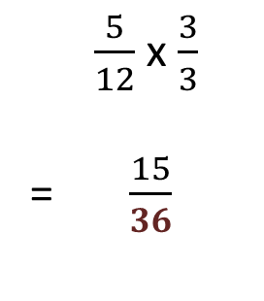
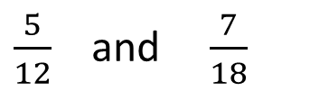
Addition of Rational Numbers
Add $\frac{5}{12}$ and $\frac{7}{18}$
Step 2
The equivalent fractions of is obtained such that their common denominator is 36
$\frac{5}{12}$and$\frac{7}{18}$
$\frac{5}{12}$ x $\frac{3}{3}$
= $\frac{15}{36}$
$\frac{7}{18}$ x $\frac{2}{2}$
= $\frac{14}{36}$
Notes:
Notes for Teacher – N/A
Suggestions: N/A
Source of Multimedia Objects (Image/audio/ Video/Animation) used in this slide - N/A

Slide 8
Addition of Rational Numbers
Add $\frac{5}{12}$ and $\frac{7}{18}$
Find the LCM of the denominators 12 and 18
LCM = (12, 18)
= 36
Notes:
Notes for Teacher – N/A
Suggestions: N/A
Source of Multimedia Objects (Image/audio/ Video/Animation) used in this slide - N/A

Slide 9

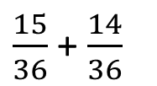
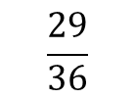

Addition of Rational Numbers
Add $\frac{5}{12}$ and $\frac{7}{18}$
Step 3
Add the two rational numbers as in case 1
=
Notes:
Notes for Teacher – N/A
Suggestions: N/A
Source of Multimedia Objects (Image/audio/ Video/Animation) used in this slide - N/A

Slide 10


Addition of Rational Numbers
Find the sum of $\frac{4}{7}$ + $\frac{2}{9}$ + $\frac{1}{21}$
Step 1
LCM of the denominators = 7,9,21
LCM = 7,9,21
= 63
Solution
Notes:
Notes for Teacher – N/A
Suggestions: N/A
Source of Multimedia Objects (Image/audio/ Video/Animation) used in this slide - N/A

Slide 11


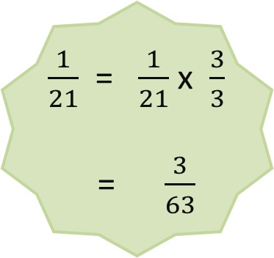
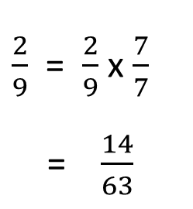
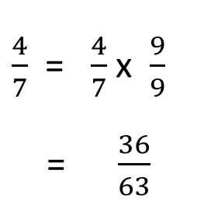

Addition of Rational Numbers
Find the sum of $\frac{4}{7}$ + $\frac{2}{9}$ + $\frac{1}{21}$
Step 2
Find equivalent fractions of each rational number with same denominator 63
$\frac{4}{7}$ + $\frac{2}{9}$ + $\frac{1}{21}$
$\frac{1}{21}$ = $\frac{1}{21}$ x $\frac{3}{3}$
= $\frac{3}{63}$
$\frac{4}{7}$ = $\frac{4}{7}$ x $\frac{9}{9}$
= $\frac{36}{63}$
$\frac{2}{9}$ = $\frac{2}{9}$ x $\frac{7}{7}$
= $\frac{14}{63}$
Solution
Notes:
Notes for Teacher – N/A
Suggestions: N/A
Source of Multimedia Objects (Image/audio/ Video/Animation) used in this slide - N/A

Slide 12

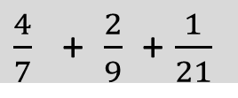

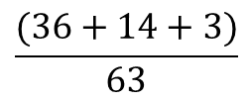
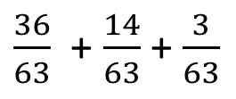

Addition of Rational Numbers
Step 3 : Add all the 3 rational numbers
Find the sum of $\frac{4}{7}$ + $\frac{2}{9}$ + $\frac{1}{21}$
Step 3: Add all the 3 rational numbers
$\frac{36}{63}$ + $\frac{14}{63}$ + $\frac{3}{63}$
$\frac{4}{7}$ + $\frac{2}{9}$ + $\frac{1}{21}$
$$\frac{(36+14+3)}{63}$$
$$\frac{53}{63}$$
$$\frac{53}{63}$$
Solution
Notes:
Notes for Teacher – N/A
Suggestions: N/A
Source of Multimedia Objects (Image/audio/ Video/Animation) used in this slide - N/A

Slide 13

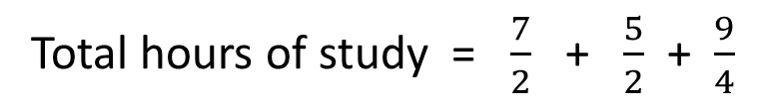
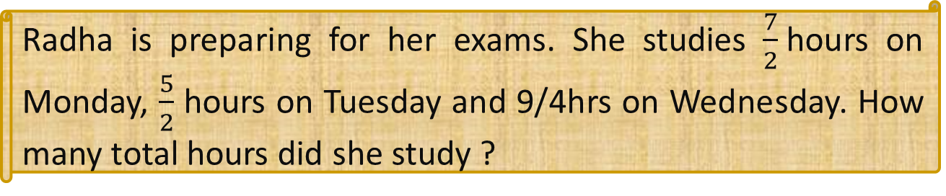
Addition of Rational Numbers
Radha is preparing for her exams. She studies $\frac{7}{2}$hours on Monday, $\frac{5}{2}$ hours on Tuesday and 9/4hrs on Wednesday. How many total hours did she study ?
Total hours of study = $\frac{7}{2}$ + $\frac{5}{2}$ + $\frac{9}{4}$
Step 1
Find LCM of the denominators 2,2,4
LCM = 2,2,4
LCM = 4
Solution
Notes:
Notes for Teacher – N/A
Suggestions: N/A
Source of Multimedia Objects (Image/audio/ Video/Animation) used in this slide -
https://pixabay.com/photos/student-school-learn-education-411947/

Slide 14

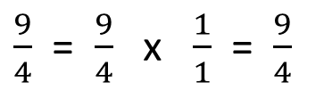
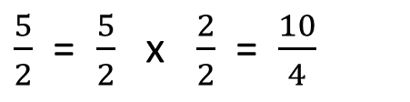
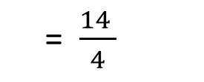
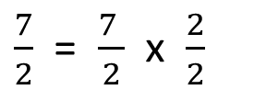
Addition of Rational Numbers
Total hours of study = $\frac{7}{2}$ + $\frac{5}{2}$ + $\frac{9}{4}$
Step 2
$\frac{7}{2}$ = $\frac{7 }{2}$ x $\frac{2}{2}$
= $\frac{14 }{4}$
$\frac{5}{2}$ = $\frac{5}{2}$ x $\frac{2}{2}$ = $\frac{10}{4}$
$\frac{9}{4}$ = $\frac{9}{4}$ x $\frac{1}{1}$ = $\frac{9}{4}$
Find equivalent fractions of each rational number with denominator 4
Solution
Notes:
Notes for Teacher – N/A
Suggestions: N/A
Source of Multimedia Objects (Image/audio/ Video/Animation) used in this slide -
https://ccsearch.creativecommons.org/photos/155c99de-321b-43c7-9c46-2109eecacbd4

Slide 15
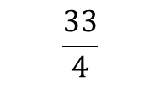
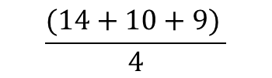
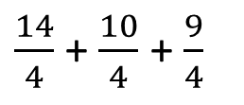

Addition of Rational Numbers
Total hours of study = $\frac{7}{2}$ + $\frac{5}{2}$ + $\frac{9}{4}$
Step 3
Add all the 3 rational numbers
$\frac{14}{4}$ + $\frac{10}{4}$ + $\frac{9}{4}$
$$\frac{(14+10+9) }{4}$$
$$\frac{33}{4}$$
Solution
Notes:
Notes for Teacher – N/A
Suggestions: N/A
Source of Multimedia Objects (Image/audio/ Video/Animation) used in this slide –
https://ccsearch.creativecommons.org/photos/155c99de-321b-43c7-9c46-2109eecacbd4

Slide 16




Addition of Rational Numbers
Total hours of study = $\frac{7}{2}$ + $\frac{5}{2}$ + $\frac{9}{4}$
Radha studied totally for $\frac{33}{4}$hours
= 8 and $\frac{1 }{4}$ hours
Solution
Notes:
Notes for Teacher – N/A
Suggestions: N/A
Source of Multimedia Objects (Image/audio/ Video/Animation) used in this slide –
https://pixabay.com/vectors/hooray-joy-happy-joyful-yay-jump-25568/
https://pixabay.com/illustrations/thumbs-up-smiley-face-emoji-happy-4007573/

Slide 17



MM Index
Slide# | Thumbnail | Source and Attribution
13,14,15 |  | https://pixabay.com/photos/student-school-learn-education-411947/
16 |  | https://pixabay.com/vectors/hooray-joy-happy-joyful-yay-jump-25568/
16 |  | https://pixabay.com/illustrations/thumbs-up-smiley-face-emoji-happy-4007573/

