Slide 1
Multiplication
of
Rational Numbers
Notes:
Notes for Teacher –N/A
Suggestions: N/A
Source of Multimedia Objects (Image/audio/ Video/Animation) used in this slide - N/A

Slide 2



Multiplication of Rational Numbers
Introduction
Multiplication of rational numbers is similar to
multiplication of fractions
Product of two rational numbers =
Definition
If and are two rational numbers then
Notes:
Notes for Teacher –N/A
Suggestions: N/A
Source of Multimedia Objects (Image/audio/ Video/Animation) used in this slide - N/A
https://pixabay.com/vectors/book-reading-blue-smile-read-1524010/

Slide 3

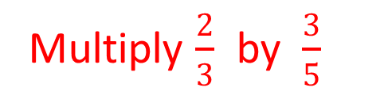
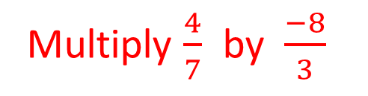
Multiplication of Rational Numbers
Examples:
Multiply $\frac{2}{3}$ by $\frac{3}{5}$
444÷
2
2
__
__
__
3
2 X 3
_____
3
X
5
3 X 5
5
Multiply $\frac{4}{7}$ by $\frac{−8}{3}$
444÷
-32
4
__
_____
-8
4 X -8
__
_____
7
X
3
7 X 3
21
Notes:
Notes for Teacher –N/A
Suggestions: N/A
Source of Multimedia Objects (Image/audio/ Video/Animation) used in this slide - N/A
https://pixabay.com/illustrations/book-character-glasses-show-1773756/

Slide 4






Multiplication of Rational Numbers
Gopal’s truck gives him a mileage of 32/5 miles per litre of petrol. He fills the tank with 11/2 litre of petrol. How far can his truck go?
Distance covered per litre of petrol
(Mileage of the truck)
Distance covered with litre of petrol
The truck will cover
Notes:
Notes for Teacher –N/A
Suggestions: N/A
Source of Multimedia Objects (Image/audio/ Video/Animation) used in this slide - N/A
https://pixabay.com/vectors/truck-toy-vehicle-cartoon-pickup-33608/
https://pixabay.com/vectors/boy-kid-child-playing-happy-158152/

Slide 5




MM Index
Slide# | Thumbnail | Source and Attribution
2 |  | https://pixabay.com/vectors/book-reading-blue-smile-read-1524010/
3 |  | https://pixabay.com/illustrations/book-character-glasses-show-1773756/
4 |  | https://pixabay.com/vectors/truck-toy-vehicle-cartoon-pickup-33608/ https://pixabay.com/vectors/boy-kid-child-playing-happy-158152/

