Slide 1
OPERATIONS
ON
RATIONAL NUMBERS
Notes:
Notes for Teacher – N/A
Suggestions: N/A
Source of Multimedia Objects (Image/audio/ Video/Animation) used in this slide - N/A

Slide 2







Operations on Rational Numbers
Match the following
Notes:
Notes for Teacher – N/A
Suggestions: N/A
Source of Multimedia Objects (Image/audio/ Video/Animation) used in this slide - N/A

Slide 3
Operations on Rational Numbers
Answer
Notes:
Notes for Teacher – N/A
Suggestions: N/A
Source of Multimedia Objects (Image/audio/ Video/Animation) used in this slide - N/A

Slide 4
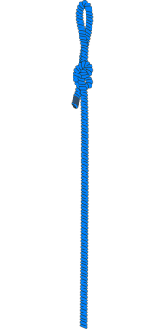








Operations on Rational Numbers
Solve the following
From a rope 10m long, two pieces of length m and
are cut off. Find the length of the remaining rope
Total length of rope = 10m
Length of two pieces =
Length of the remaining rope
Answer
Notes:
Notes for Teacher – N/A
Suggestions: N/A
Source of Multimedia Objects (Image/audio/ Video/Animation) used in this slide –
https://pixabay.com/vectors/rope-tau-tool-1295003/
https://pixabay.com/vectors/tie-rope-knot-blue-295115/

Slide 5

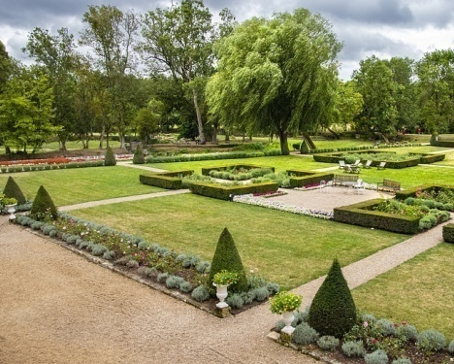


Operations on Rational Numbers
Find the area of a square garden whose side measures metres
Side X side
Area of the square garden = side x side
Answer
Notes:
Notes for Teacher – N/A
Suggestions: N/A
Source of Multimedia Objects (Image/audio/ Video/Animation) used in this slide -
https://pixabay.com/photos/garden-french-france-green-nature-4480633/

Slide 6


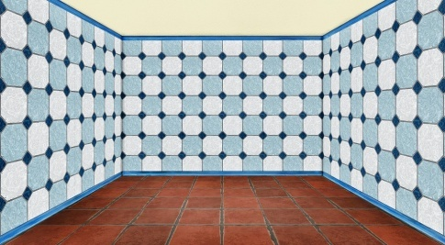



Operations on Rational Numbers
Area of a room is sq.metre. If its breadth is metre,
find its length.
length
breadth
Area of the room = length x breadth
l
l
Answer
l = 12m
Notes:
Notes for Teacher – N/A
Suggestions: N/A
Source of Multimedia Objects (Image/audio/ Video/Animation) used in this slide -
https://pixabay.com/illustrations/space-empty-interior-ground-tiles-2137495/

Slide 7




MM Index
Slide# | Thumbnail | Source and Attribution
3 |  | https://pixabay.com/vectors/rope-tau-tool-1295003/
3 |  | https://pixabay.com/vectors/tie-rope-knot-blue-295115/
4 |  | https://pixabay.com/photos/garden-french-france-green-nature-4480633/
5 |  | https://pixabay.com/illustrations/space-empty-interior-ground-tiles-2137495/

