Slide 1
Rational Numbers Between Two Rational Numbers
Notes:
Notes for Teacher – N/A
Suggestions: N/A
Source of Multimedia Objects (Image/audio/ Video/Animation) used in this slide - N/A

Slide 2
Rational Numbers
Rational Numbers between any two rational numbers
Introduction
Case of Integers
In between -5 and +5, there are 9 integers
(-4,-3,-2,-1,0,1,2,3,4)
In between -5 and -4, there are no integers
Negative Integers
Positive Integers
-5
-4
-3
-2
-1
0
1
2
3
4
5
Notes:
Notes for Teacher – N/A
Suggestions: N/A
Source of Multimedia Objects (Image/audio/ Video/Animation) used in this slide - N/A

Slide 3
Rational Numbers
Case of Rational numbers
Consider the number line as shown below
-1
0
1
There exists a rational number between 0 and 1 i.e. ½
Average of 0 and 1= (0+1)/2=1/2.
Average of any two numbers lies in between the numbers.
-1
0
1
Notes:
Notes for Teacher – N/A
Suggestions: N/A
Source of Multimedia Objects (Image/audio/ Video/Animation) used in this slide - N/A

Slide 4
Rational Numbers
There exists a rational number between 0 and 1/2 i.e. 1/4
-1
0
1
There exists a rational number between 0 and 1/4 i.e. 1/8
-1
0
1
Proceeding in the same manner, we can get infinitely many rational numbers between 0 and 1
Thus, there exist infinitely many rational numbers between any two rational numbers
Notes:
Notes for Teacher – N/A
Suggestions: N/A
Source of Multimedia Objects (Image/audio/ Video/Animation) used in this slide - N/A

Slide 5


Rational Numbers
Rational numbers between any two rational numbers having same denominator
Find rational numbers between -5 and -4
Step 1
Express -5 and -4 as rational numbers
Notes:
Notes for Teacher – N/A
Suggestions: N/A
Source of Multimedia Objects (Image/audio/ Video/Animation) used in this slide - N/A

Slide 6


Rational Numbers
Step 2
Start by multiplying and dividing by 3
When multiplied and divided by 3 there exist 2 rational numbers.

Slide 7


Rational Numbers
Step 2
Next multiply and divide by 5
When multiplied and divided by 5, there exist 4 rational numbers

Slide 8


Rational Numbers
Step 2
Next, multiply and divide by 7
When multiplied and divided by 7, there exist 6 rational numbers
Notes:
Notes for Teacher – N/A
Suggestions: N/A
Source of Multimedia Objects (Image/audio/ Video/Animation) used in this slide - N/A

Slide 9

Rational Numbers
Step 3
The numerators of the two rational numbers
are -35 and -28
Between -35 and -28 there exist numbers -34, -33, -32, -31, -30, -29
Rational numbers between
Notes:
Notes for Teacher – N/A
Suggestions: N/A
Source of Multimedia Objects (Image/audio/ Video/Animation) used in this slide - N/A

Slide 10
Rational Numbers
Note
In order to get more rational numbers between -5/1 and -4/1 we multiply and divide -5/1 and -4/1 by larger numerals.
﻿If you multiply and divide by 12, you can write 11 rational numbers.
The pattern continues similarly.

Slide 11


Rational Numbers
Rational numbers between -5/1 and -4/1
On multiplying and dividing by 15
Notes:
Notes for Teacher – N/A
Suggestions: N/A
Source of Multimedia Objects (Image/audio/ Video/Animation) used in this slide - N/A

Slide 12
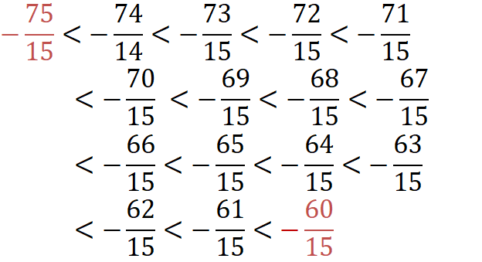

Rational Numbers
Rational numbers between -75/15 and -60/15
There are 14 rational numbers between
Notes:
Notes for Teacher – N/A
Suggestions: N/A
Source of Multimedia Objects (Image/audio/ Video/Animation) used in this slide - N/A

Slide 13

Rational Numbers
Rational numbers between any two rational numbers having different denominators
Consider two rational numbers
Step 1
Find the LCM of the denominators 7 and 8
LCM(7,8) = 56
Notes:
Notes for Teacher – N/A
Suggestions: N/A
Source of Multimedia Objects (Image/audio/ Video/Animation) used in this slide - N/A

Slide 14


Rational Numbers
Step 2
Multiply the numerator and denominator of each rational number such that both rational numbers have the LCM as denominator
Notes:
Notes for Teacher – N/A
Suggestions: N/A
Source of Multimedia Objects (Image/audio/ Video/Animation) used in this slide - N/A

Slide 15

Rational Numbers
Step 3
The rational numbers between 32/56 and 35/56 are
Notes:
Notes for Teacher – N/A
Suggestions: N/A
Source of Multimedia Objects (Image/audio/ Video/Animation) used in this slide - N/A

Slide 16
MM Index
Slide# | Thumbnail | Source and Attribution

