Slide 1
You and Your Family –
A Rational Number
Notes:
Notes for Teacher - < Information for further reference or explanation >
Suggestions: <Ideas/ Images/ Animations / Others – To make better representation of the content >
Source of Multimedia Objects (Image/audio/ Video/Animation) used in this slide -
1. <Short Description> - <SOURCE URL>

Slide 2
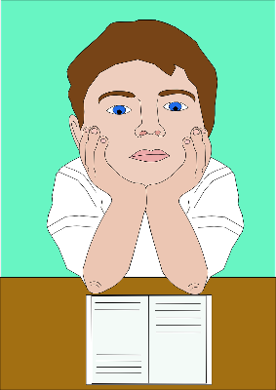

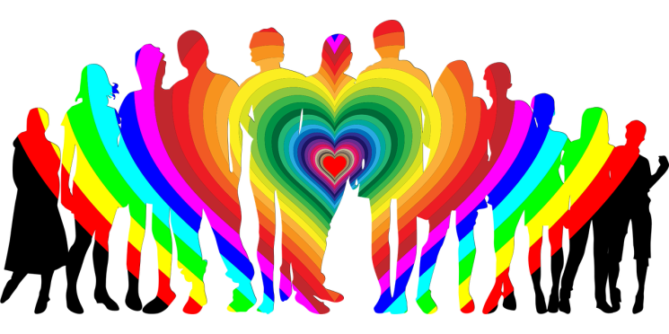
You and Your Family
That’s you
0.
This is your family
0.
Notes:
Asset Type: Value content
Notes for Teacher - A rational number is defined as a number that can be expressed in the form p/q, where p and q are integers and q is not 0. Sometimes this is referred to as a simple fraction. So
rational numbers include integers &amp; fractions.
Take the analogy of a family. Imagine the denominator represents your entire family,
and the numerator represents you, as a part of the family. Although there is a line
demarcating the numerator and denominator, the fraction is one entire unit denoting
strong stable support to the numerator.
Suggestions: <Ideas/ Images/ Animations / Others – To make better representation of the content >
Details of Multimedia Objects (Image/audio/ Video/Animation) used in this slide -
https://pixabay.com/vectors/student-homework-reading-pupil-29492/
https://pixabay.com/vectors/family-love-rainbow-boy-child-2112266/

Slide 3

You and Your Family
Family - A strong support system of every member
Mutual Love
Kindness
Respect
Positivity
Loyalty
Team
Work
Notes:
Asset Type: Value content
Notes for Teacher - Hence the essential qualities of a family are:
• All the family members need to be attached to each other through mutual love,
kindness, respect, team work, mutual loyalty and a positive sensitivity towards
each other.
• They need to form a strong support system for every member of the family.
Suggestions: <Ideas/ Images/ Animations / Others – To make better representation of the content >
Details of Multimedia Objects (Image/audio/ Video/Animation) used in this slide -
Human chain– Creative commons - https://pixabay.com/illustrations/child-series-kindergarten-figure-1096177/
Source Types -
SSSVV GALLERY
ORIGINAL (SELF CLICKED)
ORIGINAL (USING SHAPES/Ms PPT FEATURES)
ORIGINAL (USING PHOTOSHOP/HAND DRAWN SKETCH)
CR FREE CREATIVE COMMONS SEARCH
SSSVV AUTHORIZED LINKS
Others

Slide 4
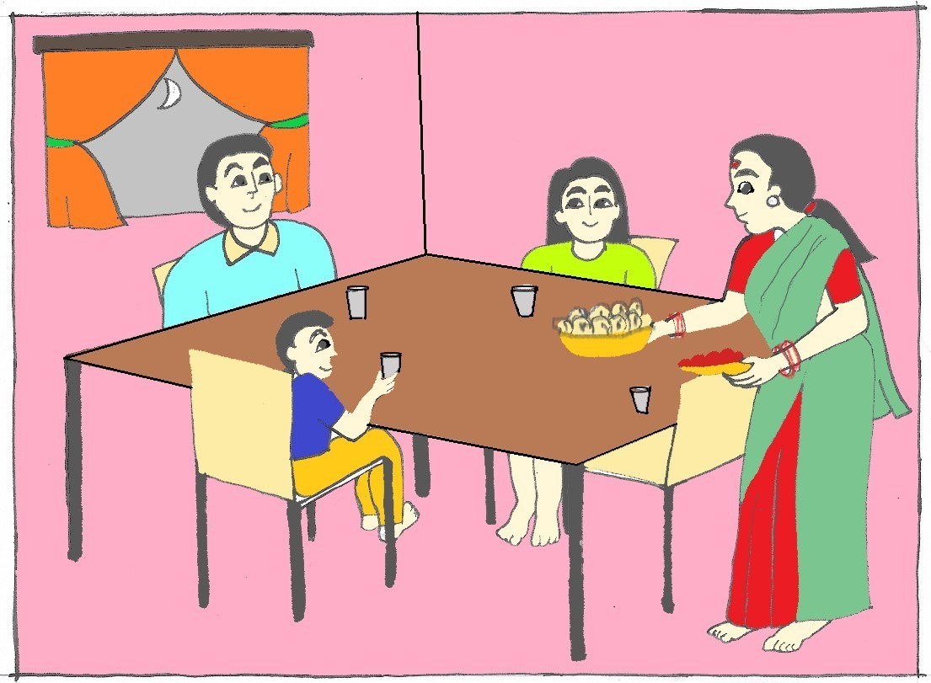
You and Your Family
- A Story
A family dinner
Notes:
Asset Type: Value content
Notes for Teacher - < Information for further reference or explanation >
Suggestions: <Ideas/ Images/ Animations / Others – To make better representation of the content >
Details of Multimedia Objects (Image/audio/ Video/Animation) used in this slide -
Image- SSSVV Gallery (Family)

Slide 5
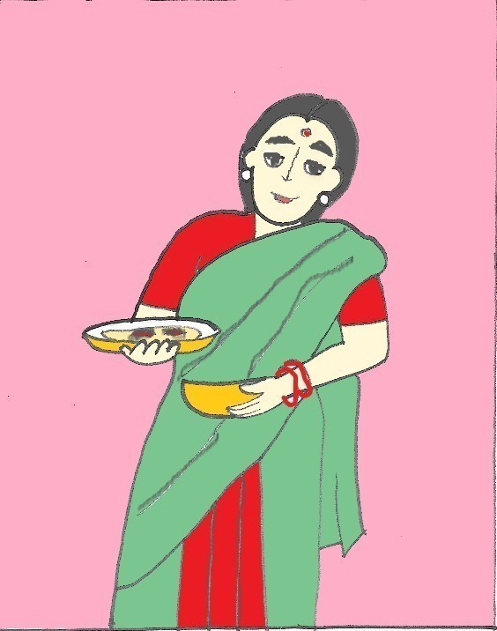
You and Your Family
Mother prepared the dinner after a very long & tiring day. She placed a plate of Sabzi & Rotis in front of the father…….But the rotis were burnt.
Notes:
Asset Type: Value content
Notes for Teacher - < Information for further reference or explanation >
Suggestions: <Ideas/ Images/ Animations / Others – To make better representation of the content >
Details of Multimedia Objects (Image/audio/ Video/Animation) used in this slide -
Image- SSSVV Gallery (Mother)

Slide 6
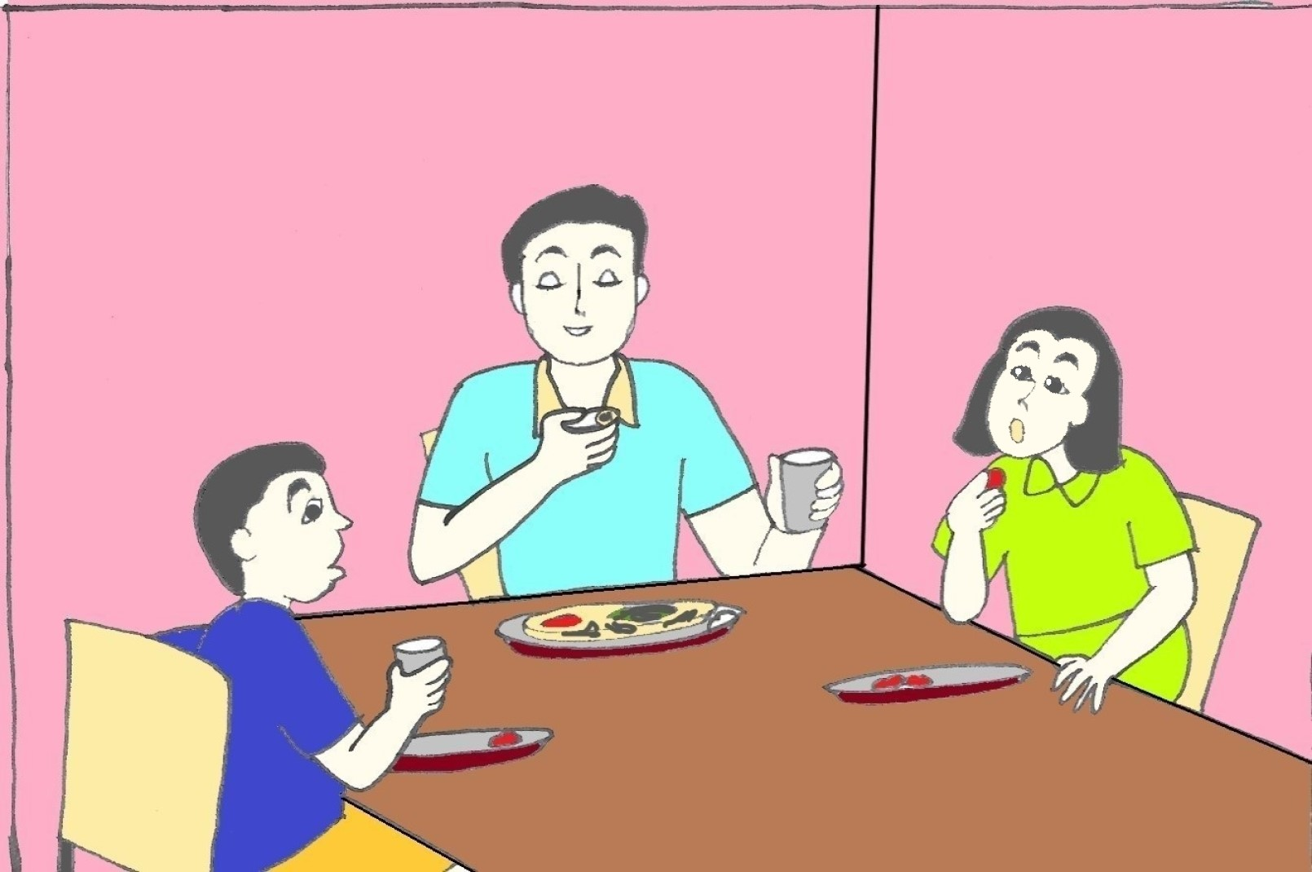
You and Your Family
?
?
Father quietly ate his rotis without any comment.
Notes:
Asset Type: Value content
Notes for Teacher - < Information for further reference or explanation >
Suggestions: <Ideas/ Images/ Animations / Others – To make better representation of the content >
Details of Multimedia Objects (Image/audio/ Video/Animation) used in this slide -
Image- SSSVV Gallery (Father)

Slide 7
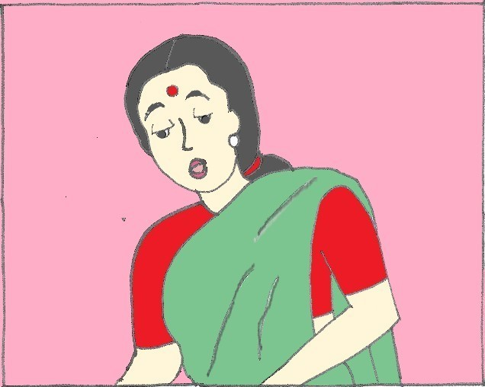
You and Your Family
The mother apologized to their father for the burnt rotis
Notes:
Asset Type: Value content
Notes for Teacher - < Information for further reference or explanation >
Suggestions: <Ideas/ Images/ Animations / Others – To make better representation of the content >
Details of Multimedia Objects (Image/audio/ Video/Animation) used in this slide -
Image- SSSVV Gallery (Mother)

Slide 8
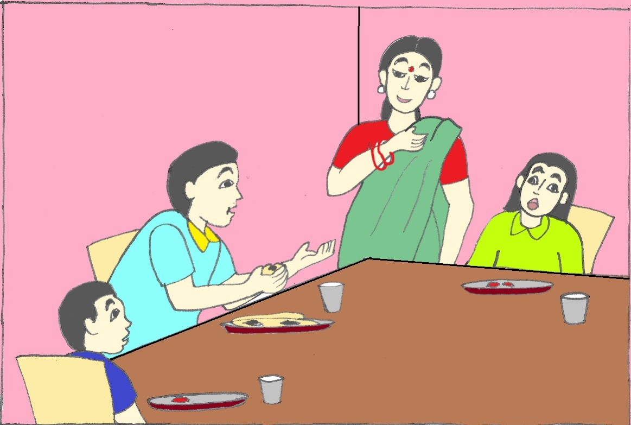
You and Your Family
?!
?
Don’t worry dear,
I love the burnt rotis
Notes:
Asset Type: Value content
Notes for Teacher - < Information for further reference or explanation >
Suggestions: <Ideas/ Images/ Animations / Others – To make better representation of the content >
Details of Multimedia Objects (Image/audio/ Video/Animation) used in this slide -
Image- SSSVV Gallery (Family)

Slide 9
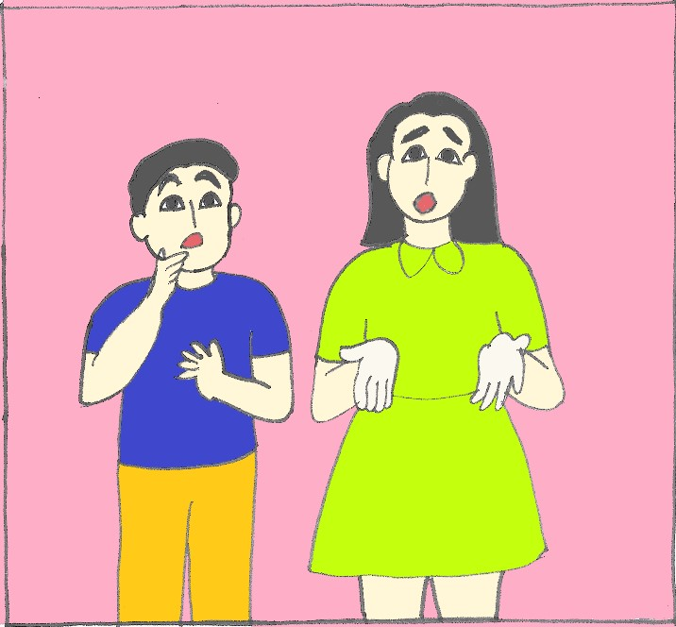
You and Your Family
Dad! Do you really love burnt rotis?
Notes:
Asset Type: Value content
Notes for Teacher - < Information for further reference or explanation >
Suggestions: <Ideas/ Images/ Animations / Others – To make better representation of the content >
Details of Multimedia Objects (Image/audio/ Video/Animation) used in this slide -
Image- SSSVV Gallery (siblings)

Slide 10
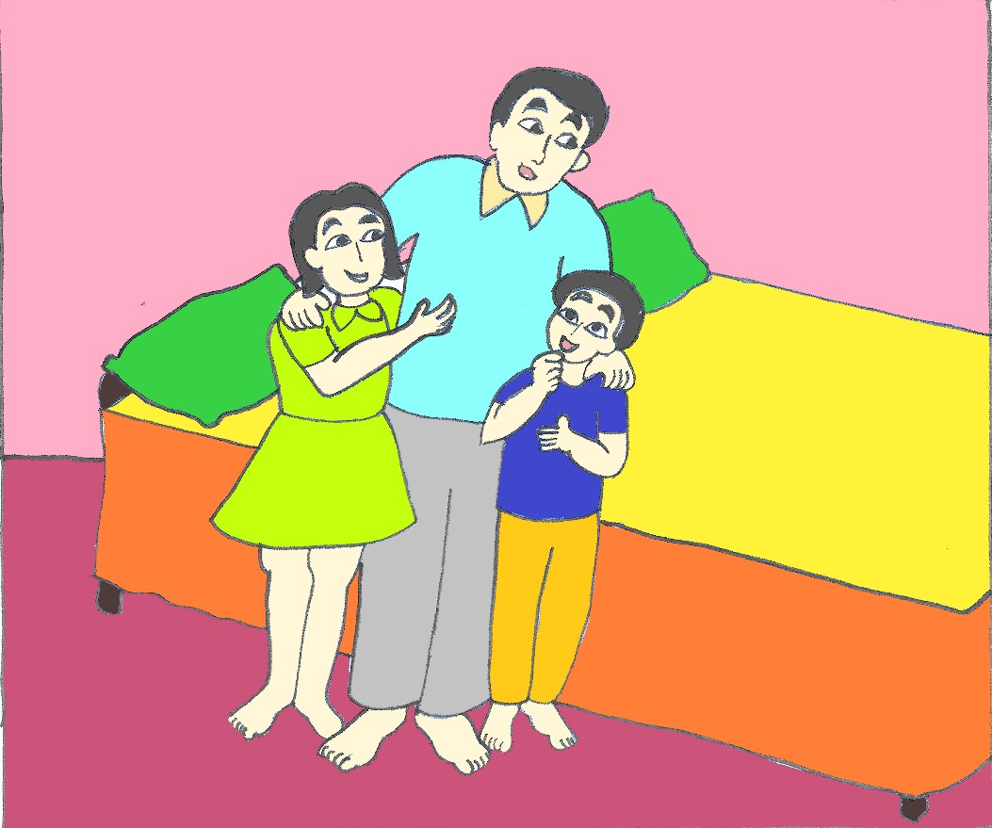
You and Your Family
Your mother
puts in a very long day at work and is very tired”. Moreover a burnt roti is never going to hurt anyone, but harsh words would!
Accept one another’s faults
Celebrate each other’s differences
Notes:
Asset Type: Value content
Notes for Teacher - He put his arms around their shoulders and said, “your mother puts in a very long day at
work and is very tired. Moreover a burnt roti is never going to hurt anyone, but harsh
words would!”
He continued to say “Life is full of imperfect things and imperfect people. I am myself
hardly perfect.”
But what the children learnt from that incident got fixed on their minds over years. They
learnt to accept one another’s faults and to celebrate each other’s differences. They
understood that this is one of the most important keys for building a healthy, growing
and lasting relationship.
So Children! Remember!
• Love the people who treat you right &amp; show compassion towards people who
don’t.
• This is true not only with your family members but also with everyone else in the
society around you.
• Kindness towards others is most important in life.
• People may or may not remember what you do to them or they may forget what
you said to them. But they will always remember the way you made them feel.
Suggestions: <Ideas/ Images/ Animations / Others – To make better representation of the content >
Details of Multimedia Objects (Image/audio/ Video/Animation) used in this slide -
Image- SSSVV Gallery (Father)

Slide 11
People may or may not remember what you do to them or they may forget what you said to them. But they will always remember the way you made them feel.
Notes:
Asset Type: Value content
Notes for Teacher - < Information for further reference or explanation >
Suggestions: <Ideas/ Images/ Animations / Others – To make better representation of the content >
Details of Multimedia Objects (Image/audio/ Video/Animation) used in this slide -

Slide 12



MM Index
Slide# | Thumbnail | Source and Attribution
2 |  | https://pixabay.com/vectors/student-homework-reading-pupil-29492/
2 |  | https://pixabay.com/vectors/family-love-rainbow-boy-child-2112266/
3 |  | https://pixabay.com/illustrations/child-series-kindergarten-figure-1096177/

