Slide 1
Classification of Algebraic Expressions
Notes:
Notes for Teacher - < Information for further reference or explanation >
Suggestions: <Ideas/ Images/ Animations / Others – To make better representation of the content >
Source of Multimedia Objects (Image/audio/ Video/Animation) used in this slide -
1. <Short Description> - <SOURCE URL>

Slide 2
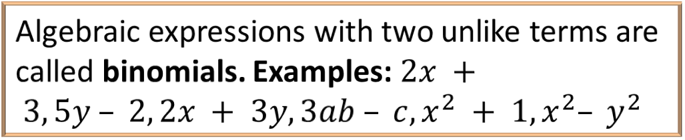
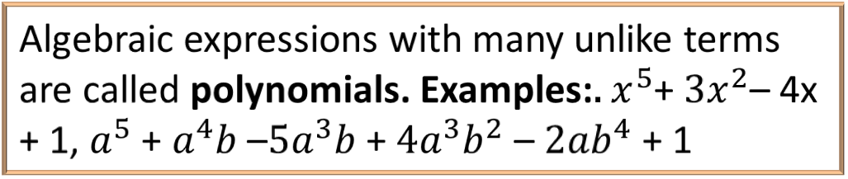
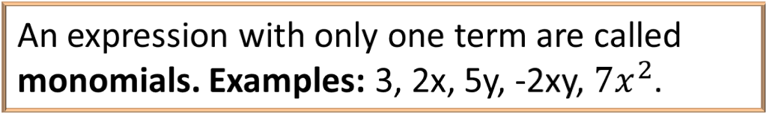
Classification of Algebraic Expressions
Monomial
An expression with only one term are called monomials. Examples: 3, 2x, 5y, -2xy, $7x^{2}$.
Algebraic expressions with two unlike terms are called binomials. Examples: $2x + 3, 5y – 2, 2x + 3y, 3ab – c, x^{2} + 1, x^{2}– y^{2}$
Binomial
Algebraic expressions with three unlike terms are called trinomials. Examples: 3x + 2y + 3, x + y + z, ab + 2bc + 3ca
Trinomial
Algebraic expressions with many unlike terms are called polynomials. Examples: $x^{5}$+ $3x^{2}$– 4x + 1, $a^{5}$ + $a^{4}b$ –$5a^{3}b$ + $4a^{3}b^{2}$– ${2ab}^{4}$ + 1
Polynomial
Notes:
Notes for Teacher –
1) Like terms in an algebraic expression can be added up. Therefore, a + 2a is not a binomial as its value is 3a and it’s a monomial.
2) In terms of polynomials, variables are raised to whole powers. i.e. powers or exponents of variables are positive integers or zero.
When the power is zero, the variable becomes a constant. Thus, 2x ⁻³ cannot be the term of a polynomial – the exponent is a negative number.
y ½ is not the term of a polynomial - the exponent is a fraction.
Suggestions: <Ideas/ Images/ Animations / Others – To make better representation of the content >
Source of Multimedia Objects (Image/audio/ Video/Animation) used in this slide -
1. <Short Description> - <SOURCE URL>

Slide 3
MM Index
Slide# | Thumbnail | Source and Attribution

