Slide 1
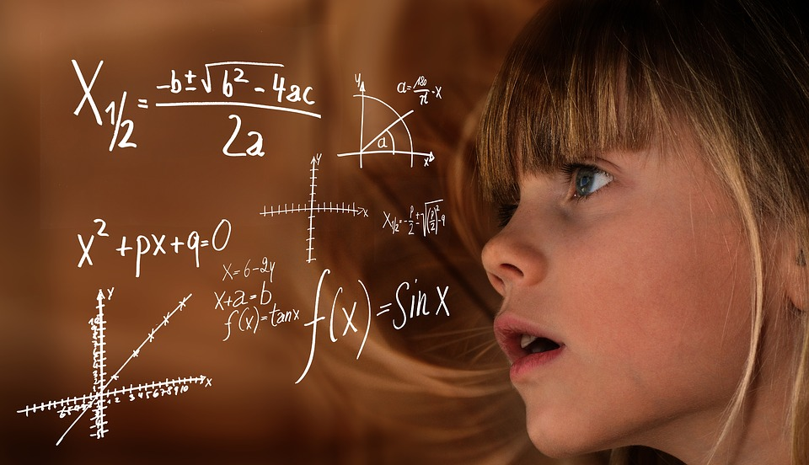
Like & Unlike Terms
Notes:
Notes for Teacher - < Information for further reference or explanation >
Suggestions: <Ideas/ Images/ Animations / Others – To make better representation of the content >
Source of Multimedia used in this slide - <Please provide source URL where we find the image and the license agreement>

Slide 2

Like Terms
What are like terms?
Terms which contain the same variable are called 'like terms'.
Notes:
Notes for Teacher - < Information for further reference or explanation >
Suggestions: <Ideas/ Images/ Animations / Others – To make better representation of the content >
Source of Multimedia used in this slide - <Please provide source URL where we find the image and the license agreement>

Slide 3
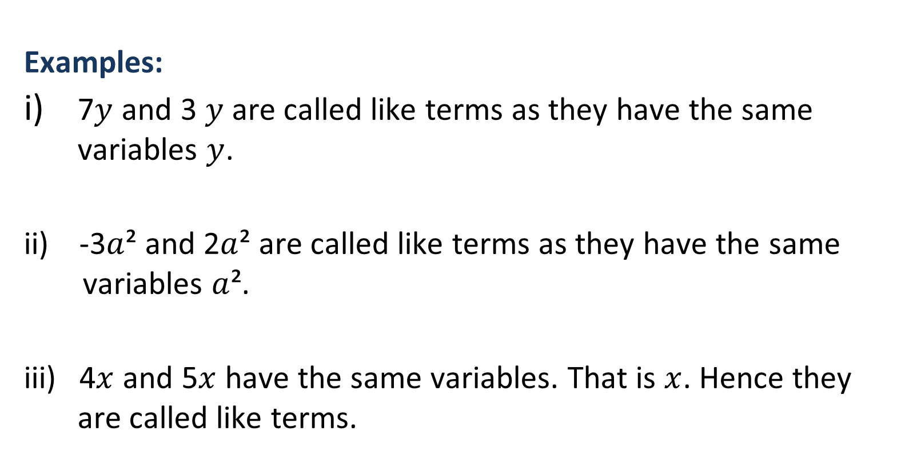
Like Terms
Examples:
7$y$ and 3 $y$ are called like terms as they have the same variables $y$.
ii) -3$a$² and 2$a$² are called like terms as they have the same variables $a$².
iii) 4$x$ and 5$x$ have the same variables. That is $x$. Hence they are called like terms.
Notes:
Notes for Teacher - < Information for further reference or explanation >
Suggestions: <Ideas/ Images/ Animations / Others – To make better representation of the content >
Source of Multimedia used in this slide - <Please provide source URL where we find the image and the license agreement>

Slide 4

Unlike Terms
What are unlike terms?
Terms which have different variables are called 'unlike terms'.
Notes:
Notes for Teacher - < Information for further reference or explanation >
Suggestions: <Ideas/ Images/ Animations / Others – To make better representation of the content >
Source of Multimedia used in this slide - <Please provide source URL where we find the image and the license agreement>

Slide 5
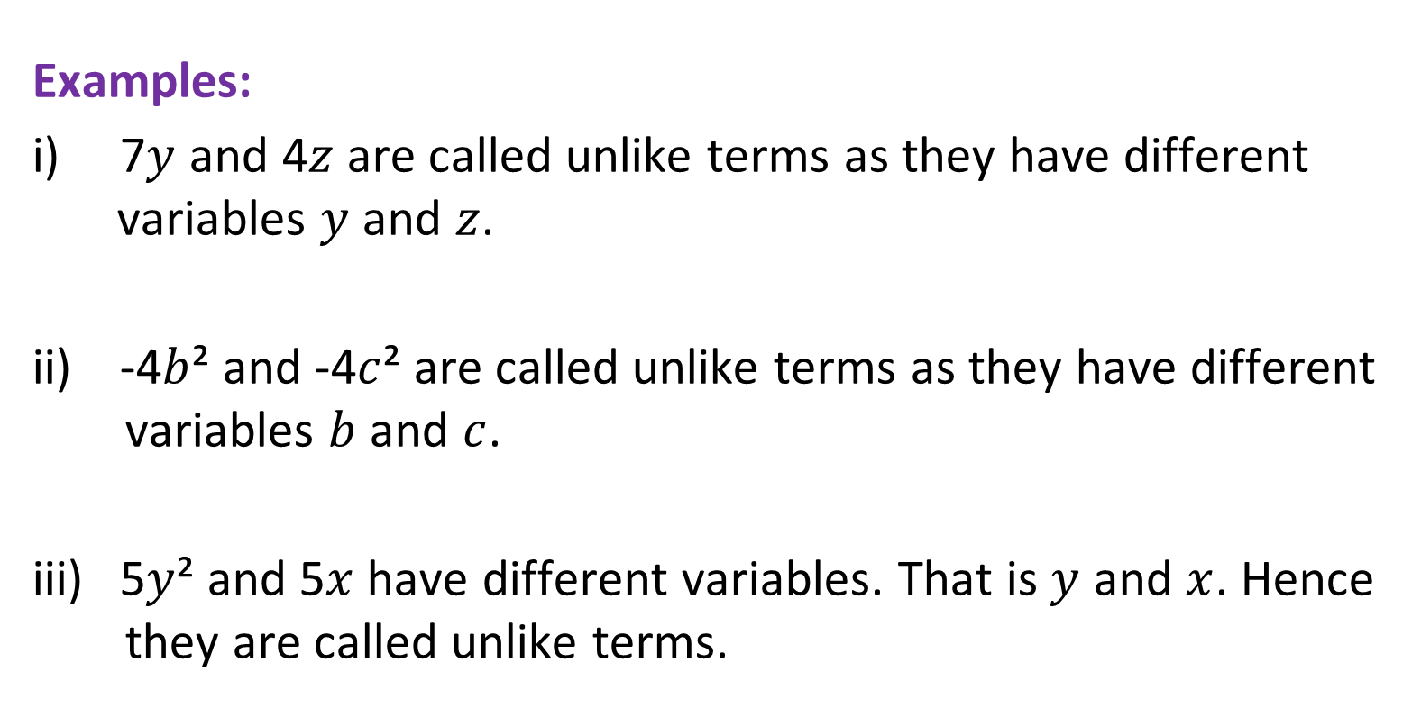
Unlike Terms
Examples:
i) 7$y$ and 4$z$ are called unlike terms as they have different variables $y$ and $z$.
ii) -4$b$² and -4$c$² are called unlike terms as they have different variables $b$ and $c$.
iii) 5$y$² and 5$x$have different variables. That is $y$ and $x$. Hence they are called unlike terms.
Notes:
Notes for Teacher - < Information for further reference or explanation >
Suggestions: <Ideas/ Images/ Animations / Others – To make better representation of the content >
Source of Multimedia used in this slide - <Please provide source URL where we find the image and the license agreement>

Slide 6
Simple ways to identify like and unlike terms
Ignore the numerical coefficients
Concentrate on the algebraic part of the terms
Check the variables in the term, they must be same.
Check the power of each variable in the terms. They must be the same.
Two things do not matter --
  The numerical coefficients of the terms
  The order in which the variables are multiplied.
Notes:
Notes for Teacher - < Information for further reference or explanation >
Suggestions: <Ideas/ Images/ Animations / Others – To make better representation of the content >
Source of Multimedia used in this slide - <Please provide source URL where we find the image and the license agreement>

Slide 7
Attribution / Citation
Slide # | Thumbnail | Source link | Author
1 |  | https://pixabay.com/illustrations/learn-mathematics-child-girl-2300141/ | Geralt
2 |  | https://pixabay.com/photos/stormtrooper-star-wars-lego-storm-2899993/ | Aitoff
4 |  | https://pixabay.com/photos/stormtrooper-star-wars-lego-storm-2899982/ | Aitoff
Notes:
Notes for Teacher - < Information for further reference or explanation >
Suggestions: <Ideas/ Images/ Animations / Others – To make better representation of the content >
Source of Multimedia used in this slide - <Please provide source URL where we find the image and the license agreement>

