Slide 1
Addition and Subtraction of Algebraic Expressions
Notes:
Notes for Teacher - < Information for further reference or explanation >
Suggestions: <Ideas/ Images/ Animations / Others – To make better representation of the content >
Source of Multimedia Objects (Image/audio/ Video/Animation) used in this slide -
1. <Short Description> - <SOURCE URL>

Slide 2
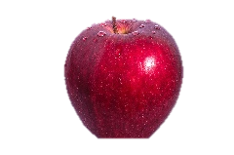
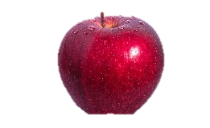
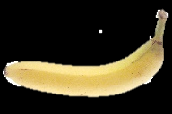
Addition or subtraction of like terms
When you were first learning to add, you would do "three apples and two apples are five apples".
You have learned that "you can't add apples and bananas". That is, "three apples and two bananas" is just a pile of five fruits;
it isn't something like "five apples" or "five bananas". Combining like terms works much the same way.
5
Notes:
Notes for Teacher - < Information for further reference or explanation >
Suggestions: <Ideas/ Images/ Animations / Others – To make better representation of the content >
Source of Multimedia Objects (Image/audio/ Video/Animation) used in this slide -
Banana- https://commons.wikimedia.org/wiki/File:Banana_(1).jpg
Apple - https://www.pexels.com/photo/apple-fruit-healthy-food-39803/

Slide 3
When you add like terms, follow the following steps.
Addition or subtraction of like terms
Obtain the numerical coefficients of all like terms
Find the sum of numerical coefficients of like terms
Write the required sum as a similar term, with the literal factor same as the literal factor of the given like terms and the numerical coefficient is the sum obtained in step 2

Slide 4
Follow the same steps when you subtract a term from another like term.
Addition or subtraction of like terms
For example,
2x²y
+
7x²y
+
9x²y
x²y
x²y
x²y
x²y
x²y
x²y
x²y
x²y
x²y
x²y
=
18x²y
x²y
x²y
x²y
x²y
x²y
x²y
x²y
x²y

Slide 5
Follow the same steps when you subtract a like term from another
Addition or subtraction of like terms
2) Add – 4ab, - 3ab, and – 6ab
a) The literal factor of like terms is ab and the numerical coefficients are - 4, - 3 and - 6 respectively
b) Sum of the numerical coefficients is (- 4 ) + (- 3) + (- 6) = - 13
c) Thus, ( - 4ab ) + ( - 3ab) + ( -6ab ) = - 13ab
3) Add 4x³y², - 2x³y², - 3x³y², 6x³y²
a) The literal factor of like terms is x³y² , the numerical coefficients are 4, - 2, - 3 and 6 respectively
b) Sum of numerical coefficients is 4 + ( - 2 ) + ( - 3 ) + 6 = 5
c) Thus, 4x³y² + (- 2x³y²) + ( - 3x³y² ) + 6x³y² = 5x³y²

Slide 6
Addition or subtraction of like terms
4) Subtract 9x²y from 12x²y
a) The literal factor of like terms is x²y and the numerical coefficients are 9 and 12
b) To obtain the difference 12x²y – 9x²y , find the difference 12 – 9 = 3
c) Thus,12x²y – 9x²y = 3x²y
5) Subtract - 5xy from 3xy
a) The literal factor is xy
b) 3xy – ( - 5xy ) = 3xy + 5xy = 8xy
Notes:
Notes for Teacher - < Information for further reference or explanation >
Suggestions: http://www.chilimath.com/algebra/intro/cmb/images/diag2.gif
Source of Multimedia Objects (Image/audio/ Video/Animation) used in this slide -

Slide 7
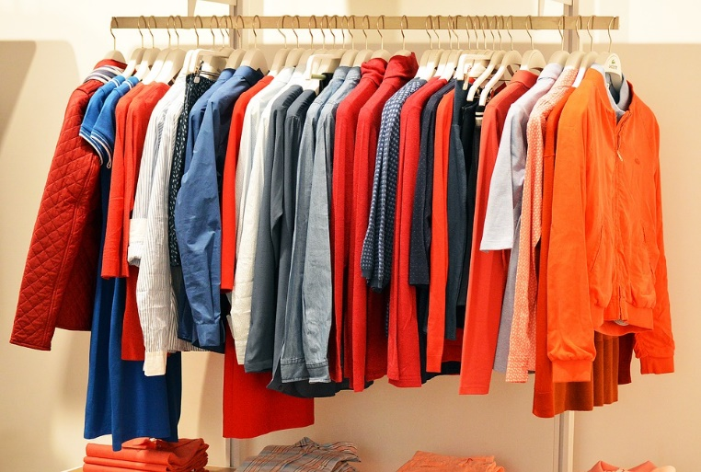


Addition and subtraction of algebraic expressions with like and unlike terms
When cleaning your room, do you keep your clothes
Together or Scattered ?
In a way, you are combining the like “terms” of your room.
Notes:
Notes for Teacher - < Information for further reference or explanation >
Suggestions: <Ideas/ Images/ Animations / Others – To make better representation of the content >
Source of Multimedia Objects (Image/audio/ Video/Animation) used in this slide -
Blankets - https://pixabay.com/photos/sheets-towels-blankets-linen-clean-72155/
Clothes - https://pixabay.com/photos/store-clothes-clothing-line-1338629/
Pillows - https://pxhere.com/en/photo/1229056

Slide 8
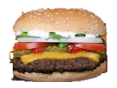
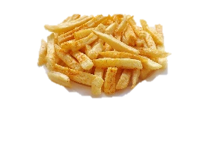

Addition and subtraction of algebraic expressions with like and unlike terms
Now you have an idea of grouping like terms. Look at the following example. Consider the following family order:
How can we write this in Algebraic form?
Can we write this in Algebra as: 2b + f + d + 3b +2f + 2d ?
Notes:
Notes for Teacher - < Information for further reference or explanation >
Suggestions: <Ideas/ Images/ Animations / Others – To make better representation of the content >
Source of Multimedia Objects (Image/audio/ Video/Animation) used in this slide -
Fries- https://pixabay.com/photos/french-fries-food-french-plate-1351062/
Burger- https://pxhere.com/en/photo/819865
Soft Drink - https://pixabay.com/illustrations/soft-drink-drink-fresh-cool-2916290/

Slide 9
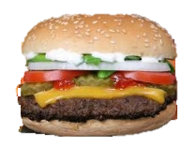
Addition and subtraction of algebraic expressions with like and unlike terms
What do we get if we combine the like items ?
We get a simplified list as follows:
We can write this as: 5b + 3f + 3d
Notes:
Notes for Teacher - < Information for further reference or explanation >
Suggestions: <Ideas/ Images/ Animations / Others – To make better representation of the content >
Source of Multimedia Objects (Image/audio/ Video/Animation) used in this slide -
Fries- https://pixabay.com/photos/french-fries-food-french-plate-1351062/
Burger- https://pxhere.com/en/photo/819865
Soft Drink - https://pixabay.com/illustrations/soft-drink-drink-fresh-cool-2916290/

Slide 10
Addition and subtraction of algebraic expressions with like and unlike terms
In adding algebraic expressions containing like and unlike terms, we collect different groups of like terms and find the sum of like terms in each group by the method discussed above.
Add: 3x + 5x
Horizontal method:
3x + 5x = 8x
Vertical method:
3x
+5x
8x

Slide 11
Addition and subtraction of algebraic expressions with like and unlike terms
Try and find the sum of :
20a³ + 35b² - 10c and 12 a³ + 30 b² -2c
Horizontal method:
(20a³ + 35b² - 10c) + ( 12 a³ + 30 b² -2c)
= 20a³ + 35b² - 10c + 12 a³ + 30 b² -2c
= 20a³ + 12 a³ + 35b² + 30 b² - 10c -2c
= 32 a³ + 65 b² - 12c

Slide 12
Addition and subtraction of algebraic expressions with like and unlike terms
Find the sum of :
20a³ + 35b² - 10c and 12 a³ + 30 b² -2c
Vertical method:
20a³ + 35b² - 10c
+ 12 a³ + 30 b² -2c
= 32a³ + 65 b² -12c

Slide 13
Addition and subtraction of algebraic expressions with like and unlike terms
Subtraction:
Subtraction is addition of the additive inverse. To subtract an algebraic expression from another, change the sign of each term of the expression to be subtracted and then add the two expressions.
1. Subtract 4a³ from – 10a³
Horizontal Method Vertical Method
= -10a³ – 4a³
= -14a³
─ 10a³
- 4a³
─ 14a³

Slide 14
Addition and subtraction of algebraic expressions with like and unlike terms
2. Subtract x – y – z from 6x + 2y + 2z
Horizontal Method
Vertical Method
6x + 2y + 2z 6x + 2y + 2z
(-) x – y – z -x + y + z
5x + 3y + 3z
(6x + 2y + 2z) – (x – y – z)
= 6x +2y + 2z – x + y + z
= 6x – x + 2y + y + 2z +z
= 5x + 3y + 3z

Slide 15
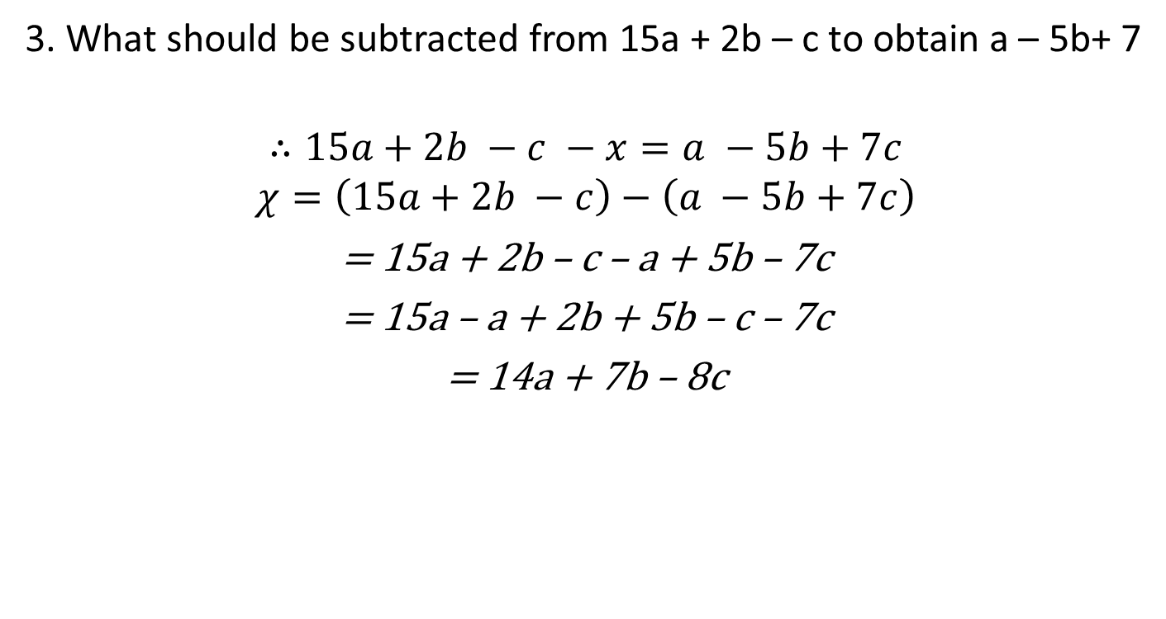
Addition and subtraction of algebraic expressions with like and unlike terms
3. What should be subtracted from 15a + 2b – c to obtain a – 5b+ 7
$$∴15a+2b −c −x=a −5b+7c$$
$$χ=\left(15a+2b −c\right)−\left(a −5b+7c\right)$$
= 15a + 2b – c – a + 5b – 7c
= 15a – a + 2b + 5b – c – 7c
= 14a + 7b – 8c

Slide 16
Addition and subtraction of algebraic expressions with like and unlike terms
Let us assume that unknown polynomial by x
If m = 16x² + 10y + 2z, n = -10x² – 11y – z, find 3m+n
Sol: m = 16x² + 10y + 2z
3m = 3(16x² + 10y + 2z)
3m = 48x² + 30y + 6z
3m+n = (48x² + 30y + 6z) + (-10x² – 11y – z)
= 48x² + 30y +6z – 10x² – 11y – z
= 38x² + 19y + 5z

Slide 17
Addition and subtraction of algebraic expressions with like and unlike terms
For Example:
1) Add 17x +3 and 13x – 1
(17x + 3) + (13x – 1)
= (17x + 13x ) + ( 3 – 1 ) (combining like terms)
= 30x + 2
2) Simplify 8x + 7y + 4x – 3y
8x + 7y + 4x – 3y
= (8x + 4x) + (7y – 3y) (combining like terms)
= 12x + 4y

Slide 18
Subtraction of algebraic expressions
When you subtract one algebraic expression from another, follow the following steps.
Change the sign of all terms in the algebraic expression which is to be subtracted
Then add the two expressions
E.g.
1) Subtract 2x – 7y + 4 from 5x – 2y +1
(5x – 2y +1) – (2x – 7y + 4) = 5x – 2y + 1 – 2x + 7y – 4
= (5x – 2x) + (-2y + 7y) + (1 – 4) (combining like terms)
= 3x + 5y – 3

Slide 19
Subtraction of algebraic expressions
2) Simplify (4x² + xy + 3y²) – (x² + y² – 3xy)
(4x² + xy + 3y²) – (x² + y² – 3xy)
= (4x² + xy + 3y²) –x² – y² + 3xy
= (4x² – x²) + (xy + 3xy) + (3y² – y²) (combining like terms)
= 3x² + 4xy + 2y²

Slide 20







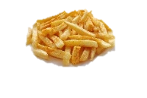
MM Index
Slide# | Thumbnail | Source and Attribution
2 |  | https://commons.wikimedia.org/wiki/File:Banana_(1).jpg https://www.pexels.com/photo/apple-fruit-healthy-food-39803/
6 |  | https://pixabay.com/photos/sheets-towels-blankets-linen-clean-72155/ https://pixabay.com/photos/store-clothes-clothing-line-1338629/ https://pxhere.com/en/photo/1229056
7,8 |  | https://pixabay.com/photos/french-fries-food-french-plate-1351062/ https://pxhere.com/en/photo/819865 https://pixabay.com/illustrations/soft-drink-drink-fresh-cool-2916290/

