Slide 1
Degree of a Polynomial
Notes:
Notes for Teacher - < Information for further reference or explanation >
Suggestions: <Ideas/ Images/ Animations / Others – To make better representation of the content >
Source of Multimedia Objects (Image/audio/ Video/Animation) used in this slide -
1. <Short Description> - <SOURCE URL>

Slide 2
Degree of a Monomial
Degree of a monomial is the sum of the degree of all its variables.
E.g.: Degree of 4x³yz⁴
= 3+1+4 = 8

Slide 3
Degree of a Monomial
Monomial | Exponents of x / y / z |  |  | Degree of the monomial
 | x | y | z
x | 1 | - | - | 1
7x² | 2 | - | - | 2
-3xyz | 1 | 1 | 1 | 1 + 1 +1 = 3
8y²z² | - | 2 | 2 | 2 + 2 = 4

Slide 4
Degree of a Polynomial
The degree of a polynomial with only one variable is the largest exponent of that variable.
Consider a polynomial with only one variable say, 2x – 4x² + 3.
The variable is ‘x’ and the highest exponent of x is 2.
The degree of the polynomial is 2.
The degree of the polynomial y⁶ – 2y³ + y is 6
the degree of 2 – 3x² + 4x⁵ + 2x⁴ – 4x + x3 is 5

Slide 5
Degree of a Polynomial
To find the degree of a polynomial with more than one variable, we need to look at each term.
For each term, find the degree by adding the exponents of each variable in it.
The largest such degree is the degree of the polynomial.

Slide 6
Degree of a Polynomial
For example, What is the degree of 3x³y² + 2xy + y³ – 4x +3?
The degree of the term 3x³y² is: exponent of x + exponent of y = 3 + 2 = 5
The degree of 2xy is 1 + 1 = 2, the degree of y³ is 3 and the degree of - 4x is 1.
The highest degree of the terms is 5. Thus the degree of the polynomial is 5.

Slide 7
Polynomials in standard form
Consider a polynomial, 3x³ + 7x² – 2x + 5.
.
Notice the exponent of the terms.
The polynomials are written this way, with the terms written in decreasing order of exponents
With the largest exponent first, the next highest next, and so forth, are called polynomials in standard form.

Slide 8
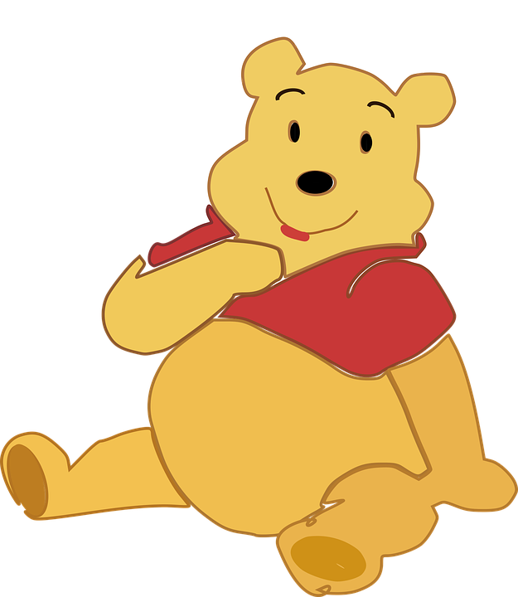
Degree of Zero
Remember that the degree of a constant is zero.
Notes:
Winnie (Multimedia): https://pixabay.com/vectors/baby-pooh-winnie-2028307/

Slide 9
Zero of Polynomial
The value which is substituted in place of the variable so that the whole expression becomes zero is called zero of polynomial.
E.g.
1) In x - 2 and 2x – 4, 2 is the zero of the polynomial

Slide 10
Degree of the Expression
Compare the degrees of all the terms in an expression.
The highest of the degrees of all the terms of an expression is called the degree of the expression.

Slide 11
Degree of the Expression
Algebraic Expression | Degree of eachterm |  |  |  | Degree of expression
 | 1st term | 2nd term | 3rd term | 4th term
7xy² | 3 | - | - | - | 3
3y - x²y² | 1 | 4 | - | - | 4
4x² + 3xyz + y | 2 | 3 | 1 | - | 3
pq - 6p²q² - p²q + 9 | 2 | 4 | 3 | 0 | 4

Slide 12
MM Index
Slide# | Thumbnail | Source and Attribution
8 |  | https://pixabay.com/vectors/baby-pooh-winnie-2028307/

