Slide 1
Algebra –
Ancient Indian History
Notes:
Notes for Teacher - < Information for further reference or explanation >
Suggestions: <Ideas/ Images/ Animations / Others – To make better representation of the content >
Source of Multimedia Objects (Image/audio/ Video/Animation) used in this slide -
1. Paper Scroll - https://pixabay.com/illustrations/paper-stationery-parchment-old-68833/

Slide 2
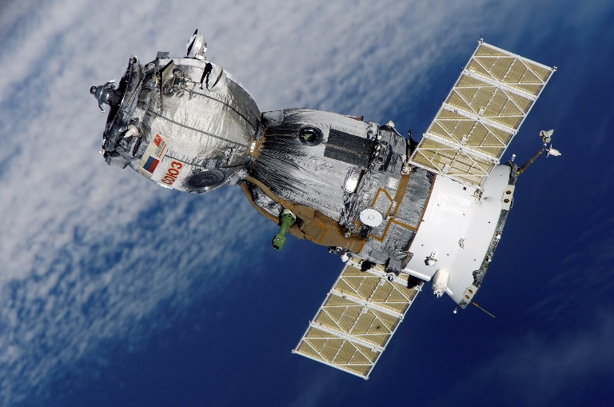
Algebra - Ancient Indian History
We get TV telecast from satellites. You must have heard the name of Aryabhatta, the first satellite of India.
Do you know after whom the satellite was named?
Aryabhatta
Notes:
Notes for Teacher - < Information for further reference or explanation >
Suggestions: <Ideas/ Images/ Animations / Others – To make better representation of the content >
Source of Multimedia Objects (Image/audio/ Video/Animation) used in this slide -
1. Satellite - https://www.pexels.com/photo/space-technology-research-science-41006/

Slide 3
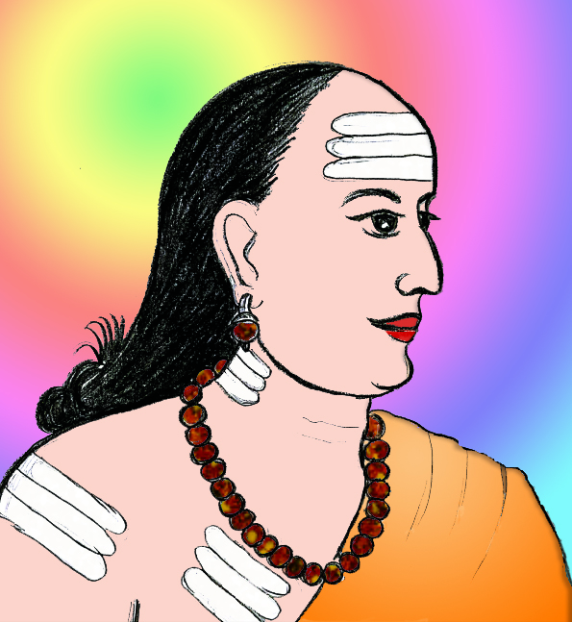
Algebra - Ancient Indian History
Aryabhatta - 6th Century Mathematician from India, developed and used algebraic expressions
The word Algebra comes from the East, from the Arabic word 'Al-Jabr’.
Notes:
Notes for Teacher - We must be proud of our ancient Indians who developed great sciences even without the modern facilities we have today.
However, in the modern days, the science of Algebra developed separately though they have taken advantage of eastern sciences.
Suggestions: <Ideas/ Images/ Animations / Others – To make better representation of the content >
Source of Multimedia Objects (Image/audio/ Video/Animation) used in this slide -
1. aryabhatta- SSSVV gallery (Keyword- astronomer)

Slide 4




Algebra - Ancient Indian History
Algebra uses Mathematical statements to describe things that vary over time. Examples are variations in -
Climate
Quality
Education
Lifestyle
Notes:
Notes for Teacher - We must be proud of our ancient Indians who developed great sciences even without the modern facilities we have today.
However, in the modern days, the science of Algebra developed separately though they have taken advantage of eastern sciences.
Suggestions: <Ideas/ Images/ Animations / Others – To make better representation of the content >
Source of Multimedia Objects (Image/audio/ Video/Animation) used in this slide -
Climate- https://pixabay.com/illustrations/cloud-sun-sunny-partly-cloudy-1987416/
Education - https://pixabay.com/illustrations/child-i-am-a-student-book-figure-3326960/
Lifestyle - https://pixabay.com/vectors/bag-hold-shopping-white-woman-2850502/
Quality - https://pixabay.com/illustrations/feedback-star-rating-user-rating-2800867/

Slide 5





MM Index
Slide# | Thumbnail | Source and Attribution
2 |  | https://www.pexels.com/photo/space-technology-research-science-41006/
4 |  | Climate- https://pixabay.com/illustrations/cloud-sun-sunny-partly-cloudy-1987416/
4 |  | Education - https://pixabay.com/illustrations/child-i-am-a-student-book-figure-3326960/
4 |  | Lifestyle - https://pixabay.com/vectors/bag-hold-shopping-white-woman-2850502/
4 |  | Quality - https://pixabay.com/illustrations/feedback-star-rating-user-rating-2800867/

