Slide 1
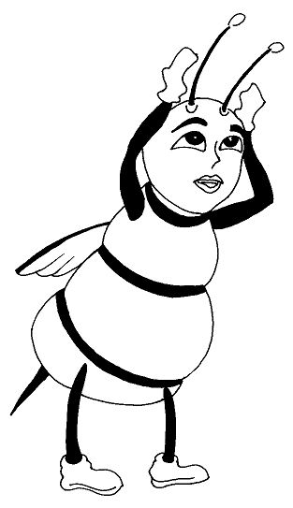
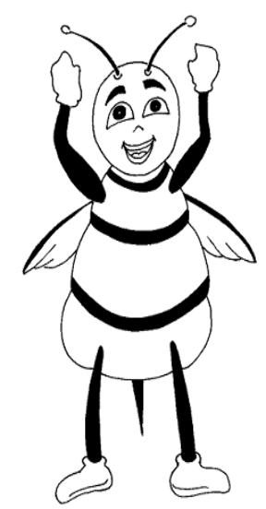
CLASS PARTY
L + W + S =juice
a + b + c= d
Notes:
Notes for Teacher - < Information for further reference or explanation >
Suggestions: <Ideas/ Images/ Animations / Others – To make better representation of the content >
Source of Multimedia Objects (Image/audio/ Video/Animation) used in this slide –
Bee 1: SSSVV Gallery-Keyword-Clip art, cartoon
Bee 2: SSSVV Gallery-keyword-Clip art, cartoon

Slide 2
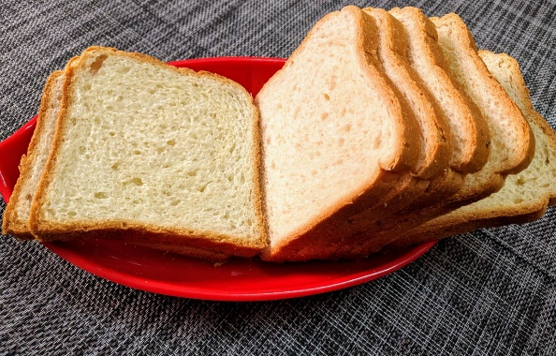
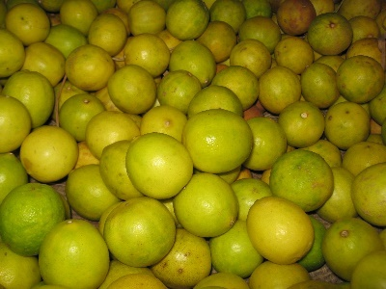
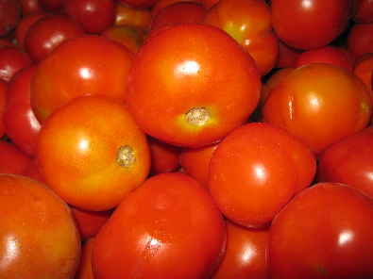
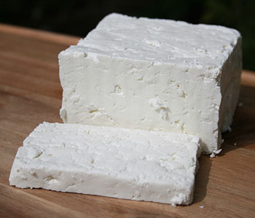
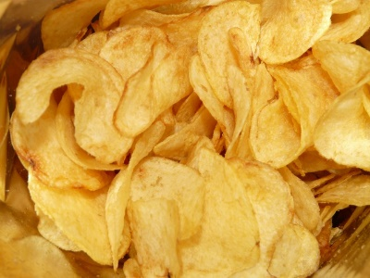
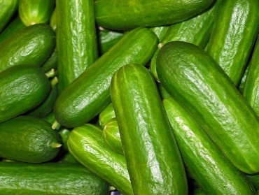
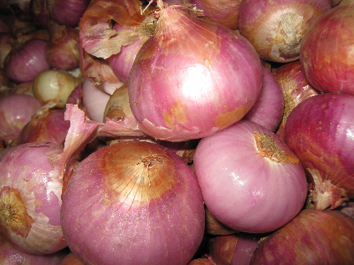
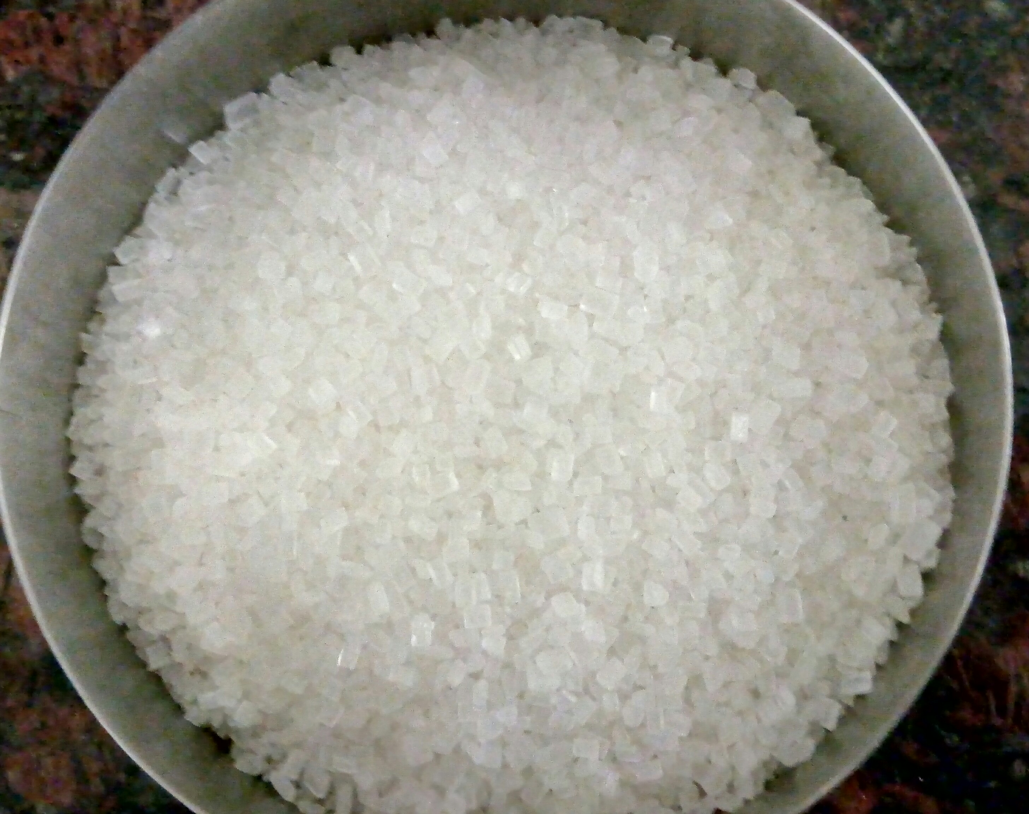
ACTIVITY… CLASS PARTY
AIM : To use simple equations to plan a party
MATERIALS REQUIRED : Food Items according to the menu decided
FOR EXAMPLE : Chips, lemons, water, sugar, bread, cheese or paneer, tomatoes, onions, cucumber etc.
Notes:
Notes for Teacher - < Information for further reference or explanation >
Suggestions: <Ideas/ Images/ Animations / Others – To make better representation of the content >
Source of Multimedia Objects (Image/audio/ Video/Animation) used in this slide -
1. Potato chips: https://pixabay.com/photos/chips-potato-chips-food-eat-fat-643/
2. Paneer: SSSVV Gallery-Keyword- Cottage Cheese
3. Tomato: SSSVV Gallery-keyword-tomato
4. Lemon: SSSVV Gallery-Keyword-lemon
5. Bread: SSSVV Gallery-Keyword-bread
6. Onion: SSSVV Gallery-keyword-onion
7. Cucumber: https://pixabay.com/photos/cucumbers-vegetables-cucumber-2446470/
8. Sugar: SSSVV Gallery-Keyword -sugar

Slide 3
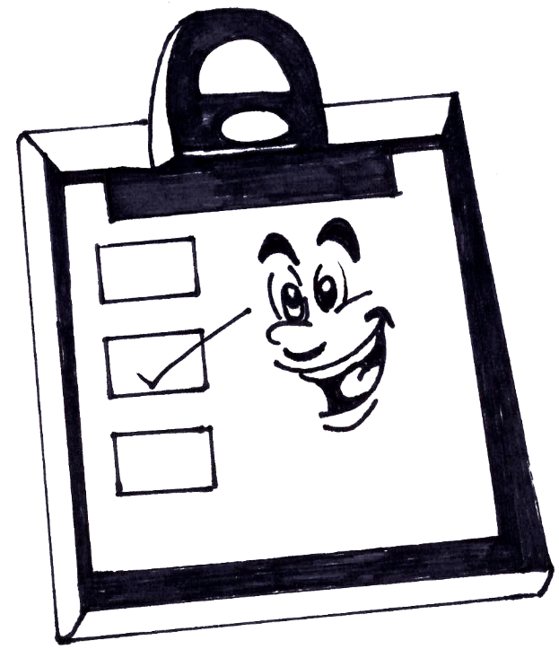
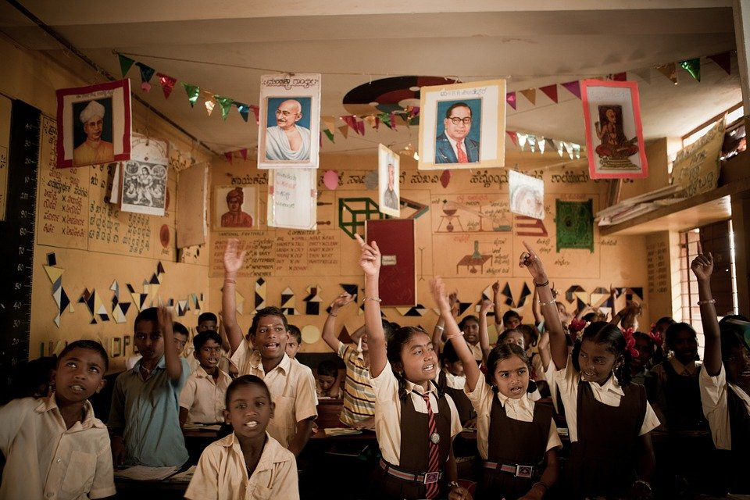
ACTIVITY: PROCEDURE
The class is divided into 3 or more groups with 10 children in each group.
Each group of students will decide upon menu for the party in the previous class.
Children can bring one or more items of their choice for the menu decided.
BREAD
JUICE
Notes:
Notes for Teacher - < Information for further reference or explanation >
Suggestions: <Ideas/ Images/ Animations / Others – To make better representation of the content >
Source of Multimedia Objects (Image/audio/ Video/Animation) used in this slide -
Children: https://pixabay.com/photos/akshaya-patra-children-1023784/
Cartoon board: SSSVV Gallery-Keyword-Clip art, cartoon

Slide 4
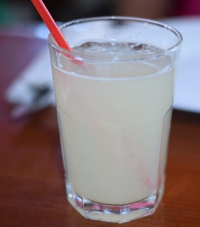
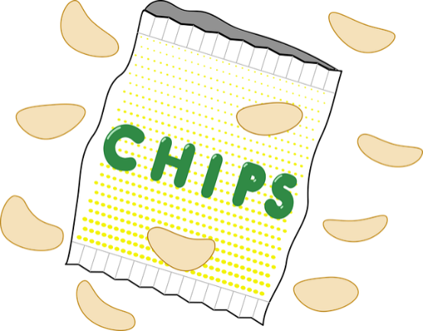
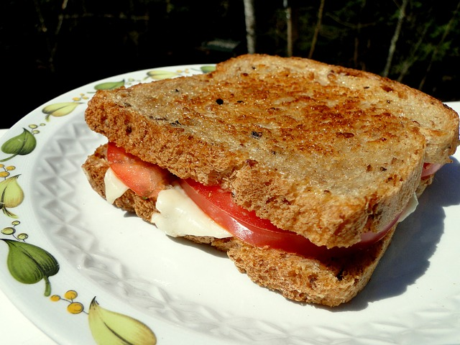
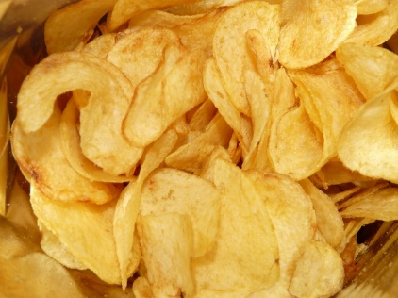
ACTIVITY: PROCEDURE
Each group has to form linear equations for each item they make and serve.
For Example:
If a group decides to give lemonade, sandwich and chips, they have to form linear equations for each item they make.
Notes:
Notes for Teacher - < Information for further reference or explanation >
Suggestions: <Ideas/ Images/ Animations / Others – To make better representation of the content >
Source of Multimedia Objects (Image/audio/ Video/Animation) used in this slide -
Sandwich: https://pixabay.com/photos/sandwich-lunch-grilled-cheese-meal-49244/
Lemon juice: https://pixabay.com/photos/lemon-lemonade-lemon-juice-served-2629261/
Chips: https://pixabay.com/photos/chips-potato-chips-unhealthy-thick-448746/
Chips: https://pixabay.com/vectors/bag-chips-crisps-junk-food-2029481/

Slide 5
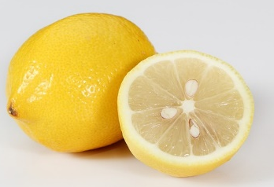
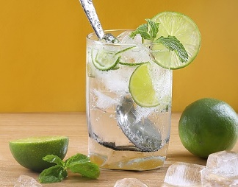
ACTIVITY: MAKING SIMPLE EQUATIONS
For Example : LEMONADE
1 glass of lemonade = 1 lemon + 2 teaspoons sugar + 200 ml water.
Let us denote :
          1 glass of lemonade by 'g’,
          Lemon by 'l’,
          1 tsp sugar by ‘s',
          1 liter of water by 'w’.
The equation for 1 glass of lemonade is
g = l + 2s + (w/5)
Notes:
Notes for Teacher - < Information for further reference or explanation >
Suggestions: <Ideas/ Images/ Animations / Others – To make better representation of the content >
Source of Multimedia Objects (Image/audio/ Video/Animation) used in this slide -
Lemon: https://pixabay.com/photos/lemon-fruit-vegetable-2121307/
Lemon juice: https://pixabay.com/photos/lemon-lemon-juice-juice-fresh-lemon-2610759/

Slide 6


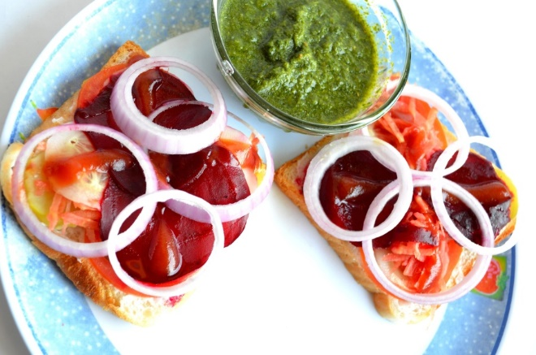
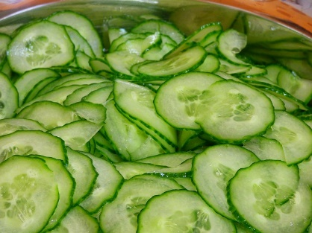
ACTIVITY: MAKING SIMPLE EQUATIONS
For Example: SANDWICH
1 sandwich 's'
slices of bread 'b‘
tomatoes 't'
Cucumber ' v‘
Cheese 'c'
1s=2b+c+(t/6)+(v/10)
Notes:
Notes for Teacher - < Information for further reference or explanation >
Suggestions: <Ideas/ Images/ Animations / Others – To make better representation of the content >
Source of Multimedia Objects (Image/audio/ Video/Animation) used in this slide -
Cucumber discs: https://pixabay.com/photos/cucumber-discs-salad-green-1238008/
Sandwich: https://pixnio.com/food-and-drink/burgers-and-sandwiches/sandwich-breakfast-diet-food-onion-tomato-bread-salad-lunch#
Tomato: SSSVV Gallery-keyword-tomato
Bread: SSSVV Gallery-keyword-slices of bread

Slide 7


ACTIVITY: MAKING SIMPLE EQUATIONS
1 loaf of bread has 12 slices.
Let us start the equation with
1 loaf of bread 'p' has 12 slices of bread ' b'
p = 12 b , 5p = 60 b
If 5 children are planning to bring bread
Then
(5p/5) = (60/5)
If 1 child is bringing 1 loaf of bread and 10 tomatoes, then the expression will be
p + 10t
Notes:
Bread: SSSVV Gallery-Keyword-bread
Bread: SSSVV Gallery-keyword-slices of bread

Slide 8


ACTIVITY: To form Equations
To form equations at random:
First start with the solution and work backwards.
Apply any operation on both sides of the equation .
Form another equation.
For example t = 6
Multiplying and subtracting 2 on both sides
2t= 12 2t - 2 = 12 - 2
We conclude that t=6 is the solution to
2t = 12 & 2t - 2 = 12 - 2
Notes:
Notes for Teacher - < Information for further reference or explanation >
Suggestions: <Ideas/ Images/ Animations / Others – To make better representation of the content >
Source of Multimedia Objects (Image/audio/ Video/Animation) used in this slide -
1. Question mark: SSSVV Gallery-Keyword- Clip art, cartoon

Slide 9

ACTIVITY: To form Equations
Earlier we solved an equation to find the solution.
Now try to form an equation from the solution :
    adding the same number on both sides of the equation.
    divide both sides of the equation by the same number .
What are the new equations formed ?
Is t=6 still a solution to these new equations ?
Notes:
Notes for Teacher - < Information for further reference or explanation >
Suggestions: <Ideas/ Images/ Animations / Others – To make better representation of the content >
Source of Multimedia Objects (Image/audio/ Video/Animation) used in this slide-
1. Question mark: SSSVV Gallery-Keyword- Clip art, cartoon

Slide 10

CONCLUSION
LINEAR EQUATIONS CAN BE USED TO PLAN A CLASS PARTY.
Notes:
Notes for Teacher - < Information for further reference or explanation >
Suggestions: <Ideas/ Images/ Animations / Others – To make better representation of the content >
Source of Multimedia Objects (Image/audio/ Video/Animation) used in this slide -
1. Book: https://pixabay.com/vectors/book-reading-blue-smile-read-1524010/

Slide 11
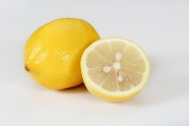


MM INDEX
Slide # | Thumb Nail | Source and attributions
2 |  | Potato chips: https://pixabay.com/photos/chips-potato-chips-food-eat-fat-643/
2 |  | Cucumber: https://pixabay.com/photos/cucumbers-vegetables-cucumber-2446470/
3 |  | Children: https://pixabay.com/photos/akshaya-patra-children-1023784/
4 |  | Sandwich: https://pixabay.com/photos/sandwich-lunch-grilled-cheese-meal-49244/
4 |  | Lemon juice: https://pixabay.com/photos/lemon-lemonade-lemon-juice-served-2629261/
4 |  | Chips: https://pixabay.com/photos/chips-potato-chips-unhealthy-thick-448746/
4 |  | Chips: https://pixabay.com/vectors/bag-chips-crisps-junk-food-2029481/
5 |  | Lemon: https://pixabay.com/photos/lemon-fruit-vegetable-2121307/
5 |  | Lemon juice: https://pixabay.com/photos/lemon-lemon-juice-juice-fresh-lemon-2610759/
6 |  | Cucumber discs: https://pixabay.com/photos/cucumber-discs-salad-green-1238008/
6 |  | Sandwich: https://pixnio.com/food-and-drink/burgers-and-sandwiches/sandwich-breakfast-diet-food-onion-tomato-bread-salad-lunch#
10 |  | Book: https://pixabay.com/vectors/book-reading-blue-smile-read-1524010/
Notes:
Potato chips: https://pixabay.com/photos/chips-potato-chips-food-eat-fat-643/
Paneer: SSSVV Gallery-Keyword- Cottage Cheese
Tomato: SSSVV Gallery-keyword-tomato
Lemon: SSSVV Gallery-Keyword-lemon
Bread: SSSVV Gallery-Keyword-bread
Onion: SSSVV Gallery-keyword-onion
Cucumber: https://pixabay.com/photos/cucumbers-vegetables-cucumber-2446470/

