Slide 1
EXERCISE
TRANSPOSITION METHOD
Notes:
Notes for Teacher - < Information for further reference or explanation >
Suggestions: <Ideas/ Images/ Animations / Others – To make better representation of the content >
Source of Multimedia Objects (Image/audio/ Video/Animation) used in this slide -
1. <Short Description> - <SOURCE URL>

Slide 2
Solve the following equations using transposition method
x+5 = 3
x+5=3 or x= 3-5 or x=-2
b) x-4 = 8
x-4 = 8 or x=8+4 or x=12
c) 3x-2 = 16
3x=16+2 or 3x=18
x=18/3 or x=6

Slide 3
Solve the following equations using transposition method
d)
-6x = 20 –x or -6x+x=20
-5x=20 or x=20/(-5) i.e. x=-4
e)
5x-8=2x +7 or 5x-2x -8 =7
3x-8 =7 or 3x=7+8 or 3x = 15
i.e. x= 15/3 or x=5

Slide 4
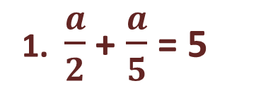
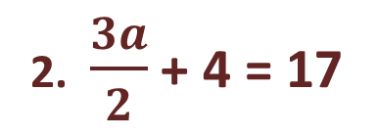
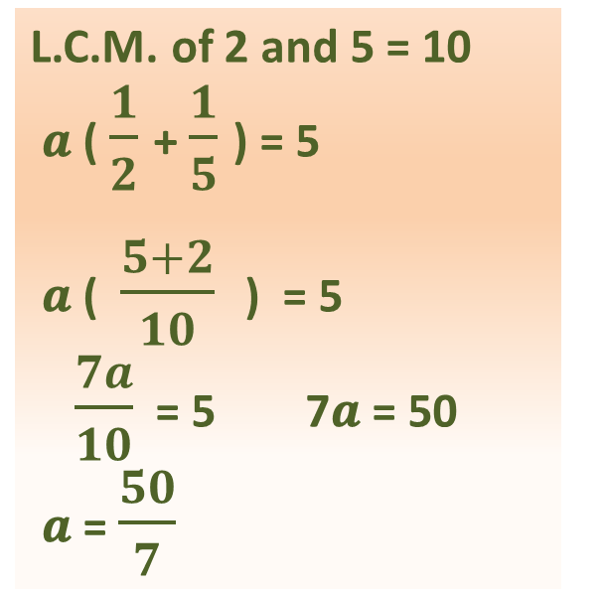
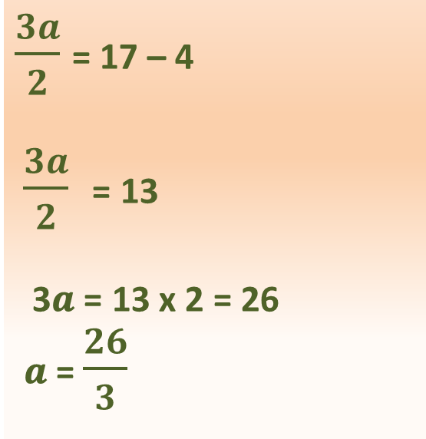
Solve the following equations using transposition method
Solve :
Ans
Ans
Notes:
Notes for Teacher - < Information for further reference or explanation >
Suggestions: <Ideas/ Images/ Animations / Others – To make better representation of the content >
Source of Multimedia Objects (Image/audio/ Video/Animation) used in this slide -
1. <Short Description> - <SOURCE URL>

Slide 5
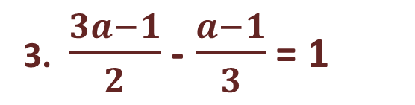
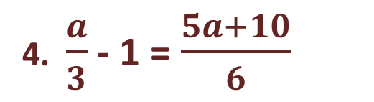
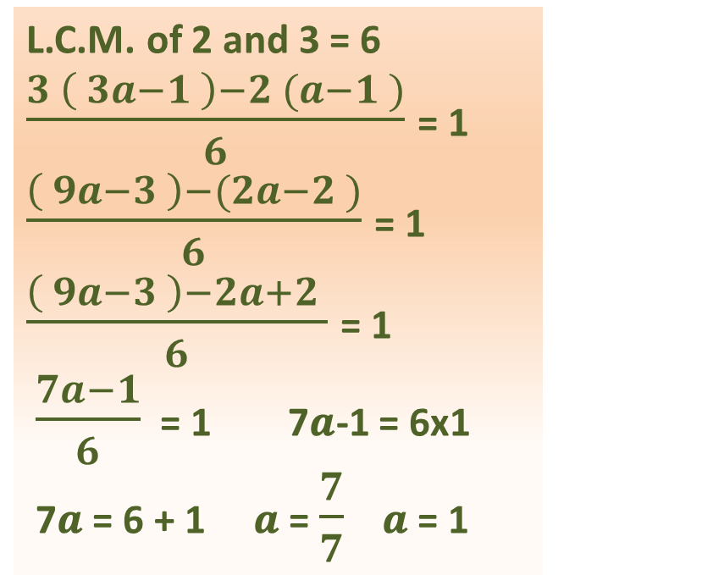
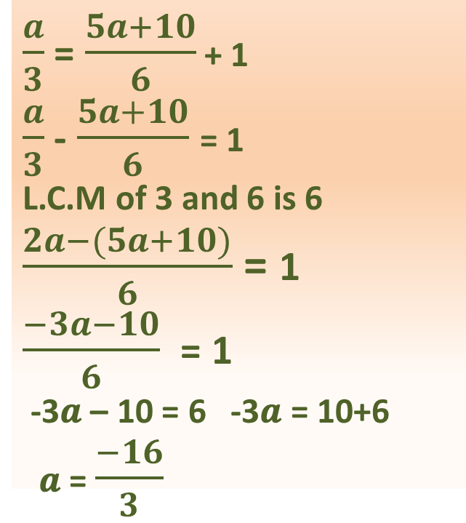
Solve the following equations using transposition method
Ans
Ans
Notes:
Notes for Teacher - < Information for further reference or explanation >
Suggestions: <Ideas/ Images/ Animations / Others – To make better representation of the content >
Source of Multimedia Objects (Image/audio/ Video/Animation) used in this slide -
1. <Short Description> - <SOURCE URL>

Slide 6
MM Index
Slide # | Thumb Nail | Source and Attributions

