Slide 1

SOLVE USING TRIAL AND ERROR METHOD
5
4
9
x
Notes:
Notes for Teacher - < Information for further reference or explanation >
Suggestions: <Ideas/ Images/ Animations / Others – To make better representation of the content >
Source of Multimedia Objects (Image/audio/ Video/Animation) used in this slide -
1. Image of Thumbs Up- https://pixabay.com/illustrations/samuel-thumbs-up-laugh-cool-thumb-1233415/

Slide 2

Q 1. Check whether the value of the variable given makes the equation true.
Solve using trial and error method
  i. 3x + 7 = 22, x = 0
    ii. 11y – 6 = 60, y = 6
ANS:
Put x=0 in 3x+7 = (3x0)+7 = 0+7 = 7 ≠ 22
The equation is not true when x=0
ANS:
Put y = 6 in 11y–6=(11x6)-6= 66 – 6 = 60
The equation is true when y = 6
Answer
Answer
Notes:
Notes for Teacher - < Information for further reference or explanation >
Suggestions: <Ideas/ Images/ Animations / Others – To make better representation of the content >
Source of Multimedia Objects (Image/audio/ Video/Animation) used in this slide -
1.Image of Thumbs Up- https://pixabay.com/illustrations/samuel-thumbs-up-laugh-cool-thumb-1233415/

Slide 3
Q 2. Substitute the values given in the bracket and tick the one that satisfies the equation
Solve the following
i. x + 3 = 5 (4, 1, 2)
Ans:
Put x=4 in x+3=5,
4+3=7 ≠ 5
Put x=1 in x+3=5
1+3=4 ≠ 5
Put x=2 in x+3=5
2+3=5 = 5
Hence x=2 satisfies the equation x+3=5.
Answer
Notes:
Notes for Teacher - < Information for further reference or explanation >
Suggestions: <Ideas/ Images/ Animations / Others – To make better representation of the content >
Source of Multimedia Objects (Image/audio/ Video/Animation) used in this slide –
1.Image of Thumbs Up- https://pixabay.com/illustrations/samuel-thumbs-up-laugh-cool-thumb-1233415/

Slide 4
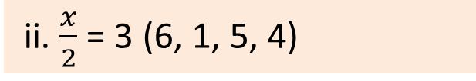
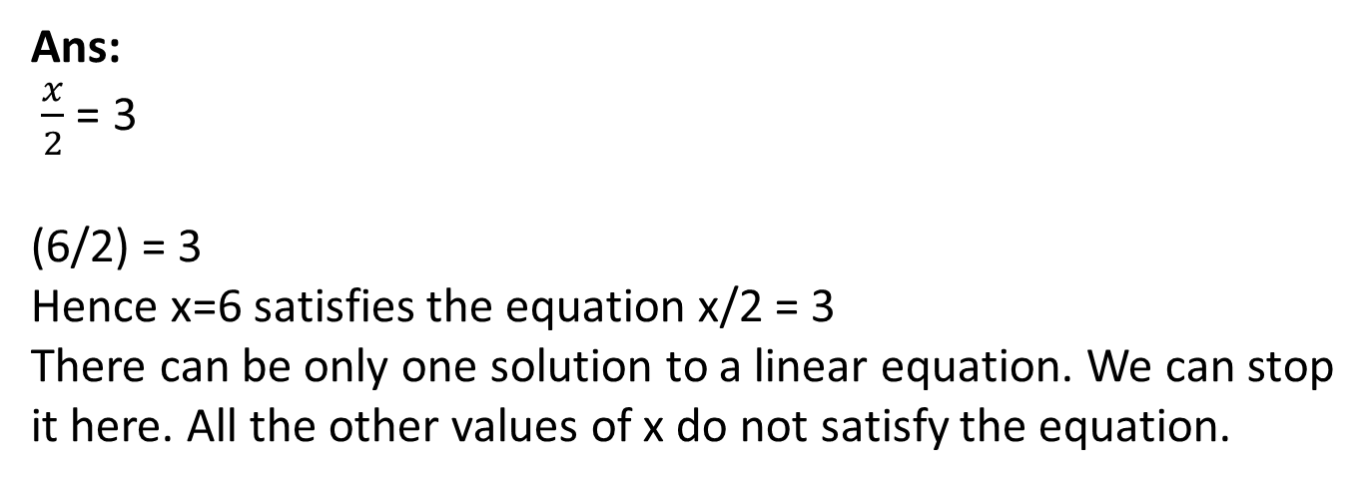
Q 2. Substitute the values given in the bracket and tick the one that satisfies the equation.
Solve the following
ii. $\frac{x}{2}$ = 3 (6, 1, 5, 4)
Ans:
$\frac{x}{2}$ = 3
(6/2) = 3
Hence x=6 satisfies the equation x/2 = 3
There can be only one solution to a linear equation. We can stop it here. All the other values of x do not satisfy the equation.
Answer
Notes:
Notes for Teacher - < Information for further reference or explanation >
Suggestions: <Ideas/ Images/ Animations / Others – To make better representation of the content >
Source of Multimedia Objects (Image/audio/ Video/Animation) used in this slide -
1.Image of Thumbs Up- https://pixabay.com/illustrations/samuel-thumbs-up-laugh-cool-thumb-1233415/

Slide 5
Q3. Solve the following simple equations by trial and error method.
Solve the following
a) 14+m = 17
Ans:
Put m=1, we get 14+m = 14+1 = 15
Put m=3, we get 14+3 = 17
Since L.H.S. = R.H.S. when m=3, m=3 is the solution
Answer
Notes:
Notes for Teacher - < Information for further reference or explanation >
Suggestions: <Ideas/ Images/ Animations / Others – To make better representation of the content >
Source of Multimedia Objects (Image/audio/ Video/Animation) used in this slide -
1.Image of Thumbs Up- https://pixabay.com/illustrations/samuel-thumbs-up-laugh-cool-thumb-1233415/

Slide 6
Q3. Solve the following simple equations by trial and error method.
Solve the following
b) 2(b+9) = 20
Ans:
Put b = 0
2(0+9) = 2x9 = 18
Put b = 1
2(1+9) = 2x10 = 20 = R.H.S.
b=1 is the answer
Answer
Notes:
Notes for Teacher - < Information for further reference or explanation >
Suggestions: <Ideas/ Images/ Animations / Others – To make better representation of the content >
Source of Multimedia Objects (Image/audio/ Video/Animation) used in this slide -
1.Image of Thumbs Up- https://pixabay.com/illustrations/samuel-thumbs-up-laugh-cool-thumb-1233415/

Slide 7
Q3. Solve the following simple equations by trial and error method.
Solve the following
c) 5m+10 = 25
Ans:
Put m=1
(5x1)+10 = 5+10 = 15
Put m=2
(5x2)+10 = 10+10 = 20
Put m=3
(5x3)+10 = 15+10 = 25 R.H.S.
Hence m=3 is the solution for 5m+10 = 25
Answer
Notes:
Notes for Teacher - < Information for further reference or explanation >
Suggestions: <Ideas/ Images/ Animations / Others – To make better representation of the content >
Source of Multimedia Objects (Image/audio/ Video/Animation) used in this slide -
1.Image of Thumbs Up- https://pixabay.com/illustrations/samuel-thumbs-up-laugh-cool-thumb-1233415/

Slide 8

MM Index
Slide# | Thumbnail | Source and Attribution
1, 2,3, 4, 5,6, 7 |  | https://pixabay.com/illustrations/samuel-thumbs-up-laugh-cool-thumb-1233415/
Notes:
Notes for Teacher - < Information for further reference or explanation >
Suggestions: <Ideas/ Images/ Animations / Others – To make better representation of the content >
Source of Multimedia Objects (Image/audio/ Video/Animation) used in this slide -

