Slide 1
Value The Expression
Notes:
Notes for Teacher - < Information for further reference or explanation >
Suggestions: <Ideas/ Images/ Animations / Others – To make better representation of the content >
Source of Multimedia Objects (Image/audio/ Video/Animation) used in this slide -
1. <Short Description> - <SOURCE URL>

Slide 2
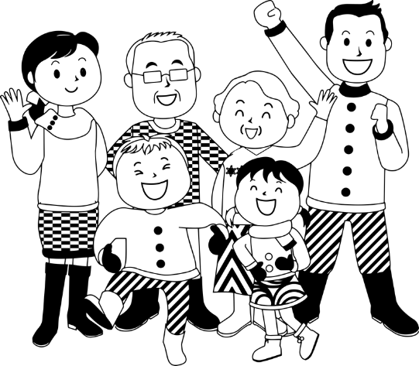
Algebraic Expressions
While solving an equation and using a formula, the value of an expression depends on
A. Constants and B. Variables
In our lives too we have a constant and many variable values. Constant can be said to be our family background at the time of our birth in which have no control.
Notes:
Notes for Teacher –
Family- https://pixabay.com/illustrations/family-generations-grandparents-4246410/

Slide 3


Constants & Variables in Life
But as we grow, we can add variables in the form of cultivation of human values that change our
Name,
Fame,
Reputation,
etc.
The expression we create in the society and success in life depends on these variables that we keep adding.
Notes:
Notes for Teacher –
Carpet- https://pixabay.com/vectors/cinema-movie-premiere-premiere-1293881/
Man - https://pixabay.com/vectors/darkness-smart-suit-business-3399600/

Slide 4
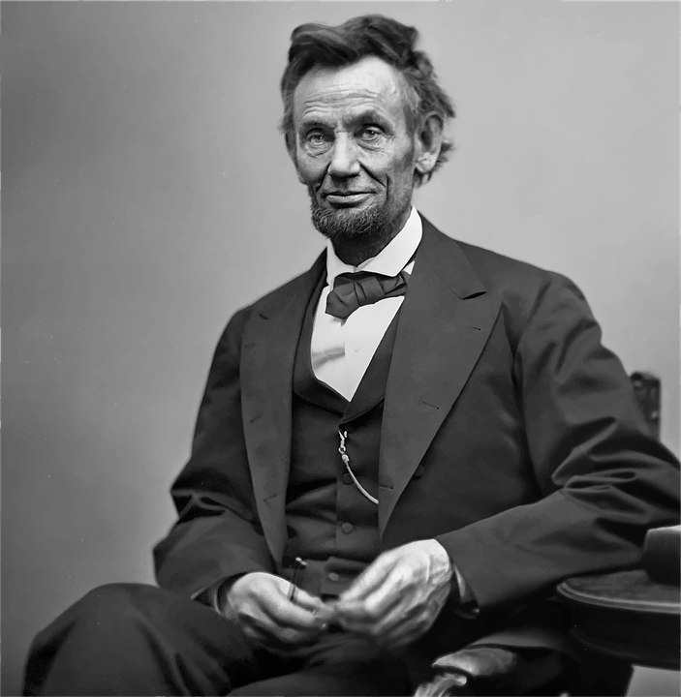
Life Lesson
Abraham Lincoln, coming from a poor background.
He learnt from his mother, to be unafraid of his financial position, to speak truth & conduct himself with dignity & self-respect.
Constant
Variable
Notes:
Notes for Teacher –
Abraham - https://pixabay.com/vectors/person-man-abraham-lincoln-5432770/

Slide 5

Life Lesson
When little Abraham was disrespected by his friends for wearing old & shabby clothes, his mother consoled him that poverty, though viewed in poor light by others, will eventually help him gain respect.
Notes:
Notes for Teacher –

Slide 6

Life Lesson
Lincoln later in his life declared, “You may disrespect me, but truth cannot be disrespected. It will emerge triumphant”
He proceeded on the path of Truth and Self confidence and became the President of the United states of America.
Notes:
Notes for Teacher –
Lincoln Narrative –
Divine Discourse by Sathya Sai Baba, 'My Dear Students', Vol 2, Ch 9, Feb 24, 2005.-- Courtesy – Sister Rama Ganapathy’s blog http://evaluetion.blogspot.com/search/label/Dignity
Image- https://pixabay.com/vectors/abraham-lincoln-president-united-36438/

Slide 7


Discussion
1. Children, can you think of any other constant in life?
One more constant in our life is God
2. How can we achieve this constant?
By allowing in the 5 values, which are also constants
Human Values
Notes:
Notes for Teacher –
(for the first question , let children come out with their thoughts. The teacher can add:
One more constant in our life is God).
How can we achieve this constant?
(By allowing in the 5 values, which are also constants, i.e. they never change).
Images
Pray - https://pixabay.com/vectors/boy-divine-god-male-man-prayer-1299588/
Values- http://media.radiosai.org/journals/Vol_01/07Dec01/04_COVER_STORY_2/Related_story2.htm

Slide 8

Life Lesson
Your place in the society is because of your good human values you develop and your positive attitude towards people around you and not necessarily family background.
Notes:
Notes for Teacher –
Image- https://pixabay.com/illustrations/volunteer-charity-cloud-community-1326758/

Slide 9






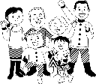


MM Index
Slide# | Thumbnail | Source and Attribution
4 |  | https://pixabay.com/vectors/person-man-abraham-lincoln-5432770/
5 |  | https://pixabay.com/photos/cry-harm-accident-pain-suffering-2764843/
6 |  | https://pixabay.com/vectors/abraham-lincoln-president-united-36438/
8 |  | https://pixabay.com/illustrations/volunteer-charity-cloud-community-1326758/
3 |  | Carpet- https://pixabay.com/vectors/cinema-movie-premiere-premiere-1293881/ Man - https://pixabay.com/vectors/darkness-smart-suit-business-3399600/
2 |  | https://pixabay.com/illustrations/family-generations-grandparents-4246410/
7 |  | https://pixabay.com/vectors/boy-divine-god-male-man-prayer-1299588/
7 |  | http://media.radiosai.org/journals/Vol_01/07Dec01/04_COVER_STORY_2/Related_story2.htm

