Slide 1
MEDIAN OF A
TRIANGLE

Slide 2
Median Of A Triangle
A
Consider a triangle ABC
Choose the mid point of side BC at point D
B
C
D
Join vertex A to point D
AD is the median of the triangle
A median of a triangle is a line segment that joins any vertex of the triangle to the midpoint of its opposite side.

Slide 3
Median Of A Triangle
Consider a ∆ ABC
A
F
E
B
C
D
A triangle consists of three sides therefore, a triangle has three medians
Medians are AD,BE and CF

Slide 4
Centroid Of A Triangle
The point of intersection of 3 medians is called centroid
A
F
G
E
B
C
D
In ∆ABC, the medians AD , BE and CF meet at a point G. The point ‘G’ is the centroid of the triangle.

Slide 5
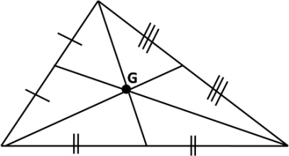
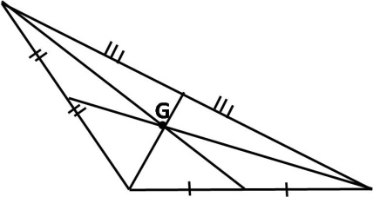
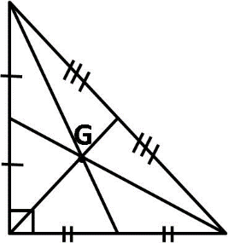
Position Of The Centroid
Observe that, in below triangles the centroid lies with in the triangle
Sl No
Type of triangle
Figure
1
Acute angled triangle
2
Obtuse angled triangle
3
Right angled triangle
Notes:
For this slide changes inside is not possible as it is the tabular form which converted int oJPEG and inserted in the slide.

Slide 6
MM Index
Slide# | Thumbnail | Source and Attribution

