Slide 1
ALTITUDE OF A
TRIANGLE

Slide 2
Altitude Of A Triangle
Consider ∆ ABC
A
The line segment AD is drawn from vertex A to the base BC perpendicularly.
AD is an altitude of the ∆ ABC
B
D
C
Definition: The altitude of a triangle is a line segment drawn from any vertex of the triangle to the opposite side (base) of the triangle perpendicularly.

Slide 3
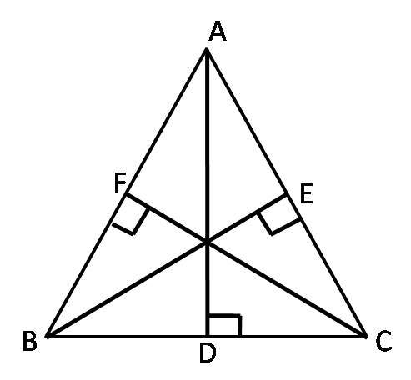
Altitude Of A Triangle
Any triangle has three vertices and hence any triangle can have maximum of three altitudes
Observe in the above ∆ABC, the three altitudes of the triangle are AD, BE, and CF.
Notes:
Already we have shown in the previous slide about altitudes here we included two more. BE and CF .

Slide 4
Altitude As A Measure Of Height
A
The perpendicular distance between the vertex and base is the shortest distance and hence it is the measure of the height of the triangle.
Height of the triangle
B
D
C
Any altitude of the triangle is a measure of its height.
Notes:
Any altitude of the triangle is a measure of its height.
In the above ∆ABC, the altitude AD is perpendicular to the base BC of the triangle. Hence it is the shortest distance between the vertex A and the base. Hence the altitude AD can be considered as a measure of the height of the triangle.

Slide 5
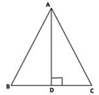
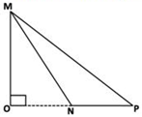
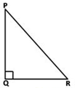
Position of altitude in different triangles
Sl No | Type of Triangle | Position of Altitude
1 | Acute angled triangle | AD lies inside the triangle
2 | Obtuse angled triangle | MO lies outside the triangle
3 | Right angled triangle | PQ lies on the triangle
Notes:
The position of the altitude is not the same in all triangles. Observe the following triangle
For an Acute angled triangle, the altitude AD lies inside the triangle.
For an Obtuse angled triangle, the base NP is extended to meet the altitude at O. The altitude MO lies outside the triangle.
For a Right angled triangle, the side PQ itself acts as an altitude as it is perpendicular to the base QR from vertex P. Similarly the side QR is also another altitude of the triangle. Thus the altitudes PQ and QR lie on the triangle.
For this slide changes inside is not possible as it is the tabular form which converted int oJPEG and inserted in the slide.

Slide 6
MM Index
Slide# | Thumbnail | Source and Attribution

