Slide 1
EXTERIOR
ANGLE PROPERTY
Notes:
Notes for Teacher - < Information for further reference or explanation >
Suggestions: <Ideas/ Images/ Animations / Others – To make better representation of the content >
Source of Multimedia Objects (Image/audio/ Video/Animation) used in this slide -
1. <Short Description> - <SOURCE URL>

Slide 2
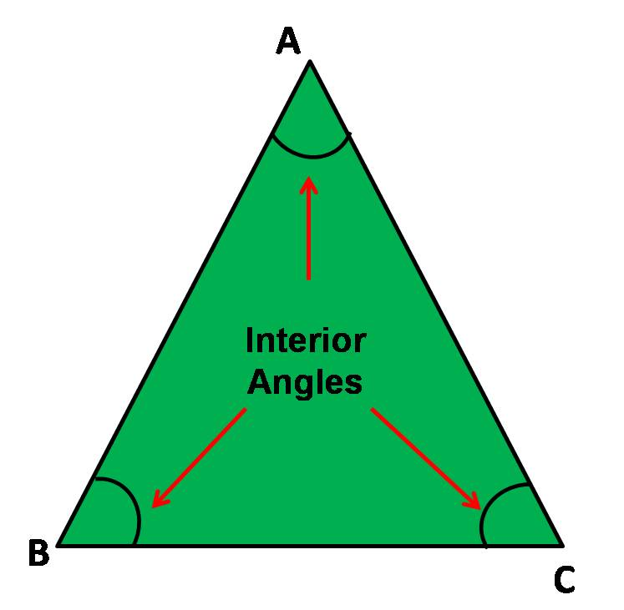
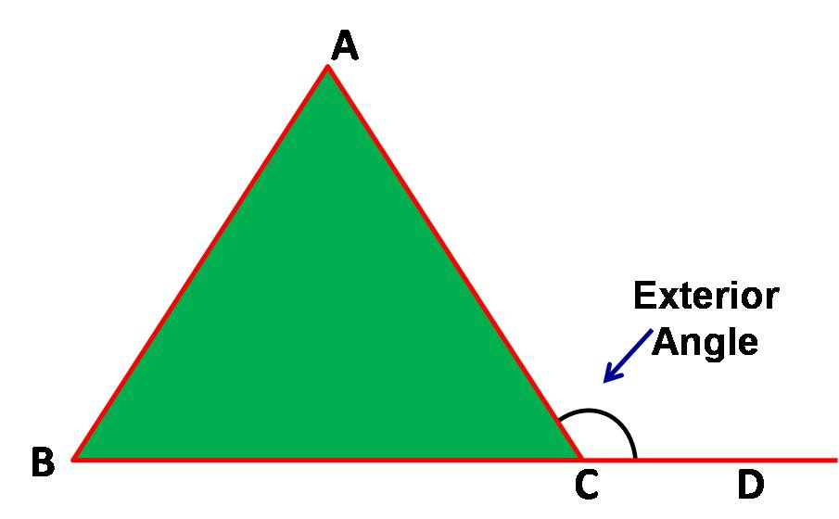
Exterior Angle Property
Interior and Exterior angles of a triangle
Notes:
Notes for Teacher - < Information for further reference or explanation >
Suggestions: <Ideas/ Images/ Animations / Others – To make better representation of the content >
Source of Multimedia Objects (Image/audio/ Video/Animation) used in this slide -
1. <Short Description> - <SOURCE URL>

Slide 3
Exterior Angle Property
Exterior angles of a triangle
Definition: The angle formed by any side of the triangle and the extension of its adjacent side is called the exterior angle of the triangle
Exterior angles
A
In the given figure ∠ACD + ∠ ACB
= 180°
Interior angles
Exterior angles
B
C
D
Exterior angles
Exterior angle + Adjacent interior angle = 180°
Notes:
Notes for Teacher - < Information for further reference or explanation >
Suggestions: <Ideas/ Images/ Animations / Others – To make better representation of the content >
Source of Multimedia Objects (Image/audio/ Video/Animation) used in this slide -
1. <Short Description> - <SOURCE URL>

Slide 4
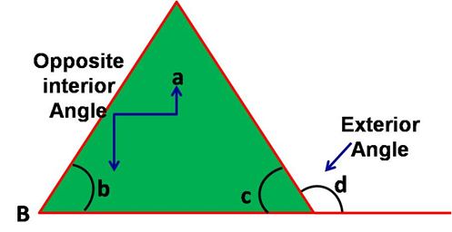
Exterior Angle Property
Exterior angle property of a triangle
a
∠d = ∠a + ∠b
Notes:
Notes for Teacher - < Information for further reference or explanation >
Suggestions: <Ideas/ Images/ Animations / Others – To make better representation of the content >
Source of Multimedia Objects (Image/audio/ Video/Animation) used in this slide -
1. <Short Description> - <SOURCE URL>

Slide 5
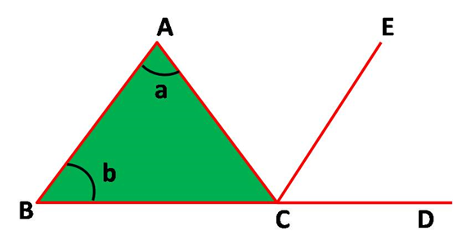
Exterior Angle Property
In ∆ ABC,extend the base BC to D.
From C, draw a line CE parallel to AB.
Given: In ∆ABC , ∠ACD is an exterior angle.
To show: ∠ACD = ∠a + ∠b
Notes:
Notes for Teacher - < Information for further reference or explanation >
Suggestions: <Ideas/ Images/ Animations / Others – To make better representation of the content >
Source of Multimedia Objects (Image/audio/ Video/Animation) used in this slide -
1. <Short Description> - <SOURCE URL>

Slide 6
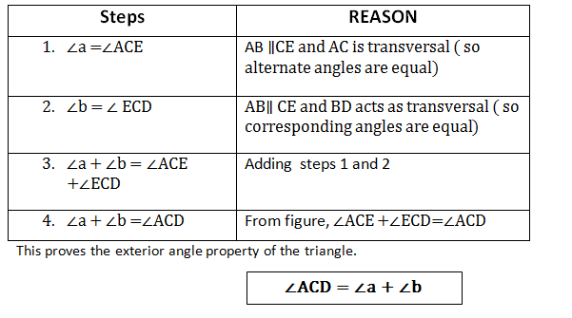
Exterior Angle Property
Proof Of Exterior Angle Property
Notes:
Notes for Teacher - < Information for further reference or explanation >
Suggestions: <Ideas/ Images/ Animations / Others – To make better representation of the content >
Source of Multimedia Objects (Image/audio/ Video/Animation) used in this slide -
1. <Short Description> - <SOURCE URL>

Slide 7
Exterior Angle Property
ILLUSTRATION
80°
b
To find the unknown angles ‘a‘ and ‘b‘ by applying exterior angle property.
40°
a
Notes:
Notes for Teacher - < Information for further reference or explanation >
Suggestions: <Ideas/ Images/ Animations / Others – To make better representation of the content >
Source of Multimedia Objects (Image/audio/ Video/Animation) used in this slide -
1. <Short Description> - <SOURCE URL>

Slide 8
Exterior Angle Property
SOLUTION
To find the unknown angles ‘a’ and ‘b’
Applying exterior angle property we get,
80° = 40° + a
a = 80° - 40°
a = 40°
We know that,
80° + b = 180°(linear
Pair )
b= 180° - 80°
b= 100°
80°
b
40°
a
Notes:
Notes for Teacher - < Information for further reference or explanation >
Suggestions: <Ideas/ Images/ Animations / Others – To make better representation of the content >
Source of Multimedia Objects (Image/audio/ Video/Animation) used in this slide -
1. <Short Description> - <SOURCE URL>

Slide 9
MM Index
Slide# | Thumbnail | Source and Attribution
2
3
4

