Slide 1
FIND THE UNKNOWN ANGLES

Slide 2
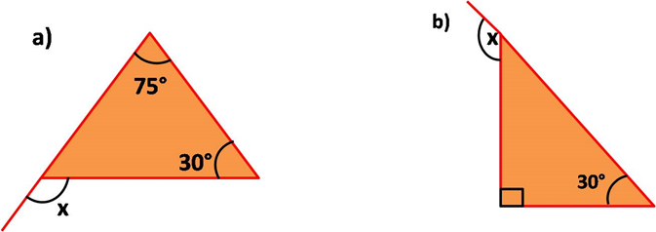
Find The Unknown Angles
Question : 1
Find the value of the unknown exterior angle ’x’ in the following figures.
Answer
Answer
a) x =75° + 30° = 105°
b) x =90° + 30° = 120°
Notes:
Asset Type: Assessments
Answers:
Question 1 :
x =75° + 30° = 105°
x =90° + 30° = 120°
Notes for Teacher - < Information for further reference or explanation >
Suggestions: <Ideas/ Images/ Animations / Others – To make better representation of the content >
Details of Multimedia Objects (Image/audio/ Video/Animation) used in this slide -
1. <Short Description> - <SOURCE TYPE> <SOURCE URL>
e.g. Gandhiji- CC - http://en.wikipedia.org/wiki/File:Portrait_Gandhi.jpg
Source Types -
SSSVV GALLERY - SG
ORIGINAL CREATION /MM APP REQUEST - OC
CREATIVE COMMONS SEARCH - CC
SSSVV AUTHORIZED LINKS / Google Customised Search - SA

Slide 3
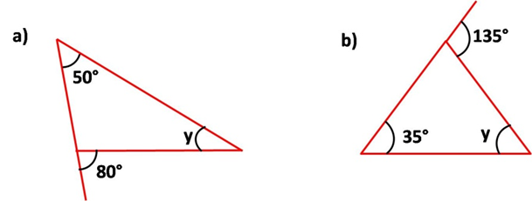
Find The Unknown Angles
Question : 2
Find the value of the unknown interior angle ‘y’ in the following figure.
Answer
Answer
50° + y = 80 y= 30°
b) 35° + y = 135° y= 100°
Notes:
Asset Type: Assessments
Answers Question 2:
a) 50° + y = 80 b) 35° + y = 135°
y= 30° y= 100°

Slide 4
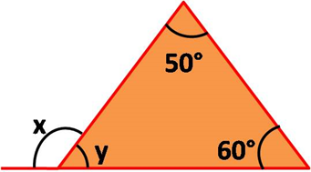
Find The Unknown Angles
Question : 3
Find the value of ‘x’ and ‘y’ in the given figure.
Answer
x= 50° + 60° = 110°
x + y =180°
y= 70°
Notes:
Asset Type: Assessments
Answers :Question 3
x= 50° + 60° = 110°
x+y =180°
y= 70°

Slide 5
Find The Unknown Angles
Question : 4
In a triangle, measure of an exterior angle is 120° and one of the opposite interior angles are in the ratio of 7:5. Find the measure of the opposite interior angles.
Answer
Let the opposite interior angles be 7x and 5x
7x+5x = 120°
12x = 120°
x= 120° /12
= 10
So, the opposite interior angles are 70° and 50°
Notes:
Asset Type: Assessments
Answers :
Question :4
Let the interior opposite angles be 7x and 5x
7x+5x = 120°
12x = 120°
x= 120° /12
= 10
So, the interior opposite angles are 70° and 50°
Question 5
Let the opposite interior angle be x
x+x = 140°
2x = 140°
x= 70°
So each opposite interior angles is 70°

Slide 6
Find The Unknown Angles
Question : 5
In a triangle, measure of an exterior angle is 140° and both the opposite interior angles are equal. Find the measure of both the opposite interior angles.
Answer
Let the opposite interior angle be x
x + x = 140°
2x = 140°
x = 70°
So each opposite interior angle is 70°

Slide 7
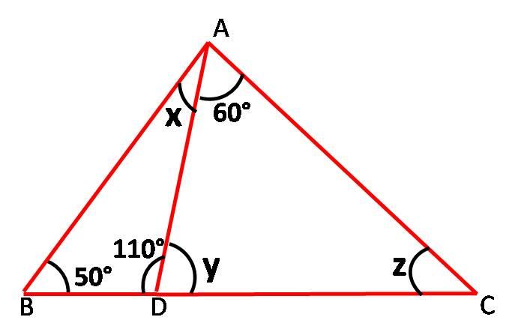
Find The Unknown Angles
Question : 6
In the given figure ,find the value of x, y and z.
In Δ ADC , Exterior angle is 110°
·: 60° + Z = 110°
Z= 50°
Also 110° + Y = 180°
Y= 70°
Also, In Δ ABD, exterior angle is Y = 70°
·: 50° + X = 70°
X = 20°
Answer
Notes:
Asset Type: Assessments
Answers :
Question 6
In $∆ADC$, Exterior angle is 110°
∴ 60° +z = 110°
z = 70°
Also 110° +y = 180° (linear pair)
y=70°
Also , In $∆ABD$ , exterior angle is y= 70°
∴ 50° +x = 70°
X= 20°
(These are assesment given tp children to solve)

Slide 8
MM Index
Slide# | Thumbnail | Source and Attribution

