Slide 1
TRIANGLES
IN ARCHITECTURE

Slide 2
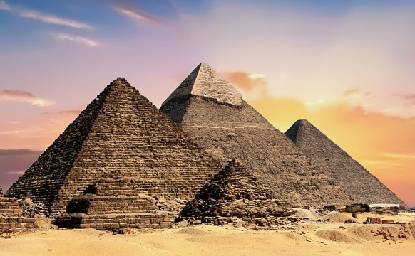
Triangles in Architecture
Pyramids of Giza in Egypt. Each of the four sides that form the pyramid are made up of equilateral triangles.
Notes:
Details of Multimedia Objects (Image/audio/ Video/Animation) used in this slide -
<Pyramids of egypt> - <( labelled for reuse with modification)>
https://pixabay.com/photos/pyramids-egypt-egyptian-ancient-2371501/
Source Types -
SSSVV GALLERY - SG
ORIGINAL CREATION /MM APP REQUEST - OC
CREATIVE COMMONS SEARCH - CC
SSSVV AUTHORIZED LINKS / Google Customised Search - SA
Asset Type: Interesting Asides
Notes for Teacher - < Information for further reference or explanation >
Suggestions: <Ideas/ Images/ Animations / Others – To make better representation of the content >
Details of Multimedia Objects (Image/audio/ Video/Animation) used in this slide -
1. <Short Description> - <SOURCE TYPE> <SOURCE URL>
e.g. Gandhiji- CR FREE CREATIVE COMMONS SEARCH - http://en.wikipedia.org/wiki/File:Portrait_Gandhi.jpg
Source Types -
SSSVV GALLERY
ORIGINAL (SELF CLICKED)
ORIGINAL (USING SHAPES/Ms PPT FEATURES)
ORIGINAL (USING PHOTOSHOP/HAND DRAWN SKETCH)
CR FREE CREATIVE COMMONS SEARCH
SSSVV AUTHORIZED LINKS
Others

Slide 3
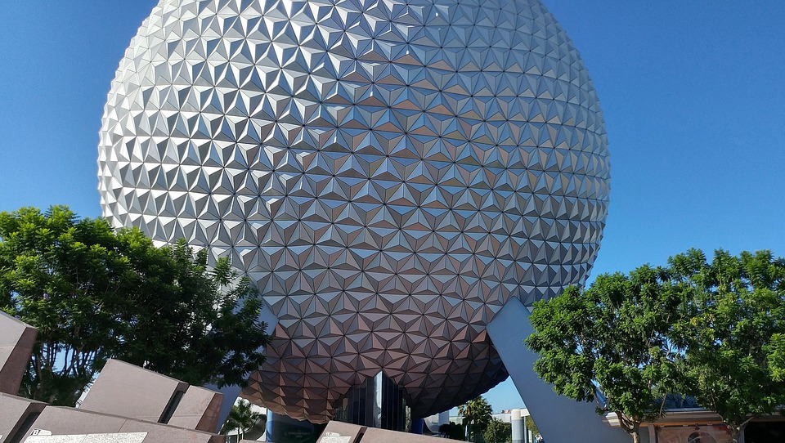
Triangles in Architecture
The Disney Epcot center dome is made up entirely of triangles.
Notes:
<Disney epcot> - <( labelled for reuse with modification)>
https://pixabay.com/en/epcot-disney-world-florida-1909805/

Slide 4
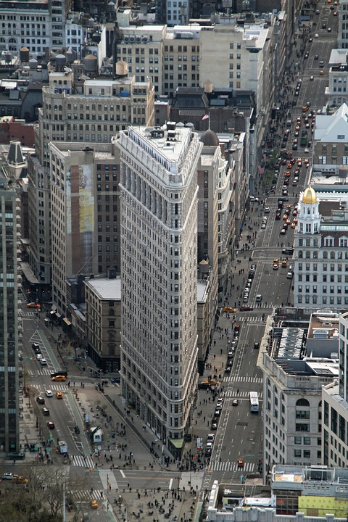
Triangles in Architecture
Isosceles triangle are found in modern architecture . The Flatiron building in Newyork city is built on a triangular block.
Notes:
<The flatiron building in newyork city t> - <( labelled for non commercial reuse with
https://pixabay.com/en/flatiron-building-manhattan-new-york-1401035/

Slide 5



MM Index
Slide# | Thumbnail | Source and Attribution
2 |  | https://pixabay.com/photos/pyramids-egypt-egyptian-ancient-2371501/
3 |  | https://pixabay.com/en/epcot-disney-world-florida-1909805/
4 |  | https://pixabay.com/en/flatiron-building-manhattan-new-york-1401035/

