Slide 1
ACTIVITY TO VERIFY PROPERTIES OF EQUILATERAL TRIANGLE

Slide 2
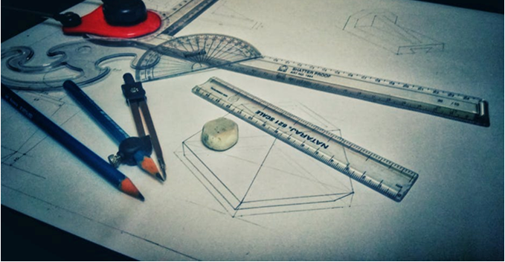
Activity To Verify Properties Of Equilateral Triangle
Aim:
To verify the
properties of
equilateral triangle.
Materials required:
Scale
Pencil
Protractor
3 Sticks of same size
(which can be pasted on white sheet of paper)
Notes:
Pencil protractor : https://www.pexels.com/photo/758503/
(labeled for reuse with modification)

Slide 3
Activity To Verify Properties Of Equilateral Triangle
Questions to recall
1.What is an equilateral triangle?
Expected Answer: A triangle in which all three sides are equal is called an equilateral triangle.
2.What are the properties of an equilateral triangle?
Expected answer: In an equilateral triangle, all sides are equal and all angles are equal.

Slide 4
Activity To Verify Properties Of Equilateral Triangle
Procedure:
Step 1: Paste the sticks on the chart paper or white sheet so as to form a triangle. Name the triangle as ABC
Step 2: Measure the length of each side and write the measurements along the sides as shown below. Note the length of each side in the observation.
Step 3: Measure all the angles using a protractor and note the observation.
A
6cm
6cm
B
6cm
C

Slide 5
Activity To Verify Properties Of Equilateral Triangle
Observation:
Length of side AB=......
Length of side BC=......
Length of side CA=......
Measure of angle A=......
Measure of angle B=......
Measure of angle C=......
All sides of the triangle are equal and all the angles are equal to 60 degrees .
Conclusion: Properties of an equilateral triangle are verified.

Slide 6
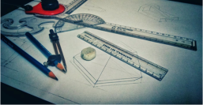
MM Index
Slide# | Thumbnail | Source and Attribution
2 |  | https://www.pexels.com/photo/758503/

