Slide 1
ACTIVITY TO VERIFY PROPERTIES OF ISOSCELES TRIANGLE

Slide 2
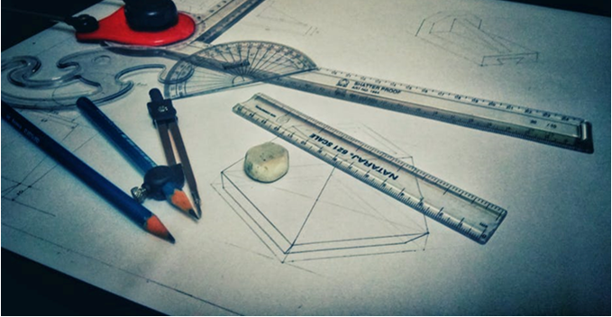
Activity To Verify Properties Of Isosceles Triangle
Aim:
To verify the
properties of an
Isosceles triangle.
Materials required:
Scale
Pencil
Protractor
2 Sticks of same size and one stick of different size (which can be pasted on a paper)
Gum
Chart paper or a white sheet of paper.
Notes:
Pencil protractor : https://www.pexels.com/photo/758503/
(labeled for reuse with modification)

Slide 3
Activity To Verify Properties Of Isosceles Triangle
Questions to recall:
1. What is an Isoceles triangle?
Expected answer: A triangle in which any two sides are equal is called an Isosceles triangle.
2. What are the properties of an Isosceles triangle?
Expected answer:
1. Two sides are equal.
2. Two base angles opposite to the two equal sides are equal.

Slide 4
Activity To Verify Properties Of Isosceles Triangle
Procedure:
A
Step 1: Paste the sticks on the chart paper so as to form a triangle. Name it as ABC.
Step 2: Measure the length of the sides. Write the measurements along the sides as shown. Enter the measurements in the observation.
Step 3: Measure all the angles using a protractor and note it in the observation.
6cm
6cm
B
4cm
C

Slide 5
Activity To Verify Properties Of Isosceles Triangle
Observation:
Length of side AB=......
Length of side BC=......
Length of side CA=......
Measure of angle A=......
Measure of angle B=......
Measure of angle C=......
Two sides of the triangle are equal. The base angles opposite to the equal sides are also equal.
Conclusion: Properties of an isosceles triangle are verified.

Slide 6
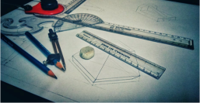
MM Index
Slide# | Thumbnail | Source and Attribution
2 |  | https://www.pexels.com/photo/758503/

