Slide 1
Solve The Problems

Slide 2
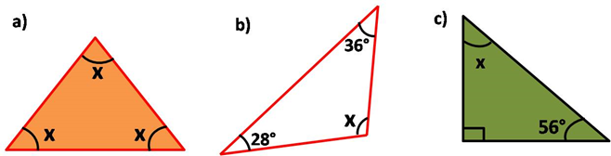
Angle Sum Property
( 1.1 ) Find the value of ‘x’ in the following triangles
Answer
x+x+x = 180°
3x = 180°
x = 60°
Notes:
Answers :
(1) a. x+x+x = 180°
3x = 180°
x = 60°
b. 28°+36°+x=180°
x= 180°- 36°- 28°
x= 34°
c. x +90°+56° = 180°
x=180°-90°-56°
x= 34°

Slide 3
Angle Sum Property
( 1.2 ) Find the value of ‘x’ in the following triangles
Answer
28°+36°+x=180°
x= 180°- 36°- 28°
x= 116°
Notes:
Answers :
(1) a. x+x+x = 180°
3x = 180°
x = 60°
b. 28°+36°+x=180°
x= 180°- 36°- 28°
x= 34°
c. x +90°+56° = 180°
x=180°-90°-56°
x= 34°

Slide 4
Angle Sum Property
( 1.3 ) Find the value of ‘x’ in the following triangles
Answer
x +90°+56° = 180°
x=180°-90°-56°
x= 34°
Notes:
Answers :
(1) a. x+x+x = 180°
3x = 180°
x = 60°
b. 28°+36°+x=180°
x= 180°- 36°- 28°
x= 34°
c. x +90°+56° = 180°
x=180°-90°-56°
x= 34°

Slide 5
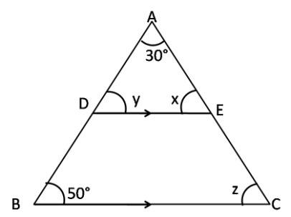
Angle Sum Property
(2) In ∆ABC, DE||BC, Find x, y , z
As DE||BC, AB acts as transversal
So y = 50°
(corresponding angles are equal)
In ∆ADE, 30°+ x+y = 180°
30°+ x+50° = 180°
x = 100°
AS DE ||BC, AC acts as transversal
z =x=100°
(corresponding angles are equal)
Answer
Notes:
(2) As DE||BC , AB acts as transversal
So y = 50° ( cprresponding angles are equal)
In ∆ADE, 30° +x+y = 180°
30°+x+50° = 180°
x = 100°
AS DE ||BC , AC acts as transversal
z =x=100° ( cprresponding angles are equal)

Slide 6
Angle Sum Property
(3) If the angles of a triangle are in the ratio 1 : 4 : 5 , find the angles.
Answer
1x + 4x + 5x = 180 °
10x = 180°
x= 18
So, angles of a triangle 1x , 4x , 5x are 18 °,72°, 90 °
Notes:
(3)1x + 4x + 5x = 180 °
10x = 180°
x= 18
So, angles of a triangle 1x , 4x , 5x are 18 ° ,72° , 90 °

Slide 7
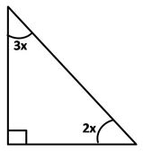
Angle Sum Property
(4) The acute angles of a right angled triangle are in the ratio of 2:3 find the angles.
Answer
2x + 3x + 90° = 180°
5x + 90 ° = 180°
5x = 90°
x = 18 °
So the two acute angles are
2x = 2 X18 °= 36°
3x = 3X18 ° =54°

Slide 8
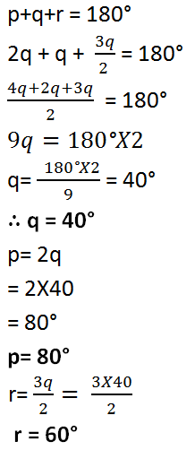
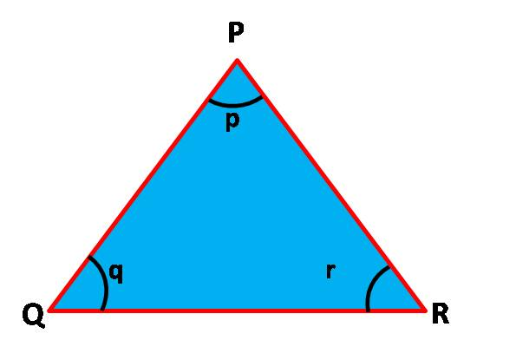
Angle Sum Property
(5) In ∆ PQR , if p = 2q and 2r = 3q, then calculate the angles the triangle.
Answer

Slide 9
MM Index
Slide# | Thumbnail | Source and Attribution

