Slide 1
ACTIVITY ON LENGTH OF
SIDES PROPERTY

Slide 2
Activity On Length Of Sides Property
Aim :
To verify that the sum of the lengths of any two sides of a triangle is greater than the third side in different triangles.
Resources required :
A set of 9 sticks of sizes-4cm,4cm,4cm,6cm,6cm,7cm,8cm,9cm,10cm– sets of 4 or 5 (according to class size)
Observation sheet – 1 each per team
Gum – 1 each per team.
Pen – 1 each per team.
Pencil-1 each per team
Eraser-1 each per team
7. Ruler-1 each per team
Notes:
Asset Type: Suggested Activity
Notes for Teacher - < Information for further reference or explanation >
Suggestions: <Ideas/ Images/ Animations / Others – To make better representation of the content >
Details of Multimedia Objects (Image/audio/ Video/Animation) used in this slide -
1. <Short Description> - <SOURCE TYPE> <SOURCE URL>
e.g. Gandhiji- CC - http://en.wikipedia.org/wiki/File:Portrait_Gandhi.jpg
Source Types -
SSSVV GALLERY - SG
ORIGINAL CREATION /MM APP REQUEST - OC
CREATIVE COMMONS SEARCH - CC
SSSVV AUTHORIZED LINKS / Google Customised Search - SA

Slide 3
Activity On Length Of Sides Property
Triangle (Stick the triangles in below boxes) | Measure of sides (cm) | Sum of two sides (cm) | Third Side (cm) | Sum of two sides > third side
Equilateral ∆ABC | AB = | AB + BC = | CA = | Yes/No
 | BC = | BC + CA = | AB = | Yes/No
 | CA = | CA + AB= | BC = | Yes/No
Isosceles ∆DEF | DE = | DE + EF = | FD = | Yes/No
 | EF = | EF + FD = | DE = | Yes/No
 | FD = | FD + DE = | EF = | Yes/No
Scalene ∆GHI | GH = | GH + HI = | IG = | Yes/No
 | HI = | HI + IG = | GH = | Yes/No
 | IG = | IG + GH = | HI = | Yes/No
Observation sheet
Notes:
It’s a tabular form created in Word and made JPEG image and inserted here.

Slide 4
Activity On Length Of Sides Property
Questions to recall:
1.How are triangles classified based on their side?
Expected Answer: Triangles are classified as Equilateral, Isosceles and Scalene triangles based on their sides.
2.Define the above triangles.
Expected Answer:
A triangle in which all sides are equal is called an Equilateral triangle.
A triangle in which any two sides are equal is called an Isosceles triangle.
A triangle in which all sides are unequal is called a Scalene triangle.

Slide 5
Activity On Length Of Sides Property
Procedure :
Divide the class into groups of 6 students each.
Distribute one set of 9 sticks to each group.
Each group has to construct an Equilateral, Isosceles and Scalene triangles using the given 9 sticks.
Each group measure the sticks using a ruler and construct the three triangles using the given sticks.
Each pair of students in the group to stick the constructed triangle on the observation sheet. Also they could name the triangles as triangle ABC,DEF and PQR.
Notes:
Asset Type: Suggested Activity
Notes for Teacher - Teacher asks each pair of students in the group to stick the constructed triangle on the observation sheet(to ensure equal participation of all team members)
Suggestions: <Ideas/ Images/ Animations / Others – To make better representation of the content >
Details of Multimedia Objects (Image/audio/ Video/Animation) used in this slide -
1. <Short Description> - <SOURCE TYPE> <SOURCE URL>
e.g. Gandhiji- CC - http://en.wikipedia.org/wiki/File:Portrait_Gandhi.jpg
Source Types -
SSSVV GALLERY - SG
ORIGINAL CREATION /MM APP REQUEST - OC
CREATIVE COMMONS SEARCH - CC
SSSVV AUTHORIZED LINKS / Google Customised Search - SA

Slide 6
Activity On Length Of Sides Property
Procedure :
6. After all the 3 triangles are constructed and stuck on the observation sheet, the students are instructed to measure the length of the sides of each triangle and enter it along the sides of the triangle stuck on the observation sheet as well as enter them in the column in the observation sheet.
7. Complete the calculation in the observation sheet.

Slide 7
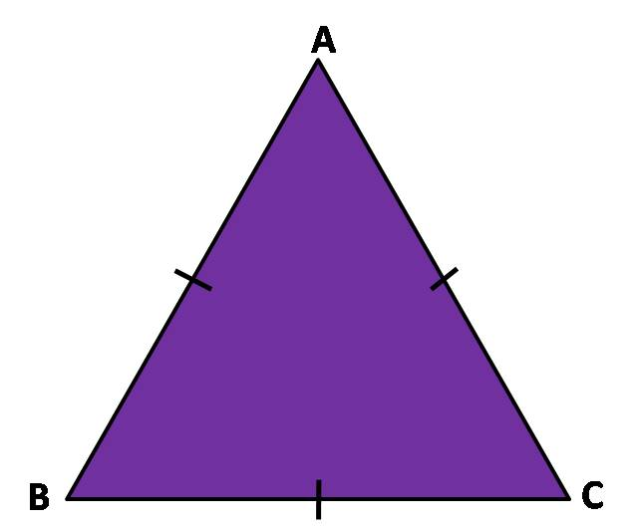
Activity On Length Of Sides Property
Equilateral
Measure of sides (cm)
AB =
BC =
CA =
4cm
4cm
4cm
Sum of two sides ( cm)
AB+ BC = ---------
BC + CA = ---------
CA + AB = ---------
Third side ( cm)
CA = --------------
AB = --------------
BC = ---------------
Is sum of two sides > third side ??
YES
Notes:
Is sum of two sides > third side
Answer : yes

Slide 8
Activity On Length Of Sides Property
Isosceles
D
Measure of sides (cm)
DE =
EF =
FD =
6cm
6cm
E
7cm
F
Sum of two sides ( cm)
DE+ EF = ---------
EF + FD = ---------
FD + DE = ---------
Third side ( cm)
FD = --------------
DE = --------------
EF = ---------------
Is sum of two sides > third side ??
YES

Slide 9
Activity On Length Of Sides Property
Scalene
G
Measure of sides (cm)
GH=
HI =
IG =
8cm
10cm
H
9 cm
I
Sum of two sides ( cm)
GH+ HI= ---------
HI + IG = ---------
IG + GH = ---------
Third side ( cm)
IG = --------------
GH = --------------
HI = ---------------
Is sum of two sides > third side ??
YES

Slide 10
Activity On Length Of Sides Property
Triangle | Measure of sides (cm) | Sum of two sides (cm) | Third Side (cm) | Sum of two sides > third side
Equilateral | AB =4 | AB + BC =8 | CA =4 | YES
 | BC =4 | BC + CA =8 | AB =4 | YES
 | CA =4 | CA + AB=8 | BC =4 | YES
Isosceles | DE =6 | DE + EF =13 | FD =6 | YES
 | EF =7 | EF + FD =13 | DE =6 | YES
 | FD =6 | FD + DE =12 | EF =7 | YES
Scalene | GH =8 | GH + HI =17 | IG =10 | YES
 | HI =9 | HI + IG =19 | GH =8 | YES
 | IG =10 | IG + GH =18 | HI =9 | YES
A
4 cm
4 cm
Observation sheet
B
c
4 cm
D
6 cm
6 cm
E
F
7 cm
G
8 cm
10 cm
H
I
9 cm
Notes:
It’s a tabular form created in Word and made JPEG image and inserted here.

Slide 11
Activity On Length Of Sides Property
CONCLUSION
Sum of the lengths of any two sides of a triangle is always greater than the third side of the triangle.
Length of sides property is verified.

Slide 12
MM Index
Slide# | Thumbnail | Source and Attribution

