Slide 1

Identifying Symmetry and Lines of Symmetry
Notes:
Notes for Teacher – N/A
Suggestions: N/A
Source of Multimedia Objects (Image/audio/ Video/Animation) used in this slide - N/A

Slide 2
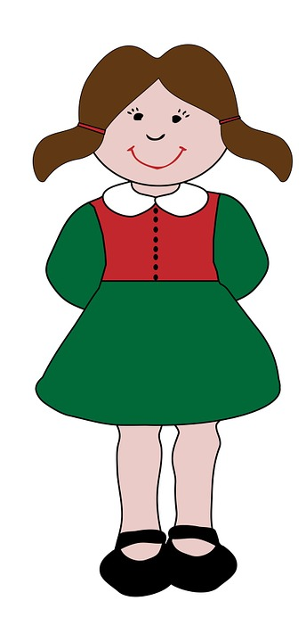
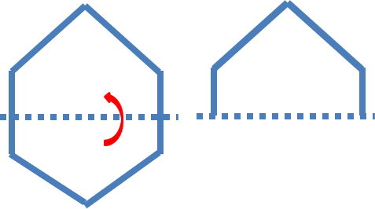
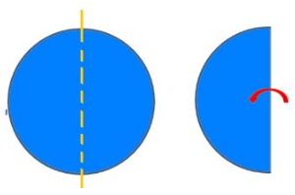
Symmetric Figures
A figure is said to be symmetrical if we can fold or divide it into half such that the two halves match each other exactly.
Notes:
Notes for Teacher – N/A
Suggestions: N/A
Source of Multimedia Objects (Image/audio/ Video/Animation) used in this slide -
Girl - https://pixabay.com/illustrations/children-kids-child-girl-boy-163541/
Symmetry image – Original contribution

Slide 3
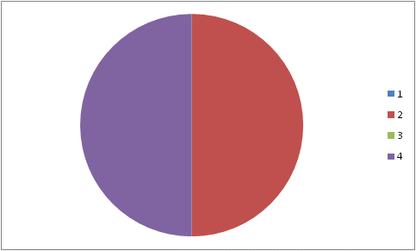
Symmetric Figures
The dotted line is called the line of symmetry.
This line divides the figure in to two equal halves.
Notes:
Notes for Teacher – N/A
Suggestions: N/A
Source of Multimedia Objects (Image/audio/ Video/Animation) used in this slide -
Girl - https://pixabay.com/illustrations/children-kids-child-girl-boy-163541/
Shapes – Original contribution – Power point auto shapes.

Slide 4
Lines of Symmetry
A line of symmetry divides a symmetrical shape in to half.
An object or figure may have one, two or more number of lines of symmetry.
Notes:
Notes for Teacher – N/A
Suggestions: N/A
Source of Multimedia Objects (Image/audio/ Video/Animation) used in this slide - N/A

Slide 5
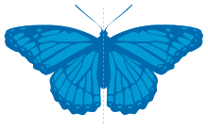
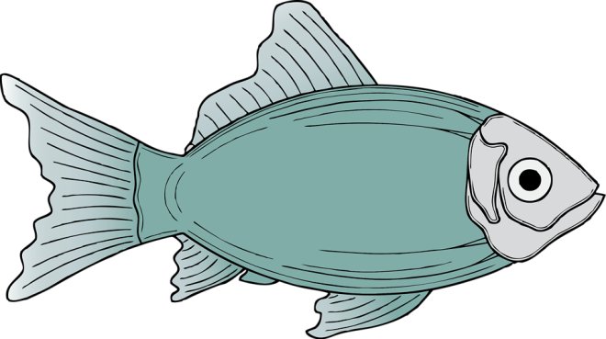

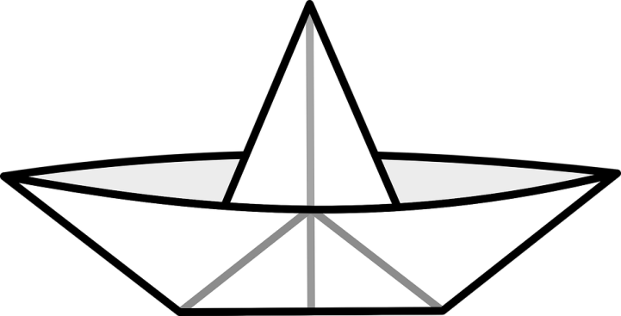
Shapes possessing one line of Symmetry
Shapes can be folded along the dotted line such that the two halves are exactly the same.
Notes:
Notes for Teacher – N/A
Suggestions: N/A
Source of Multimedia Objects (Image/audio/ Video/Animation) used in this slide –
Fish: http://www.freestockphotos.biz/stockphoto/10702
Boat - https://pixabay.com/vectors/paper-boat-toy-folded-crafts-34131/
Butter Fly -https://commons.wikimedia.org/wiki/File:Simetria-bilateria.svg
Alphabets – Original contribution

Slide 6


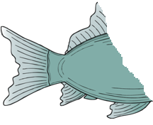


Lines of Symmetry
If we fold it along any other dotted line the two halves will not match each other.
These shapes possess only one line of symmetry.
Notes:
Notes for Teacher – N/A
Suggestions: N/A
Source of Multimedia Objects (Image/audio/ Video/Animation) used in this slide –
Fish: http://www.freestockphotos.biz/stockphoto/10702

Slide 7



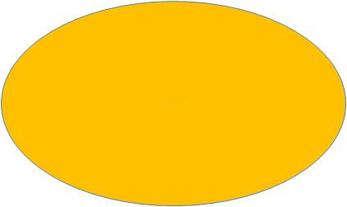

Two lines of Symmetry
Horizontal Line
Horizontal Line
Vertical Line
Vertical Line
Notes:
Notes for Teacher – N/A
Suggestions: N/A
Source of Multimedia Objects (Image/audio/ Video/Animation) used in this slide –
Shapes – Original contribution

Slide 8

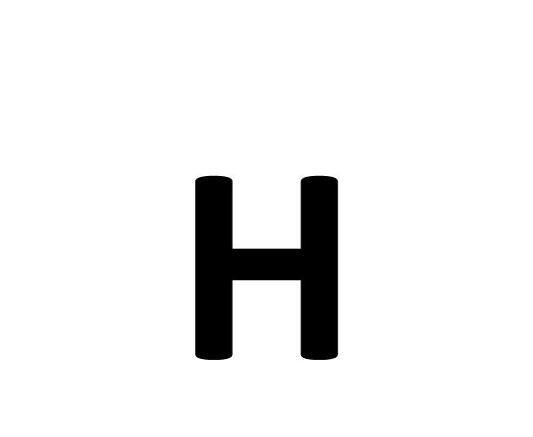


Two lines of Symmetry
Vertical Line
Horizontal Line
Some shapes can be folded along the vertical line and horizontal line into identical halves.
Both the vertical and horizontal lines are lines of symmetry.
Notes:
Notes for Teacher – N/A
Suggestions: N/A
Source of Multimedia Objects (Image/audio/ Video/Animation) used in this slide –
Alphabets – Original contribution

Slide 9


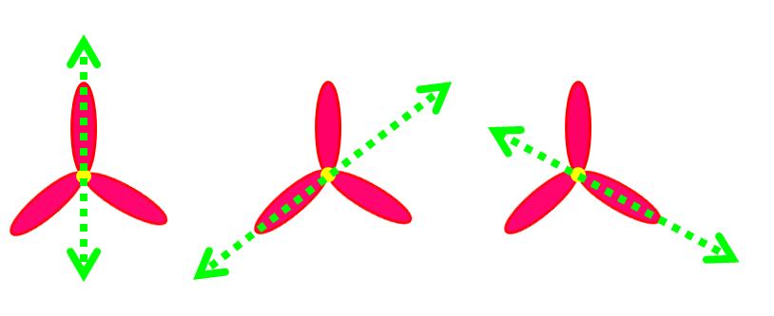

Three lines of Symmetry
If we fold these shapes along the dotted lines, the resulting halves will be identical.
Equilateral Triangles
All these shapes have three lines of symmetry.
Notes:
Notes for Teacher – N/A
Suggestions: N/A
Source of Multimedia Objects (Image/audio/ Video/Animation) used in this slide –
Triangle- https://en.wikipedia.org/wiki/File:Green_equilateral_triangle_point_up.svg
Shape – Original Contribution

Slide 10

Symmetry in Square
A square has four lines of symmetry.
Notes:
Notes for Teacher – N/A
Suggestions: N/A
Source of Multimedia Objects (Image/audio/ Video/Animation) used in this slide –
Shape – Original Contribution

Slide 11
Symmetry in regular pentagon
A pentagon has five lines of symmetry.
A regular polygon of ‘n’ sides will have ‘n’ lines of symmetry.
Notes:
Notes for Teacher – N/A
Suggestions: N/A
Source of Multimedia Objects (Image/audio/ Video/Animation) used in this slide –
Shape – Original Contribution

Slide 12
Line of symmetry in a circle
In a circle, if we draw any line through the center of the circle it is a line of symmetry.
A circle, therefore, has infinite number of lines of symmetry.
Notes:
Notes for Teacher – N/A
Suggestions: N/A
Source of Multimedia Objects (Image/audio/ Video/Animation) used in this slide –
Shape – Original Contribution

Slide 13
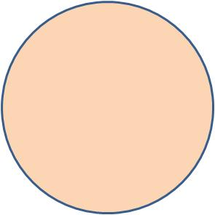
Line of symmetry in a circle
Now observe the circle. We will fold it along the dotted line which is not the center.
This fold along the dotted lines does not create two identical halves. So, this line is not the line of symmetry.
Notes:
Notes for Teacher – N/A
Suggestions: N/A
Source of Multimedia Objects (Image/audio/ Video/Animation) used in this slide –
Shape – Original Contribution

Slide 14

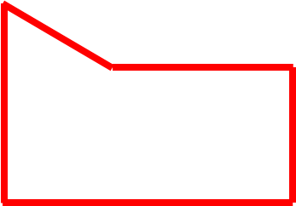

Asymmetrical Figures
If we cannot fold a figure/shape in to two identical halves then they are asymmetrical figures.
Such figures do not have any lines of symmetry.
These figures will not give identical halves in whichever direction we fold.
Notes:
Notes for Teacher – N/A
Suggestions: N/A
Source of Multimedia Objects (Image/audio/ Video/Animation) used in this slide –
Shape – Original Contribution
Tree – https://pixabay.com/vectors/tree-forest-trunk-nature-leaves-576847/
House - http://www.freestockphotos.biz/stockphoto/14938

Slide 15
Mirror Symmetry
Observe the pink coloured shape. Place a mirror along the end of the shape.
We get an identical shape on the other side of the line.
So line symmetry is also called as mirror symmetry.
Notes:
Notes for Teacher – N/A
Suggestions: N/A
Source of Multimedia Objects (Image/audio/ Video/Animation) used in this slide –
Shape – Original Contribution

Slide 16

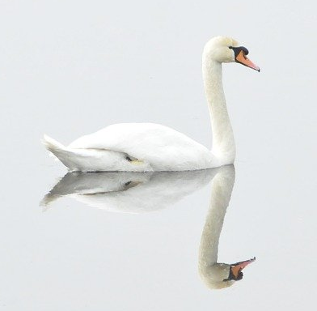
Reflection Symmetry
Image
Image
Reflection
Reflection
The image is reflected in the water below and both are identical to each other.
The water line becomes the line of symmetry.
Line symmetry, Mirror symmetry, Reflection symmetry are all the same.
Notes:
Notes for Teacher – N/A
Suggestions: N/A
Source of Multimedia Objects (Image/audio/ Video/Animation) used in this slide –
Mountain mirror image - https://commons.wikimedia.org/wiki/File:Mount_Hood_reflected_in_Mirror_Lake,_Oregon.jpg
Bird mirror image - https://pixabay.com/photos/swan-bird-nature-water-bird-293157/

Slide 17
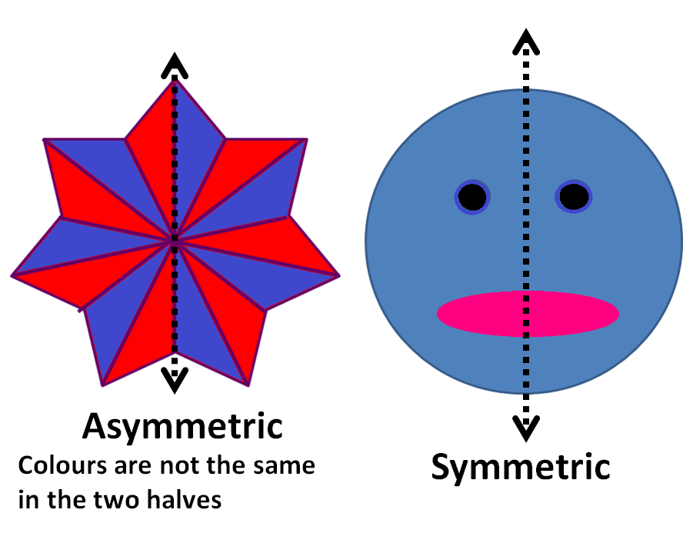
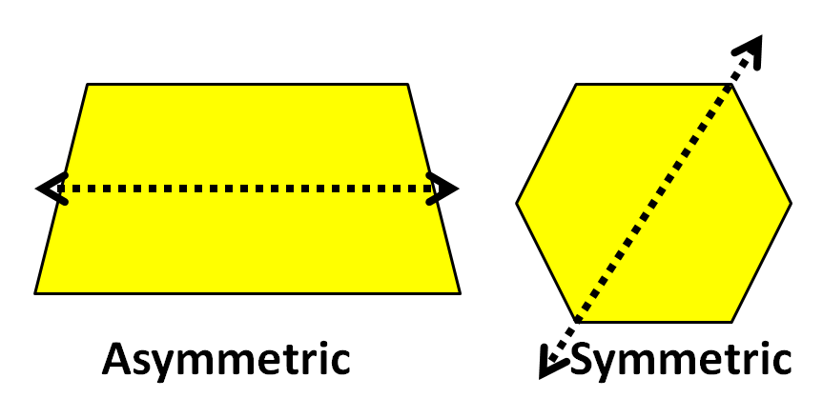
Observations
A symmetrical shape has two halves which look like mirror images of each other
An asymmetrical shape has two halves which do not make a mirror image
Notes:
Notes for Teacher – N/A
Suggestions: N/A
Source of Multimedia Objects (Image/audio/ Video/Animation) used in this slide –
Shape – Original Contribution

Slide 18
MM Index
Slide# | Thumbnail | Source and Attribution
2,3 |  | https://pixabay.com/illustrations/children-kids-child-girl-boy-163541/
5 |  | http://www.freestockphotos.biz/stockphoto/10702 https://pixabay.com/vectors/paper-boat-toy-folded-crafts-34131/ https://commons.wikimedia.org/wiki/File:Simetria-bilateria.svg
6 |  | http://www.freestockphotos.biz/stockphoto/10702
9 |  | https://en.wikipedia.org/wiki/File:Green_equilateral_triangle_point_up.svg
14 |  | https://pixabay.com/vectors/tree-forest-trunk-nature-leaves-576847/
14 |  | http://www.freestockphotos.biz/stockphoto/14938
16 |  | https://commons.wikimedia.org/wiki/File:Mount_Hood_reflected_in_Mirror_Lake,_Oregon.jpg
16 |  | https://pixabay.com/photos/swan-bird-nature-water-bird-293157/

