Slide 1
Practical Uses of Symmetry in Daily Life
Notes:
Notes for Teacher - < Information for further reference or explanation >
Suggestions: <Ideas/ Images/ Animations / Others – To make better representation of the content >
Source of Multimedia Objects (Image/audio/ Video/Animation) used in this slide -
1. <Short Description> - <SOURCE URL>

Slide 2
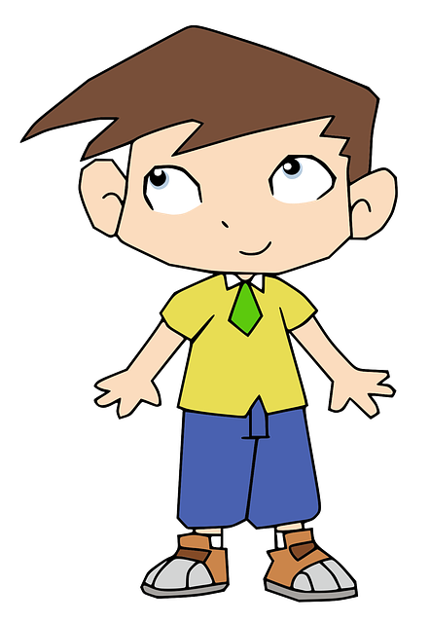
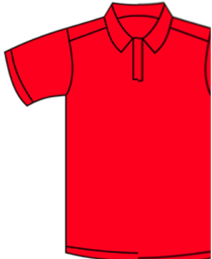
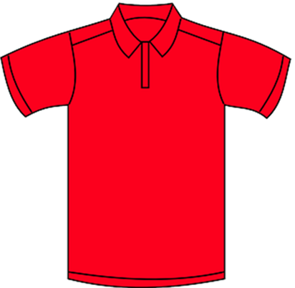
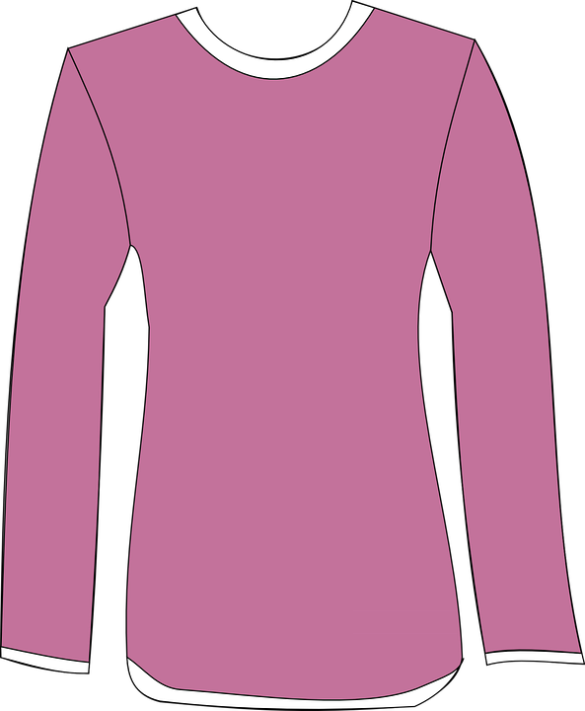
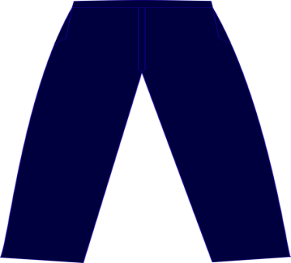
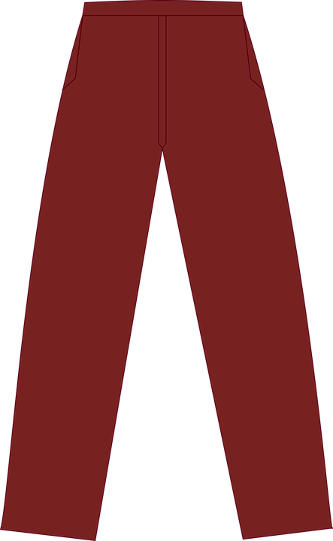
Symmetry in our daily life
The uniform that you wear is symmetrical.
Would you like to wear a shirt with one half sleeve and the other to be sleeveless?
Notes:
Asset Type: Day to Day Relevance
Notes for Teacher – N/A
Suggestions: N/A
Details of Multimedia Objects (Image/audio/ Video/Animation) used in this slide -
1. Red shirt - https://pixabay.com/en/polo-shirt-t-shirt-shirt-clothing-48105/
2. Pink shirt - https://pixabay.com/en/blouse-pink-clothing-female-shirt-154159/
3. Maroon pant - https://pixabay.com/en/pants-maroon-cloth-2414348/
4. Blue pant - https://pixabay.com/en/pants-blue-cloth-2414349/
5. Boy - https://pixabay.com/vectors/boy-child-comic-characters-human-2027946/
Source Types -
CR FREE CREATIVE COMMONS SEARCH

Slide 3
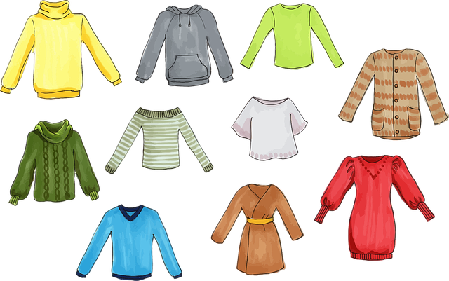
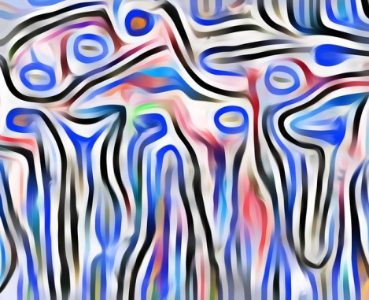
Symmetry in our daily life
Observe the T-shirt and some casual dresses that you wear. They have symmetrical designs.
Asymmetrical design creates an incomplete feeling in our brain.
Notes:
https://pixabay.com/vectors/blouse-clothes-clothing-colorful-1297721/
https://pixabay.com/illustrations/pattern-floral-seamless-wallpaper-6019976/

Slide 4
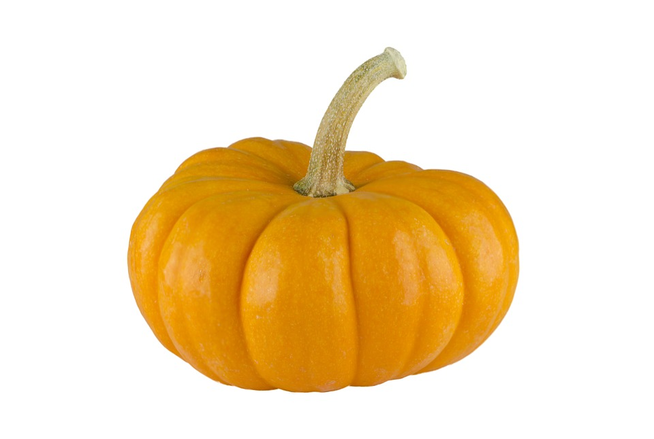
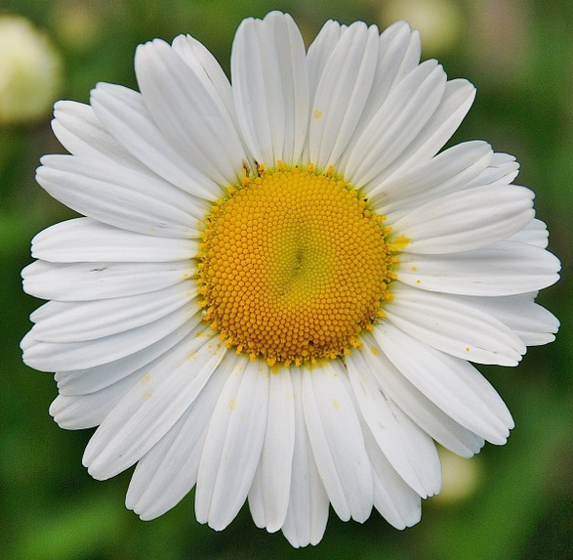
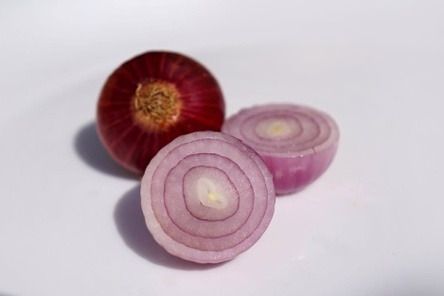
Symmetry in our daily life
Vegetables and Flowers follow Symmetry as well
Vegetables
Flowers
Notes:
Asset Type: Day to Day Relevance
Notes for Teacher – N/A
Suggestions: N/A
Details of Multimedia Objects (Image/audio/ Video/Animation) used in this slide -
Pumpkin: https://pixabay.com/en/pumpkin-white-back-ground-squash-963043/
3. Onion : https://pixabay.com/photos/spices-onion-purple-food-cut-3005240/
2. Flower: https://pixabay.com/en/floral-daisy-blossom-plant-natural-50157/
Source Types -
CR FREE CREATIVE COMMONS SEARCH

Slide 5
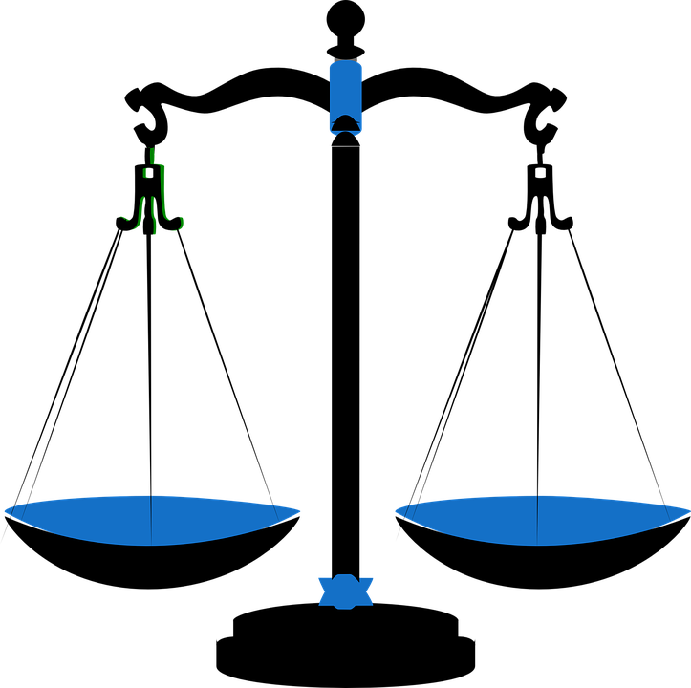
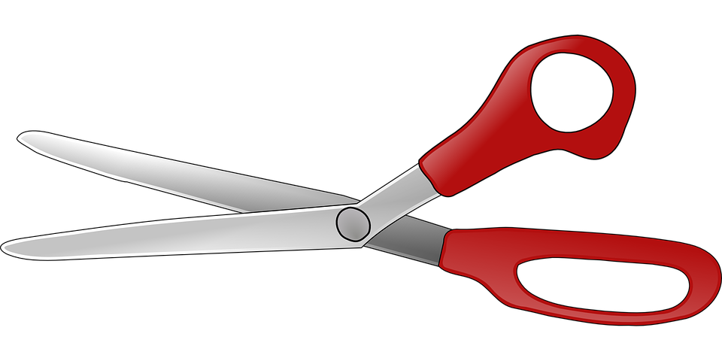
Symmetry in our daily life
Simple Gadgets are symmetrical. The tools that are symmetrical are handier to use.
- - - - - - - - - - - - - - - - - - - - - - - -
Scissors
Weighing Balance
Notes:
Asset Type: Day to Day Relevance
Notes for Teacher - Move on to the next slide.
Suggestions: <Ideas/ Images/ Animations / Others – To make better representation of the content >
Details of Multimedia Objects (Image/audio/ Video/Animation) used in this slide -
Weighing Scale: https://pixabay.com/en/scales-balance-measure-weigh-blue-309810/
Scissors: https://pixabay.com/en/scissors-office-open-scissor-tool-28697/
Source Types -
CR FREE CREATIVE COMMONS SEARCH

Slide 6
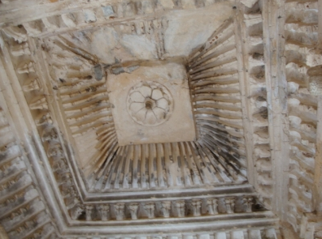
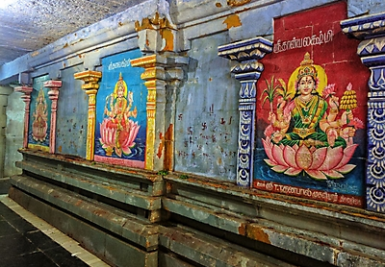
Symmetry in our daily life
Ceilings and walls of temples have symmetrical designs to create harmony and balance
Notes:
Details of Multimedia Objects (Image/audio/ Video/Animation) used in this slide -
Ceiling : https://www.srisathyasaividyavahini.org/index.php/component/joomgallery/default/religious-1065.html
Wall : https://www.srisathyasaividyavahini.org/index.php/component/joomgallery/default/temple-wall-painting-8270.html

Slide 7
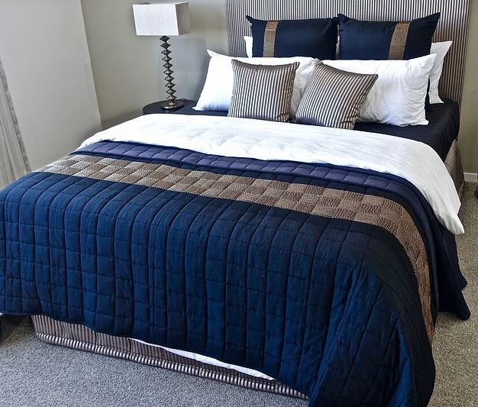
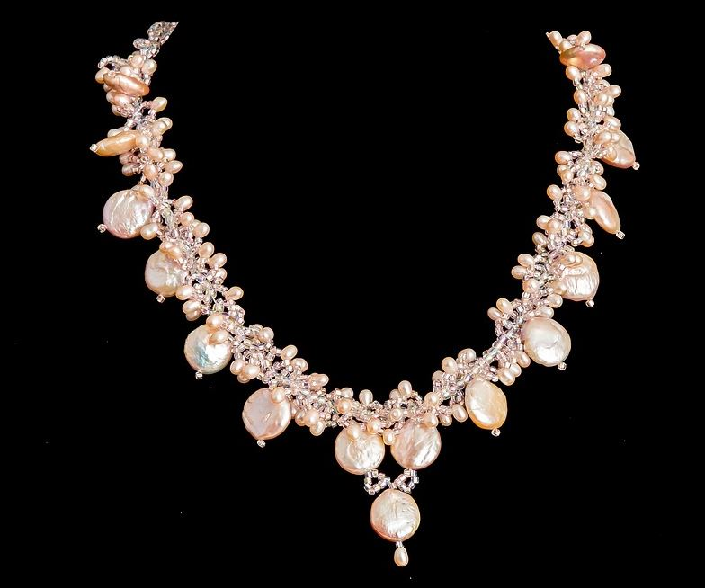
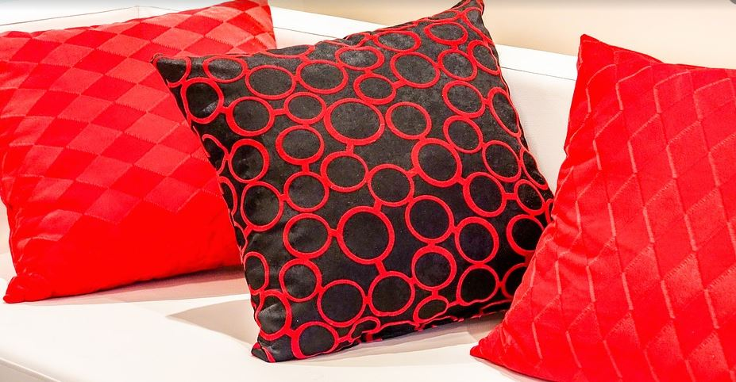
Symmetry in our daily life
The bedsheets, pillow covers and jewels that we use all have symmetrical designs in it.
Notes:
Notes to the Teacher: Asymmetrical designs create a sort of visual disturbance. Designers prefer symmetrical design as it gives a pleasing effect to human brain.
Moreover symmetrical design in jewellery-making reduces the cost and amount of time taken to complete it.
Details of Multimedia Objects (Image/audio/ Video/Animation) used in this slide -
Pillow cover: https://pixabay.com/en/pillow-sofa-cozy-furniture-2092155/
Cot with bedsheet : https://pixabay.com/en/bed-bedroom-pillows-design-modern-1834916/
Necklace: https://pixabay.com/en/necklace-pearl-jewelry-luxury-gift-2125146/

Slide 8
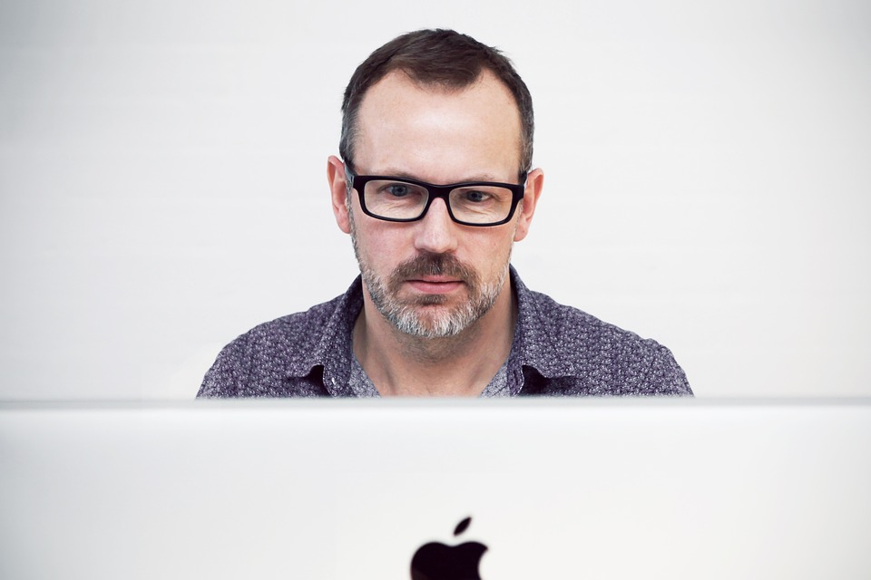
Symmetry in our daily life
One of the best examples that nature has created is Human Face
_ _ _ _ _ _ _ _ _ _ _
The human face and body are considered to be perfectly symmetrical in nature.
Notes:
Notes for Teacher – Photographers try to bring more of symmetry in the picture that they capture because symmetry makes the photograph visually more appealing. Asymmetrical photographs give a sort of weird look.
The human face and body is considered to be symmetrical in nature. The more the symmetry is there in the human body the more the person looks beautiful and attractive. That’s why sometimes when we try taking selfies, our face looks weird because it is not symmetrical.
Suggestions: N/A
Details of Multimedia Objects (Image/audio/ Video/Animation) used in this slide -
1. Facial Symmetry:CC: https://pixabay.com/en/man-male-adult-person-caucasian-1209494/
Source Types -
CR FREE CREATIVE COMMONS SEARCH

Slide 9
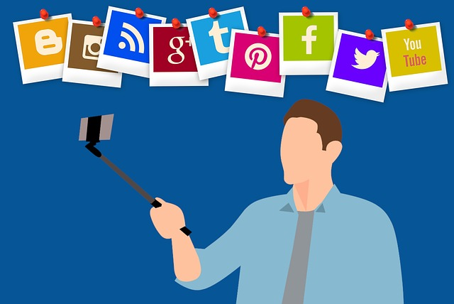
Symmetry in our daily life
The more the symmetry is there in the human body the more the person looks beautiful and attractive. That’s why sometimes our face looks weird in a selfie.
There is no symmetry in a selfie
Notes:
Asset Type: Day to Day Relevance
Notes for Teacher – N/A
Suggestions: N/A
Details of Multimedia Objects (Image/audio/ Video/Animation) used in this slide - N/A
https://pixabay.com/illustrations/selfie-social-media-man-post-love-3677225/
Other images – Created using ppt tools

Slide 10







MM Index
Slide# | Thumbnail | Source and Attribution
2 |  | https://pixabay.com/vectors/boy-child-comic-characters-human-2027946/
2 |  | https://pixabay.com/en/polo-shirt-t-shirt-shirt-clothing-48105/
2 |  | https://pixabay.com/en/pants-blue-cloth-2414349/
2 |  | https://pixabay.com/en/blouse-pink-clothing-female-shirt-154159/
2 |  | https://pixabay.com/en/pants-maroon-cloth-2414348/
3 |  | https://pixabay.com/vectors/blouse-clothes-clothing-colorful-1297721/ https://pixabay.com/illustrations/pattern-floral-seamless-wallpaper-6019976/
4 |  | https://pixabay.com/en/scales-balance-measure-weigh-blue-309810/
4 |  | https://pixabay.com/en/scissors-office-open-scissor-tool-28697/
5 |  | https://pixabay.com/en/pumpkin-white-back-ground-squash-963043/
5 |  | https://pixabay.com/en/floral-daisy-blossom-plant-natural-50157/
5 |  | https://pixabay.com/photos/spices-onion-purple-food-cut-3005240/
6 |  | SSSVV Gallery-Keyword-roof
6 |  | SSSVV Gallery-Keyword-temple wall

Slide 11
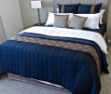



MM Index
Slide# | Thumbnail | Source and Attribution
7 |  | https://pixabay.com/en/bed-bedroom-pillows-design-modern-1834916/
7 |  | https://pixabay.com/en/pillow-sofa-cozy-furniture-2092155/
7 |  | https://pixabay.com/en/necklace-pearl-jewelry-luxury-gift-2125146/
8 |  | https://pixabay.com/en/man-male-adult-person-caucasian-1209494/
9 |  | https://pixabay.com/illustrations/selfie-social-media-man-post-love-3677225/

