Slide 1
Activity to Learn Lines of Symmetry
Notes:
Notes for Teacher - < Information for further reference or explanation >
Suggestions: <Ideas/ Images/ Animations / Others – To make better representation of the content >
Source of Multimedia Objects (Image/audio/ Video/Animation) used in this slide -
1. <Short Description> - <SOURCE URL>

Slide 2


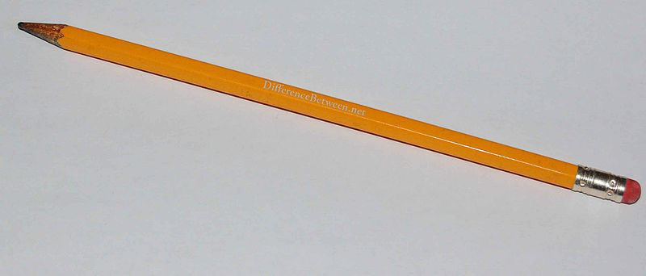

LINE OF SYMMETRY
Aim - To find lines of symmetry of the given shapes
Materials Required
Scissors
Pencil
Paper
Scale
Notes:
Notes for Teacher - < Information for further reference or explanation >
The teacher must ask the students to bring the materials the previous day itself. The students must bring the materials on their won.
Suggestions: <Ideas/ Images/ Animations / Others – To make better representation of the content >
Source of Multimedia Objects (Image/audio/ Video/Animation) used in this slide -
<Scissors> - <https://openclipart.org/detail/22372/scissors>
<Paper> - <https://pixabay.com/en/paper-sheets-colours-red-green-305095/>
<Pencil> - <https://commons.wikimedia.org/wiki/File:Pencil-db.jpg>
<Scale> - <https://openclipart.org/detail/308824/shinwa-15cm-ruler>

Slide 3
QUESTIONS TO RECALL
What is a line of symmetry?
The axis or line of symmetry is an imaginary line that runs through the center of a line or shape creating two perfectly identical halves.
2. How many lines of symmetry are there in a regular polygon?
A regular polygon has as many lines of symmetry as it has sides. They may have several lines of symmetry.
Notes:
Notes for Teacher - < Information for further reference or explanation >
Teacher must ask the questions to recall the line of symmetry
Suggestions: <Ideas/ Images/ Animations / Others – To make better representation of the content >
Source of Multimedia Objects (Image/audio/ Video/Animation) used in this slide -
<Scissors> - <https://www.kisspng.com/png-scissors-clip-art-public-domain-drawings-578403/>
<Paper> - <https://pixabay.com/en/paper-sheets-colours-red-green-305095/>
<Pencil> - <https://commons.wikimedia.org/wiki/File:Pencil-db.jpg>
<Scale> - <https://commons.wikimedia.org/wiki/File:Ruler_4scales.jpg>

Slide 4
PROCEDURE
Step 1: Cut the sheets by drawing the shapes of equilateral triangle, square, regular pentagon, and regular hexagon.
Step 2: Starting with a triangle, by folding the paper, find out the number of lines of symmetry in each figure.
Let us see the lines of symmetry for square:
Notes:
Notes for Teacher - < Information for further reference or explanation >
Teacher must ask the questions to recall the line of symmetry
Suggestions: <Ideas/ Images/ Animations / Others – To make better representation of the content >
Source of Multimedia Objects (Image/audio/ Video/Animation) used in this slide -
<Scissors> - <https://www.kisspng.com/png-scissors-clip-art-public-domain-drawings-578403/>
<Paper> - <https://pixabay.com/en/paper-sheets-colours-red-green-305095/>
<Pencil> - <https://commons.wikimedia.org/wiki/File:Pencil-db.jpg>
<Scale> - <https://commons.wikimedia.org/wiki/File:Ruler_4scales.jpg>

Slide 5
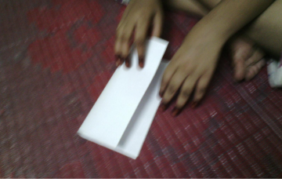
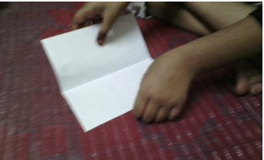

Line of Symmetry - Square
  Fold it along its length into two such that the halves exactly overlap
1
2
  Unfold the shape and look at the creased line
Along the Length
Line of symmetry
Notes:
Notes for Teacher – N/A
Suggestions: N/A
Source of Multimedia Objects (Image/audio/ Video/Animation) used in this slide - N/A
Original Contribution: vishmom@gmail.com

Slide 6
Line of Symmetry - Square
  Fold it along its breadth into two such that the halves exactly overlap
3
4
  Unfold the shape and look at the creased line
Along the Breadth
Another Line of symmetry
Notes:
Notes for Teacher – N/A
Suggestions: N/A
Source of Multimedia Objects (Image/audio/ Video/Animation) used in this slide - N/A

Slide 7
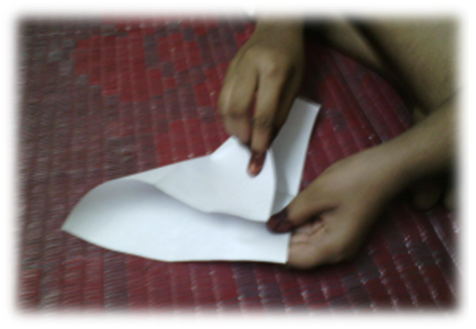
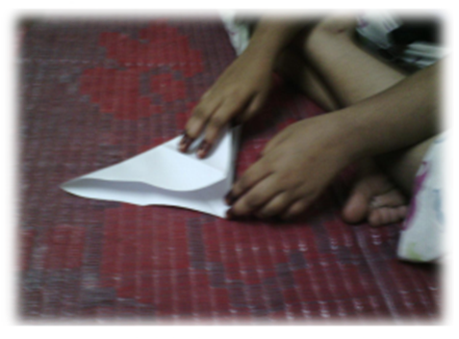
Line of Symmetry - Square
  Fold it along its diagonal into two such that the halves exactly overlap
5
6
  Unfold the shape and look at the creased line
Along the Diagonal
Another Line of symmetry
Notes:
Notes for Teacher – N/A
Suggestions: N/A
Source of Multimedia Objects (Image/audio/ Video/Animation) used in this slide -
Image – Original Contribution - vishmom@gmail.com

Slide 8
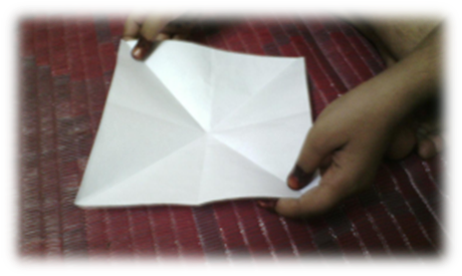
Line of Symmetry - Square
Step 3: Draw a dotted line over lines of fold.
Step 4: These dotted lines indicate lines of symmetry.
There are four lines of symmetry for a square.
Notes:
Notes for Teacher – N/A
Suggestions: N/A
Source of Multimedia Objects (Image/audio/ Video/Animation) used in this slide -
Image – Original Contribution - vishmom@gmail.com

Slide 9
OBSERVATION
Square - 4 lines of symmetry
Equilateral Triangle
3 lines of symmetry
Pentagon - 5 lines of symmetry
Hexagon - 6 lines of symmetry
Notes:
Notes for Teacher - < Information for further reference or explanation >
Teacher must ask the questions to recall the line of symmetry
Suggestions: <Ideas/ Images/ Animations / Others – To make better representation of the content >
Source of Multimedia Objects (Image/audio/ Video/Animation) used in this slide -
<Scissors> - <https://www.kisspng.com/png-scissors-clip-art-public-domain-drawings-578403/>
<Paper> - <https://pixabay.com/en/paper-sheets-colours-red-green-305095/>
<Pencil> - <https://commons.wikimedia.org/wiki/File:Pencil-db.jpg>
<Scale> - <https://commons.wikimedia.org/wiki/File:Ruler_4scales.jpg>

Slide 10
CONCLUSION
A regular polygon has as many lines of symmetry as it has sides
Notes:
Notes for Teacher - < Information for further reference or explanation >
Teacher must ask the questions to recall the line of symmetry
Suggestions: <Ideas/ Images/ Animations / Others – To make better representation of the content >
Source of Multimedia Objects (Image/audio/ Video/Animation) used in this slide -
<Scissors> - <https://www.kisspng.com/png-scissors-clip-art-public-domain-drawings-578403/>
<Paper> - <https://pixabay.com/en/paper-sheets-colours-red-green-305095/>
<Pencil> - <https://commons.wikimedia.org/wiki/File:Pencil-db.jpg>
<Scale> - <https://commons.wikimedia.org/wiki/File:Ruler_4scales.jpg>

Slide 11



MM Index
Slide# | Thumbnail | Source and Attribution
2 |  | https://openclipart.org/detail/22372/scissors
2 |  | https://commons.wikimedia.org/wiki/File:Pencil-db.jpg
2 |  | https://pixabay.com/en/paper-sheets-colours-red-green-305095/
2 |  | https://openclipart.org/detail/308824/shinwa-15cm-ruler
5-8 |  | Original Contribution -vishmom@gmail.com

