Slide 1
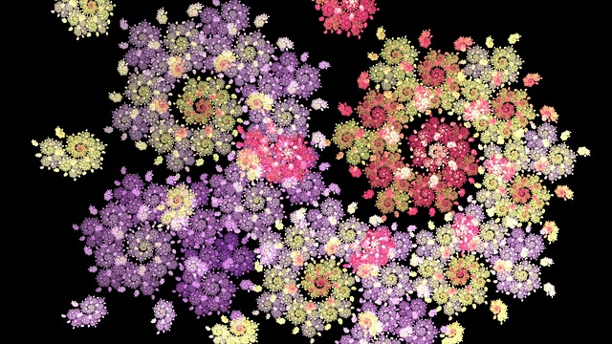
FRACTALS
Notes:
Notes for Teacher - < Information for further reference or explanation >
Suggestions: <Ideas/ Images/ Animations / Others – To make better representation of the content >
Source of Multimedia Objects (Image/audio/ Video/Animation) used in this slide -
https://pixabay.com/illustrations/fractal-fractal-art-digital-art-1597774/

Slide 2
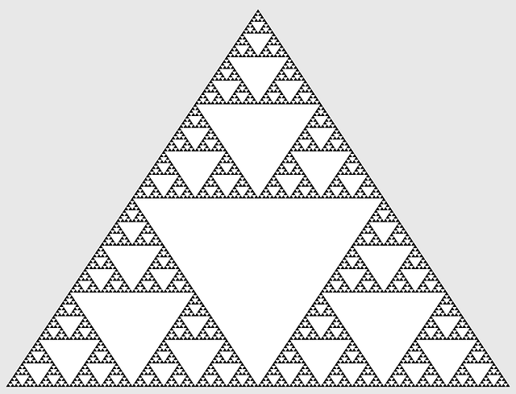
FRACTALS
A fractal is a pattern, based on a mathematical function that is repeatable, self-similar, and that cannot be scaled. Different functions have different patterns.
Notes:
https://pixabay.com/vectors/mathematics-sierpinski-triangle-696806/

Slide 3
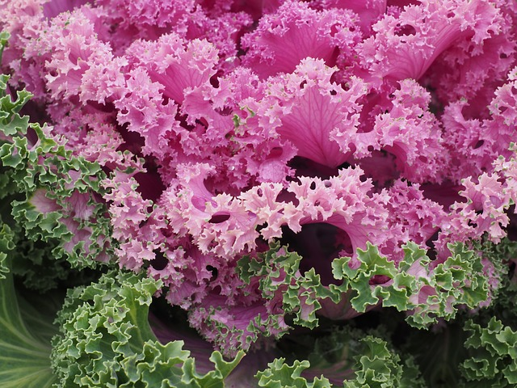
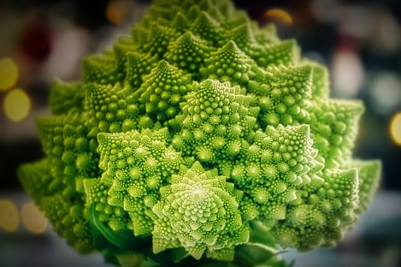
FRACTALS
The structure can be split into parts, each one is a miniature of the whole, having self-similarity.
Notes:
https://pixabay.com/photos/ornamental-cabbage-leaves-kraus-779950/
https://pixabay.com/photos/romanesco-cauliflower-vegetables-3920110/

Slide 4
IMAGE OF A SNOWFLAKE
Every Koch snowflake is a fractal curve also known as Koch curve, Koch star.
It can be built up in a sequence of stages as an equilateral triangle and each stage makes outward bends to form smaller triangles.
It has an infinite perimeter.
Notes:
Original contribution

Slide 5

IMAGE OF A SNOWFLAKE
Here, each Koch curve starts as a triangle, which gets built up into triangles of equal sizes outward, thus forming a beautiful pattern of Snowflake
Notes:
https://pixabay.com/vectors/koch-snowflake-maths-design-3271115/

Slide 6
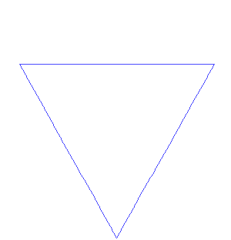
IMAGE OF A SNOWFLAKE
Here, each Koch curve starts as a triangle, which gets built up into triangles of equal sizes outward, thus forming a beautiful pattern of Snowflake
Notes:
https://en.wikipedia.org/wiki/Fractal#/media/File:Von_Koch_curve.gif
Attribution: António Miguel de Campos

Slide 7
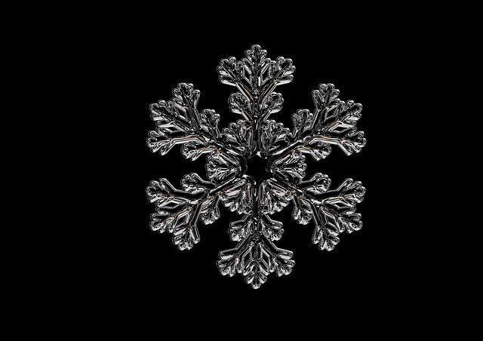
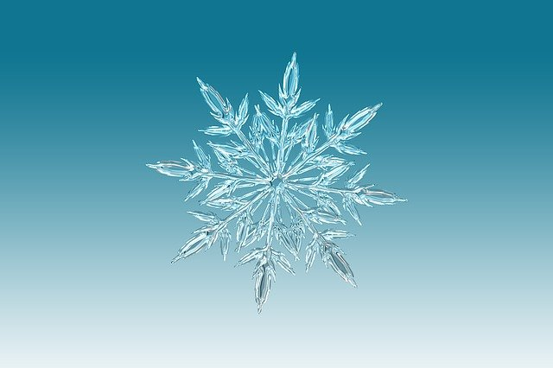
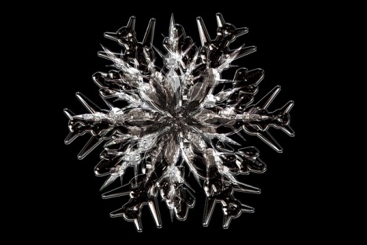
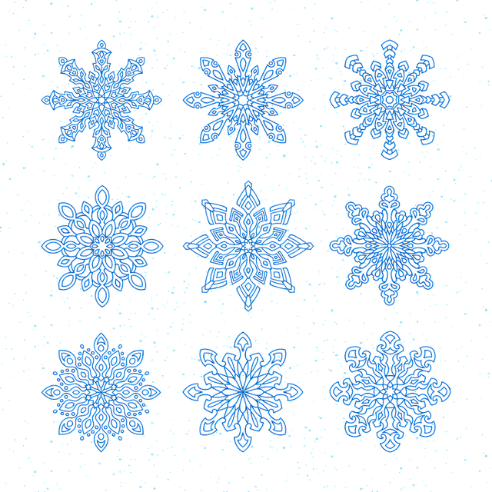
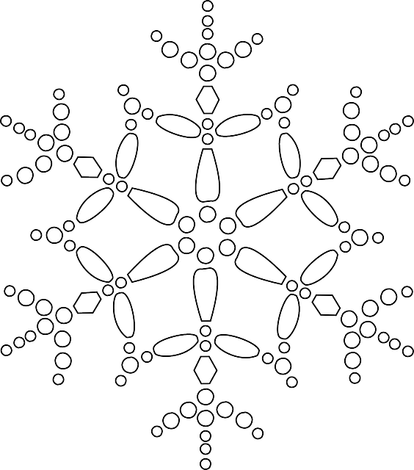
IMAGES OF SNOWFLAKES
Here are some images of snowflakes
Notes:
https://pixabay.com/illustrations/snowflakes-vector-new-year-s-eve-1523381/
https://pixabay.com/vectors/star-snow-snowflake-season-winter-145393/
https://pixabay.com/illustrations/ice-crystal-ice-form-frost-fabric-528534/
https://pixabay.com/illustrations/snowflake-ice-crystal-snow-ice-5544636/
https://pixabay.com/illustrations/snowflake-ice-crystal-winter-snow-1065155/
https://en.wikipedia.org/wiki/Fractal#/media/File:Von_Koch_curve.gif

Slide 8









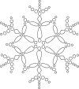
MM Index
Slide no | Thumbnail | Source
1 |  | https://pixabay.com/illustrations/fractal-fractal-art-digital-art-1597774/
2 |  | https://pixabay.com/vectors/mathematics-sierpinski-triangle-696806/
3 |  | https://pixabay.com/photos/ornamental-cabbage-leaves-kraus-779950/ https://pixabay.com/photos/romanesco-cauliflower-vegetables-3920110/
5 |  | https://pixabay.com/vectors/koch-snowflake-maths-design-3271115/
6 |  | https://en.wikipedia.org/wiki/Fractal#/media/File:Von_Koch_curve.gif Attribution: António Miguel de Campos
7 |  | https://pixabay.com/illustrations/snowflakes-vector-new-year-s-eve-1523381/ https://pixabay.com/vectors/star-snow-snowflake-season-winter-145393/ https://pixabay.com/illustrations/ice-crystal-ice-form-frost-fabric-528534/ https://pixabay.com/illustrations/snowflake-ice-crystal-snow-ice-5544636/ https://pixabay.com/illustrations/snowflake-ice-crystal-winter-snow-1065155/

