Slide 1
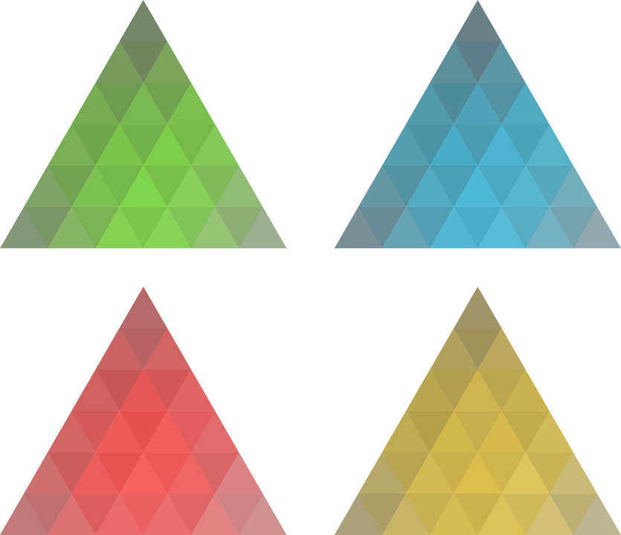
Introduction to Congruence
Notes:
Notes for Teacher - < Information for further reference or explanation >
Suggestions: <Ideas/ Images/ Animations / Others – To make better representation of the content >
Source of Multimedia Objects (Image/audio/ Video/Animation) used in this slide -
Triangle- https://pixabay.com/vectors/threesome-green-blue-red-yellow-1995194/

Slide 2
Introduction to Congruence
Consider the two pictures shown below:
Both stars are of same shape and size.
Both stars are of same shape but different size.
Notes:
Asset Type: Main Script
Notes for Teacher - < Information for further reference or explanation >
Suggestions: Consider the two pictures shown below:
Observe the difference between the two pictures.
In first picture both stars are same shape and size.In the second picture both stars are of same shape but different size.
Details of Multimedia Objects (Image/audio/ Video/Animation) used in this slide -
ORIGINAL CREATION /MM APP REQUEST – OC

Slide 3


Definition
Congruence = Exactly the same shape and size.
Two A4 sized papers are congruent, even when they are rotated in any direction.
Notes:
Asset Type: Main Script
Notes for Teacher - < Information for further reference or explanation >
Suggestions:
Any two shapes are said to be congruent if they have exactly the same shape and size.
Any two A4 size plain paper are congruent. Even when they are rotated (any orientation),they are congruent to each other.
Details of Multimedia Objects (Image/audio/ Video/Animation) used in this slide -
A4_paper- CR FREE CREATIVE COMMONS SEARCH - https://pixabay.com/photos/business-branding-blank-paper-792113/

Slide 4
Identifying congruent shapes-Method of Superposition
Place any two objects on each other.
If they are perfect fit, they are said to be congruent. This is called method of Superposition. Example : Two A4 sized sheets placed on each other.
Notes:
Asset Type: Main Script
Notes for Teacher - < Information for further reference or explanation >
Suggestions:
When two shapes are superimposed(laid over) on each other and they fit perfectly into each other,then the shapes are said to be congruent.This method is called method of superposition and is used to check if any two figures are congruent.
The two A4 size sheets when placed over each other are a perfect fit. Hence the two sheets are congruent.
Details of Multimedia Objects (Image/audio/ Video/Animation) used in this slide -
A4_paper- CR FREE CREATIVE COMMONS SEARCH - https://pixabay.com/photos/business-branding-blank-paper-792113/

Slide 5
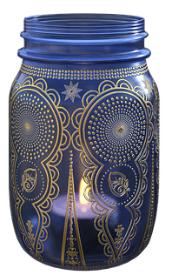
Congruent or Similar?
Two jars are congruent
when they have same size and shape
Two jars are similar if they have same shape but different size
Notes:
Asset Type: Main Script
Notes for Teacher - < Information for further reference or explanation >
Suggestions:
Any two objects having exactly same size and shape are said to be congruent
Two jars are congruent.
Any two objects having same shape but different size are said to similar.
Two jars are similar.
Details of Multimedia Objects (Image/audio/ Video/Animation) used in this slide -
Mason Jars- CR FREE CREATIVE COMMONS SEARCH - https://pixabay.com/illustrations/jar-candles-candle-mason-jar-4004158/

Slide 6
Symbol for congruence
Consider the figures F1 and F2 shown below
F1
F2
The two figures are congruent.
Symbol for congruence is ≅
Here F1 ≅ F2
Notes:
Asset Type: Main Script
Notes for Teacher - < Information for further reference or explanation >
Suggestions:
Consider the figures F1 and F2 shown below
The two figures are congruent. Symbol for congruence is ≅
Here F ≅ F2
Details of Multimedia Objects (Image/audio/ Video/Animation) used in this slide -
ORIGINAL CREATION /MM APP REQUEST - OC

Slide 7



MM Index
Slide# | Thumbnail | Source and Attribution
3,4 |  | https://pixabay.com/photos/business-branding-blank-paper-792113/
5 |  | https://pixabay.com/illustrations/jar-candles-candle-mason-jar-4004158/
1 |  | https://pixabay.com/vectors/threesome-green-blue-red-yellow-1995194/

