Slide 1
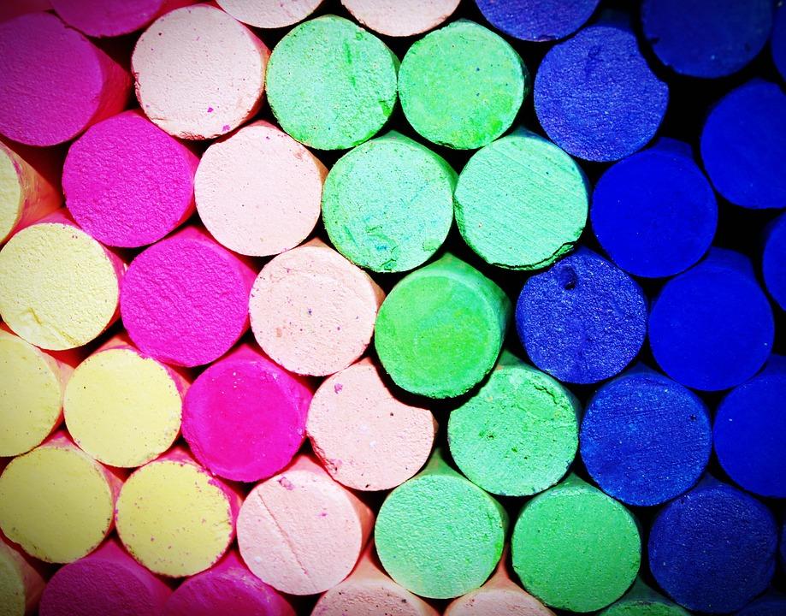
Activity on
CONGRUENT SHAPES
Notes:
Notes for Teacher - < Information for further reference or explanation >
Suggestions: <Ideas/ Images/ Animations / Others – To make better representation of the content >
Source of Multimedia Objects (Image/audio/ Video/Animation) used in this slide -
1. Chalk peices - https://pixabay.com/photos/background-blackboard-blue-board-1869471/

Slide 2
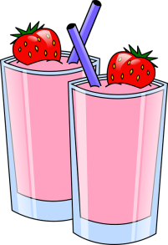
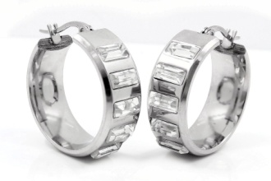
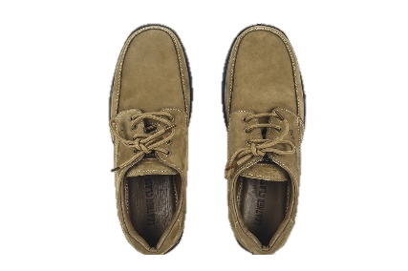
RECALLING CONGRUENT SHAPES
1.What are congruent shapes?
Any TWO shapes are congruent if they
have same shape and size.
2.Are the ear rings worn by your class mate congruent?
Yes, any pair of ear rings are congruent.
3.Are shoes/slippers worn by you congruent?
No, because shoes/slippers are of same size but of different shape.
Notes:
Notes for Teacher - Teacher starts the activity by recalling congruent shapes.
Suggestions: <Ideas/ Images/ Animations / Others – To make better representation of the content >
Source of Multimedia Objects (Image/audio/ Video/Animation) used in this slide -
Juice glass- https://pixabay.com/vectors/drinks-strawberry-pink-frozen-34377/
Ear rings-https://pixabay.com/photos/earrings-circles-steel-734677/
Shoes-https://pixabay.com/photos/shoes-leather-pair-fashion-825671/

Slide 3

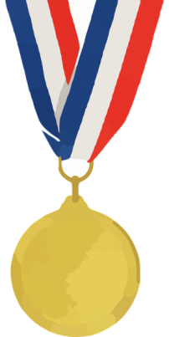
ACTIVITY
Divide the class into 4 groups.
Each group is given 5 min to list out the congruent shapes in class.
Teacher reads out the answer.
The group that lists out maximum number of
congruent shapes will be declared winner.
Notes:
Notes for Teacher –
Material required - pen, pencil, eraser, ruler(one per team)
Setting of activity - Indoor
Type of activity - Group Activity
Suggestions: <Ideas/ Images/ Animations / Others – To make better representation of the content >
Source of Multimedia Objects (Image/audio/ Video/Animation) used in this slide -
List out-https://pixabay.com/illustrations/exam-scientific-experiment-2428208/
Winner badge-https://pixabay.com/vectors/medal-gold-award-olympics-winner-295094/

Slide 4
Observations
The following congruent shapes were observed..
Two full chalks
--------------
--------------
--------------
--------------
Notes:
Notes for Teacher –
Possible congruent shapes listed could be
Two bangles worn by one girl in the class.
Two coins of same denomination.
Two tiffin boxes of same size and shape.
Two pens of same make.
Two chairs.
Two tiles on the floor(if the floor is tiled)
Suggestions: <Ideas/ Images/ Animations / Others – To make better representation of the content >

Slide 5
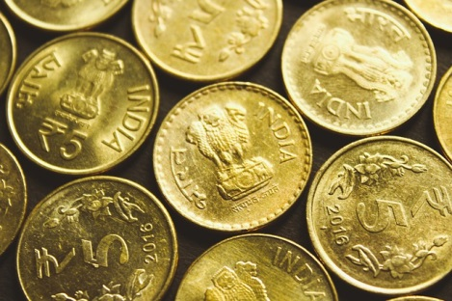
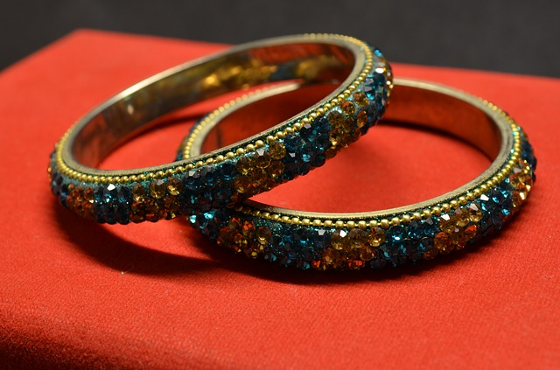
Look out for these possible congruent shapes
Coins of the same denomination
Bangles of your classmate
Notes:
Notes to the teacher:
Possible congruent shapes listed could be
Two bangles worn by one girl in the class.
Two coins of same denomination.
Two tiffin boxes of same size and shape.
Two pens of same make.
Two chairs in the class.
Two tiles on the floor(if the floor is tiled)
Image source:
https://pixabay.com/photos/bracelets-bangles-valuables-390090/
https://pixabay.com/photos/rupee-indian-india-money-bank-note-4395557

Slide 6
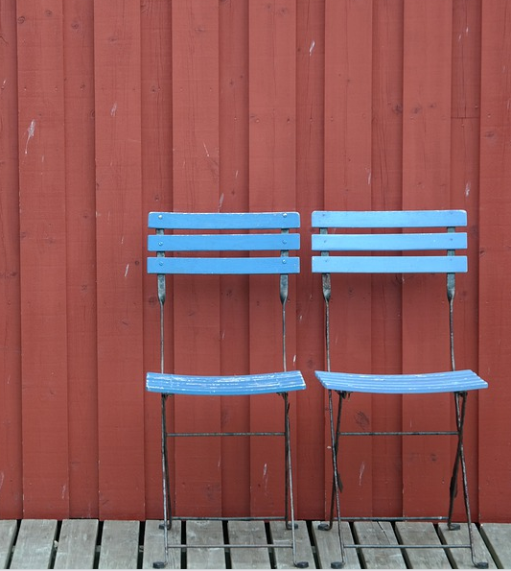
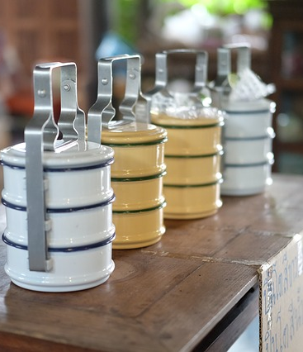
Look out for these possible congruent shapes
Chairs of same make
Same type of Tiffin Boxes
Notes:
Source of Multimedia Objects (Image/audio/ Video/Animation) used in this slide –
https://pixabay.com/photos/wall-wooden-wall-red-boards-chairs-4467345/
https://pixabay.com/photos/pinto-put-the-food-container-3628571/

Slide 7
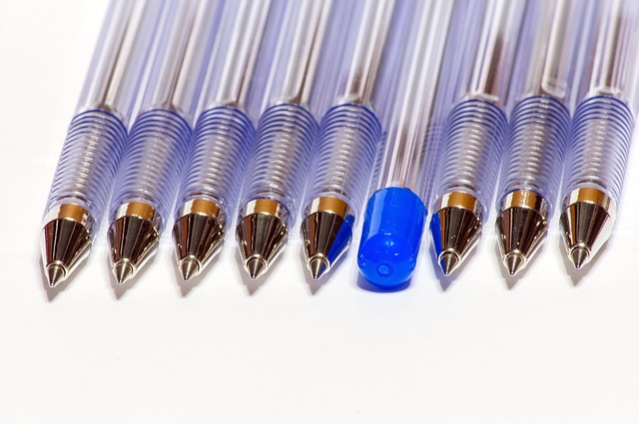
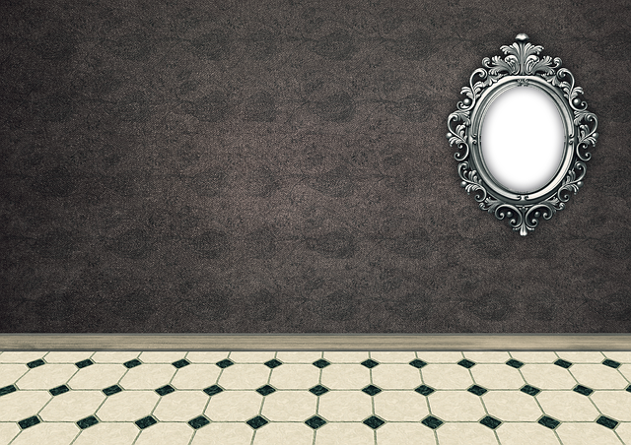
Look out for these possible congruent shapes
Same type of pens
Same type of Floor tiles
Notes:
Source of Multimedia Objects (Image/audio/ Video/Animation) used in this slide -
https://pixabay.com/vectors/pen-pencil-design-business-drawing-42404/
https://pixabay.com/photos/pens-stationery-office-set-blue-1736044/

Slide 8






MM Index
Slide# | Thumbnail | Source and Attribution
1 |  | Chalk pieces- https://pixabay.com/photos/background-blackboard-blue-board-1869471/
2 |  | Juice glass- https://pixabay.com/vectors/drinks-strawberry-pink-frozen-34377/
2 |  | Ear rings-https://pixabay.com/photos/earrings-circles-steel-734677/
2 |  | Shoeshttps://pixabay.com/photos/shoes-leather-pair-fashion-825671/
3 |  | List out-https://pixabay.com/illustrations/exam-scientific-experiment-2428208/
3 |  | Winner badge-https://pixabay.com/vectors/medal-gold-award-olympics-winner-295094/
Notes:
Notes for Teacher –
Possible congruent shapes listed could be
Two bangles worn by one girl in the class.
Two coins of same denomination.
Two tiffin boxes of same size and shape.
Two pens of same make.
Two chairs in the class.
Two tiles on the floor(if the floor is tiled)
Suggestions: <Ideas/ Images/ Animations / Others – To make better representation of the content >
Source of Multimedia Objects (Image/audio/ Video/Animation) used in this slide -

Slide 9



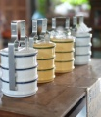
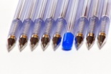

MM Index
Slide# | Thumbnail | Source and Attribution
5 |  | Bangles- https://pixabay.com/photos/bracelets-bangles-valuables-390090/ Indian coins- https://pixabay.com/photos/rupee-indian-india-money-bank-note-4395557/
6 |  | Chairs - https://pixabay.com/photos/wall-wooden-wall-red-boards-chairs-4467345/
6 |  | https://pixabay.com/photos/pinto-put-the-food-container-3628571
7 |  | https://pixabay.com/photos/pens-stationery-office-set-blue-1736044/
7 |  | https://pixabay.com/illustrations/room-empty-interior-ground-tiles-2103285/
Notes:
Notes for Teacher –
Possible congruent shapes listed could be
Two bangles worn by one girl in the class.
Two coins of same denomination.
Two tiffin boxes of same size and shape.
Two pens of same make.
Two chairs in the class.
Two tiles on the floor(if the floor is tiled)
Suggestions: <Ideas/ Images/ Animations / Others – To make better representation of the content >
Source of Multimedia Objects (Image/audio/ Video/Animation) used in this slide -

