Slide 1
Investigate Congruent Figures
Notes:
Notes for Teacher - < Information for further reference or explanation >
Suggestions: <Ideas/ Images/ Animations / Others – To make better representation of the content >
Source of Multimedia Objects (Image/audio/ Video/Animation) used in this slide -
1. <Short Description> - <SOURCE URL>

Slide 2

The Hot Seat!!
Notes:
Source of Multimedia Objects (Image/audio/ Video/Animation) used in this slide -
1. Yes or No image - https://pixabay.com/illustrations/decision-question-response-1013752/

Slide 3


QUESTION: 1
CORRECT
TRUE
Are all right angles congruent?
INCORRECT
FALSE
You are correct!
Congruent angles
have equality of measure. Right angles are equal in measure 90, hence implies congruence.
You are incorrect!
Congruent angles
have equality of measure. Right angles are equal in measure 90, hence implies congruence.
NEXT
Notes:
Source of Multimedia Objects (Image/audio/ Video/Animation) used in this slide -
1. Happy Minion - http://pngimg.com/download/36257
2. Confused Minion - http://pngimg.com/download/36244

Slide 4


QUESTION: 2
CORRECT
TRUE
Do two congruent figures have the same area?
INCORRECT
FALSE
You are correct!
Congruent figures
have same area. But
the converse is not true. Figures of same area
need not be congruent.
You are incorrect!
Congruent figures
have same area. But
the converse is not true. Figures of same area
need not be congruent.
NEXT
Notes:
Source of Multimedia Objects (Image/audio/ Video/Animation) used in this slide -
1. Minion with Guitar: http://pngimg.com/download/36301
2. Surprised Minion - http://pngimg.com/download/36257

Slide 5


QUESTION: 3
INCORRECT
TRUE
Are triangles with the same perimeter congruent?
CORRECT
FALSE
You are correct!
They may have
different sides
though equal
perimeter.
You are incorrect!
They may have
different sides
though equal
perimeter.
NEXT
Notes:
Source of Multimedia Objects (Image/audio/ Video/Animation) used in this slide -
1. Minion with Guitar: http://pngimg.com/download/36301
2. Surprised Minion - http://pngimg.com/download/36257

Slide 6

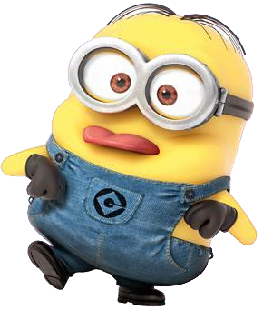
QUESTION: 4
Are any two quadrilaterals congruent?
INCORRECT
TRUE
CORRECT
FALSE
You are correct!
Not all quadrilaterals
are congruent.
Ex: Rectangle and Square.
You are incorrect!
Not all quadrilaterals
are congruent.
Ex: Rectangle and Square
NEXT
Notes:
Source of Multimedia Objects (Image/audio/ Video/Animation) used in this slide -
1.Minion with Guitar: http://pngimg.com/download/36301
2. Minion with tongue out - http://pngimg.com/download/36294

Slide 7
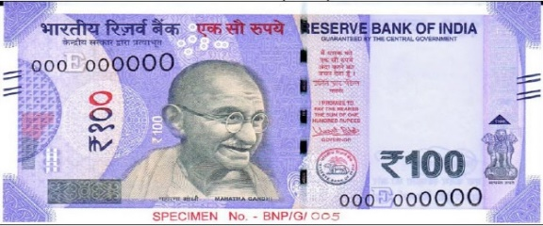
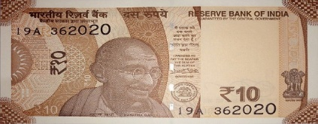
QUESTION: 5
INCORRECT
TRUE
Are 10 Rupee notes and 100 Rupee notes congruent?
CORRECT
FALSE
You are correct!
The notes are of different sizes.
Hence they are not congruent.
Rs. 10 Note: 123mm x 63 mm
Rs. 100 Note: 157mm x 73 mm
You are incorrect!
The notes are of different sizes. Hence, they are not congruent.
Rs. 10 Note: 123mm x 63 mm
Rs. 100 Note: 157mm x 73 mm
NEXT
Notes:
Source of Multimedia Objects (Image/audio/ Video/Animation) used in this slide -
1. Rs. 10 note: https://commons.wikimedia.org/wiki/File:India_new_10_INR,_MG_series,_2018,_obverse.jpg
2. Rs. 100 note: https://commons.wikimedia.org/wiki/File:Rs_100_note_front_view.jpg

Slide 8
QUESTION: 6
In congruent rectangles, are the area & perimeter equal?
CORRECT
TRUE
INCORRECT
FALSE
You are incorrect!
Congruent rectangles have same length and breadth. Hence, equal area and perimeter
Area= l x b
Perimeter= 2 (l+b)
You are correct!
Congruent rectangles have same length and breadth. Hence equal area and perimeter
Area= l x b
Perimeter= 2 (l+b)
NEXT

Slide 9
QUESTION: 7
Will any two acute angles always be congruent?
INCORRECT
TRUE
CORRECT
FALSE
You are correct!
An Acute angle is any angle <90°.
They may be different angles.
Hence need not be always congruent.
You are incorrect!
An Acute angle is any angle <90°.
They may be different angles.
Hence, need not be always congruent.
NEXT

Slide 10
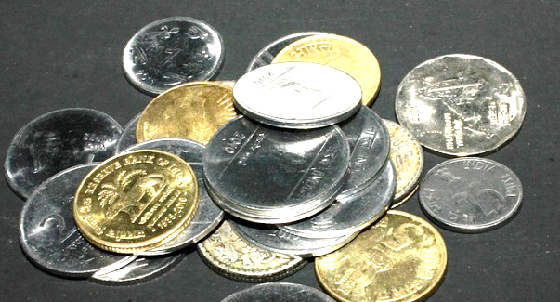
QUESTION: 8
Are all coins congruent?
INCORRECT
TRUE
CORRECT
FALSE
You are correct!
They are of different radius. Hence need not be congruent.
You are incorrect!
They are of different radius. Hence, need not be congruent.
NEXT
Notes:
Source of Multimedia Objects (Image/audio/ Video/Animation) used in this slide -
Coins - https://pixabay.com/photos/rupees-money-coins-currency-390472/

Slide 11
QUESTION: 9
Two rectangles ABCD & PQRS are congruent. If the length of the rectangle ABCD is 12 m & its perimeter is 40m, find the length & breadth of rectangle PQRS.
Answer!
For rectangle ABCD,
Perimeter=2 (l+b)
40=2(12+b)
b=8 m
Since rectangle ABCD is congruent to rectangle PQRS,
Breadth of PQRS = 8 m
Length of PQRS = 12 m
ANSWER
NEXT

Slide 12
QUESTION: 10
Circle C1 is congruent to circle C2. If the radius of C1 is 5 cm, Find the diameter of C2.
Answer!
Circle C1 is congruent to C2, so radius are equal.
Diameter of C2 = 2 * (Radius of C1)
= 2*5
= 10 cm
Diameter of C2 = 10 cm
ANSWER
FINISH

Slide 13


Good job!!
Notes:
Source of Multimedia Objects (Image/audio/ Video/Animation) used in this slide -
Confetti - https://pixabay.com/illustrations/confetti-streamer-party-carnival-1925258/
Victory cup - https://pixabay.com/illustrations/cup-victory-winner-award-gold-1010916/

Slide 14











MM Index
Slide# | Thumbnail | Source and Attribution
2 |  | Yes or No image - https://pixabay.com/illustrations/decision-question-response-1013752/
3 |  | Happy Minion - http://pngimg.com/download/36257 2. Confused Minion - http://pngimg.com/download/36244
4,5,6 |  | Minion with Guitar: http://pngimg.com/download/36301 Surprised Minion - http://pngimg.com/download/36257
6 |  | Minion with tongue out - http://pngimg.com/download/36294
7 |  | Rs. 10 note: https://commons.wikimedia.org/wiki/File:India_new_10_INR,_MG_series,_2018,_obverse.jpg Rs. 100 note: https://commons.wikimedia.org/wiki/File:Rs_100_note_front_view.jpg
10 |  | Coins - https://pixabay.com/photos/rupees-money-coins-currency-390472/
13 |  | Confetti - https://pixabay.com/illustrations/confetti-streamer-party-carnival-1925258/ Victory cup - https://pixabay.com/illustrations/cup-victory-winner-award-gold-1010916/

