Slide 1
Congruency
in the world around us
Notes:
Notes for Teacher - < Information for further reference or explanation >
Suggestions: <Ideas/ Images/ Animations / Others – To make better representation of the content >
Source of Multimedia Objects (Image/audio/ Video/Animation) used in this slide -
1. <Short Description> - <SOURCE URL>

Slide 2
Congruency in the world
around us
Let’s see how fascinating shapes are around us
Notes:
Asset Type: Main Script
Notes for Teacher – NA
Suggestions:
Congruent shapes are often seen in the world around us.
It is indeed fascinating to find the reason behind this.
Here are few examples.
Details of Multimedia Objects (Image/audio/ Video/Animation) used in this slide - NA

Slide 3
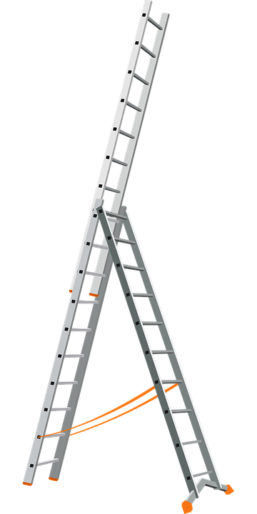
Steps of a ladder
Congruent steps ensure that we do not slip while climbing.
Notes:
Asset Type: Main Script
Notes for Teacher NA
Suggestions:
The steps of a ladder are made congruent to each other.
This ensures that we do not slip while climbing.
Details of Multimedia Objects (Image/audio/ Video/Animation) used in this slide -
Ladder - CREATIVE COMMONS SEARCH – CC- https://pixabay.com/vectors/aluminium-ladder-metal-tool-work-1295387/

Slide 4
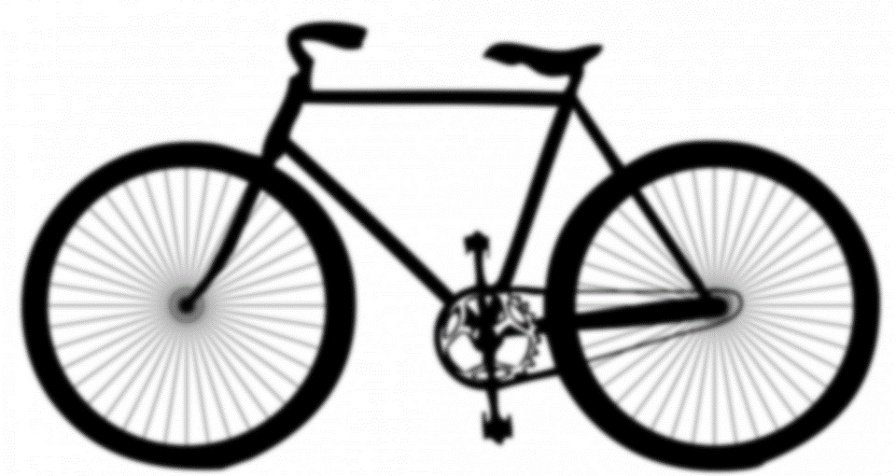
Wheels of a bicycle
Wheels are horizontal to the road and help the bicycle move with ease.
Notes:
Asset Type: Main Script
Notes for Teacher - NA
Suggestions:
Both wheels of the bicycle are congruent to each other.
This ensures that the bicycle is perfectly horizontal to the road and bicycle moves with ease.
Details of Multimedia Objects (Image/audio/ Video/Animation) used in this slide -
Bicycle - CREATIVE COMMONS SEARCH – CC- https://pixabay.com/illustrations/black-shape-transport-bicycle-bike-163595/

Slide 5

Overhead Bridges
Triangular structures enhance the structural strength of the bridge.
Notes:
Asset Type: Main Script
Notes for Teacher -NA
Suggestions:
Often bridges are made of triangular structures. These triangular structures are congruent to each other. This enhances the structural strength of the bridge.
Details of Multimedia Objects (Image/audio/ Video/Animation) used in this slide -
Bridge - CREATIVE COMMONS SEARCH – CC- https://pixabay.com/photos/golden-gate-bridge-san-francisco-388917/

Slide 6
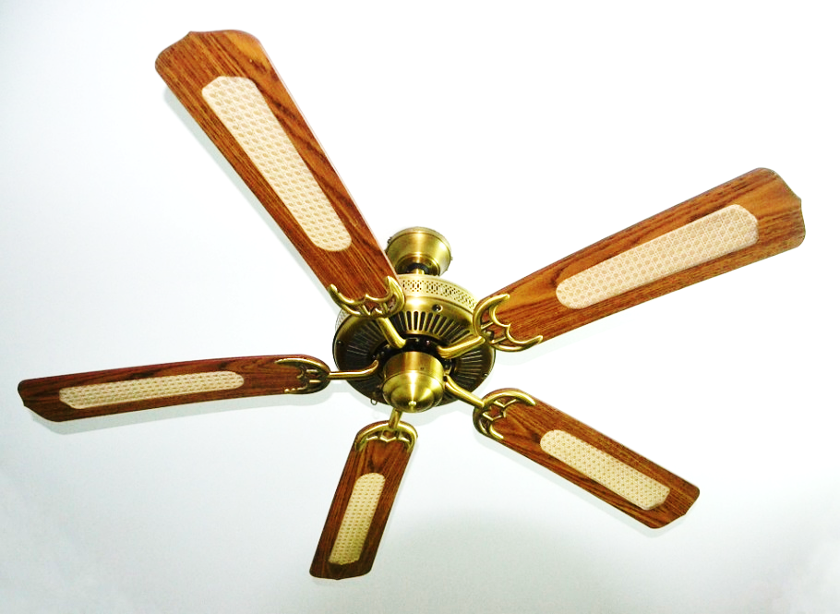
Blades of a fan
Congruent blades add beauty and ensure better air circulation.
Notes:
Asset Type: Main Script
Notes for Teacher - NA
Suggestions:
Observe that the blades of a fan are congruent in shape. This enhances the beauty and also the congruent blades ensure better air circulation.
Thus we observe that congruent shapes add great value to our daily life.
Details of Multimedia Objects (Image/audio/ Video/Animation) used in this slide -
Fan-blades - CREATIVE COMMONS SEARCH – CC- https://pixabay.com/photos/ceiling-fan-fan-whirling-ceiling-1016677/

Slide 7

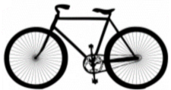


MM Index
Slide# | Thumbnail | Source and Attribution
3 |  | https://pixabay.com/vectors/aluminium-ladder-metal-tool-work-1295387/
4 |  | https://pixabay.com/illustrations/black-shape-transport-bicycle-bike-163595/
5 |  | https://pixabay.com/photos/golden-gate-bridge-san-francisco-388917/
6 |  | https://pixabay.com/photos/ceiling-fan-fan-whirling-ceiling-1016677/

