Slide 1
Congruency in Egyptian Pyramids
Notes:
Notes for Teacher - < Information for further reference or explanation >
Suggestions: <Ideas/ Images/ Animations / Others – To make better representation of the content >
Source of Multimedia Objects (Image/audio/ Video/Animation) used in this slide -
1. <Short Description> - <SOURCE URL>

Slide 2
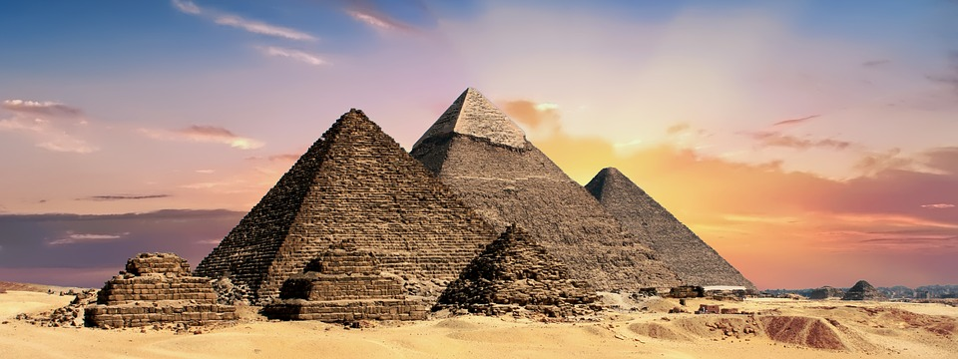
Congruency in Egyptian Pyramids
Each face of the Pyramid is an equilateral triangle of same size and is congruent to the other.
Notes:
Asset Type: Main Script
Notes for Teacher - < Information for further reference or explanation >
Suggestions: Details of Multimedia Objects (Image/audio/ Video/Animation) used in this slide -
Pyramid - CREATIVE COMMONS SEARCH – CC- https://pixabay.com/photos/pyramids-egypt-egyptian-ancient-2371501/

Slide 3
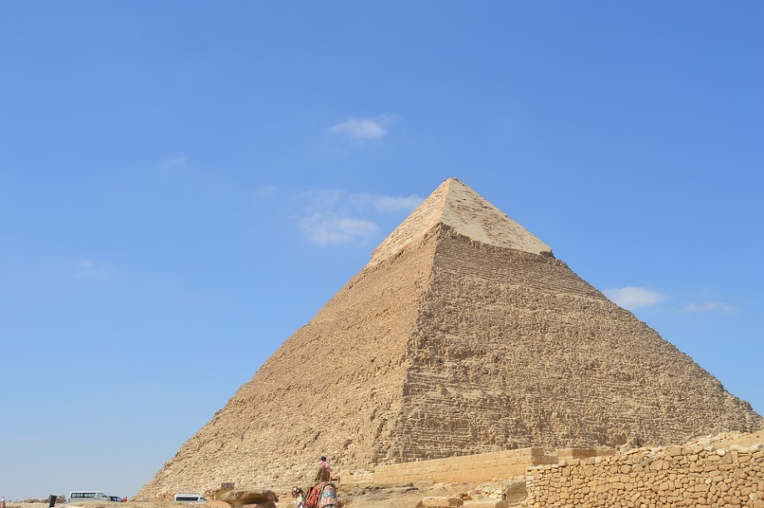
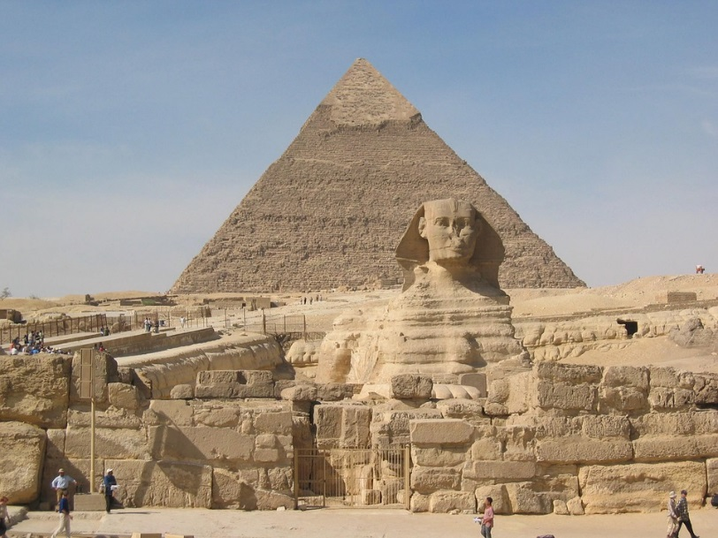
Congruency in Egyptian Pyramids
The largest Pyramid is
Pyramid of Khufu or Pyramid of Cheops.
Khufu
Cheops
Notes:
Asset Type: Main Script
Notes for Teacher - The largest Pyramid is known as Pyramid of Khufu or Pyramid of Cheops. The biggest among the three is the oldest of the seven wonders of ancient world and the only one still remaining intact to a great extent. It is about 147 m in height and has a square base with each side of the base being about 230 m length. The base is so perfect that the error is within 58 mm in length between side to side.
Suggestions:
Details of Multimedia Objects (Image/audio/ Video/Animation) used in this slide -
Khufu Pyramid - CREATIVE COMMONS SEARCH – CC- https://pixabay.com/photos/egypt-pyramid-travel-pharaoh-1968250/
Cheops Pyramid - CREATIVE COMMONS SEARCH – CC- https://pixabay.com/photos/sphinx-pyramids-cheops-chephren-349550/

Slide 4
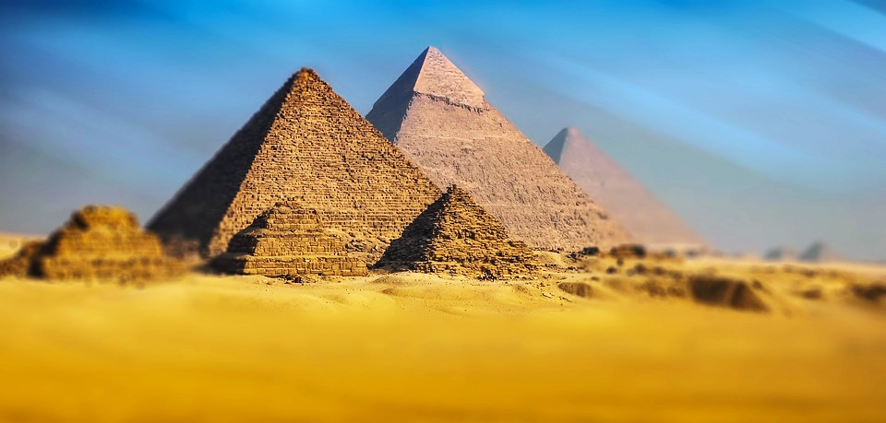
Congruency in Egyptian Pyramids
The biggest is the oldest pyramid.
The base is so perfect with very minimal error.
147 m in height and a square base 230 m length.
Notes:
Asset Type: Main Script
Notes for Teacher - < Information for further reference or explanation >
Suggestions:
Details of Multimedia Objects (Image/audio/ Video/Animation) used in this slide -
Giza Pyramid - CREATIVE COMMONS SEARCH – CC- https://pixabay.com/photos/giza-pyramid-pyramids-of-giza-egypt-1756946/

Slide 5
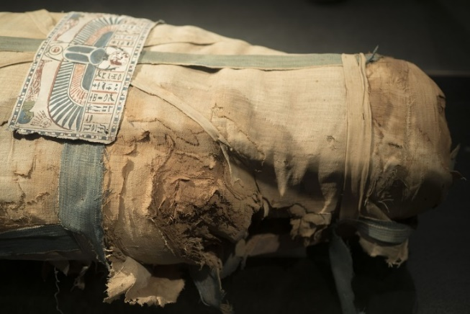
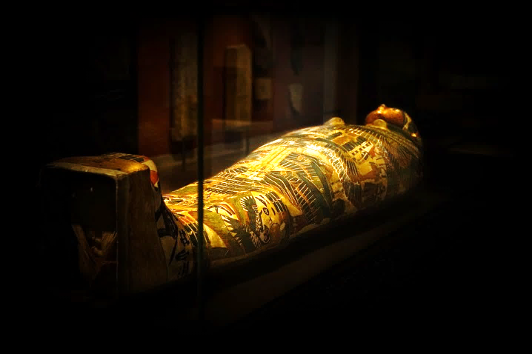
Why Pyramids were built?
Belief was that when their king (pharoah) died, his spirit remained.
So, dead body was preserved by embalming
Tomb had gold vessels, furniture, food etc. need for king’s afterlife.
Notes:
Asset Type: Main Script
Notes for Teacher - < Information for further reference or explanation >
Suggestions: Consider the two pictures shown below:
Observe the difference between the two pictures.
In first picture both stars are same shape and size.In the second picture both stars are of same shape but different size.
Details of Multimedia Objects (Image/audio/ Video/Animation) used in this slide -
Egypt Mummy - CREATIVE COMMONS SEARCH – CC- https://pixabay.com/photos/egypt-mummy-egyptian-ancient-3208124/
Egypt Mummy2 - CREATIVE COMMONS SEARCH – CC- https://pixabay.com/photos/history-egypt-sarcofaag-pyramid-1901078/

Slide 6
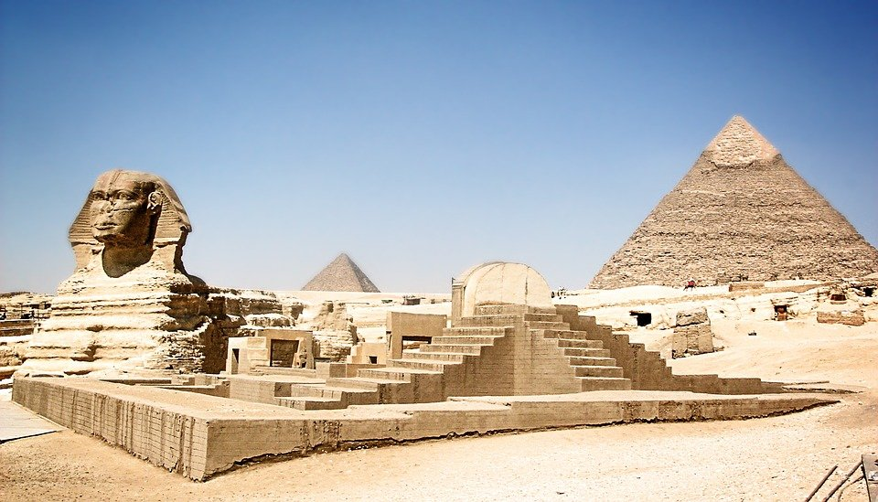
The fascinating Pyramids
The story about the Pyramids as well as its unique structure fascinates all.
Notes:
Asset Type: Main Script
Notes for Teacher - < Information for further reference or explanation >
Suggestions: Consider the two pictures shown below:
Observe the difference between the two pictures.
In first picture both stars are same shape and size.In the second picture both stars are of same shape but different size.
Details of Multimedia Objects (Image/audio/ Video/Animation) used in this slide -
Pyramid- https://pixabay.com/photos/egypt-pyramids-egyptian-ancient-2267089/

Slide 7





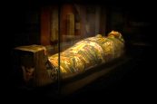

MM Index
Slide# | Thumbnail | Source and Attribution
2 |  | CC-https://pixabay.com/photos/pyramids-egypt-egyptian-ancient-2371501/
3 |  | https://pixabay.com/photos/egypt-pyramid-travel-pharaoh-1968250/ CC- https://pixabay.com/photos/sphinx-pyramids-cheops-chephren-349550/
4 |  | https://pixabay.com/photos/giza-pyramid-pyramids-of-giza-egypt-1756946/
5 |  | https://pixabay.com/photos/egypt-mummy-egyptian-ancient-3208124/
5 |  | https://pixabay.com/photos/history-egypt-sarcofaag-pyramid-1901078/
6 |  | https://pixabay.com/photos/egypt-pyramids-egyptian-ancient-2267089/

