Slide 1
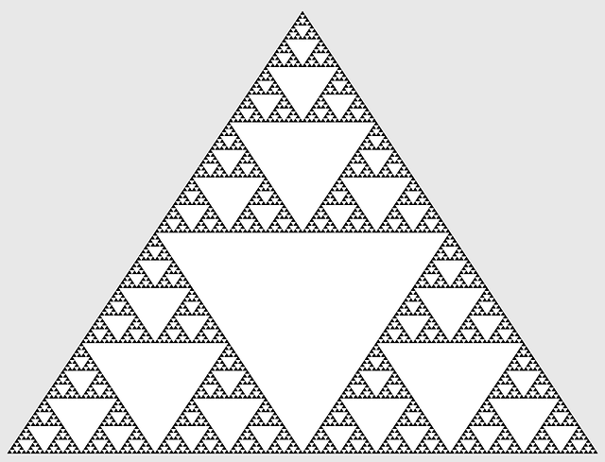
SAS Congruency criteria
Notes:
Notes for Teacher –N/A
Suggestions: N/A
Source of Multimedia Objects (Image/audio/ Video/Animation) used in this slide -
1. https://pixabay.com/fr/vectors/les-math%C3%A9matiques-sierpinski-696806/

Slide 2
SAS Congruency criteria
A
4cm
Case i : To construct a triangle congruent to ∆ABC with only one side EF = 6cm
30°
B
6cm
C
D
D
D
E
6cm
F
E
6cm
F
E
6cm
F
None of the triangles are congruent to ∆ABC
Two triangles cannot be congruent if one side of a triangle is equal to the one side of another triangle
Notes:
Notes for Teacher –N/A
Suggestions: N/A
Source of Multimedia Objects (Image/audio/ Video/Animation) used in this slide - N/A

Slide 3
SAS Congruency criteria
A
4cm
Case ii : To construct a triangle congruent to ∆ABC with one side EF = 6cm and ∠E = 30°
30°
B
6cm
C
D
D
D
30°
60°
80°
90°
120°
30°
70°
30°
30°
E
6cm
F
E
6cm
F
E
6cm
F
None of the triangles are congruent to ∆ABC
Two triangles cannot be congruent if one side and one angle of a triangle are equal to the one side and one angle of another triangle
Notes:
Notes for Teacher –N/A
Suggestions: N/A
Source of Multimedia Objects (Image/audio/ Video/Animation) used in this slide - N/A

Slide 4
SAS Congruency criteria
A
4cm
Case iii : To construct a triangle congruent to ∆ABC with EF = 6cm, DE = 4cm and ∠E = 30°
30°
B
6cm
C
D
A
4cm
4cm
30°
30°
B
6cm
C
E
6cm
F
All six parts of one triangle match with all six parts of other triangle
Two triangles can be congruent if two sides and the included angle of a triangle are equal to the corresponding two sides and the included angle of another triangle
Notes:
Notes for Teacher –N/A
Suggestions: N/A
Source of Multimedia Objects (Image/audio/ Video/Animation) used in this slide - N/A

Slide 5
SAS Congruency criteria
Statement
If two sides and the included angle of a triangle are equal to two corresponding sides and the included angle of another triangle, then the two triangles are said to be congruent by SAS congruency criteria.
SAS stands for Side-Angle-Side
Notes:
Notes for Teacher –N/A
Suggestions: N/A
Source of Multimedia Objects (Image/audio/ Video/Animation) used in this slide - N/A

Slide 6
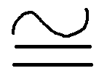
SAS Congruency criteria
EXAMPLE 1
P
N
QR = MN (S)
20°
∠R = ∠N = 20° (A)
M
Q
20°
RP = NL (S)
R
P,L
L
Q,M
20°
R,N
So by applying SAS congruency rule we get ∆PQR ∆LMN
Notes:
Notes for Teacher – Two sides QR and RP of ∆PQR are equal to corresponding sides MN and NL of ∆LMN.
∠R (common angle between sides QR and RP) of ∆PQR is equal to corresponding ∠N (common angle between sides MN and NL) of ∆LMN.
Suggestions: N/A
Source of Multimedia Objects (Image/audio/ Video/Animation) used in this slide - N/A

Slide 7
SAS Congruency criteria
A
X
EXAMPLE 2
25°
25°
B
C
Y
Z
AB = XY (S)
∠B = ∠Z = 25° (A)
BC = YZ (S)
Sides AB and BC of ΔABC are equal to the corresponding sides XY and YZ of ΔXYZ.
Common angle between sides AB and BC is ⦟B=25° but the corresponding common angle between sides XY and YZ
i.e. ∠Y is unknown
We cannot establish a one-to-one correspondence between the included angles. Hence Hence ∆ABC ≇ ∆XYZ
Notes:
The corresponding sides AB and BC of ∆ABC are equal to the corresponding sides XY and YZ of ∆XYZ.
However the common angle between sides AB and BC is ⦟B=25° but the corresponding common angle between sides XY and YZ i.e.⦟Y is unknown.
Hence SAS congruency cannot be applied.∆ABC ≇ ∆XYZ since we cannot establish a one to one correspondence between the vertices.

Slide 8
MM Index
Slide# | Thumbnail | Source and Attribution
1 |  | https://pixabay.com/fr/vectors/les-math%C3%A9matiques-sierpinski-696806/

