Slide 1
ASA Congruency criteria
Notes:
Notes for Teacher - < Information for further reference or explanation >
Suggestions: <Ideas/ Images/ Animations / Others – To make better representation of the content >
Source of Multimedia Objects (Image/audio/ Video/Animation) used in this slide -
1. <Short Description> - <SOURCE URL>

Slide 2
ASA Congruency criteria
Statement
Two triangles become congruent if -
1. Three sides of one triangle match with three sides of other triangle (SSS rule) or
2. Two sides and the included angle of one triangle match with two sides and the corresponding included angle of other triangle (SAS rule).
With similar reasoning as in SSS and SAS, we have the ASA congruence criteria
Notes:
Notes for Teacher - < Information for further reference or explanation >
Suggestions: <Ideas/ Images/ Animations / Others – To make better representation of the content >
Source of Multimedia Objects (Image/audio/ Video/Animation) used in this slide -
1. <Short Description> - <SOURCE URL>

Slide 3
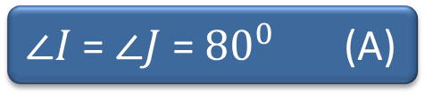

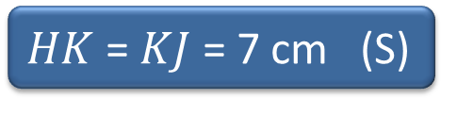

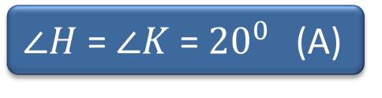


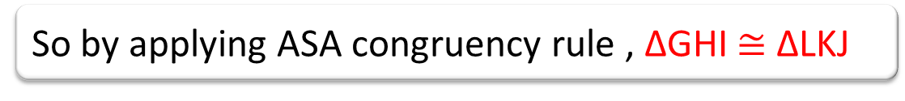
ASA Congruency criteria
Example
$∠I$ = $∠J$ = ${80}^{0}$ (A)
L
G
G
I
I
J
$${80}^{0}$$
$${80}^{0}$$
$${80}^{0}$$
$HK$ = $KJ$ = 7 cm (S)
7 cm
7 cm
$${20}^{0}$$
$${20}^{0}$$
$${20}^{0}$$
$∠H$ = $∠K$ = ${20}^{0}$ (A)
H
K
So by applying ASA congruency rule , ∆GHI $≅$ ∆LKJ

Slide 4








ASA Congruency criteria
L
G
G
I
The corresponding relationships are
I
J
$${80}^{0}$$
$${80}^{0}$$
$${80}^{0}$$
7cm
7cm
$${20}^{0}$$
$${20}^{0}$$
G L
H K
$${20}^{0}$$
H
K
I J
G,L
I,J
$${80}^{0}$$
$${80}^{0}$$
On superimposing the two triangles their congruence is confirmed
7cm
$${20}^{0}$$
$${20}^{0}$$
H,K

Slide 5





Justification of ASA Congruency criteria
CASE 1
Suppose only one angle of ΔDEF say ⦟E =60° is known
A
B
$${40}^{0}$$
$${60}^{0}$$
C
Many triangles possible
5 cm
D
D
D
E
$${60}^{0}$$
F
E
$${60}^{0}$$
F
E
$${60}^{0}$$
F
None of the triangles are congruent to ∆ABC
Two triangles cannot be congruent if one angle of a triangle is equal to the corresponding one angle of another triangle
Notes:
STEP 1
In order to construct a triangle ∆DEF congruent to ∆ABC ,suppose only one angle say ⦟E =60° is known.Many triangles are possible as shown below

Slide 6





Justification of ASA Congruency criteria
CASE 2
2 parameters of ΔDEF are known say EF=5cm and ⦟ E=60°.
D
D
A
$${40}^{0}$$
$${60}^{0}$$
$${60}^{0}$$
F
$${60}^{0}$$
F
B
C
E
E
5 cm
5 cm
5 cm
D
None of the triangles are congruent to ∆ABC
Two triangles cannot be congruent if one side and one angle of a triangle are equal to the one corresponding side and one corresponding angle of another triangle
$${60}^{0}$$
F
E
5 cm
Notes:
STEP-2
Suppose two parameters of triangle ∆DEF are known say EF=5cm and ⦟E=60°. The following triangles are possible

Slide 7



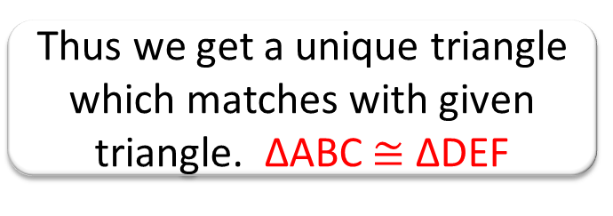

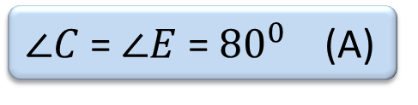

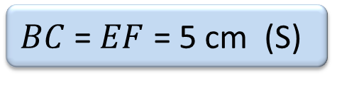

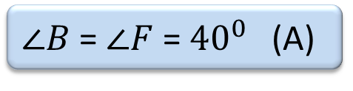
Justification of ASA Congruency criteria
CASE 3
3 parameters of ΔDEF are known say EF=5cm, ⦟F=40° and ⦟E=60°.
A
D
$${40}^{0}$$
$${60}^{0}$$
C
$${60}^{0}$$
$${40}^{0}$$
B
E
F
5 cm
5 cm
In the triangles, ∆ABC and ∆DEF
On superimposing the triangles we observe their congruence
$∠B$ = $∠F$ = ${40}^{0}$ (A)
A,D
$BC$ = $EF$ = 5 cm (S)
$∠C$ = $∠E$ = ${80}^{0}$ (A)
B,F
$${40}^{0}$$
$${60}^{0}$$
C,E
Thus we get a unique triangle which matches with given triangle. ∆ABC $≅$ ∆DEF
5 cm
Notes:
STEP 3
Suppose three parameters of triangle ∆DEF are known say EF=5cm , ⦟F=40°. and ⦟E=60°. The triangle is as shown below

Slide 8
MM Index
Slide# | Thumbnail | Source and Attribution

