Slide 1
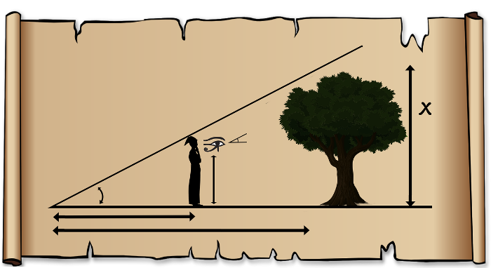
RHS Congruency Rule
Notes:
Notes for Teacher - < Information for further reference or explanation >
Suggestions: <Ideas/ Images/ Animations / Others – To make better representation of the content >
Source of Multimedia Objects (Image/audio/ Video/Animation) used in this slide -
https://pixabay.com/illustrations/forester-triangle-mathematics-pay-2921203/
https://pixabay.com/illustrations/background-mosaic-pattern-polygon-2661283/
https://pixabay.com/photos/background-backdrop-geometric-2516984/

Slide 2
RHS Congruency Criteria
Statement
If the hypotenuse and one side of right angled triangle are equal to the corresponding hypotenuse and one side of another right angled triangle then both the right angled triangles are said to be congruent by RHS congruency criteria.
RHS stands for Right angle-Hypotenuse-Side
Notes:
Notes for Teacher - < Information for further reference or explanation >
Suggestions: <Ideas/ Images/ Animations / Others – To make better representation of the content >
Source of Multimedia Objects (Image/audio/ Video/Animation) used in this slide -
1. <Short Description> - <SOURCE URL>

Slide 3
RHS Congruency Example
Consider two right angled triangles ∆ABC and ∆FED.
D
B
A
8 cm
5 cm
5 cm
8 cm
E
F
C
In the figure,
⦟B = ⦟E = 90° (R)
AC = DF = 8cm (H)
BC = DE = 5cm (S)
Notes:
Notes for Teacher - < Information for further reference or explanation >
Suggestions: <Ideas/ Images/ Animations / Others – To make better representation of the content >
Source of Multimedia Objects (Image/audio/ Video/Animation) used in this slide -
1. <Short Description> - <SOURCE URL>

Slide 4
RHS Congruency Example
B
D
A
8 cm
5 cm
5 cm
8 cm
E
F
C
Observe that,
The hypotenuse AC of ∆ABC is equal to corresponding hypotenuse DF of ∆FED.
Side BC of ∆ABC is equal to corresponding side DE of ∆FED.
Notes:
Notes for Teacher - < Information for further reference or explanation >
Suggestions: <Ideas/ Images/ Animations / Others – To make better representation of the content >
Source of Multimedia Objects (Image/audio/ Video/Animation) used in this slide -
1. <Short Description> - <SOURCE URL>

Slide 5
RHS Congruency Example
B
D
A
8 cm
5 cm
5 cm
8 cm
E
F
C
So, by applying RHS congruency rule we get
∆ABC ∆FED.
Corresponding relationships are
A F , B E, C D
Notes:
Notes for Teacher - < Information for further reference or explanation >
Suggestions: <Ideas/ Images/ Animations / Others – To make better representation of the content >
Source of Multimedia Objects (Image/audio/ Video/Animation) used in this slide -
1. <Short Description> - <SOURCE URL>

Slide 6
RHS Congruency Example
On superimposing the two triangles their congruence is confirmed.
B, E
A, F
5 cm
8 cm
C, D
Notes:
Notes for Teacher - < Information for further reference or explanation >
Suggestions: <Ideas/ Images/ Animations / Others – To make better representation of the content >
Source of Multimedia Objects (Image/audio/ Video/Animation) used in this slide -
1. <Short Description> - <SOURCE URL>

Slide 7
Justification of RHS Congruency Rule
A
7 cm
B
C
4 cm
Consider a right-angled triangle ∆ABC as shown above.
Notes:
Notes for Teacher - < Information for further reference or explanation >
Suggestions: <Ideas/ Images/ Animations / Others – To make better representation of the content >
Source of Multimedia Objects (Image/audio/ Video/Animation) used in this slide -
1. <Short Description> - <SOURCE URL>

Slide 8
Justification of RHS Congruency Rule
CASE-1 In order to construct a triangle ∆DEF congruent to ∆ABC, suppose only one side EF = 4cm is known. Many triangles are possible as shown
A
7 cm
B
C
D
D
4 cm
D
E
4 cm
F
E
4 cm
F
E
4 cm
F
Notes:
Notes for Teacher - < Information for further reference or explanation >
Suggestions: <Ideas/ Images/ Animations / Others – To make better representation of the content >
Source of Multimedia Objects (Image/audio/ Video/Animation) used in this slide -
1. <Short Description> - <SOURCE URL>

Slide 9
Inference – Only One side Known
CASE-1 – CONTD..
None of the triangles are congruent to ∆ABC.
Hence, it ascertains that two right angled triangles cannot be congruent if only one side of a right angled triangle is equal to the corresponding side of another right angled triangle.
Notes:
Notes for Teacher - < Information for further reference or explanation >
Suggestions: <Ideas/ Images/ Animations / Others – To make better representation of the content >
Source of Multimedia Objects (Image/audio/ Video/Animation) used in this slide -
1. <Short Description> - <SOURCE URL>

Slide 10
Justification of RHS Congruency Rule
CASE-2 Suppose only the hypotenuse of the right angled triangle ∆DEF is known i.e. DF = 7cm. The following triangles could be possibly drawn
A
D
7 cm
D
B
4 cm
C
D
7 cm
7 cm
7 cm
E
F
E
F
E
F
Notes:
Notes for Teacher - < Information for further reference or explanation >
Suggestions: <Ideas/ Images/ Animations / Others – To make better representation of the content >
Source of Multimedia Objects (Image/audio/ Video/Animation) used in this slide -
1. <Short Description> - <SOURCE URL>

Slide 11
Inference – Only Hypotenuse Known
CASE 2 – CONTD..
None of the triangles are congruent to ∆ABC.
Hence, it ascertains that two right angled triangles cannot be congruent if only the hypotenuse of one right angled triangle is equal to the corresponding hypotenuse of another right angled triangle.
Notes:
Notes for Teacher - < Information for further reference or explanation >
Suggestions: <Ideas/ Images/ Animations / Others – To make better representation of the content >
Source of Multimedia Objects (Image/audio/ Video/Animation) used in this slide -
1. <Short Description> - <SOURCE URL>

Slide 12
Justification of RHS Congruency Rule
CASE-3
Suppose two parameters of the right angled triangle ∆DEF are known, say hypotenuse DF = 7cm and side EF = 4cm. The possible triangle could be as shown below
D
7 cm
E
4 cm
F
Notes:
Notes for Teacher - < Information for further reference or explanation >
Suggestions: <Ideas/ Images/ Animations / Others – To make better representation of the content >
Source of Multimedia Objects (Image/audio/ Video/Animation) used in this slide -
1. <Short Description> - <SOURCE URL>

Slide 13
Justification of RHS Congruency Rule
Compare the triangles
A
D
On superimposing the triangles we observe their congruence
7 cm
7 cm
A, D
4 cm
B
4 cm
C
E
F
7 cm
B, E
4 cm
C, F
Notes:
Notes for Teacher - < Information for further reference or explanation >
Suggestions: <Ideas/ Images/ Animations / Others – To make better representation of the content >
Source of Multimedia Objects (Image/audio/ Video/Animation) used in this slide -
1. <Short Description> - <SOURCE URL>

Slide 14
Justification of RHS Congruency Rule
A
D
7 cm
7 cm
B
4 cm
C
E
4 cm
F
In the triangles, ∆ABC and ∆DEF
⦟B = ⦟E = 90 ° (R)
AC = DF = 7cm (H)
BC = EF = 4cm (S)
Notes:
Notes for Teacher - < Information for further reference or explanation >
Suggestions: <Ideas/ Images/ Animations / Others – To make better representation of the content >
Source of Multimedia Objects (Image/audio/ Video/Animation) used in this slide -
1. <Short Description> - <SOURCE URL>

Slide 15
Justification of RHS Congruency Rule
A
D
7 cm
7 cm
B
4 cm
C
E
4 cm
F
Thus, we get a unique triangle which matches with given triangle.
This justifies RHS Congruency criteria.
Notes:
Notes for Teacher - < Information for further reference or explanation >
Suggestions: <Ideas/ Images/ Animations / Others – To make better representation of the content >
Source of Multimedia Objects (Image/audio/ Video/Animation) used in this slide -
1. <Short Description> - <SOURCE URL>

Slide 16
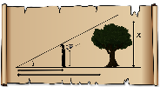
MM Index
Slide# | Thumbnail | Source and Attribution
1 |  | https://pixabay.com/illustrations/forester-triangle-mathematics-pay-2921203/

