Slide 1

Congruence of Triangles
????
????
Notes:
Notes for Teacher – N/A
Suggestions: N/A
Source of Multimedia Objects (Image/audio/ Video/Animation) used in this slide -
1. Quiz image - https://pixabay.com/illustrations/brainstorm-ideas-questions-4222728/

Slide 2
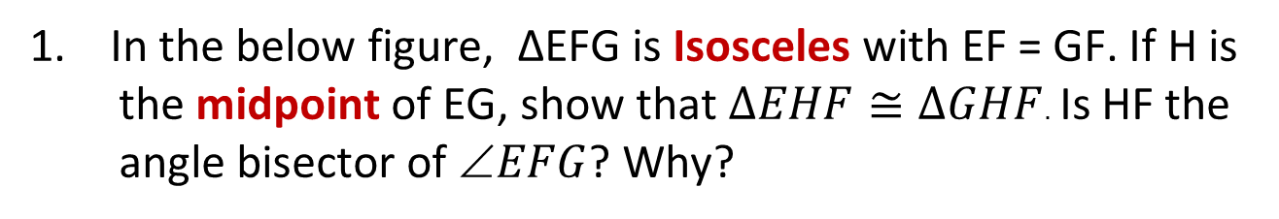
Congruence of Triangles
1. In the below figure, ∆EFG is Isosceles with EF = GF. If H is the midpoint of EG, show that $∆EHF≅∆GHF$. Is HF the angle bisector of $EFG$? Why?
F
E
H
G
Notes:
Notes for Teacher – N/A
Suggestions: N/A
Source of Multimedia Objects (Image) used in this slide – N/A

Slide 3
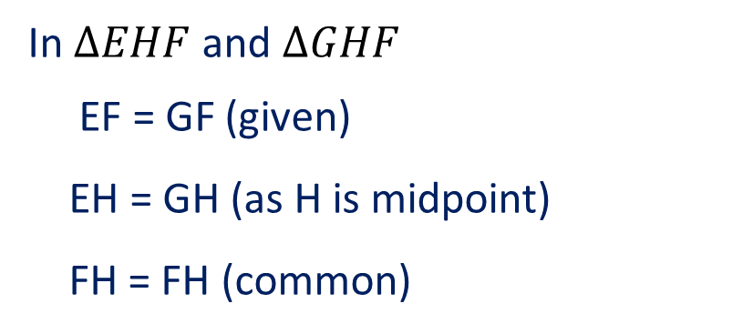
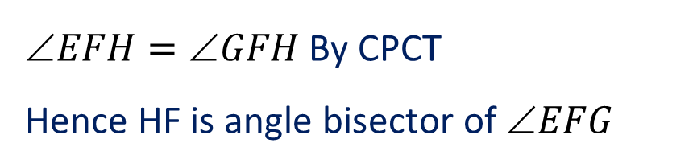

Congruence of Triangles
Answer
F
In $∆EHF$and $∆GHF$
EF = GF (given)
EH = GH (as H is midpoint)
FH = FH (common)
E
H
G
$∆EHF≅∆GHF$ (SSS congruence)
$EFH=GFH$ By CPCT
Hence HF is angle bisector of $EFG$
Notes:
Notes for Teacher – N/A
Suggestions: N/A
Source of Multimedia Objects (Image) used in this slide – N/A

Slide 4
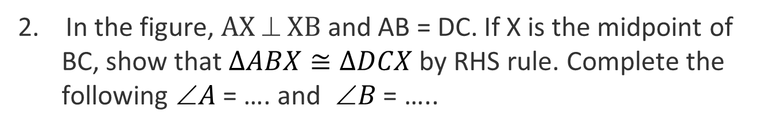
Congruence of Triangles
2. In the figure, $AX  XB$ and AB = DC. If X is the midpoint of BC, show that $∆ABX≅∆DCX$ by RHS rule. Complete the following $A$ = …. and $B$ = …..
A
B
X
C
D
Notes:
Notes for Teacher – N/A
Suggestions: N/A
Source of Multimedia Objects (Image) used in this slide – N/A

Slide 5

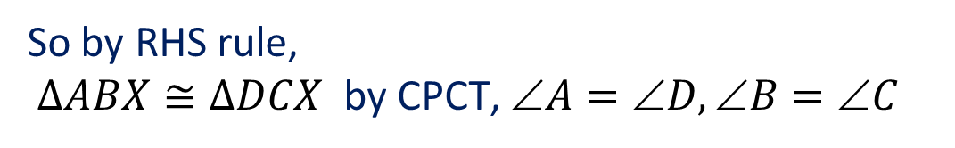

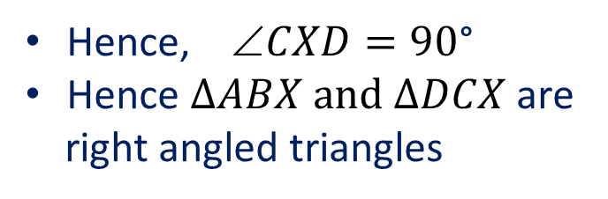
Congruence of Triangles
Answer
A
B
In ∆AXB, $AXB=90$° (given)
$AXB=CXD$
Hence, $CXD=90\text{°}$
Hence $∆ABX and ∆DCX$ are
right angled triangles
X
$AXB=∠CXD=90\text{°}$ (R)
AB = CD (given) (H)
XB = CX (X is midpoint of BC)(S)
C
D
So by RHS rule,
$∆ABX≅∆DCX$ by CPCT, $A=D,B=C$
Notes:
Notes for Teacher – N/A
Suggestions: N/A
Source of Multimedia Objects (Image) used in this slide – N/A

Slide 6
Congruence of Triangles
3. Study the given rectangle and name at least two pairs of congruent triangles. State the conditions of congruence chosen
P
Q
S
R
Notes:
Notes for Teacher – N/A
Suggestions: N/A
Source of Multimedia Objects (Image) used in this slide – N/A

Slide 7
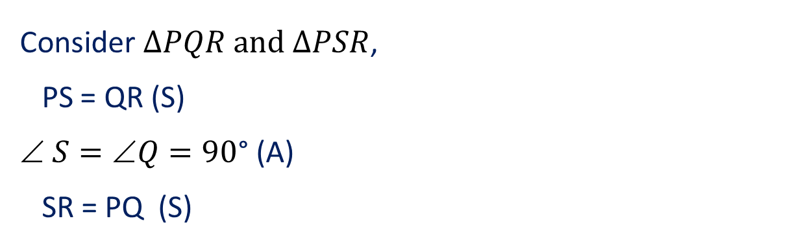

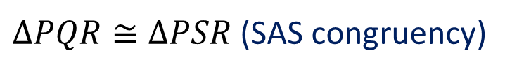
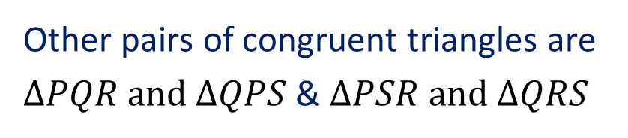
Congruence of Triangles
Answer
P
Q
Consider $∆PQR and ∆PSR$,
PS = QR (S)
$ S=∠Q=90\text{°}$ (A)
SR = PQ (S)
S
R
$∆PQR≅∆PSR$(SAS congruency)
Similarly, $∆SPQ≅∆PSR$
Other pairs of congruent triangles are
$∆PQR and ∆QPS$ & $∆PSR and ∆QRS$
Notes:
Notes for Teacher – N/A
Suggestions: N/A
Source of Multimedia Objects (Image) used in this slide – N/A

Slide 8
MM Index
Slide# | Thumbnail | Source and Attribution
1 |  | https://pixabay.com/illustrations/brainstorm-ideas-questions-4222728/

