Slide 1

Team Spirit
Notes:
Students will be able to appreciate the need to promote meaningful Team work through congruence of objectives & means to accomplish those objectives.
Value – Right Conduct
Sub Value – Goals
CBSE Sub value – Team spirit in taking responsibility and doing one’s share of work

Slide 2

Congruence in Teams
For any team or group, congruence is very important.
Unless all the team Members share identical values and identical goals, they cannot put up a good performance
Notes:
In real life, for any team or group, congruence is very important. Unless all the team Members share identical values and identical goals, they cannot put up a good performance as a team. Congruence provides several advantages:
Clear defining of team/group goals.
Giving a direction to the team /group to look ahead
Better deployment of available resources
Helps to monitor the progress
“Congruency helps us become convergent; Creating concord even if we are divergent.”
For e.g., In any sports, each team’s objective is to win the match with their opposite team. Here their congruent desire is to win the match and bring laurels to their team. A congruent desire inall the teachers of a school as a group is to impart quality education to all the students in their school.

Slide 3





Getting ready to Play
OK
Who will bring bat & ball to play cricket.
Each of us have to bring at least one item.
Let’s Go
Let’s Play Cricket
Notes:
Now let me share a story with you all.
Once, a group of boys decided to play their favourite Cricket game. So each of them decided to bring one item that is used in professional matches. It was decided that one would bring the ball, another the cricket bats, another the wickets, others the wicketkeeper gloves, batsmen gloves, protective padding, the boundary marker rope, etc.

Slide 4
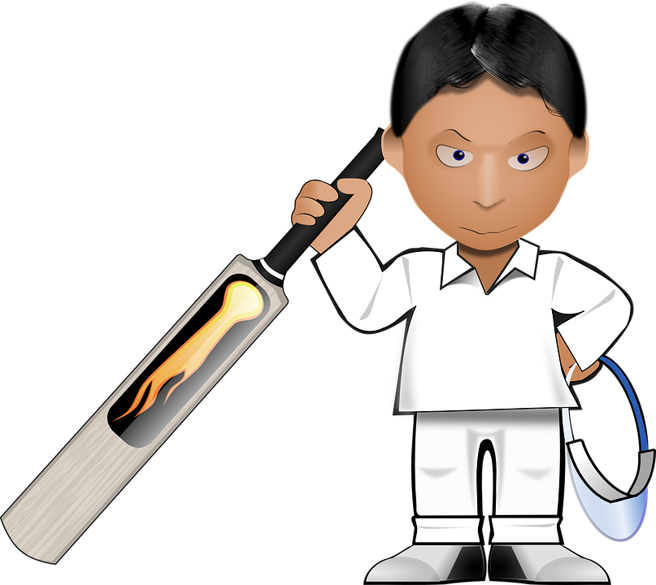
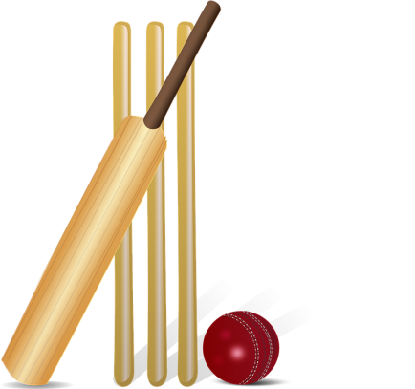
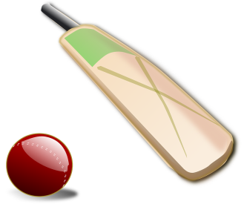
Most important Object
Notes:
It was decided that one would bring the ball, another the cricket bats, another the wickets, others the wicketkeeper gloves, batsmen gloves, protective padding, the boundary marker rope, etc.
But before the game started, they decided that the boy who had brought the most important object would get to pick the teams.

Slide 5
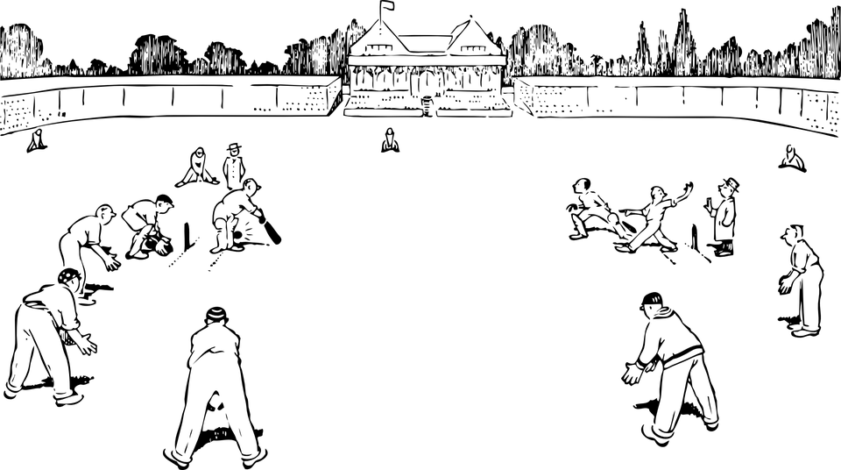
At the Game
Notes:
But it was difficult to decide which is the most important object, so they decided to just start playing, using all the objects, and gradually get rid of those items which they thought were unimportant.
Then first thing they got rid of was the set of keeper gloves; they managed to catch/stop the ball just as well without them.
Next they stopped using the boundary Marker.
Then they replaced the wickets with a couple of brick piles at either end.
And so they continued, until finally they replaced the bats with two plywood pieces, the cricket ball with a tennis ball and managed to keep playing....
At the same time a couple passed by the playground. The man said to his wife, "Look,they are playing cricket without even a proper ball or bat. I’m sure they're not enjoying the game.”
When the boys heard this comment, they realized how foolish they were. And true to the man’s comment, they were not enjoying the game at all. It was their pride and ego that made them discard all the items that were required to play a proper cricket game.
It was then they all decided together to play a proper game with all the necessary items and to enjoy it thoroughly, which they did. They had great fun together.
Children! What changed here?
In the first instance when they began their game, their egos came into play. They all lost sightof the main objective of enjoying the game.
But the moment their objective got congruent (identical), they shed off their ego and focused on the common objective—to enjoy the game.
So remember, success always comes when all the members of a team or group are on the same page and their thoughts are congruent.

Slide 6

All Play, No Fun
Look, they are playing cricket without even a proper ball or bat
I’m sure they're not enjoying the game
«««««««
Notes:
At the same time a couple passed by the playground. The man said to his wife, "Look,they are playing cricket without even a proper ball or bat. I’m sure they're not enjoying the game.”
When the boys heard this comment, they realized how foolish they were. And true to the man’s comment, they were not enjoying the game at all. It was their pride and ego that made them discard all the items that were required to play a proper cricket game.

Slide 7
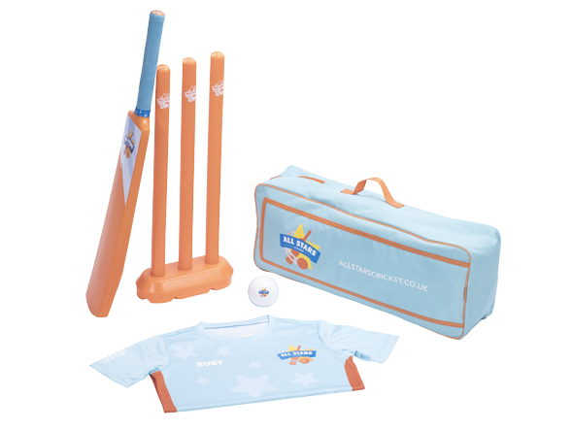
Playing with a Difference
They all decided to play a proper game with all the necessary items and to enjoy it thoroughly
Notes:
It was then they all decided together to play a proper game with all the necessary items and to enjoy it thoroughly, which they did. They had great fun together.
Children! What changed here?
In the first instance when they began their game, their egos came into play. They all lost sightof the main objective of enjoying the game.
But the moment their objective got congruent (identical), they shed off their ego and focused on the common objective—to enjoy the game.
So remember, success always comes when all the members of a team or group are on the same page and their thoughts are congruent.
https://www.hiclipart.com/free-transparent-background-png-clipart-silfx

Slide 8

Playing with a Difference
Children! What changed here?
Remember, success always comes when all the members of a team
          Keep aside egos
          Focus on Objective
          Keep thoughts congruent
Notes:
https://pixabay.com/photos/team-teamwork-together-strategy-3393037/

Slide 9








MM Index
Slide# | Thumbnail | Source and Attribution
3 |  | https://pixabay.com/photos/team-teamwork-team-spirit-together-2309036/
1,3,4,5,6 |  | https://pixabay.com/vectors/cricket-ground-pitch-sports-sketch-32265/
3,4 |  | https://pixabay.com/vectors/cricket-bat-cricketer-player-33064/
4 |  | https://pixabay.com/vectors/cricket-bat-ball-britain-british-150560/
4 |  | https://pixabay.com/vectors/cricket-cricket-bat-bat-ball-155965/
6 |  | https://pixabay.com/vectors/silhouette-walking-love-man-woman-3130823/
8 |  | https://pixabay.com/photos/team-teamwork-together-strategy-3393037/
7 |  | https://www.hiclipart.com/free-transparent-background-png-clipart-silfx

