Slide 1
PROBLEMS ON AREA & PERIMETER OF RECTANGLES AND SQUARES
Notes:
Notes for Teacher - < Information for further reference or explanation >
Suggestions: <Ideas/ Images/ Animations / Others – To make better representation of the content >
Source of Multimedia Objects (Image/audio/ Video/Animation) used in this slide -
1. <Short Description> - <SOURCE URL>

Slide 2
TICK THE CORRECT ANSWER
1. Length of a rectangle is 10cm and breadth is half of it. Then the area of rectangle is
a.50 cm² b.5 cm² c.10 cm² d.100 cm²
2. The area of a square with perimeter 100 cm is
a.50 cm² b.625 cm² c.100 cm² d.25 cm²
✔
✔
Notes:
Notes for Teacher - < Information for further reference or explanation >
Suggestions: <Ideas/ Images/ Animations / Others – To make better representation of the content >
Source of Multimedia Objects (Image/audio/ Video/Animation) used in this slide -
1. <Short Description> - <SOURCE URL>

Slide 3
TICK THE CORRECT ANSWER
3. The side of a regular pentagon of perimeter 50 cm is
a.15 cm b.25 cm c.10 cm d.5 cm
4. Perimeter of rectangle is 36cm and breadth is 6cm then length of rectangle is
a.20 cm b.6 cm c.18 cm d.12 cm
✔
✔
Notes:
Notes for Teacher - < Information for further reference or explanation >
Suggestions: <Ideas/ Images/ Animations / Others – To make better representation of the content >
Source of Multimedia Objects (Image/audio/ Video/Animation) used in this slide -
1. <Short Description> - <SOURCE URL>

Slide 4
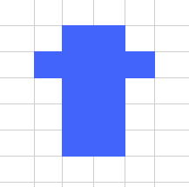
TICK THE CORRECT ANSWER
5. The perimeter of this shape (each square has a side length of 1cm)
a. 12cm
b. 18cm
c. 20cm
✔
Notes:
Notes for Teacher - < Information for further reference or explanation >
Suggestions: <Ideas/ Images/ Animations / Others – To make better representation of the content >
Source of Multimedia Objects (Image/audio/ Video/Animation) used in this slide -
1. <Short Description> - <SOURCE URL>

Slide 5
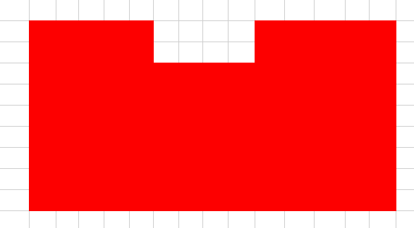
TICK THE CORRECT ANSWER
6. The diagram shows the plan view of a small pool. What is the perimeter of the pool?
a. 34m
b. 40m
c. 48m
5m
5m
✔
2m
8m
14m
Notes:
Notes for Teacher - < Information for further reference or explanation >
Suggestions: <Ideas/ Images/ Animations / Others – To make better representation of the content >
Source of Multimedia Objects (Image/audio/ Video/Animation) used in this slide -
1. <Short Description> - <SOURCE URL>

Slide 6
TRUE OR FALSE
1. If both length and breadth of a rectangle are doubled then, its perimeter is doubled.
2. The perimeter of a regular hexagon with side 3cm is 9cm.
3. For carpeting a room we find its area.
4. An increase in the perimeter need not lead to increase in area of figure.
5. Rectangles with same perimeter have equal areas.
True
False
True
True
False
Notes:
Notes for Teacher - < Information for further reference or explanation >
Suggestions: <Ideas/ Images/ Animations / Others – To make better representation of the content >
Source of Multimedia Objects (Image/audio/ Video/Animation) used in this slide -
1. <Short Description> - <SOURCE URL>

Slide 7
SOLVE THE FOLLOWING
Find the area of a rectangle whose perimeter is 30 units and whose width is 5 units.
Solution :
P=2l+2w
30=2l+10
l=10units
Area=l X w =10 X 5
= 50 unit²
5
P=30
Notes:
Notes for Teacher - < Information for further reference or explanation >
Suggestions: <Ideas/ Images/ Animations / Others – To make better representation of the content >
Source of Multimedia Objects (Image/audio/ Video/Animation) used in this slide -
1. <Short Description> - <SOURCE URL>

Slide 8
SOLVE THE FOLLOWING
2. Suppose you had a rectangle whose length was 40 meters and whose width was 15 meters. Could you construct a second rectangle with the same area, but with a length of 25 meters? What would be the width of the second rectangle? How would you compare the perimeters?
Notes:
Notes for Teacher - < Information for further reference or explanation >
Suggestions: <Ideas/ Images/ Animations / Others – To make better representation of the content >
Source of Multimedia Objects (Image/audio/ Video/Animation) used in this slide -
1. <Short Description> - <SOURCE URL>

Slide 9
SOLVE THE FOLLOWING
Solution :
l=40m w=15m
Area=l X w = 40 X 15 = 600 sq.m
If l=25m,then new w=Area/l=600/25=24m.
Perimeter of 1st rectangle=2l+2w=80+30=110m.
Perimeter of new rectangle=2l+2w=50+48=98m.
Width of the second rectangle is 24 meters. Perimeters are 110meters and 98 meters respectively.
Notes:
Notes for Teacher - < Information for further reference or explanation >
Suggestions: <Ideas/ Images/ Animations / Others – To make better representation of the content >
Source of Multimedia Objects (Image/audio/ Video/Animation) used in this slide -
1. <Short Description> - <SOURCE URL>

Slide 10
SOLVE THE FOLLOWING
3. A farmer plans to add barbed wire to the fence around his rectangular shaped field. The length of the field is 132 meters and its width is 126 meters. Find,
a) How much barbed wire will he need?
b) How much will the barbed wire cost if it sells Rupees 30 a meter?
c) How many square meter of area will the barbed wire enclose?
Notes:
Notes for Teacher - < Information for further reference or explanation >
Suggestions: <Ideas/ Images/ Animations / Others – To make better representation of the content >
Source of Multimedia Objects (Image/audio/ Video/Animation) used in this slide -
1. <Short Description> - <SOURCE URL>

Slide 11
SOLVE THE FOLLOWING
Solutions :
a) l=132m
w=126m
P=2l+2w =264+252 =516 m
b) Cost of wire = 516 X 30 = Rs.15480
c) Area enclosed= l X w = 132 X 126 = 16632m²
Notes:
Notes for Teacher - < Information for further reference or explanation >
Suggestions: <Ideas/ Images/ Animations / Others – To make better representation of the content >
Source of Multimedia Objects (Image/audio/ Video/Animation) used in this slide -
1. <Short Description> - <SOURCE URL>

Slide 12
SOLVE THE FOLLOWING
4) The area of a square plot is 108900 square meters. How many meters of fencing would be required to construct a fence around it?
Solution :
Area=side X side
108900=side X side
side(a)=330m
The side of the square a = 330 meters. Fencing required
is its perimeter = 4a = 1320 meters
Notes:
Notes for Teacher - < Information for further reference or explanation >
Suggestions: <Ideas/ Images/ Animations / Others – To make better representation of the content >
Source of Multimedia Objects (Image/audio/ Video/Animation) used in this slide -
1. <Short Description> - <SOURCE URL>

Slide 13
MM Index
Slide# | Thumbnail | Source and Attribution

