Slide 1
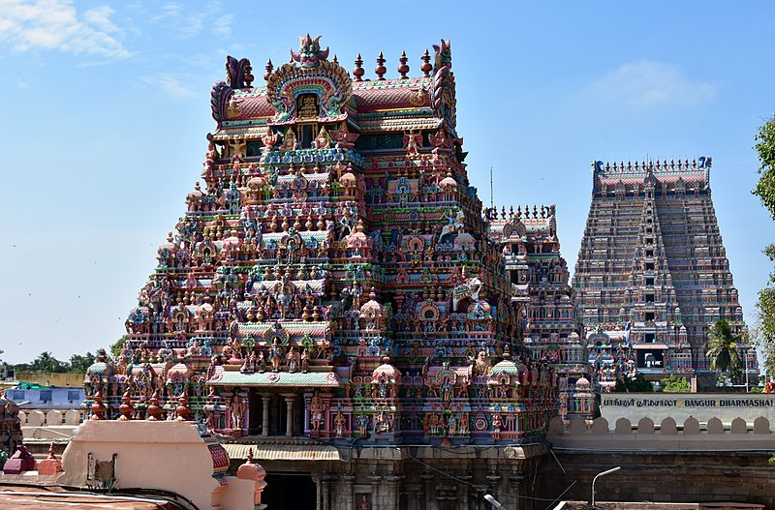
I
I
E
P
Amazing facts about Sri Ranganatha Swami temple
Integral Education FOR ALL, BY ALL
Notes:
This image was originally posted to Flickr by Prof. Mortel at https://flickr.com/photos/43714545@N06/37254366620. It was reviewed on 15 November 2017 by FlickreviewR 2 and was confirmed to be licensed under the terms of the cc-by-2.0.
1

Slide 2
Did you know?
It is one of the 108 holy homes of Lord Vishnu.
One of the biggest functioning Hindu temple in the world.
Notes:
This image was originally posted to Flickr by Prof. Mortel at https://flickr.com/photos/43714545@N06/37254366620. It was reviewed on 15 November 2017 by FlickreviewR 2 and was confirmed to be licensed under the terms of the cc-by-2.0.

Slide 3
Did you know?
Area = 156 acres with a perimeter of about 4 kms (10,710 feet).
Located on the island of Srirangam.
Notes:
This image was originally posted to Flickr by Prof. Mortel at https://flickr.com/photos/43714545@N06/37254366620. It was reviewed on 15 November 2017 by FlickreviewR 2 and was confirmed to be licensed under the terms of the cc-by-2.0.

Slide 4
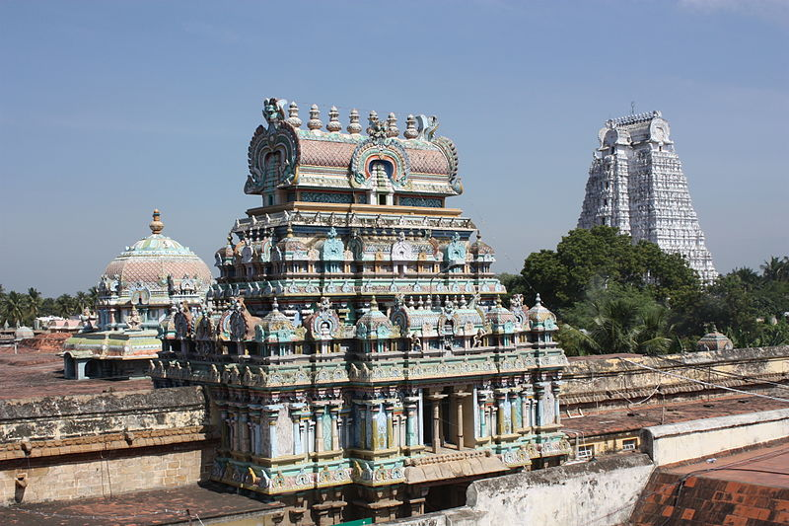
AMAZING FACTS
The Sapta-Prakaram formation
The temple is also referred to as Srirangam .
The topology of the temple is unique.
Notes:
Teacher notes - Typology – A classification according to general type, especially in archaeology, psychology, or the social sciences.
https://commons.wikimedia.org/wiki/File:Trichy,_Sri_Ranganathaswamy_Temple_(6993763451).jpg (author- Arian Zwegers)

Slide 5


MM Index
Slide# | Thumbnail | Source and Attribution
1, 2, 3 |  | This image was originally posted to Flickr by Prof. Mortel at https://flickr.com/photos/43714545@N06/37254366620. It was reviewed on 15 November 2017 by FlickreviewR 2 and was confirmed to be licensed under the terms of the cc-by-2.0.
4 |  | https://commons.wikimedia.org/wiki/File:Trichy,_Sri_Ranganathaswamy_Temple_(6993763451).jpg (Author- Arian Zwegers)

