Slide 1
Area
&
Perimeter of a Circle
Notes:
Notes for Teacher - < Information for further reference or explanation >
Suggestions: <Ideas/ Images/ Animations / Others – To make better representation of the content >
Source of Multimedia Objects (Image/audio/ Video/Animation) used in this slide -
1. <Short Description> - <SOURCE URL>

Slide 2
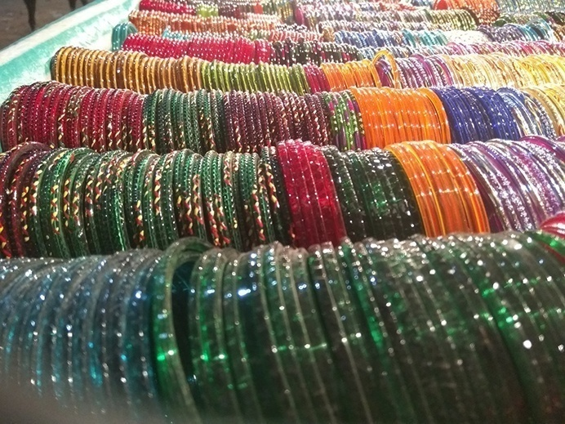


Introduction
Coins, bangle, compact disc etc are round in shape
Any round shaped figure is called a Circle
Notes:
Notes for Teacher - < Information for further reference or explanation >
Suggestions: <Ideas/ Images/ Animations / Others – To make better representation of the content >
Source of Multimedia Objects (Image/audio/ Video/Animation) used in this slide -
1. <Short Description> - <SOURCE URL>

Slide 3
Definition
A Circle is the path of all the points that are equidistant from a fixed point on a given surface
The fixed point is called the centre of the circle
Notes:
Notes for Teacher - < Information for further reference or explanation >
Suggestions: <Ideas/ Images/ Animations / Others – To make better representation of the content >
Source of Multimedia Objects (Image/audio/ Video/Animation) used in this slide -
1. <Short Description> - <SOURCE URL>

Slide 4
Parts of Circle
radius
diameter
Origin / Centre: The centre of the circle is called its origin
Diameter: The longest distance from one end of a circle to the other end is called the diameter. It always passes through the centre of the circle
Radius: The distance from the origin of the circle to any point on the circle is called the radius
Circumference: The distance around a circle is called the circumference
Notes:
Notes for Teacher - < Information for further reference or explanation >
Suggestions: <Ideas/ Images/ Animations / Others – To make better representation of the content >
Source of Multimedia Objects (Image/audio/ Video/Animation) used in this slide -
1. <Short Description> - <SOURCE URL>

Slide 5
Relation between diameter & radius
radius
r
d
diameter
The diameter (d) of a circle is double the radius (r) of the circle.
Hence, the radius is half of the diameter of a circle.
Diameter d = 2r
Notes:
Notes for Teacher - < Information for further reference or explanation >
Suggestions: <Ideas/ Images/ Animations / Others – To make better representation of the content >
Source of Multimedia Objects (Image/audio/ Video/Animation) used in this slide -
1. <Short Description> - <SOURCE URL>

Slide 6
Relation between diameter & circumference
Name of the disk | Diameter d | Circumference c | Ratio c / d
A
B
C
D
Take three or four circular discs A, B, C, D of different sizes or draw 3 or 4 circles of different radii.
Measure the lengths of the circumference of each of the discs with the help of a piece of thread.
Find their diameters and complete the following table.
You will see that the value of the ratio is slightly greater than 3, i.e. Between 3.1 and 3.2
Notes:
Notes for Teacher - < Information for further reference or explanation >
Suggestions: <Ideas/ Images/ Animations / Others – To make better representation of the content >
Source of Multimedia Objects (Image/audio/ Video/Animation) used in this slide -
1. <Short Description> - <SOURCE URL>

Slide 7

Relation between diameter & circumference
Thus, the ratio of the circumference of a circle to its diameter is same for all circles, regardless of their sizes.
This ratio is denoted by the Greek letter π
Note: We cannot write π in the form , p, q integers, q ≠ 0. In other words, the ratio π is irrational.
Notes:
Notes for Teacher - < Information for further reference or explanation >
Suggestions: <Ideas/ Images/ Animations / Others – To make better representation of the content >
Source of Multimedia Objects (Image/audio/ Video/Animation) used in this slide -
1. <Short Description> - <SOURCE URL>

Slide 8


Relation between diameter & circumference
We have = π or c = πd = 2πr (d = 2r) where c = circumference, d = diameter and r = radius of the circle
Circumference, c = πd = 2πr
The rational approximation of π is or 3.14 or 3.1416
Notes:
Notes for Teacher - < Information for further reference or explanation >
Suggestions: <Ideas/ Images/ Animations / Others – To make better representation of the content >
Source of Multimedia Objects (Image/audio/ Video/Animation) used in this slide -
1. <Short Description> - <SOURCE URL>

Slide 9
Area of a Circle
Draw a circle with any given radius say r cm
r
Now cut the circle into 16 sectors with the help of scissors and arrange them in the form of a rectangle as shown in figure
O
πr
The area of the circle is equal to the area of the figure formed
r
Notes:
Notes for Teacher - < Information for further reference or explanation >
Suggestions: <Ideas/ Images/ Animations / Others – To make better representation of the content >
Source of Multimedia Objects (Image/audio/ Video/Animation) used in this slide -
1. <Short Description> - <SOURCE URL>

Slide 10

Area of a Circle
The figure is nearly in the form of rectangle
Its length (l) is approximately equal to the sum of the arcs of 8 sectors out of a total of 16 sectors
l = Circumference of circle = πr cm
and its breadth b is approximately r cm
πr
r
Notes:
Notes for Teacher - < Information for further reference or explanation >
Suggestions: <Ideas/ Images/ Animations / Others – To make better representation of the content >
Source of Multimedia Objects (Image/audio/ Video/Animation) used in this slide -
1. <Short Description> - <SOURCE URL>

Slide 11



Area of a Circle
If the circle can be divided into as large as a number of equal sectors as possible, and these sectors are arranged as shown, the arcs of these sectors are very small and may be considered as straight lines.
πr
r
In this way the area of the circle will be very close to the area of a rectangle of length πr and breadth r.
Hence the area of a circle of radius r = πr × r = π
Area of circle, A = π
Notes:
Notes for Teacher - < Information for further reference or explanation >
Suggestions: <Ideas/ Images/ Animations / Others – To make better representation of the content >
Source of Multimedia Objects (Image/audio/ Video/Animation) used in this slide -
1. <Short Description> - <SOURCE URL>

Slide 12
Area of a Circle
Examples
1) If Radius of a circle is 4 cm, find its diameter.
Solution :
Diameter = 2 x radius
Diameter = 2 x 4
Diameter = 8 cm
r = 4 cm
D = 8 cm
D = ?

Slide 13
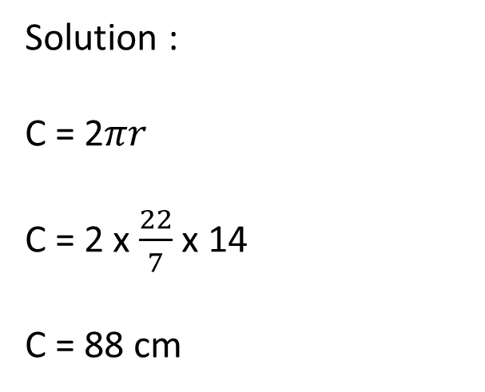
Area of a Circle
Examples
2)A circular swimming pool has a radius of 14 m.
Find the circumference of the pool.
Solution :
C = 2$πr$
C = 2 x $\frac{22}{7}$ x 14
C = 88 cm
C = 88 cm
C = ?
14 cm
Circumference of the pool = 88 cm
Notes:
Find the
circumference of the pool.

Slide 14

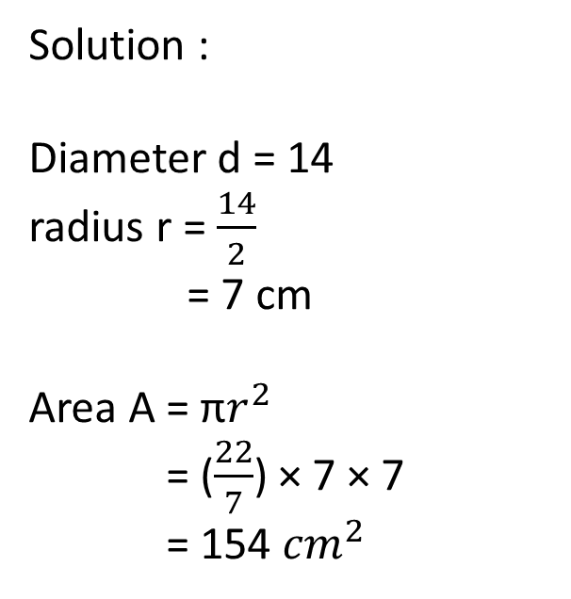
Area of a Circle
Examples
3) Find the area of a circle with a diameter 14 cm long. Use π = 22/7
Solution :
Diameter d = 14
radius r = $\frac{14}{2}$
= 7 cm
Area A = π$r^{2}$
= ($\frac{22}{7}$) × 7 × 7
= 154 ${cm}^{2}$
D = 14 cm
Area of the circle is 154 ${cm}^{2}$

Slide 15



MM Index
Slide# | Thumbnail | Source and Attribution
2 |  | https://pixabay.com/photos/coin-currency-money-finance-indian-4138688/
2 |  | https://pixabay.com/vectors/disc-pink-cd-compact-disc-dvd-153701/

