Slide 1
Different Units used in Measurement
Notes:
Notes for Teacher - < Information for further reference or explanation >
Suggestions: <Ideas/ Images/ Animations / Others – To make better representation of the content >
Source of Multimedia Objects (Image/audio/ Video/Animation) used in this slide -
1. <Short Description> - <SOURCE URL>

Slide 2
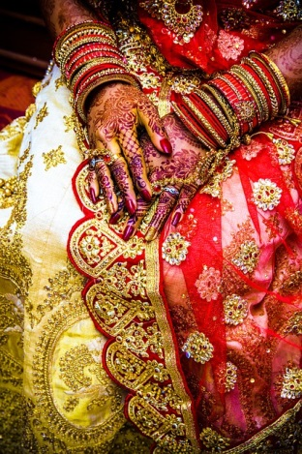
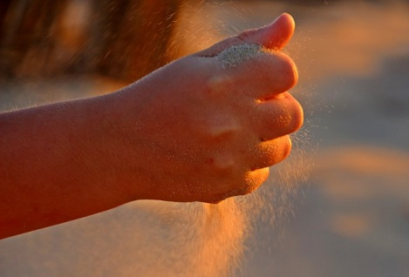
Units used in Zari work
Informal unit of measurement in zari work is Mutthi or Fist full
Decorative designs stitched on cloth using threads are called Zari work
Notes:
Notes for Teacher - < Information for further reference or explanation >
Suggestions: <Ideas/ Images/ Animations / Others – To make better representation of the content >
Source of Multimedia Objects (Image/audio/ Video/Animation) used in this slide -
<Short Description> - <SOURCE URL> https://pixabay.com/photos/mehendi-bangles-wedding-jewelry-4004296/
https://pixabay.com/photos/faust-hand-finger-closed-sand-1607060/

Slide 3
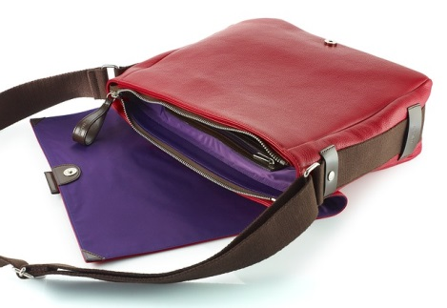
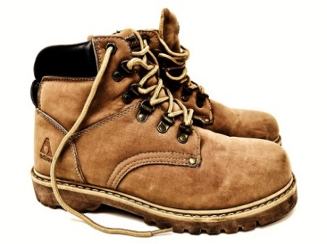
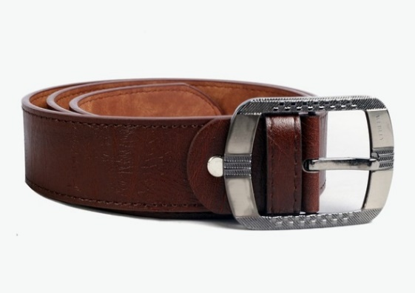
Units used in Leather work
In leather, indigenous units are used for measurement.
‘Desi’ is 4 inches x 4 inches.
For e.g. making a bag 1 foot x 1 foot, ( 9 Desi of leather ).
'Waar' is unit of length measure of zippers
Notes:
Notes for Teacher - < Information for further reference or explanation >
Suggestions: <Ideas/ Images/ Animations / Others – To make better representation of the content >
Source of Multimedia Objects (Image/audio/ Video/Animation) used in this slide -
1. <Short Description> - <SOURCE URL>
https://pixabay.com/photos/bag-red-leather-2146904/
https://pixabay.com/photos/belt-belt-buckle-metal-leather-139757/
https://pixabay.com/photos/hiking-shoes-boots-leather-3583017/

Slide 4
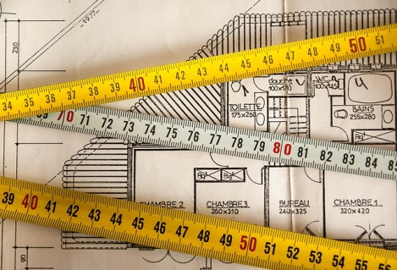
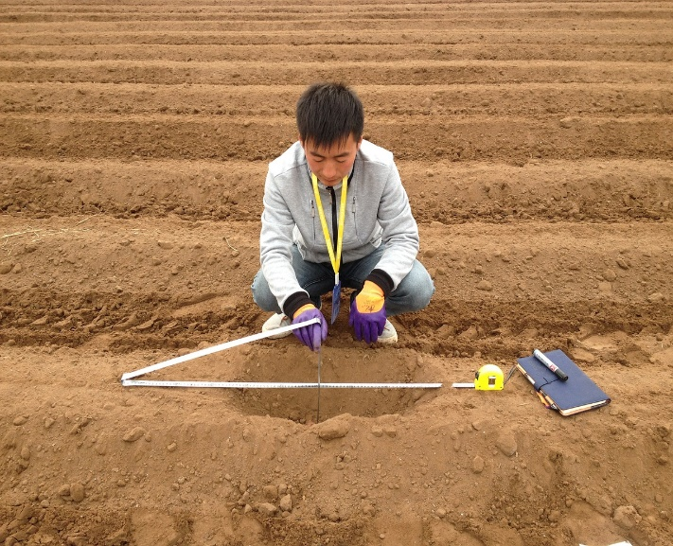
Traditional measurement units for pieces of land
Square foot, acre, etc., are usual measurement units
“Khattha”, “Bigha” are informal units used for measuring area of land.
1 Bigha = 20 Khattha
1 Khattha is around 1300 square feet
Notes:
Notes for Teacher - < Information for further reference or explanation >
Suggestions: <Ideas/ Images/ Animations / Others – To make better representation of the content >
Source of Multimedia Objects (Image/audio/ Video/Animation) used in this slide -
<Short Description> - <SOURCE URL>
https://pixabay.com/photos/plan-building-measurement-architect-2092499/
https://www.needpix.com/photo/download/391038/measuring-land-character-free-pictures-free-photos-free-images-royalty-free-free-illustrations

Slide 5
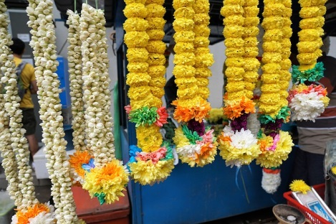
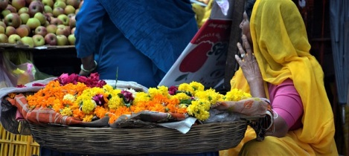
Flower Garlands
Flower strings are used for deities in India
Ladies use it on their hair
Vendors measure flowers from elbow to tip of their fingers and sell in bits
Notes:
Notes for Teacher - < Information for further reference or explanation >
Suggestions: <Ideas/ Images/ Animations / Others – To make better representation of the content >
Source of Multimedia Objects (Image/audio/ Video/Animation) used in this slide -
1. <Short Description> - <SOURCE URL>
https://pixabay.com/photos/flower-color-plant-ornament-nature-3218958/
https://pixabay.com/photos/flower-shop-seller-market-udipur-2324290/

Slide 6









MM Index
Slide# | Thumbnail | Source and Attribution
2 |  | https://pixabay.com/photos/mehendi-bangles-wedding-jewelry-4004296/
2 |  | https://pixabay.com/photos/faust-hand-finger-closed-sand-1607060/
3 |  | https://pixabay.com/photos/bag-red-leather-2146904/
3 |  | https://pixabay.com/photos/belt-belt-buckle-metal-leather-139757/
3 |  | https://pixabay.com/photos/hiking-shoes-boots-leather-3583017/
4 |  | https://pixabay.com/photos/plan-building-measurement-architect-2092499/
4 |  | https://www.needpix.com/photo/download/391038/measuring-land-character-free-pictures-free-photos-free-images-royalty-free-free-illustrations
5 |  | https://pixabay.com/photos/flower-color-plant-ornament-nature-3218958/
5 |  | https://pixabay.com/photos/flower-shop-seller-market-udipur-2324290/

