Slide 1
Use of Area and Perimeter in our Daily life
Notes:
Notes for Teacher - < Information for further reference or explanation >
Suggestions: <Ideas/ Images/ Animations / Others – To make better representation of the content >
Source of Multimedia Objects (Image/audio/ Video/Animation) used in this slide -
1. <Short Description> - <SOURCE URL>

Slide 2
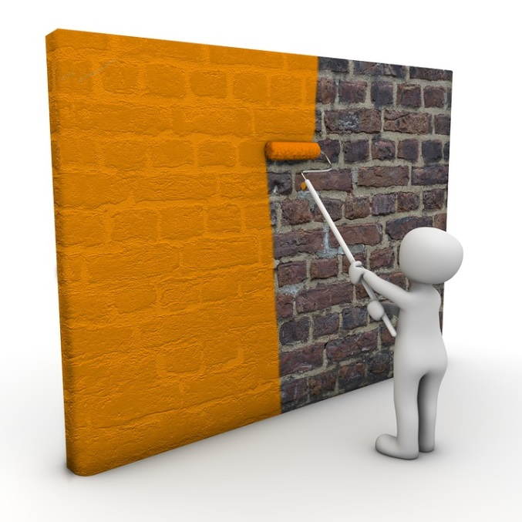
PERIMETER AND AREA
Relevance of calculation of area and perimeter in our daily life.
1) A painter calculates the area of walls to find number of cans of paint needed
Notes:
Notes for Teacher - < Information for further reference or explanation >
Suggestions: <Ideas/ Images/ Animations / Others – To make better representation of the content >
Source of Multimedia Objects (Image/audio/ Video/Animation) used in this slide -
1. <Painting> - <https://pixabay.com/illustrations/painter-wall-color-paint-1027853/>

Slide 3

PERIMETER AND AREA
2) In a farm, the area of the plot is used to estimate the number of bags of fertilizers needed for growing crops .
Notes:
Notes for Teacher - < Information for further reference or explanation >
Suggestions: <Ideas/ Images/ Animations / Others – To make better representation of the content >
Source of Multimedia Objects (Image/audio/ Video/Animation) used in this slide -
1. <Farm> - <http://www.publicdomainfiles.com/show_file.php?id=13526491218331>

Slide 4
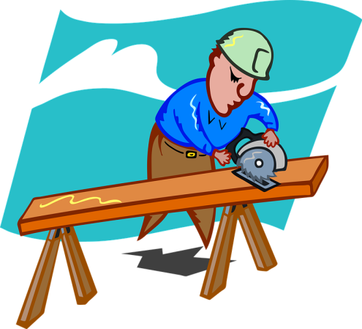

PERIMETER AND AREA
3) Professions such as carpentry and engineering make regular use of the area and the perimeter calculations.
Notes:
Notes for Teacher - Engineers use perimeters find out how much material is needed to build a truss. Example-constructing bridge with iron bars.
Carpenters purchase wooden sheets according to area requirements of the doors. They purchase glass panes according to area of windows. Window frames are purchased by calculating perimeter of the window.
Suggestions: <Ideas/ Images/ Animations / Others – To make better representation of the content >
Source of Multimedia Objects (Image/audio/ Video/Animation) used in this slide -
<Engineer> - <http://www.publicdomainfiles.com/show_file.php?id=13548576619666>
<Carpenter> - <https://pixabay.com/illustrations/craftsmen-schreiner-saw-wood-9470/>

Slide 5
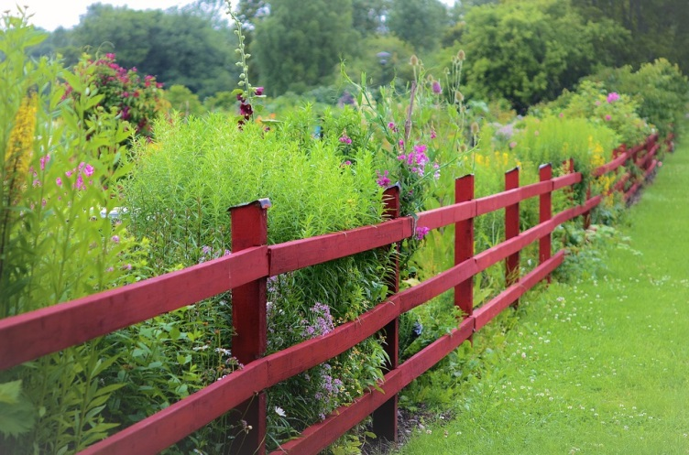

PERIMETER AND AREA
4To fence a garden , the perimeter of the garden is calculated.
5) To frame a photo, the perimeter and area of the photo should be calculated
Notes:
Notes for Teacher - < Information for further reference or explanation >
Suggestions: <Ideas/ Images/ Animations / Others – To make better representation of the content >
Source of Multimedia Objects (Image/audio/ Video/Animation) used in this slide -
<Garden with fence> - <https://pixabay.com/photos/fence-garden-wood-wooden-plank-883328/>
<Photo Frame> - <https://www.goodfreephotos.com/vector-images/gold-and-black-frame-vector-clipart.png.php>

Slide 6
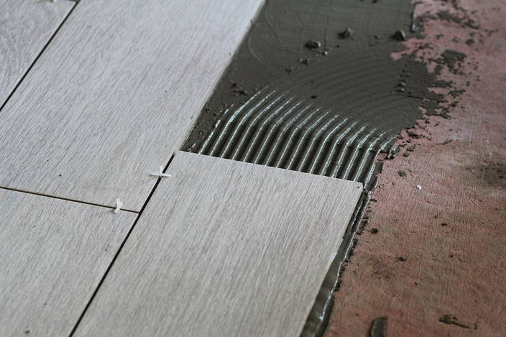
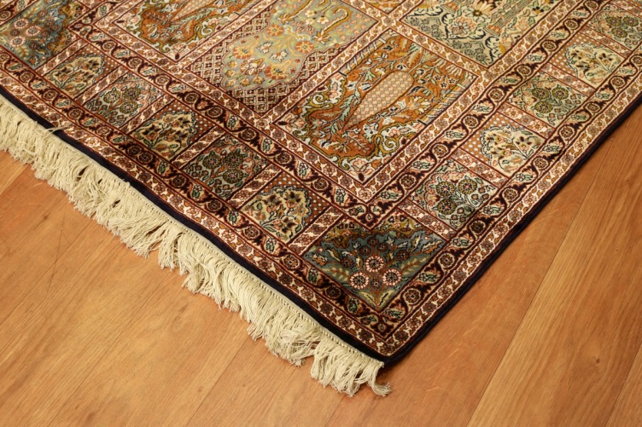
PERIMETER AND AREA
6) Area determined needed to Lay tiles on the floor
7) For purchasing a carpet, the area to be coveredis needed
Notes:
Notes for Teacher - < Information for further reference or explanation >
Suggestions: <Ideas/ Images/ Animations / Others – To make better representation of the content >
Source of Multimedia Objects (Image/audio/ Video/Animation) used in this slide -
<Tiles> - <https://pixabay.com/photos/construction-repair-cement-2748665/>
<Carpet Area> - <https://pxhere.com/en/photo/135571>

Slide 7
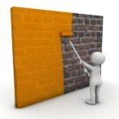







MM Index
Slide# | Thumbnail | Source and Attribution
2 |  | https://pixabay.com/illustrations/painter-wall-color-paint-1027853/
3 |  | http://www.publicdomainfiles.com/show_file.php?id=13526491218331
4 |  | <Engineer> - <http://www.publicdomainfiles.com/show_file.php?id=13548576619666> <Carpenter> - <https://pixabay.com/illustrations/craftsmen-schreiner-saw-wood-9470/>
5 |  | <Garden with fence> - https://pixabay.com/photos/fence-garden-wood-wooden-plank-883328/ <Photo Frame> - <https://www.goodfreephotos.com/vector-images/gold-and-black-frame-vector-clipart.png.php>
6 |  | <Tiles> - <https://pixabay.com/photos/construction-repair-cement-2748665/> <Carpet Area> - <https://pxhere.com/en/photo/135571>

