Slide 1
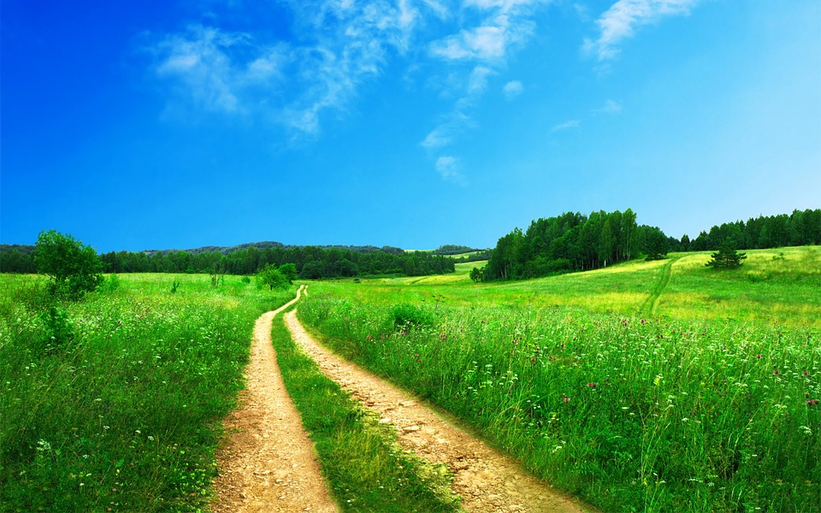
Area of Pathways
Notes:
Notes for Teacher - < Information for further reference or explanation >
Suggestions: <Ideas/ Images/ Animations / Others – To make better representation of the content >
Source of Multimedia used in this slide - <Please provide source URL where we find the image and the license agreement>
https://www.pxfuel.com/en/desktop-wallpaper-dfehr; Attribution:Wallpaper uploaded by our users,

Slide 2
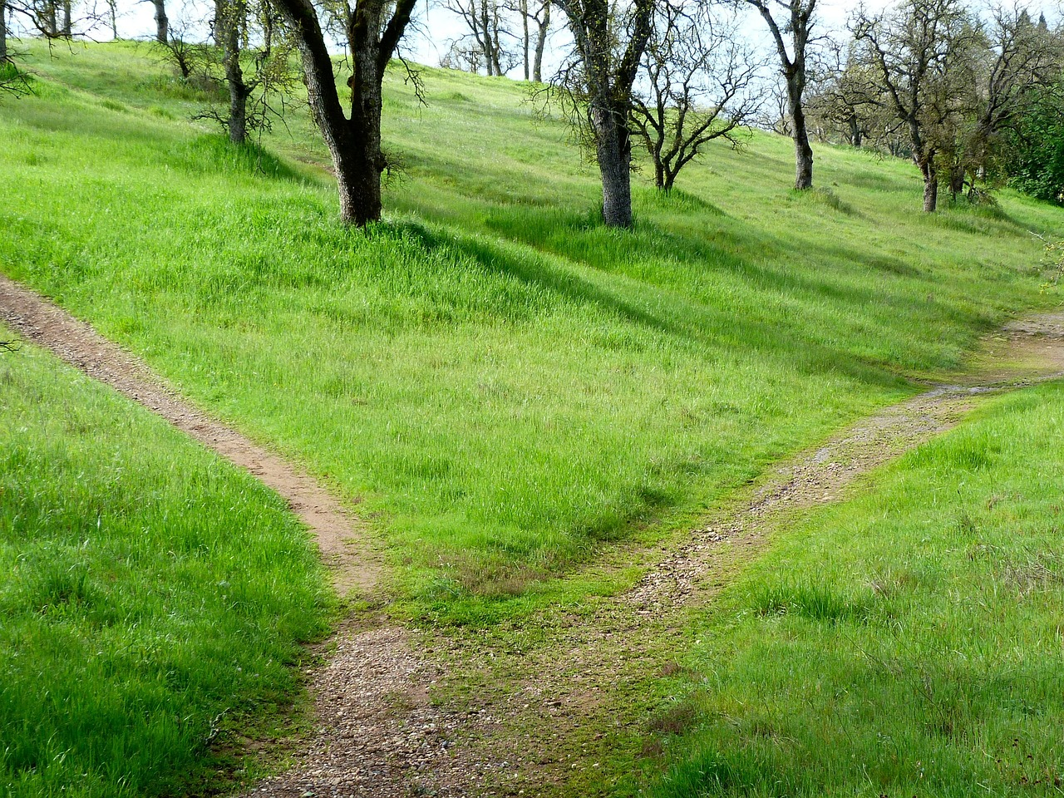
Area of Pathways
Pathways are walking areas constructed for pedestrians to walk in public areas.
It can be of various shapes, circular or rectangular.
Notes:
Source: search.creativecommons.org
URL:https://pixabay.com/photos/path-hiking-trail-grass-travel-18197/; Attribution: PublicDomainPictures

Slide 3
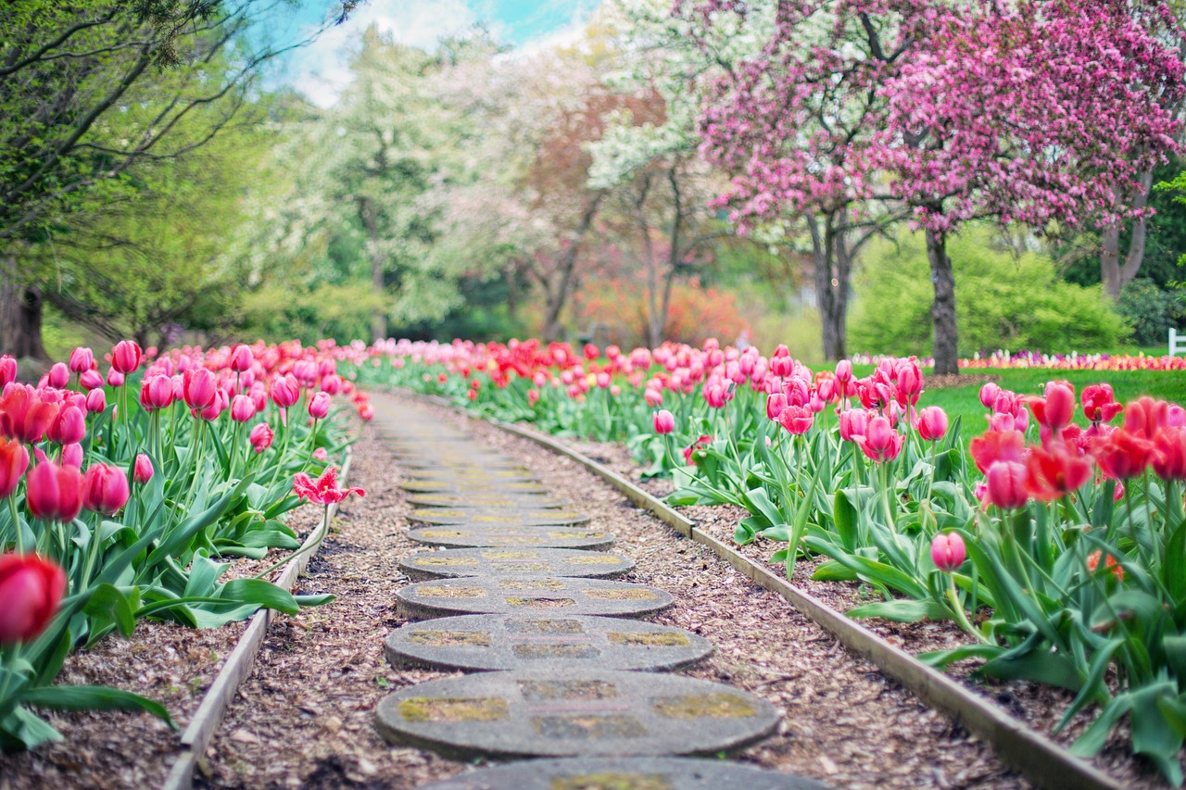
Area of Pathways
What are Pathways?
Notes:
Notes for Teacher - < Information for further reference or explanation >
Suggestions: <Ideas/ Images/ Animations / Others – To make better representation of the content >
Source of Multimedia Objects (Image/audio/ Video/Animation) used in this slide -
1. <Pathway’s picture> - https://pixabay.com/photos/pathway-path-pink-tulips-tulips-2289978/; Attribution: JillWellington

Slide 4
Rectangular Pathways
The region between the two rectangles is the pathway.
P
S
L
O
l
L
M
b
N
Q
R
B
Area of rectangular pathway = Area of larger rectangle (PQRS) – Area of smaller rectangle (LMNO)
Area of rectangular pathway = LB – lb

Slide 5
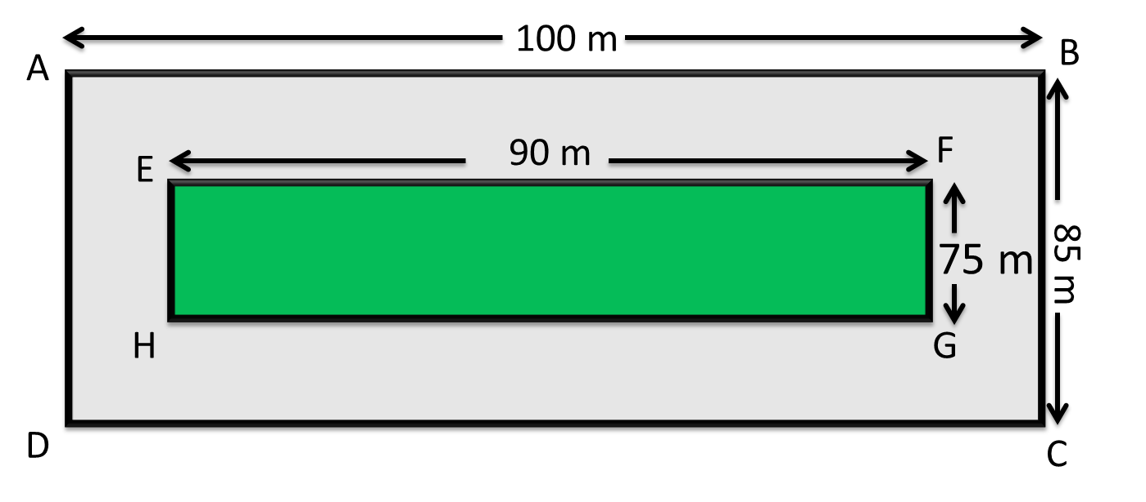
Example 1: Pathways
A rectangular garden is 90 m long and 75 m broad. A path 5 m wide is to be built out around it. Find the area of the uncoloured path.
Note: AB = L = (5m + 90m + 5m) = 100m
BC = B = (5m + 75m + 5m) = 85m
Area of rectangle ABCD = AB × BC = 100 × 85 = 8500 m²
Area of rectangle EFGH = EF × FG = 90 × 75 = 6750 m²
Area of the uncoloured path = Area of rectangle ABCD – Area of rectangle EFGH
= 8500 m² – 6750 m²
Area of the uncoloured path = 1750 m²

Slide 6

Example 2: Pathways
The length and width of a park are 20 m and 15 m respectively. There is a path of 1 m width inside the park; along the periphery. Find the area of the pathway.
1 m
1 m
Given: Length of the park = 20 m
Width of the park = 15 m
Width of the path inside the park = 1 m
Area of the pathway = ?
Length of the smaller rectangle (EF) = 20 – (1 + 1) m = 20 – 2 m = 18 m
Width of the smaller rectangle (FG) = 15 – (1 + 1) m = 15 – 2 m = 13 m
Contd..

Slide 7
Example 2: Pathways
Area of rectangle ABCD = AB × BC = 20 × 15 = 300 m²
Area of rectangle EFGH = EF × FG = 18 × 13 = 234 m²
Area of the pathway = Area of rectangle ABCD – Area of rectangle EFGH
= 300 m² – 234 m²
Area of the pathway = 66 m²

Slide 8
Circular Pathways
The region lying between two concentric circles is called annulus or the circular ring or circular pathway.
R
r
Subtract the area of the inner circle from the area of the outer circle.

Slide 9
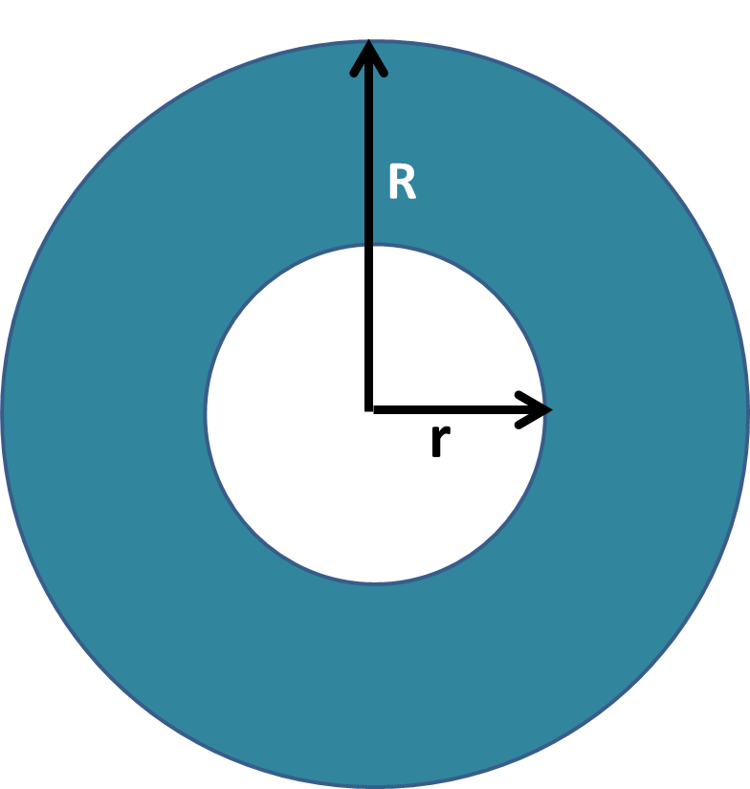
Circular Pathways
Let ' R ' be the radius of the outer circle and 'r' be the radius of the inner circle.
Area of ring = Area of outer circle – Area of inner circle
= πR² – πr²
Area of circular pathway = π (R² – r²)
π (pi) is a constant with value 3.14 approximately.

Slide 10
Example 1: Pathways
Find the area of the circular ring formed by two concentric circles, given that the radii of the outer and the inner circles are 8 cm and 4 cm respectively.
The area of the region enclosed by two concentric circles is given by:
Area = π (R² – r²)
Here, R = 8 cm and r = 4 cm
Area = 3.14 ( 8² – 4²) sq. cm
= 3.14 (64 – 16)
= 3.14 × 48
= 150.72 sq. cm
8 cm
4 cm

Slide 11
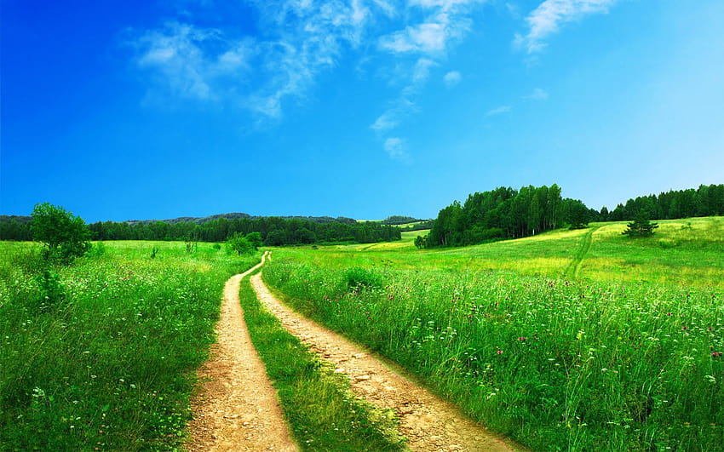
Attribution / Citation
Slide # | Thumbnail | Source link | Author
1 |  | https://www.pxfuel.com/en/desktop-wallpaper-dfehr | Wallpaper uploaded by our users,
2 |  | https://pixabay.com/photos/path-hiking-trail-grass-travel-18197 | PublicDomainPictures
3 |  | https://pixabay.com/photos/pathway-path-pink-tulips-tulips-2289978/ | JillWellington
Notes:
Notes for Teacher - < Information for further reference or explanation >
Suggestions: <Ideas/ Images/ Animations / Others – To make better representation of the content >
Source of Multimedia used in this slide - <Please provide source URL where we find the image and the license agreement>

